Slide 1
AI: Dangers
CPSC 501: Advanced Programming Techniques
Fall 2020
Jonathan Hudson, Ph.D
Instructor
Department of Computer Science
University of Calgary
Monday, August 24, 2020

Slide 2
Neural Network Specific Adversarial Attacks

Slide 3
Adversarial
We are usually nice to neural networks
We feed it data like it has seen before and get back positive results
Instead what if we are malicious and exploit how they work
Main point (neural networks are basically very complicated functions which we can back solve and exploit)

Slide 4
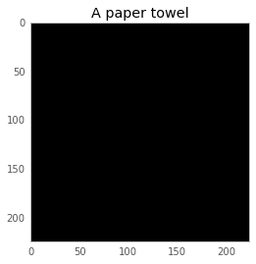
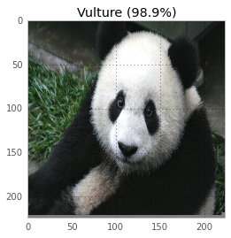
What!

Slide 5
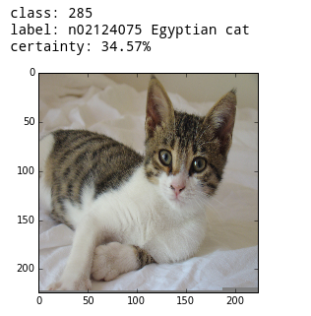
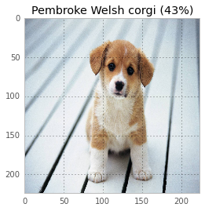
GoogLeNet
These examples are GoogLeNet from the ImageNet competition
So a large CNN, that should be (slightly) more robust against exploitation

Slide 6
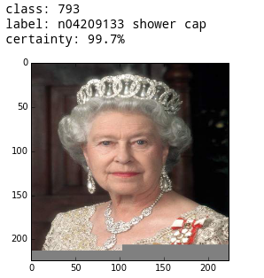
GoogLeNet
Even good CNNs can suck without our help

Slide 7
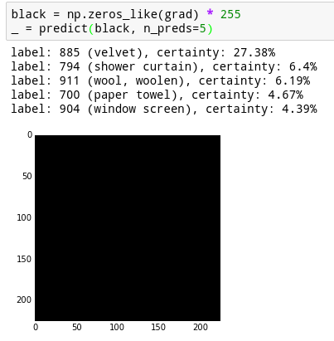
Let’s dig around inside
Make all black input
Look at labels
Even non-data has classification
We are going to play with gradients

Slide 8
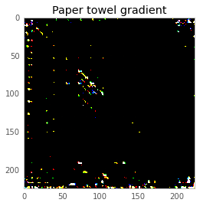
Reverse back-propogation
Take paper towel as a label
Set it to a full 1
And back propagate the neurons

Slide 9
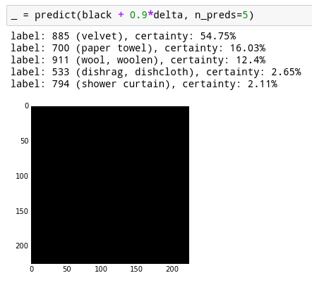
Reverse back-propogation
We can see the garbage input ourselves
So let’s drop the ratio to 1/256
We went from 4.67 to 16.03 %
On something that still looks black to us

Slide 10
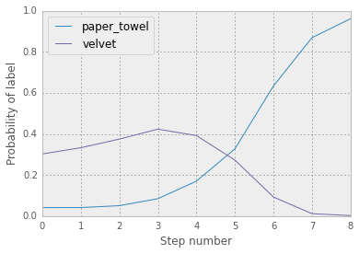
Reverse back-propogation
Looping back propogation

Slide 11
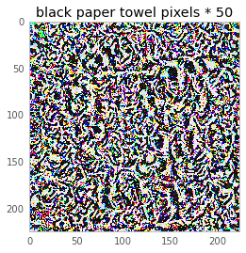
Reverse back-propogation
Force the pixel values larger so we can see underlying structure

Slide 12
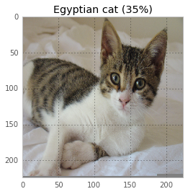
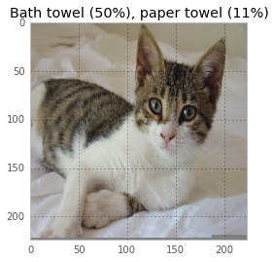
Now push this data over top of other images

Slide 13
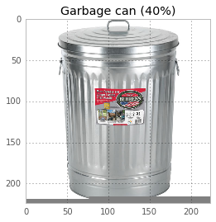
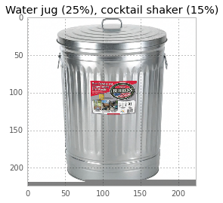
Now push this data over top of other images

Slide 14
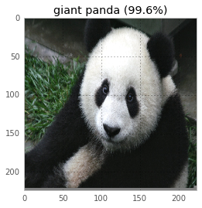
Now push this data over top of other images

Slide 15
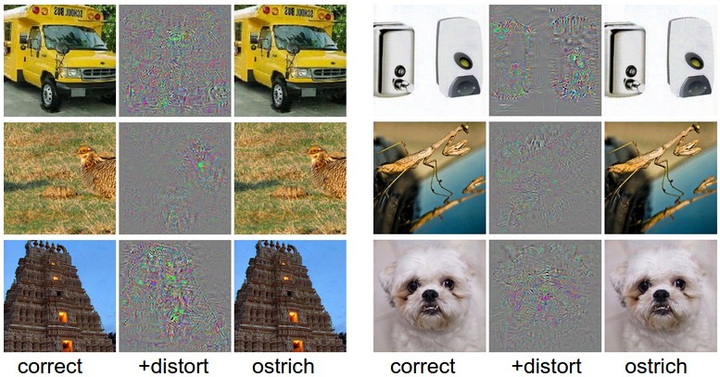
Now push this data over top of other images

Slide 16
99.6% +

Slide 17
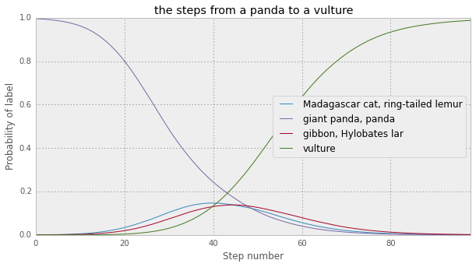
Now push this data over top of other images

Slide 18
Breaking Linear Regression
Linear classifiers that takes every input pixel and maps to labels
Take some food ones and back reverse to find image colours

Slide 19
Breaking Linear Regression
For example, Granny Smith apples are green, so the linear classifier has positive weights in the green color channel and negative weights in blue and red channels, across all spatial positions. It is hence effectively counting the amount of green stuff in the middle.
trick the Granny Smith classifier
figure out which pixels it cares about being green the most
tint those green
profit!

Slide 20
Neural Networks are Logistic Regressions
We are basically training a large function
Finding its weights
A fundamental struggle will always be the exploitability of this exact back-relationship of input and output
Doesn’t actually ‘think’ on an abstract conceptual level at this time
We can find reverse engineer mistakes based on trivial signals

Slide 21
Take-away
If we are aware of this issue we can make neural networks better
The main techniques are essentially trying to break the ability of a neural network to make direct connections between input/output
there is a struggle between models that are easy to train (e.g. models that use linear functions) and models that resist adversarial perturbations.
CNN are quite good at expected images, but anything around edges they often are very indeterminate

Slide 22
Other AI Failures

Slide 23
AI is Easy to Mis-Use
First: There is a non-ending list of these.
As long as AI exists it will be used either naively, actively negligently, or maliciously to bad ends.
Facial Recognition: being declared illegal in numerous cities, numerous non-white lawmakers in US mis-identified as criminals
Neural Network hiring recommendations for video interviews: simply should be illegal
Resume screening: good at patterns, horrendous at unique
Legal sentencing AI recommendations: repeats social biases
ImageNet: embedded biases
MIT ‘80 Million Tiny Images’ had same issue
Microsoft Tay: under 24 hours twitter corrupted it
AI trained on copyrighted art to create ‘furry’ avatars for others (stealing?)
To name only a few

Slide 24
AI is Easy to Mis-Use
Your responsibility is for honest use
AI methods rely on bias
In fact many are just ways to learn bias
It could be in your data you start with, or your methods on the data
Naïve usage of AI likely to trend towards being ‘illegal’
Right of accuser to see your algorithm and data (been cases already)
Properly fit into existing laws (employment law, sentencing laws)
Or new laws (right to own data in EU, facial recognition rights)

Slide 25
AI is Easy to Mis-Use
Just because you ‘can’ do it, doesn’t mean you ‘should’ do it
Should be honest about limitations
As valuable as showing your NN is good at identifying X image 99% accurate, it is maybe more valuable to know it fails at Y image
Is a person tracking system really a good system if a person with darker skin isn’t identified?
Diversity is a key component.
Either domain experts that can tell social/economic/race/age/etc. biases in your data
Or minorities:
Minorities can represent data cases that don’t have enough for a pattern (too few)
Or those where your/algorithm assumptions are wrong

Slide 26
Onward to … nothing.
Jonathan Hudson
jwhudson@ucalgary.ca
https://pages.cpsc.ucalgary.ca/~hudsonj/

