Slide 1
AI: TensorFlow Neural Network
CPSC 501: Advanced Programming Techniques
Fall 2020
Jonathan Hudson, Ph.D
Instructor
Department of Computer Science
University of Calgary
Monday, August 24, 2020

Slide 2
MNIST

Slide 3
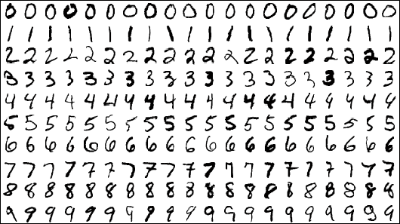
One MNIST Database
Each image is a 28x28 array, flattened out to be a 1-d tensor of size 784

Slide 4
Model
Input to model
X: image of a handwritten digit
Y: the digit value
Goal: trained model that recognizes the digit in the image

Slide 5
Model
Inference: Y_predicted = softmax(X * w + b)
We want network that predicts 10 digits
We also want the sum of our probabilities across output layer to be 1
Sigmoid activation would give use between 0 and 1
Softmax goes step further and makes sure sum of the 10 probabilities are 1 in total

Slide 6
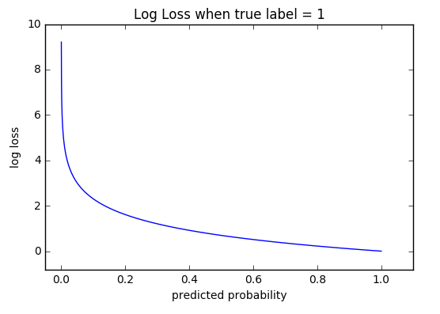
Model
Cross entropy loss: -log(Y_predicted)
Made for measuring performance of models where output is 0 to 1

Slide 7
Pre-process

Slide 8
Process data
#TF2 Includes MNIST data already (mostly for learning purposes)
mnist = tf.keras.datasets.mnist
(x_train, y_train), (x_test, y_test) = mnist.load_data()
#We need to level color data to 0 to 1 range
x_train, x_test = x_train / 255.0, x_test / 255.0
#We are classifying digits 0 to 9 class_names = list(range(10))

Slide 9
Graph (Neural Network)

Slide 10
Phase 1: Assemble our graph
model = tf.keras.models.Sequential([
tf.keras.layers.Flatten(input_shape=(28, 28)),
tf.keras.layers.Dense(10, activation='softmax')
])
Two layers
First we flatten image 2d array to a 1d tensor input
Then we make a connection from every image spot to every 0-9 integer output spot

Slide 11
Optimizer

Slide 12
Specify loss function
model.compile(
optimizer='adam’,
loss='sparse_categorical_crossentropy’,
metrics=['accuracy’])
Use ‘adam’ optimizer
We’ll discuss the loss function later in slides

Slide 13
Train

Slide 14
Train our model and evaluate it’s quality
model.fit(x_train, y_train, epochs=5)
model_loss, model_acc = model.evaluate(x_test, y_test, verbose=2)
print(f"Model Loss: {model_loss*100:.1f}%")
print(f"Model Accuray:{model_acc*100:.1f}%")

Slide 15
Output

Slide 16
Train our model and evaluate it’s quality

Slide 17
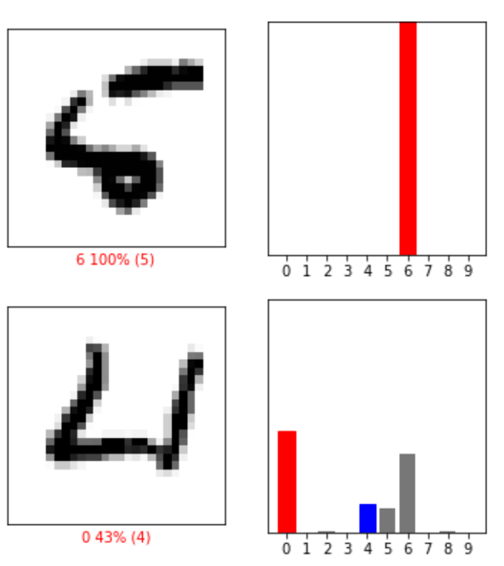
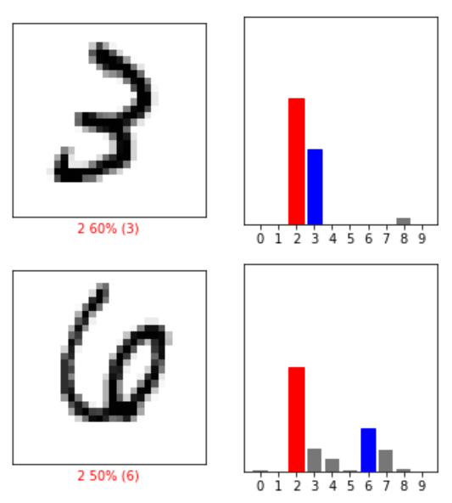
Train our model and evaluate it’s quality

Slide 18
Saving and Loading

Slide 19
Save/Load our model
model.save(‘MINST.h5’)
new_model = tf.keras.models.load_model('MINST.h5’)
Can use this model exactly the same way we were the one we made and trained
How most apps works. Make model on the development end, spend a bunch of time testing it in dev, once the accuracy is good see if size/speed can be optimized, dump into production as finished product

Slide 20
Dropout

Slide 21
Dropout
During training, some number of layer outputs are randomly ignored or “dropped out.”
the layer look-like and be treated-like a layer with a different number of nodes and connectivity to the prior layer
In effect, each update to a layer during training is performed with a different “view” of the configured layer.

Slide 22
Dropout
Dropout has the effect of making the training process noisy, forcing nodes within a layer to probabilistically take on more or less responsibility for the inputs.
Makes it hard for network to overfit, it can’t focus on creating singular paths for singular inputs to the trained output, has to try and represent the pattern

Slide 23
Dropout
One gain is that each training step is faster
Generally takes longer to train as less error updating is done (some nodes are idle each execution)
Sometimes you need bigger network than you had previously
Often larger dropout rates earlier (in CNN think of this is that we want to ignore little tiny features earlier on)
Often lower dropout rates later (in CNN think of this as that we’ve made more complex ideas, they are less likely to be overfitted)

Slide 24
Learning Rate

Slide 25
Learning Rate
Neural networks update their weights between neuron during backpropogation
How large this update can be is dependant on the learning rate
A high learning rate means they update the value by a large amount, a low learning rate means a small adjustment

Slide 26
Learning Rate
Alpha is the learning rate
J is the loss function
You can see the derivative of the loss function/ the current weight (the activation function) being the ratio of update

Slide 27
Learning Rate

Slide 28
Learning Rate Decay
Start with large learning rate and then reduce it over time
initial_learning_rate = 0.1
lr_schedule = tf.keras.optimizers.schedules.ExponentialDecay(
initial_learning_rate,
decay_steps=100000,
decay_rate=0.96,
staircase=True)

Slide 29
Learning Rate Decay
Start with large learning rate and then reduce it over time
model.compile(
optimizer=tf.keras.optimizers.SGD(learning_rate=lr_schedule),
loss='sparse_categorical_crossentropy’,
metrics=['accuracy'])
model.fit(data, labels, epochs=5)

Slide 30
Keras Optimizers
SGD
stochastic gradient descent, update based on learning rate multiplied by gradient (derivative ratio of loss and activation)
Adagrad
SGD that adapts learning rates for parameters based on how often they are update
Adadelta
robust Adagrad (adapts learning rate itself based on moving window), no need for learning rate to be set

Slide 31
Optimizers

Slide 32
Keras Optimizers
RMSprop
maintain moving average of square of gradients, divide gradient by this square when considering an update
Adam
SGD based on adaptive estimation of first and second –order moments (average and variance)
basically RMSprop with momentum

Slide 33
Keras Optimizers
Adamax – Adam but based on infinity norm
Nadam – like Adam with Nesterov momentum
Ftrl – (newer addition, explanation vague in API)

Slide 34
Loss Functions

Slide 35
Keras loss functions – basic error
MeanSquaredError: ${\left(y_{true}− y_{pred}\right)}^{2}$

Slide 36
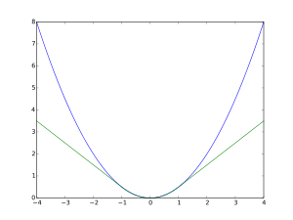
Keras loss functions – basic error
MeanSquaredError: ${\left(y_{true}− y_{pred}\right)}^{2}$
Huber: green

Slide 37
Keras loss functions – basic error
MeanSquaredLogarithmicError: ${\left(\log\left(y_{true}\right)−\log\left(y_{pred}\right)\right)}^{2}$
MeanAbsoluteError: $|y_true − y_pred$|
MeanAbsolutePercentageError : $100∗\frac{|y_{true}−y_{pred}|}{y_{true}}$
Poisson: $y_{pred}−y_{true} ∗ log⁡(y_{pred})$
KLDivergence (Kullback-Leibler): $y_{true} ∗ log⁡(\frac{y_{true}}{y_{pred}})$

Slide 38
Keras loss functions (y_true and y_pred)
CosineSimilarity: cosine similarity
Hinge: $max(1 − y_{true} ∗ y_{pred}, 0)$
Inputs expected to be -1 or 1
SquaredHinge: $max{\left(1 − y_{true} ∗ y_{pred}, 0\right)}^{2}$
CategoricalHinge: $max(neg−pos+ 1, 0)$
where $neg = sum(y_{true} ∗ y_{pred})$and $pos = max⁡(1 − y_{true})$

Slide 39
Keras loss functions – cross-entropy

Slide 40
Keras loss functions – cross-entropy
BinaryCrossentropy:
only two label classes (0 and 1)
CategoricalCrossentropy:
2 or more labels in one-hot encoding 0 = [1,0,0,0] 1= [0,1,0,0] 2=[0,0,1,0], 3=[0,0,0,1]
SparseCategoricalCrossentropy:
can use regular integer labels, 1,2,3,4

Slide 41
Onward to … convolutional neural networks.
Jonathan Hudson
jwhudson@ucalgary.ca
https://pages.cpsc.ucalgary.ca/~hudsonj/

