Slide 1
AI: TensorFlow Linear Regression
CPSC 501: Advanced Programming Techniques
Fall 2020
Jonathan Hudson, Ph.D
Instructor
Department of Computer Science
University of Calgary
Monday, August 24, 2020

Slide 2
Linear Regression
Model the linear relationship between:
dependent variable Y
explanatory variables X
Linear Regression
Finding a line of best fit for data points,
Generally involves proposing different slopes and offsets that define line and finding one that minimizes some error function for how far off points are

Slide 3
Data in

Slide 4
World Development Indicators dataset
X: birth rate
Y: life expectancy
190 countries

Slide 5
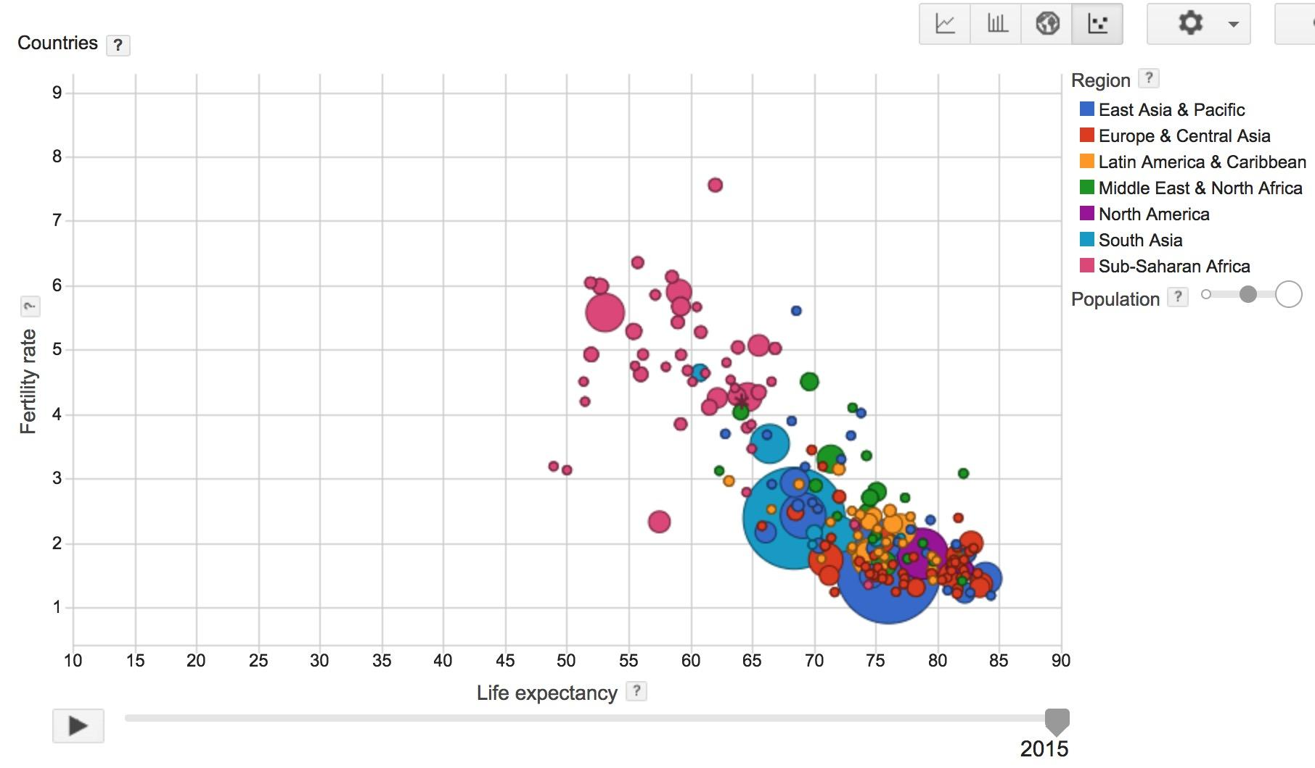
Visualization made by Google, based on data collected by World Bank

Slide 6
Data Set
birth_life_2010.txt
Country Birth rate Life expectancy
Vietnam 1.822 74.828243902
Vanuatu 3.869 70.819487805
Tonga 3.911 72.150658537
…

Slide 7
Model

Slide 8
Want
Find a linear relationship between X and Y
to predict Y from X

Slide 9
Model
Inference: Y_predicted = w * X + b
This is the equation of a line (what is Y based on X)
W is our slope and b is an offset
Mean squared error:$E[{\left(y − y_{predicted}\right)}^{2}]$
How far off each value y is from where the line said it should be

Slide 10
Phase 1: Create Model
Read data file to use as X and Y
Create weight/bias variables, w and b
Inference/prediction (that there is a line that fits these)
Loss function (squared differential)
Optimizer (gradient descent)

Slide 11
Base Code (TF2)
data, n_samples = read_birth_life_data("birth_life_2010.txt")
dataset = tf.data.Dataset.from_tensor_slices((data[:,0], data[:,1]))
w = tf.Variable(0.0)
b = tf.Variable(0.0)
def prediction(x):
return x * w + b
def squared_loss(y, y_predicted):
return (y - y_predicted) ** 2
optimizer = tf.keras.optimizers.SGD(learning_rate=0.001)

Slide 12
Datasets

Slide 13
Store data in tf.data.Dataset
tf.data.Dataset.from_tensor_slices((features, labels))
Can create by slicing existing data in parts
tf.data.Dataset.from_generator(gen, output_types, output_shapes)
Or by generating from function
Could make normal distribution data, or uniform, etc.

Slide 14
Store data in tf.data.Dataset
tf.data.Dataset.from_tensor_slices((features, labels))
dataset = tf.data.Dataset.from_tensor_slices((data[:,0], data[:,1]))
We use the method that takes file loaded data and splits into X/Y
Features → what we learn from, X
Labels → what we’ve decided the features should be called, Y

Slide 15
Store data in tf.data.Dataset
tf.data.Dataset.from_tensor_slices((features, labels))
dataset = tf.data.Dataset.from_tensor_slices((data[:,0], data[:,1]))
print(dataset.output_types) # >> (tf.float32, tf.float32)
print(dataset.output_shapes) # >> (TensorShape([]), TensorShape([]))

Slide 16
Make our model

Slide 17
1. Read data file, slice into X, Y parts in a dataset (TF2)
data, n_samples = read_birth_life_data("birth_life_2010.txt")
dataset = tf.data.Dataset.from_tensor_slices((data[:,0], data[:,1]))

Slide 18
2. Create weight and bias (TF2)
w = tf.Variable(0.0)
b = tf.Variable(0.0)

Slide 19
3. Inference (TF2)
def prediction(x):
return x * w + b
A line based on two variables slope w, and offset b
Out input X is used to calculate some output Y

Slide 20
Specify loss function (TF2)
def squared_loss(y, y_predicted):
return (y - y_predicted) ** 2
Squared differential (farther away is much worse than slightly off)

Slide 21
Create optimizer (TF2)
optimizer = tf.keras.optimizers.SGD(learning_rate=0.001)
Gradient descent is a way to minimize an objective parameterized by a model's parameters by updating the parameters in the opposite direction of the gradient of the objective function w.r.t. to the parameters.
The learning rate determines the size of the steps we take to reach a (local) minimum.

Slide 22
Train our model

Slide 23
Phase 2: Train our model
Train model using optimizer

Slide 24
Base Code (TF2)
EPOCHS = 100
for epoch in range(EPOCHS):
total_loss = 0.0
for x, y in dataset:
with tf.GradientTape() as tape:
l = squared_loss(y, prediction(x))
total_loss += l
gradients = tape.gradient(l, [w,b])
optimizer.apply_gradients(zip(gradients, [w,b]))
print('Epoch {0}: {1}'.format(epoch, total_loss / n_samples))
print(f'w:{w.numpy()} b:{b.numpy()}')

Slide 25
1. Training (TF2)
for x, y in dataset:
with tf.GradientTape() as tape:
l = squared_loss(y, prediction(x))
gradients = tape.gradient(l, [w,b])
optimizer.apply_gradients(zip(gradients, [w,b]))
For each x,y find out the error, use the error as a gradient to update w,b

Slide 26
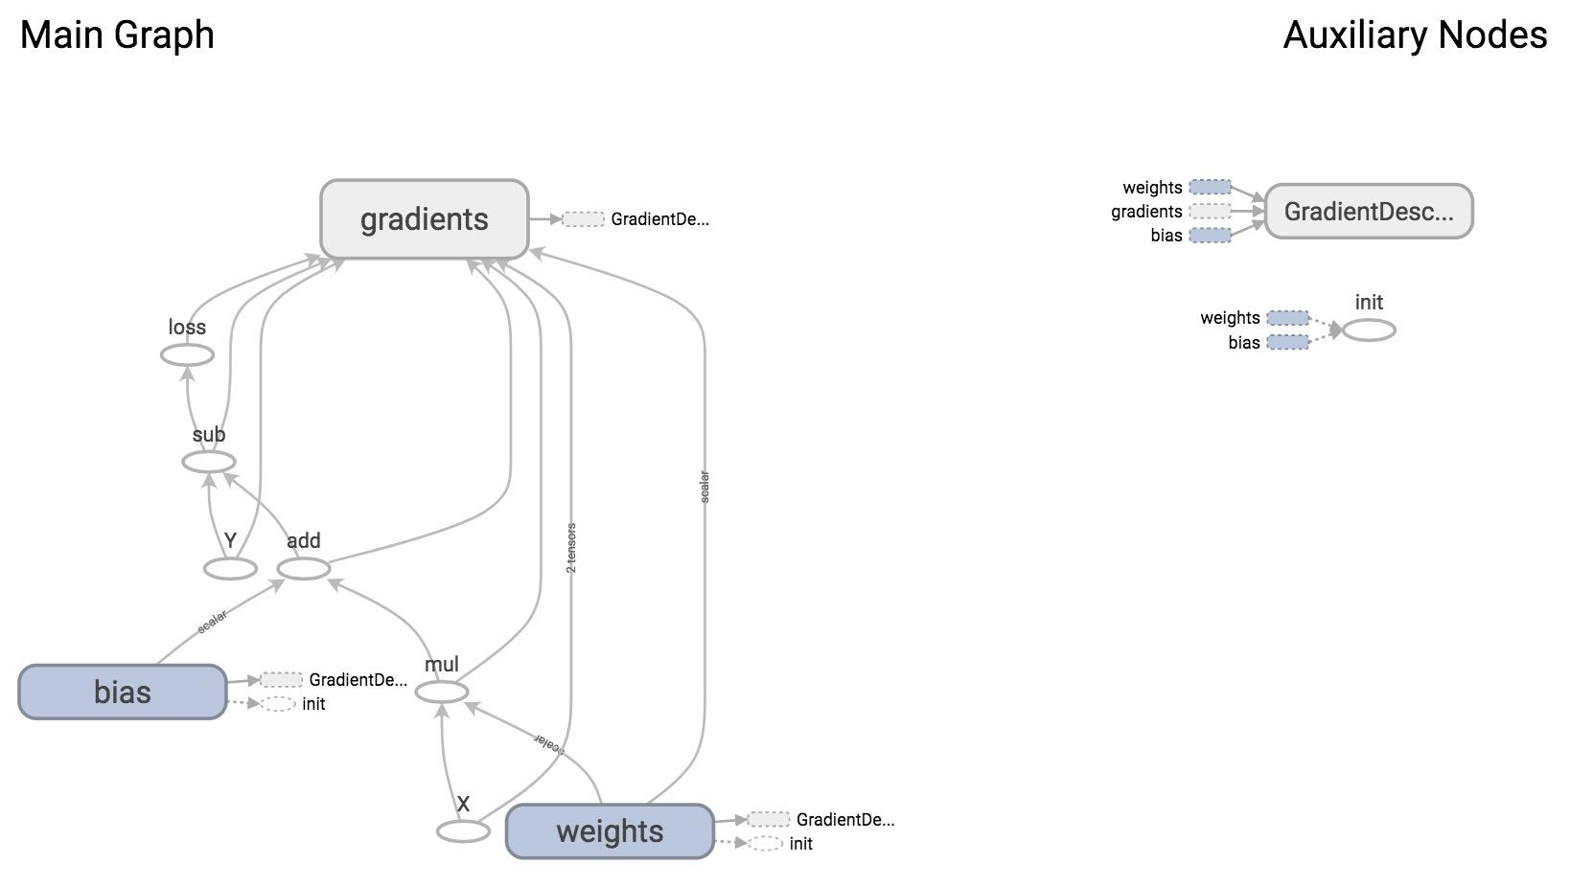

Slide 27
Optimizer
TensorFlow looks at all trainable variables that optimizer depends on and updates them

Slide 28
Trainable variables
tf.Variable(initial_value=None, trainable=True,...)
Specify if a variable should be trained or not
By default, all variables are trainable

Slide 29
Results

Slide 30
Plot the results with matplotlib

Slide 31
Even easier?
Keras

Slide 32
Same Code in Keras (TF2)
data, n_samples = read_birth_life_data("birth_life_2010.txt")
model = tf.keras.Sequential([
tf.keras.layers.Dense(1)
])
EPOCHS=100
optimizer = tf.keras.optimizers.SGD(learning_rate=0.05)
model.compile(loss='mse',optimizer=optimizer)
model.fit(data[:,0],data[:,1],epochs=EPOCHS)
w = model.layers[0].get_weights()[0][0][0]
b = model.layers[0].get_weights()[1][0]
print(w, b)

Slide 33
Onward to … TensorFlow Neural Network.
Jonathan Hudson
jwhudson@ucalgary.ca
https://pages.cpsc.ucalgary.ca/~hudsonj/

