Slide 1
AI: TensorFlow API
CPSC 501: Advanced Programming Techniques
Fall 2020
Jonathan Hudson, Ph.D
Instructor
Department of Computer Science
University of Calgary
Monday, August 24, 2020

Slide 2
Tensors

Slide 3
Constants
import tensorflow as tf
a = tf.constant([2, 2], name='a') b = tf.constant([[0, 1], [2, 3]], name='b')
tf.constant(
value,
dtype=None,
shape=None,
name='Const',
verify_shape=False
)

Slide 4
Tensors filled with a specific value
tf.zeros(shape, dtype=tf.float32, name=None)
creates a tensor of shape and all elements will be zeros
tf.zeros([2, 3], tf.int32) ==> [[0, 0, 0], [0, 0, 0]]
Similar to numpy.zeros

Slide 5
Tensors filled with a specific value
tf.zeros_like(input_tensor, dtype=None, name=None, optimize=True)
creates a tensor of shape and type (unless type is specified) as the input_tensor but all elements are zeros.
# input_tensor is [[0, 1], [2, 3], [4, 5]]
tf.zeros_like(input_tensor) ==> [[0, 0], [0, 0], [0, 0]]
Similar to numpy.zeros_like

Slide 6
Tensors filled with a specific value
tf.ones(shape, dtype=tf.float32, name=None)
tf.ones_like(input_tensor, dtype=None, name=None, optimize=True)
Similar to numpy.ones, numpy.ones_like

Slide 7
Tensors filled with a specific value
tf.fill(dims, value, name=None)
creates a tensor filled with a scalar value.
tf.fill([2, 3], 8) ==> [[8, 8, 8], [8, 8, 8]]
Similar to NumPy.full

Slide 8
Constants as sequences
tf.lin_space(start, stop, num, name=None) tf.lin_space(10.0, 13.0, 4) ==> [10. 11. 12. 13.]
tf.range(start, limit=None, delta=1, dtype=None, name='range') tf.range(3, 18, 3) ==> [3 6 9 12 15] tf.range(5) ==> [0 1 2 3 4]
NOT THE SAME AS NUMPY SEQUENCES
Tensor objects are not iterable
for _ in tf.range(4): # TypeError

Slide 9
Randomly Generated Constants
tf.random_normal
tf.truncated_normal
tf.random_uniform
tf.random_shuffle
tf.random_crop
tf.multinomial
tf.random_gamma

Slide 10
Randomly Generated Constants
tf.set_random_seed(seed)

Slide 11
Operations

Slide 12
Operations
Buduma. Fundamentals of Deep Learning. O’Reilly, 2017

Slide 13
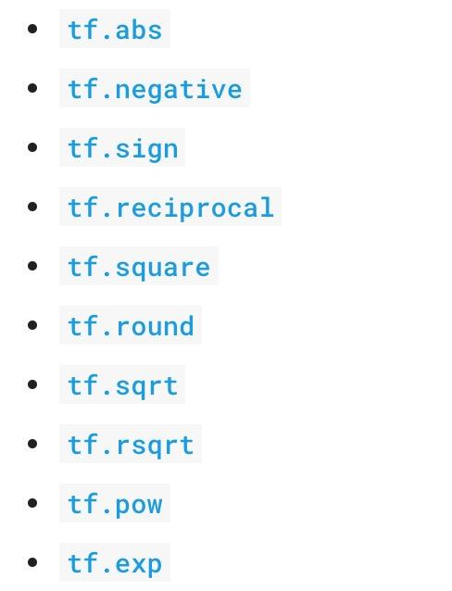
Arithmetic Ops
Pretty standard, quite similar to numpy.

Slide 14
Wizard of Div (note in TF1 session format)
a = tf.constant([2, 2], name='a')
b = tf.constant([[0, 1], [2, 3]], name='b')
with tf.Session() as sess:
print(sess.run(tf.div(b, a))) ⇒ [[0 0] [1 1]]
print(sess.run(tf.divide(b, a))) ⇒ [[0. 0.5] [1. 1.5]]
print(sess.run(tf.truediv(b, a))) ⇒ [[0. 0.5] [1. 1.5]]
print(sess.run(tf.floordiv(b, a))) ⇒ [[0 0] [1 1]]
print(sess.run(tf.realdiv(b, a))) ⇒ # Error: only works for real values
print(sess.run(tf.truncatediv(b, a))) ⇒ [[0 0] [1 1]]
print(sess.run(tf.floor_div(b, a))) ⇒ [[0 0] [1 1]]

Slide 15
Data Types

Slide 16
TensorFlow Data Types
TensorFlow takes Python natives types: boolean, numeric (int, float), strings
t_0 = 19 # scalars are treated like 0-d tensors
tf.zeros_like(t_0) # ==> 0
tf.ones_like(t_0) # ==> 1

Slide 17
TensorFlow Data Types
TensorFlow takes Python natives types: boolean, numeric (int, float), strings
t_1 = [b"apple", b"peach"] # 1-d arrays are like 1-d tensors
tf.zeros_like(t_1) # ==> [b””, b””]
tf.ones_like(t_1) # ==> TypeError: Expected string, got 1 of type

Slide 18
TensorFlow Data Types
TensorFlow takes Python natives types: boolean, numeric (int, float), strings
t_2 = [[True, False, False],
[False, False, True],
[False, True, False]] # 2-d arrays are treated like 2-d tensors
tf.zeros_like(t_2) # ==> 3x3 tensor, all elements are False
tf.ones_like(t_2) # ==> 3x3 tensor, all elements are True

Slide 19
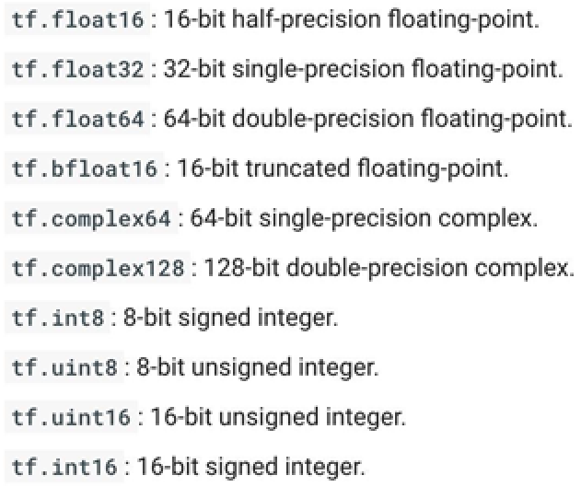
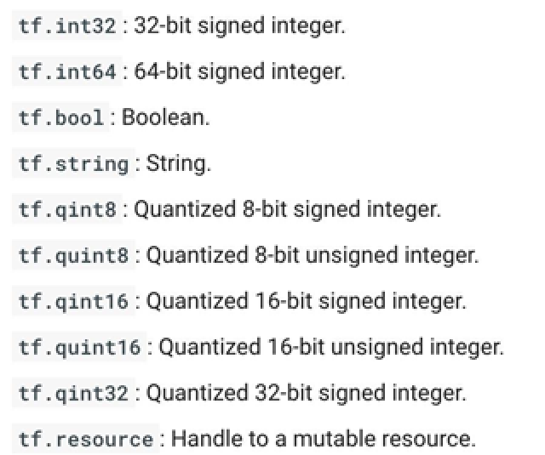
TensorFlow Data Types

Slide 20
TF vs NP Data Types
TensorFlow integrates seamlessly with NumPy
tf.int32 == np.int32 # ⇒ True
Can pass numpy types to TensorFlow ops
tf.ones([2, 2], np.float32) # ⇒ [[1.0 1.0], [1.0 1.0]]

Slide 21
Use TF DType when possible
Python native types: TensorFlow has to infer Python type
NumPy arrays: NumPy is not GPU compatible

Slide 22
Constants?

Slide 23
Constants?
What’s wrong with constants ...
… other than being constant?

Slide 24
What’s wrong with constants?
Constants are stored in the graph definition

Slide 25
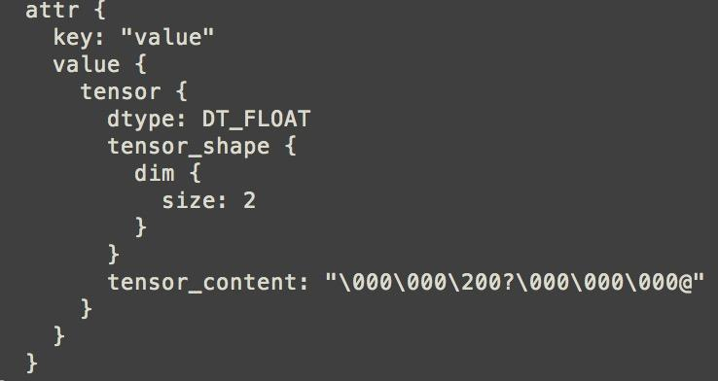
Print out the graph def
my_const = tf.constant([1.0, 2.0], name="my_const")
with tf.Session() as sess: print(sess.graph.as_graph_def())

Slide 26
What’s wrong with constants?
This makes loading graphs expensive when constants are big
Only use constants for primitive types.
Use variables or readers for more data that requires more memory

Slide 27
Variables

Slide 28
Variables (TF2)
# create variables with tf.Variable
s = tf.Variable(2, name="scalar")
m = tf.Variable([[0, 1], [2, 3]], name="matrix")
W = tf.Variable(tf.zeros([784,10]))

Slide 29
Variables
Why tf.constant but tf.Variable?
tf.Variable is a class with many ops
tf.Variable holds several ops:
x = tf.Variable(...)
x.initializer # init op
x.value() # read op
x.assign(...) # write op
x.assign_add(...) # and more

Slide 30
Shapes

Slide 31
Shapes
A tuple of dimensions
Often reported when asking about what data is ‘like’ in a graph (tensor)
(28,28) is a matrix of 28 entries by 28 entries (grayscale image)
(5) Is a one-dimensional array of length 5
() Is a scalar
(28,28,3) is a matrix of 28 by 28 entries with each entry being having three items (3d matrix) -> RGB image

Slide 32
Onward to … TensorFlow linear regression.
Jonathan Hudson
jwhudson@ucalgary.ca
https://pages.cpsc.ucalgary.ca/~hudsonj/

