Slide 1
AI: TensorFlow Applied
CPSC 501: Advanced Programming Techniques
Fall 2020
Jonathan Hudson, Ph.D
Instructor
Department of Computer Science
University of Calgary
Monday, August 24, 2020

Slide 2
import tensforflow as tf
TF Learn (tf.contrib.learn): simplified interface that helps users transition from the the world of one-liner such as scikit-learn
TF Slim (tf.contrib.slim): lightweight library for defining, training and evaluating complex models in TensorFlow.
High level API: Keras, TFLearn, Pretty Tensor
Off-the-shelf models are not the main purpose of TensorFlow
scikit is mostly off the shelf package
Keras is built-in for TF 2.0
We will be using TF 2.0

Slide 3
Why TensorFlow 2.0
Why TF 2.0
It is the default
pip install tensorflow
gives you 2.0
you have to request 1.15 (last 1.XX version, had eager execution)
Works naturally with models and keras
Annoyingly we are in transition period (lots of tutorials are 1.XX based)

Slide 4
Data

Slide 5
What’s a tensor?
An n-dimensional array
0-d tensor: scalar (number)
1-d tensor: vector
2-d tensor: matrix
and so on

Slide 6
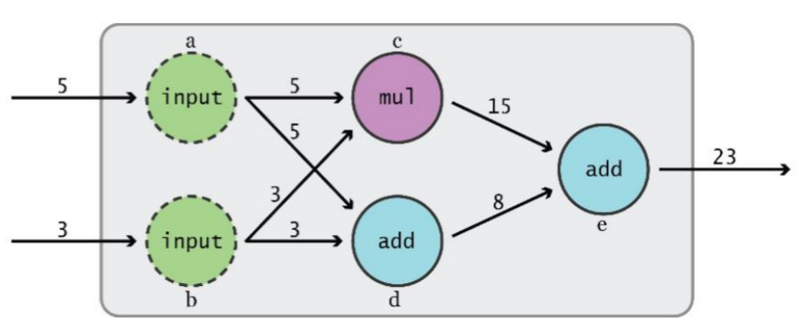
Data Flow
Tensor -> Data
Flow -> Move
Visualize TensorFlow operations as graphs

Slide 7
Data Flow
Visualize TensorFlow operations as graphs
TensorFlow 2.0 (Eager Execution)
Assembles and executes a graph at same time

Slide 8
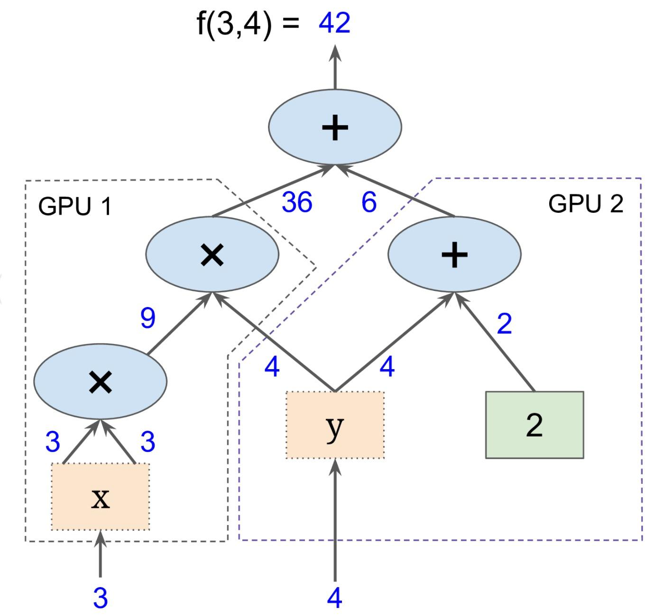
Subgraphs
Possible to break graphs into several chunks and run them parallelly across multiple CPUs, GPUs, TPUs, or other devices
Graph from Hands-On Machine Learning with Scikit-Learn and TensorFlow

Slide 9
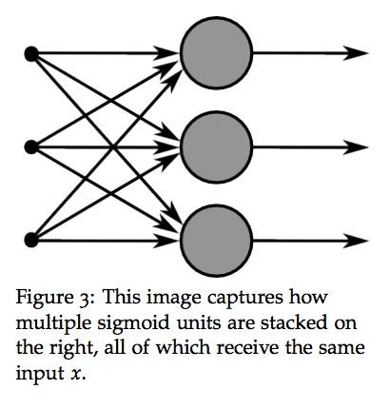
Why graphs
Save computation. Only run subgraphs that lead to the values you want to fetch.
Break computation into small, differential pieces to facilitate auto-differentiation
Facilitate distributed computation, spread the work across multiple CPUs, GPUs, TPUs, or other devices
Many common machine learning models are taught and visualized as directed graphs

Slide 10
Simple example

Slide 11
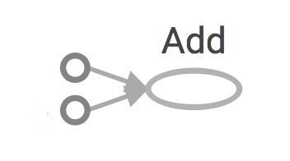
Data Flow Graphs (TF2)
import tensorflow as tf a = tf.add(3, 5) print(a)
print(a.numpy())
3
5
a
>> tf.Tensor(8, shape=(), dtype=int32)
>> 8
We now have a value 8 (eager execution)

Slide 12
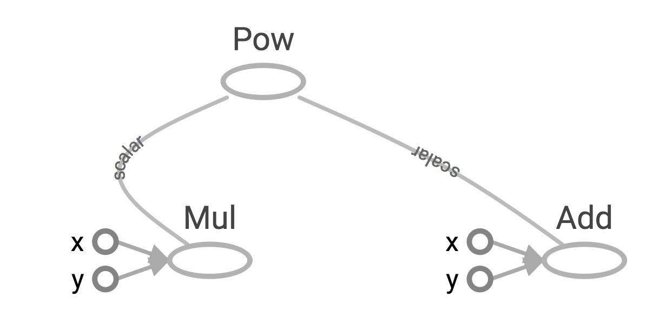
Larger graph (TF2)
x = 2 y = 3 op1 = tf.add(x, y) op2 = tf.multiply(x, y) op3 = tf.pow(op2, op1)
print(op3.numpy())

Slide 13
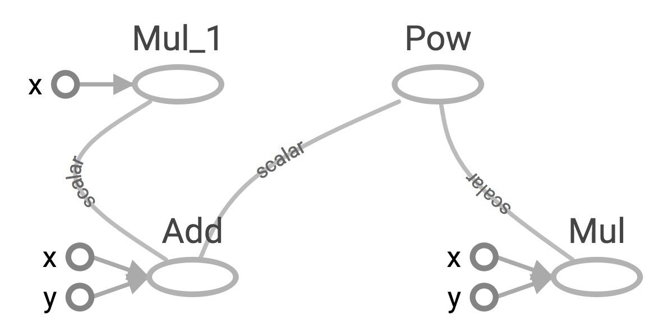
Subgraphs (TF2)
x = 2
y = 3
add_op = tf.add(x, y)
mul_op = tf.multiply(x, y)
useless = tf.multiply(x, add_op)
pow_op = tf.pow(mul_op, add_op)
print(pow_op.numpy(), useless.numpy())
useless
pow_op
add_op
mul_op

Slide 14
Visualize

Slide 15
Visualize it with TensorBoard (TF2)
@tf.function
def my_func(x, y):
return tf.add(x, y)
x = tf.constant(2)
y = tf.constant(3)
tf.summary.trace_on()
z = my_func(x, y)
writer = tf.summary.create_file_writer(logdir)
with writer.as_default():
tf.summary.trace_export(name="my_func_trace",step=0,profiler_outdir=logdir)
Create the summary writer after graph definition and before running your session

Slide 16
Run it
Go to terminal, run:
$ python [yourprogram].py $ tensorboard --logdir="./logs/tf1" --port 6006
Then open your browser and go to: http://localhost:6006/

Slide 18
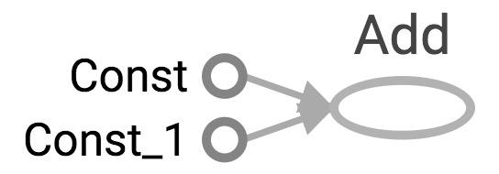
Visualize it with TensorBoard
import tensorflow as tf
a = tf.constant(2) b = tf.constant(3) x = tf.add(a, b) writer = tf.summary.FileWriter(logdir, tf.get_default_graph()) writer.close()
Question:
How to change Const, Const_1 to the names we give the variables?

Slide 19
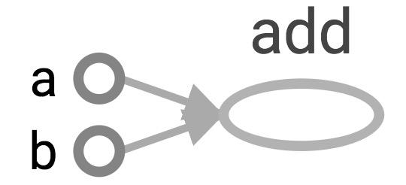
Explicitly name them
import tensorflow as tf
a = tf.constant(2, name='a') b = tf.constant(3, name='b') x = tf.add(a, b, name='add')
writer = tf.summary.FileWriter(logdir, tf.get_default_graph()) writer.close()

Slide 20
TensorBoard
TensorBoard can do much more than just visualizing your graphs.
Learning to use TensorBoard is a valuable skill.

Slide 21
Onward to … TensorFlow API.
Jonathan Hudson
jwhudson@ucalgary.ca
https://pages.cpsc.ucalgary.ca/~hudsonj/

