Slide 1
AI: TensorFlow
CPSC 501: Advanced Programming Techniques
Fall 2020
Jonathan Hudson, Ph.D
Instructor
Department of Computer Science
University of Calgary
Monday, August 24, 2020

Slide 2
Machine learning
Mathematical concepts behind deep learning have been around for decades
Programming libraries dedicated to creating and training these deep models have only been available in recent years
Often a trade-off
Flexible for research
Fast and efficient for production
TensorFlow attempts to solve this problem

Slide 3
Context (circa 2015)
Deep learning already claiming big successes
Number of developers/researchers exploding
A “zoo” of tools and libraries, some of questionable quality…

Slide 4
TensorFlow

Slide 5
What is TensorFlow?
Created by Google as an internal machine learning tool
Open sourced under the Apache 2.0 License in November 2015
An open-source software library for Machine Intelligence
numerical computation using data flow graphs
Google maintains its own internal version.
One of more than a dozen of machine intelligence libraries developed by big companies
Other libraries
https://en.wikipedia.org/wiki/Comparison_of_deep_learning_software

Slide 6
What is TensorFlow?
Open source library for numerical computation using data flow graphs
Developed by Google Brain Team to conduct machine learning research
Based on DisBelief used internally at Google since 2011
“TensorFlow is an interface for expressing machine learning algorithms, and an implementation for executing such algorithms”

Slide 7
Why TensorFlow?
Popularity
Top are Theano, Torch, and TensorFlow.
Torch framework is written in Lua, which is a wonderful language but one most popular in game development and AI community.
Theano has an additional “graph compilation” step that took significant amounts of time and frustration
TensorFlow has a much cleaner interface as compared to Theano.
TensorFlow was built with production use in mind

Slide 8
Why TensorFlow?
The ability to run in mobile environments
Easily build models that span multiple GPUs on a single machine
Train large-scale networks in a distributed fashion
Python API
Portability: CPU/GPU
Flexibility: OS environments
Visualization (TensorBoard is very useful)
Checkpoints (for managing experiments)
Large community.

Slide 9
Gradient computation: Backpropagation
train_step = tf.train.GradientDescentOptimizer(0.5).minimize(cross_entropy)
tf.train.GradientDescentOptimizer is an Optimizer object
tf.train.GradientDescentOptimizer(lr).minimize(cross_entropy) adds optimization operation to computation graph
TensorFlow graph nodes have attached gradient operations
Gradient with respect to parameters computed with backpropagation … automatically

Slide 10
Examples

Slide 11
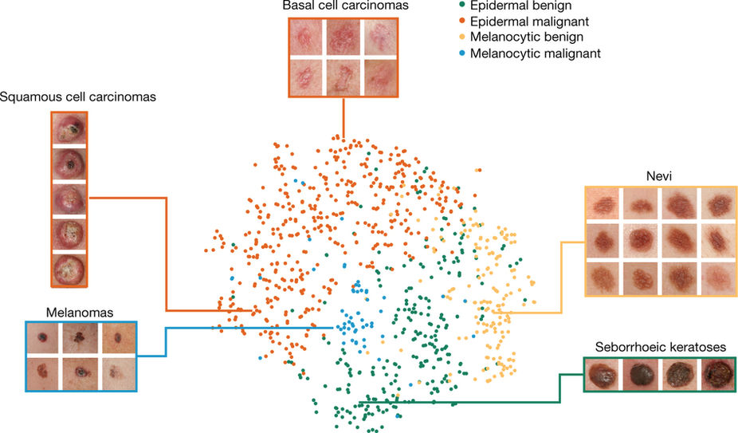
Examples: Classify skin cancer
Dermatologist-level classification of skin cancer with deep neural networks (Esteva et al., Nature 2017)

Slide 12
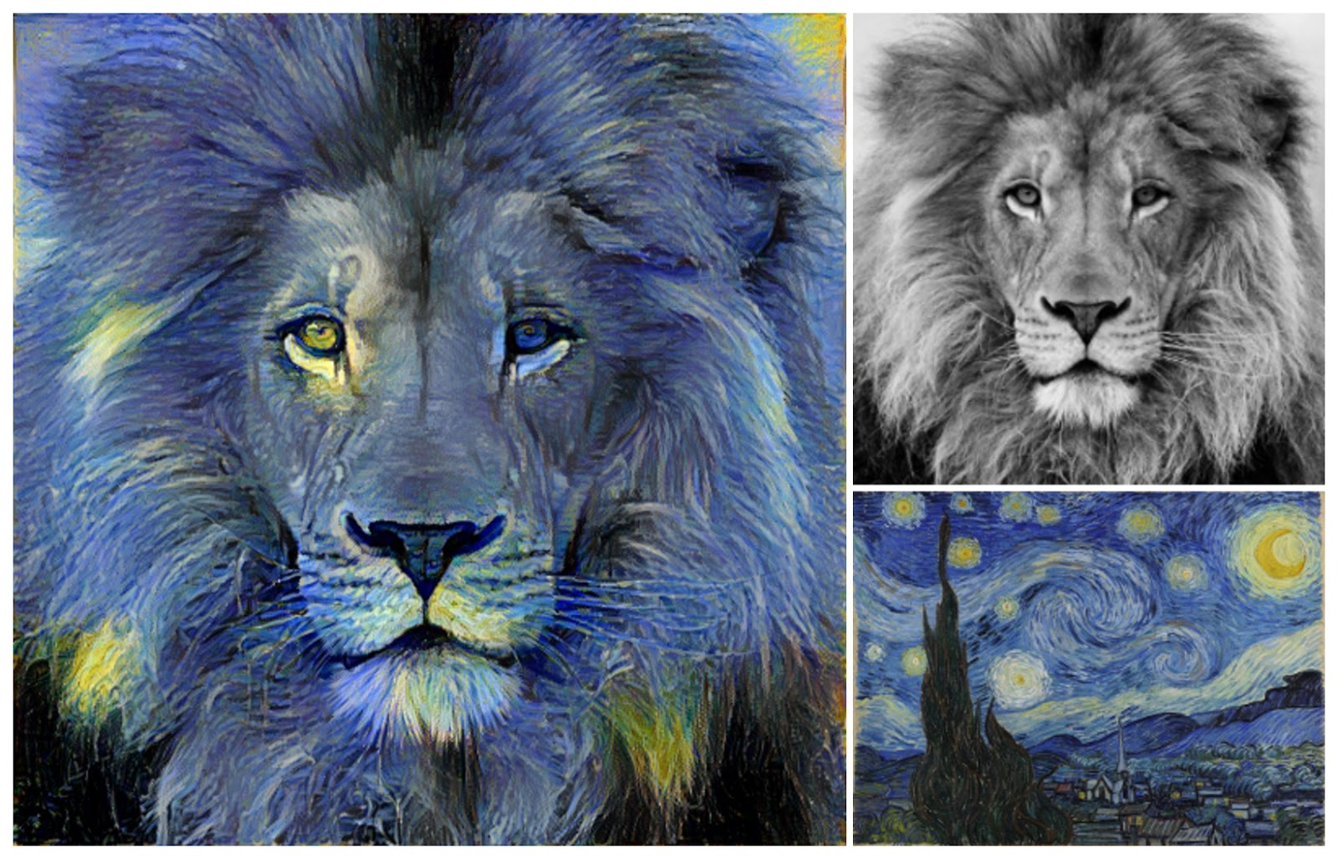
Examples: Neural Style Translation
Image Style Transfer Using Convolutional Neural Networks (Gatys et al., 2016) Tensorflow adaptation by Cameroon Smith (cysmith@github)

Slide 13
Goals
Understand TF’s approach to moving data through graphs
Explore what is built into the language as tools
Learn to build simple models for machine learning

Slide 14
Architecture

Slide 15
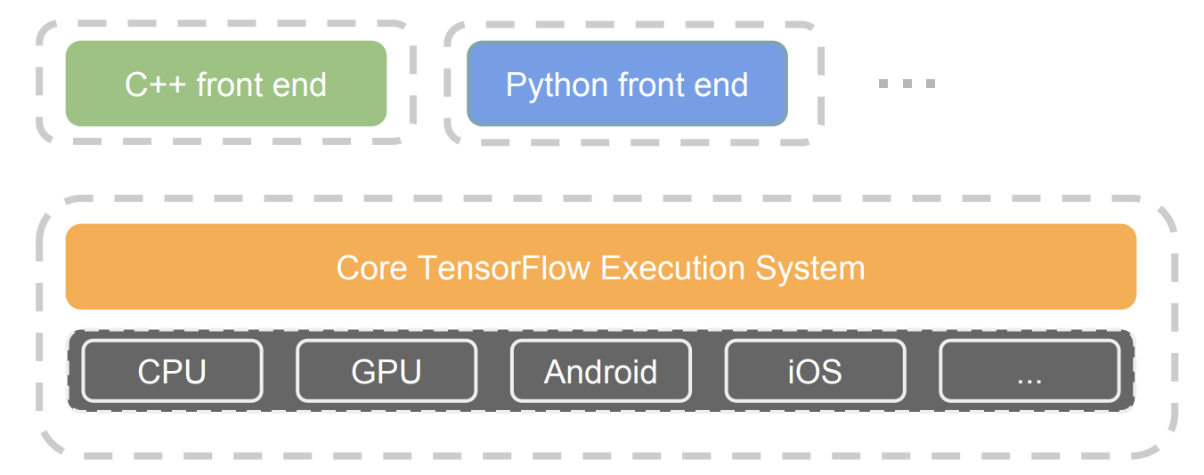
TensorFlow architecture
Core in C++
Very low overhead
Different front ends for specifying/driving the computation
Started with Python and C++
From: http://www.wsdm-conference.org/2016/slides/WSDM2016-Jeff-Dean.pdf

Slide 16
Detailed architecture
From: https://www.tensorflow.org/extend/architecture

Slide 17
Key components
Similar to MapReduce, Apache Hadoop, Apache Spark, …
From: https://www.tensorflow.org/extend/architecture

Slide 18
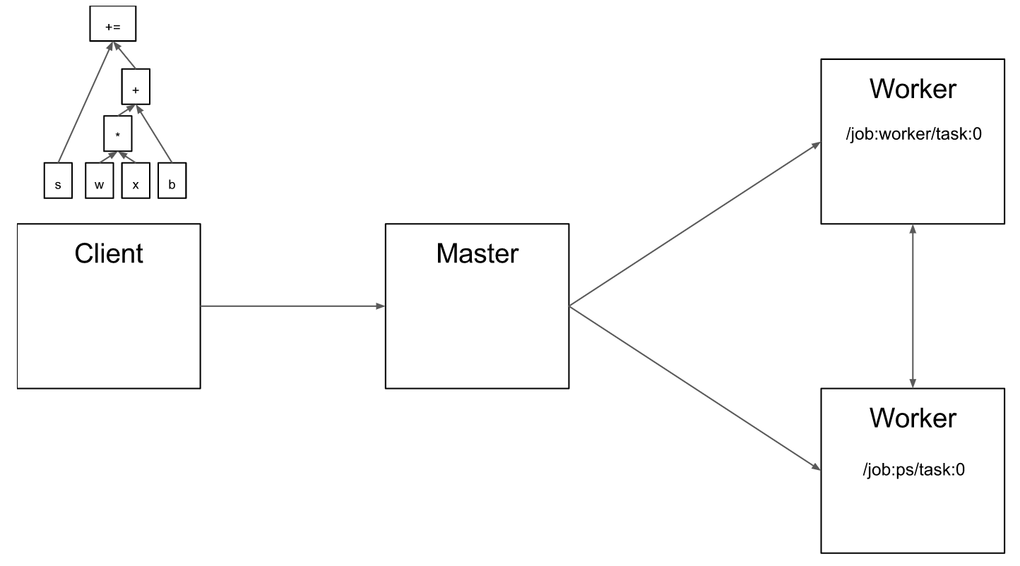
Client
From: https://www.tensorflow.org/extend/architecture

Slide 19
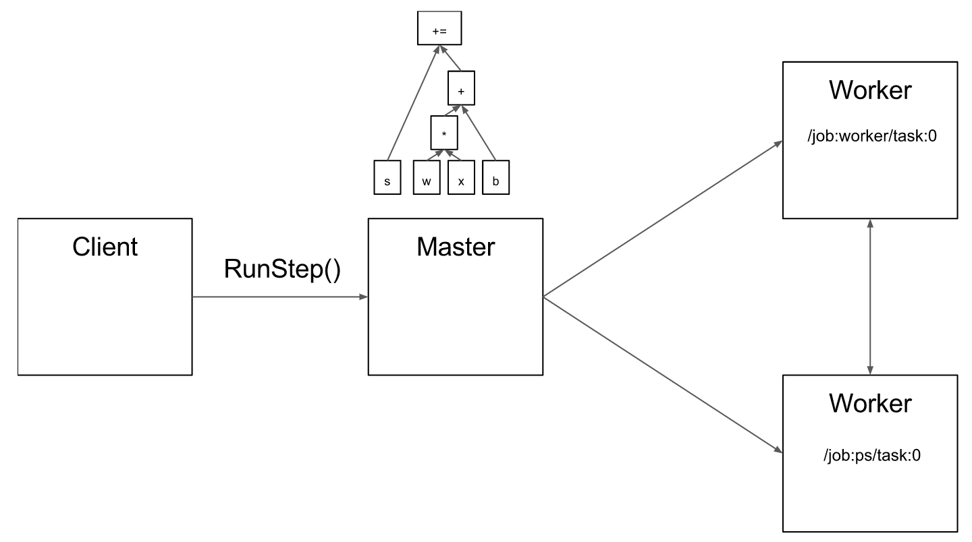
Master
From: https://www.tensorflow.org/extend/architecture

Slide 20
Compution Graphs

Slide 21
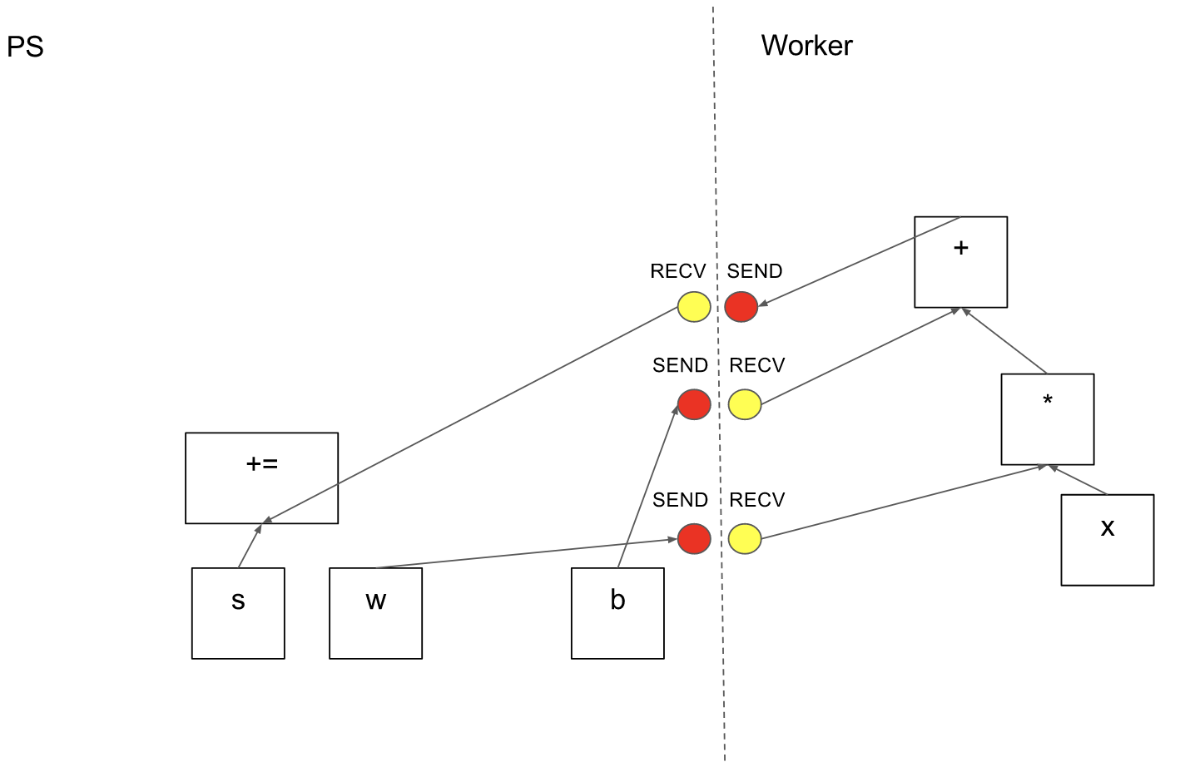
Computation graph partition
From: https://www.tensorflow.org/extend/architecture

Slide 22
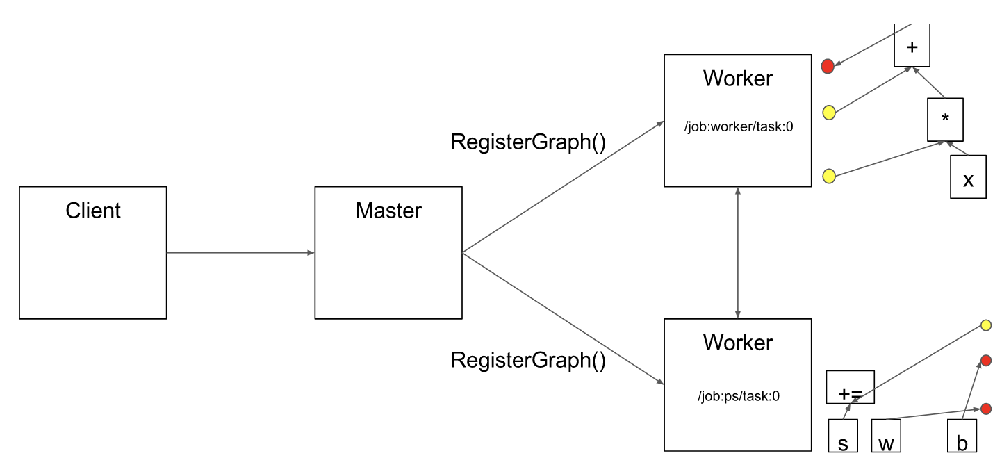
Computation graph partition
From: https://www.tensorflow.org/extend/architecture

Slide 23
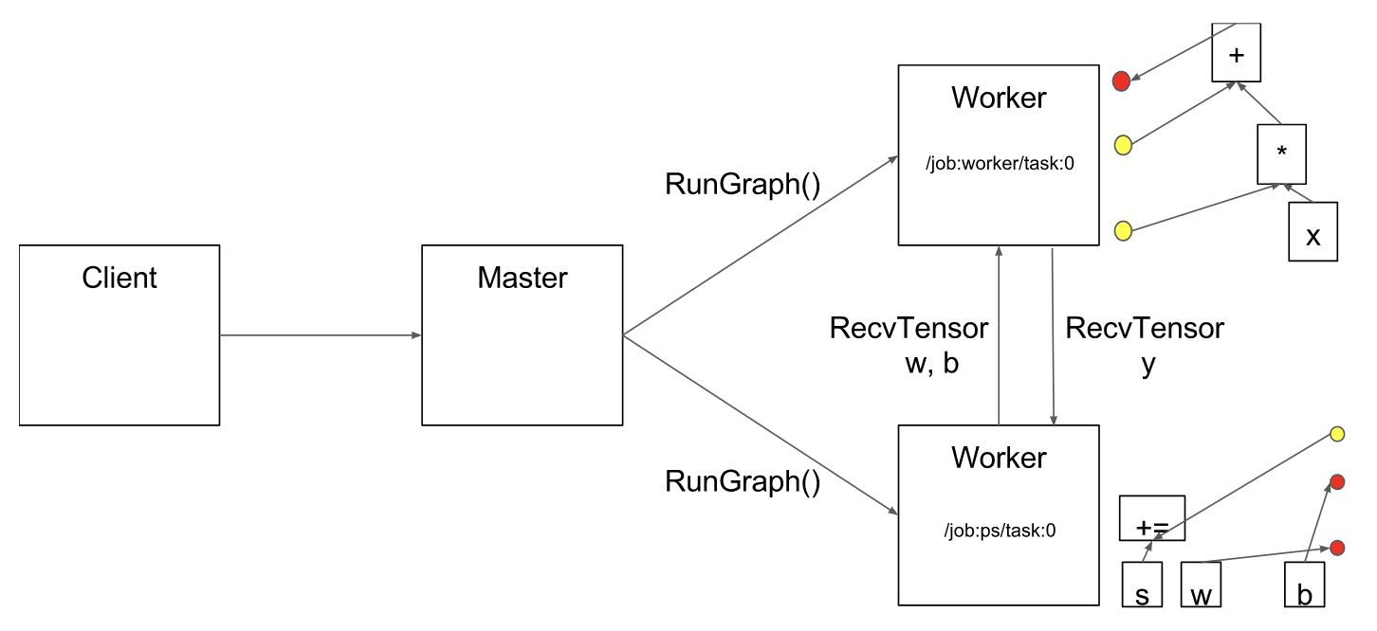
Execution
From: https://www.tensorflow.org/extend/architecture

Slide 24
Onward to … TensorFlow Applied.
Jonathan Hudson
jwhudson@ucalgary.ca
https://pages.cpsc.ucalgary.ca/~hudsonj/

