Slide 1
AI: Neural Networks
CPSC 501: Advanced Programming Techniques
Fall 2020
Jonathan Hudson, Ph.D
Instructor
Department of Computer Science
University of Calgary
Monday, August 24, 2020

Slide 2
A short history of Neural Networks
1957: Perceptron (Frank Rosenblatt): one layer network neural network
1959: first neural network to solve a real world problem, i.e., eliminates echoes on phone lines (Widrow & Hoff)
First AI Winter
1988: Backpropagation (Rumelhart, Hinton, Williams): learning a multi-layered network
Second AI Winter

Slide 3
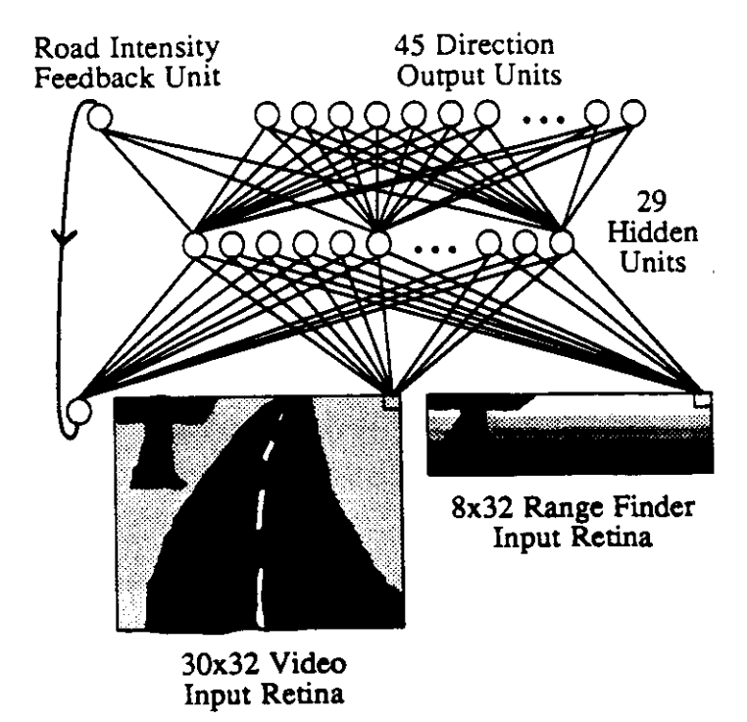
A short history of NNs
1989: ALVINN: autonomous driving car using NN (CMU)

Slide 4
A short history of NNs
1989: (LeCun) Successful application to recognize handwritten ZIP codes on mail using a “deep” network
2010s: near-human capabilities for image recognition, speech recognition, and language translation
2019 (AlphaStar) Google’s StarCraft 2 AI better than 99.8% of human players (GrandMaster level)

Slide 5
A short history of NNs

Slide 6
Perceptron
Not a Dr. Who Robot (or maybe it is?)

Slide 7
Perceptron
Invented by Frank Rosenblatt (1957): simplified mathematical model of how the neurons in our brains operate
From: http://www.andreykurenkov.com/writing/ai/a-brief-history-of-neural-nets-and-deep-learning/

Slide 8
Perceptron
Could implement AND, OR, but not XOR
From: http://www.andreykurenkov.com/writing/ai/a-brief-history-of-neural-nets-and-deep-learning/

Slide 9
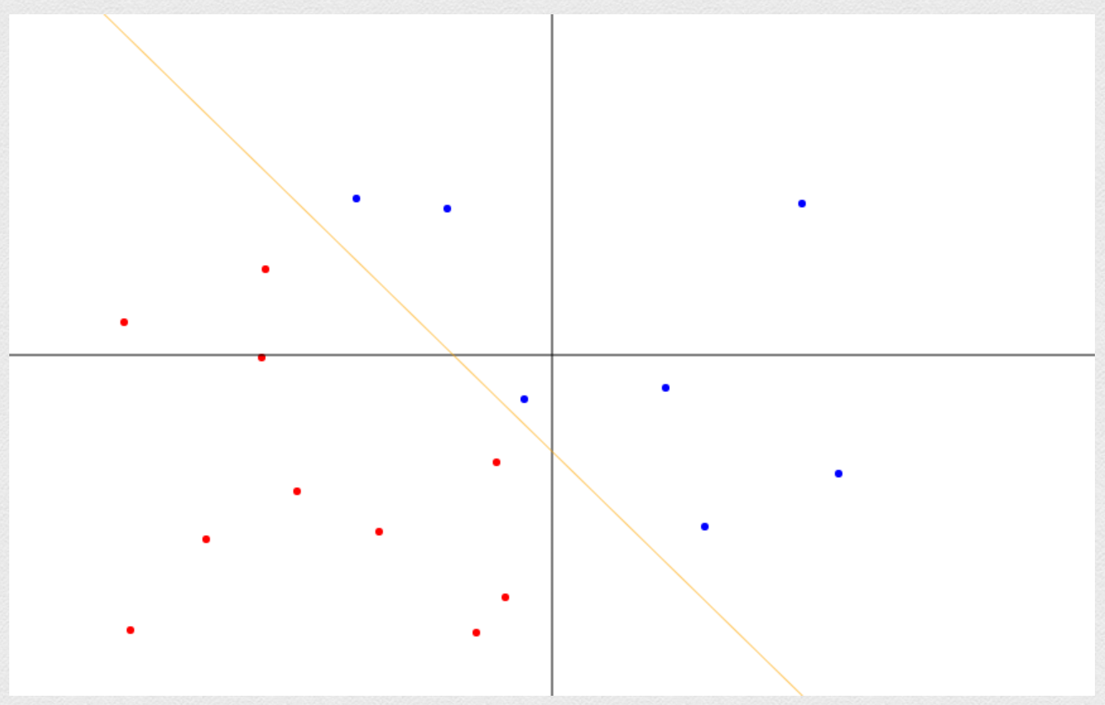
Perceptron
https://www.cs.utexas.edu/~teammco/misc/perceptron/

Slide 10
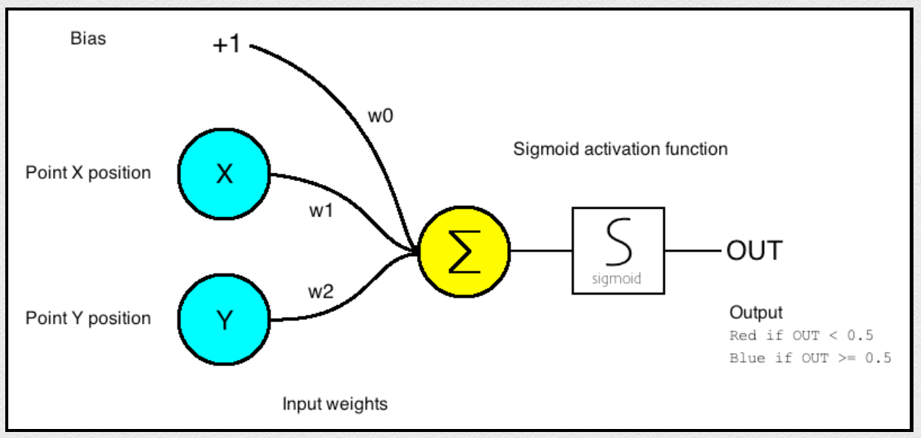
Perceptron

Slide 11
Activation Functions

Slide 12
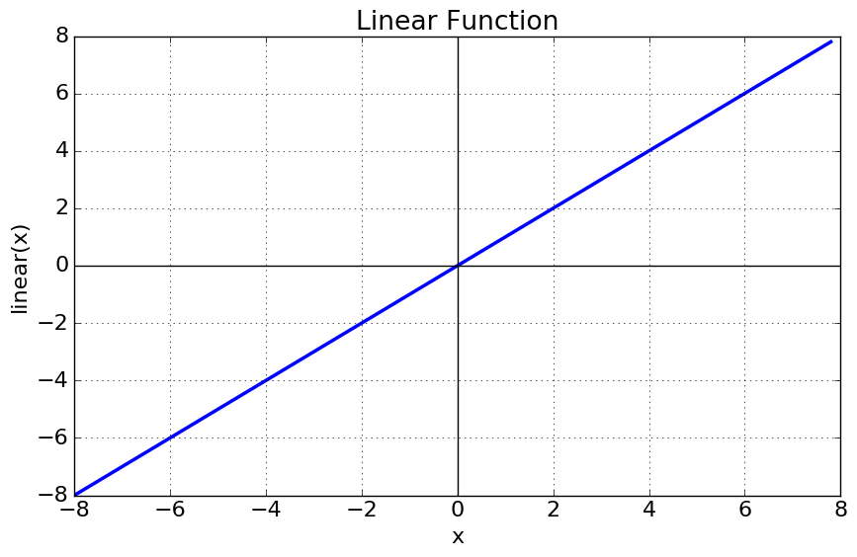
Activation Functions (Identity)

Slide 13
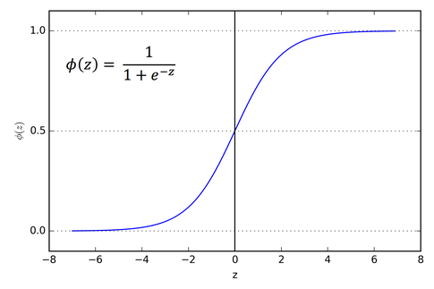
Sigmoid Activation Function

Slide 14
Sigmoid Activation Function
The main reason why we use sigmoid function is because gradations exist between (0 to 1)
Used for models where we have to predict the probability as an output.

Slide 15
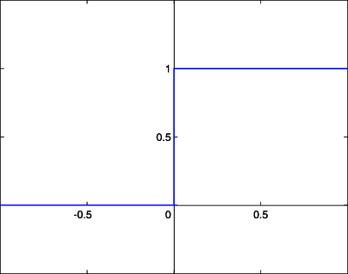
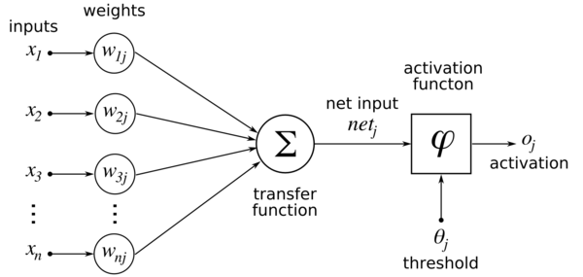
Step (Sigmoid) Activation Function
Replace a smooth function with a critical threshold point (if value exceeds then fully one answer)

Slide 16
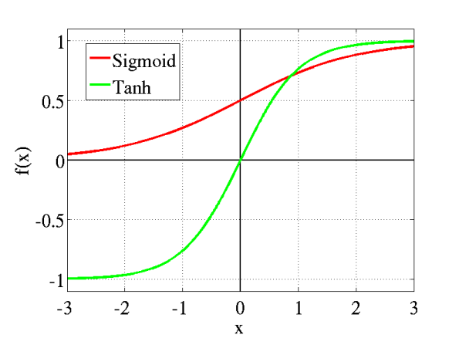
Tanh Activation Function
The advantage is that the negative inputs will be mapped strongly negative and the zero inputs will be mapped near zero in the tanh graph.
The tanh function is mainly used classification between two classes.

Slide 17
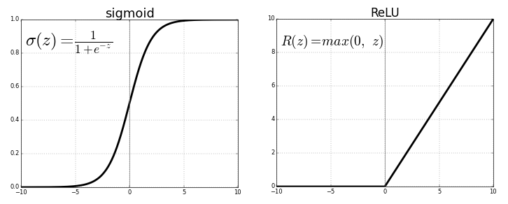
ReLU (Rectified Linear Unit) Activation Function
The ReLU is the most used activation function in the world right now.
Most used, due to Convolution Neural Network popularity
But the issue is that all the negative values become zero immediately which decreases the ability of the model to fit or train from the data properly.

Slide 18
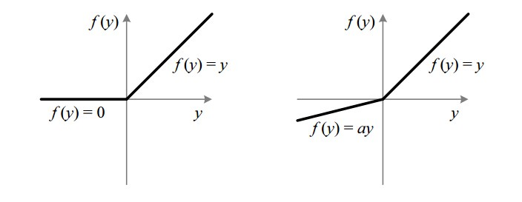
Leaky ReLU Activation Function
It is an attempt to solve the dying ReLU problem
The leak helps to increase the range of the ReLU function. Usually, the value of a is 0.01 or so.

Slide 20
Derivatives of Activation Functions

Slide 21
Layers

Slide 22
Hidden layers
Hidden layers can find features within the data and allow following layers to operate on those features
Can implement XOR
From: http://www.andreykurenkov.com/writing/ai/a-brief-history-of-neural-nets-and-deep-learning/

Slide 23
Learning: Backpropagation
From: http://www.andreykurenkov.com/writing/ai/a-brief-history-of-neural-nets-and-deep-learning/

Slide 24
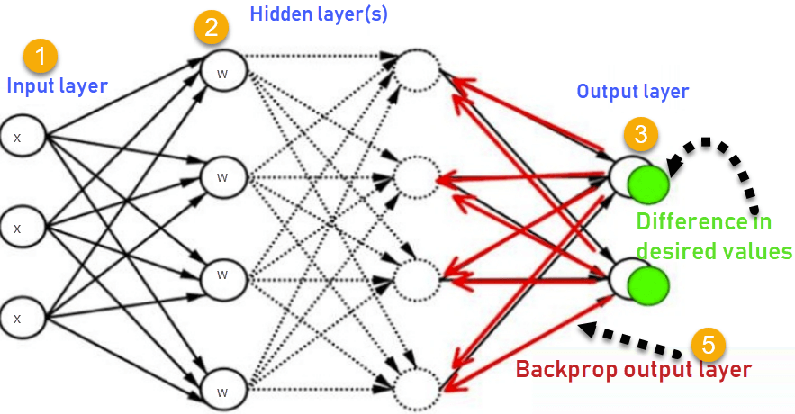
Back-Propagation

Slide 25
Back-Propagation
Inputs X, arrive through the preconnected path
Input is modeled using real weights W. The weights are usually randomly selected.
Calculate the output for every neuron from the input layer, to the hidden layers, to the output layer.
Calculate the error in the outputs
ErrorB= Actual Output – Desired Output
Travel back from the output layer to the hidden layer to adjust the weights such that the error is decreased.

Slide 26
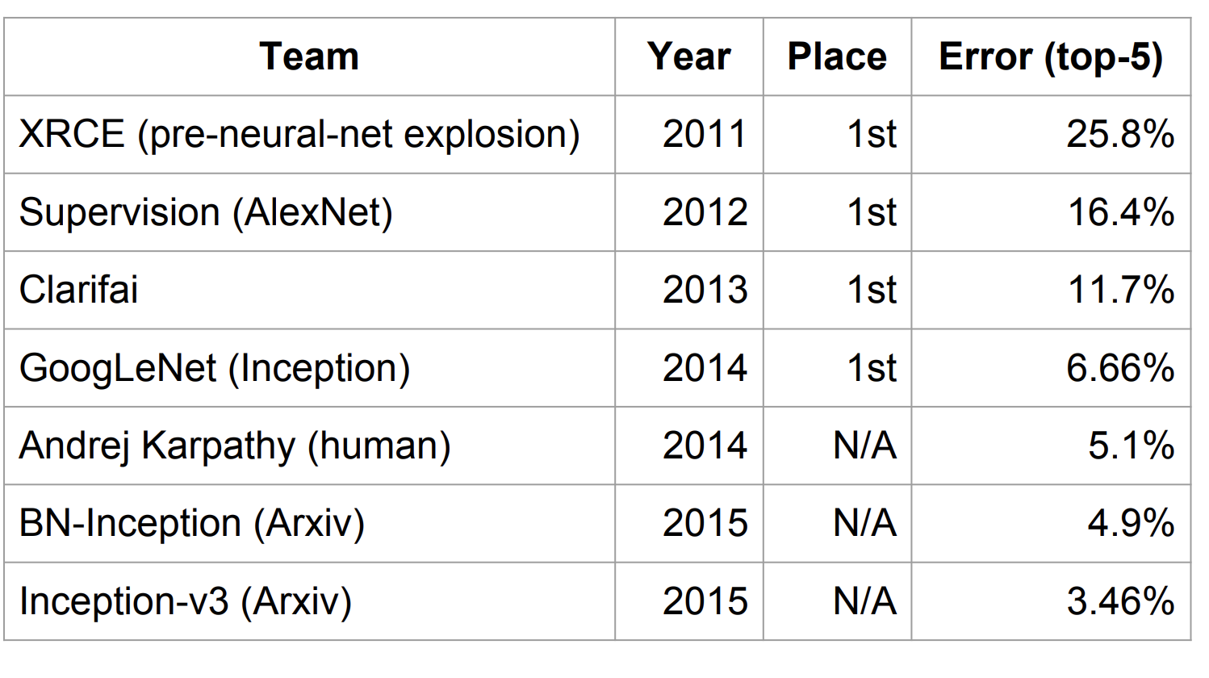
Context (circa 2015)
Deep learning already claiming big successes
Imagenet
challenge
classification
task
From: http://www.wsdm-conference.org/2016/slides/WSDM2016-Jeff-Dean.pdfz

Slide 27
Lesson: ImageNet

Slide 28
ImageNet
Not designed for people
Recently went viral
Sept 23, 2019
“ImageNet will remove 600,000 images of people stored on its database after an art project exposed racial bias in the program’s artificial intelligence system.”

Slide 29
ImageNet
First presented as a research poster in 2009
Scraped a collection of many millions of images from the internet
Trained through images categorized by Amazon Mechanical Turk workers
Crowdsourcing platform through which people can earn money performing small tasks
Sorted an average of 50 images per minute into thousands of categories
In 2012, a team from the University of Toronto used a Convolutional Neural Network to handily win the top prize
Final year 2017, and accuracy in classifying objects in the limited subset had risen from 71.8% to 97.3%. That did not include “Person” category

Slide 30
ImageNet
AI researcher Kate Crawford and artist Trevor Paglen
Training Humans — an exhibition that at the Prada Foundation in Milan
Part of their experiment also lives online at ImageNet Roulette, a website where users can upload their own photographs to see how the database might categorize them.
https://www.excavating.ai/
Example of the complexities and dangers of human classification
The sliding spectrum between supposedly unproblematic labels like “trumpeter” or “tennis player” to concepts like “spastic,” “mulatto,” or “redneck.”
ImageNet is an object lesson in what happens when people are categorized like objects.

Slide 31
Onward to … TensorFlow.
Jonathan Hudson
jwhudson@ucalgary.ca
https://pages.cpsc.ucalgary.ca/~hudsonj/

