Slide 1
AI: Introduction
CPSC 501: Advanced Programming Techniques
Fall 2020
Jonathan Hudson, Ph.D
Instructor
Department of Computer Science
University of Calgary
Monday, August 24, 2020

Slide 2
What is it?
Skynet?

Slide 3
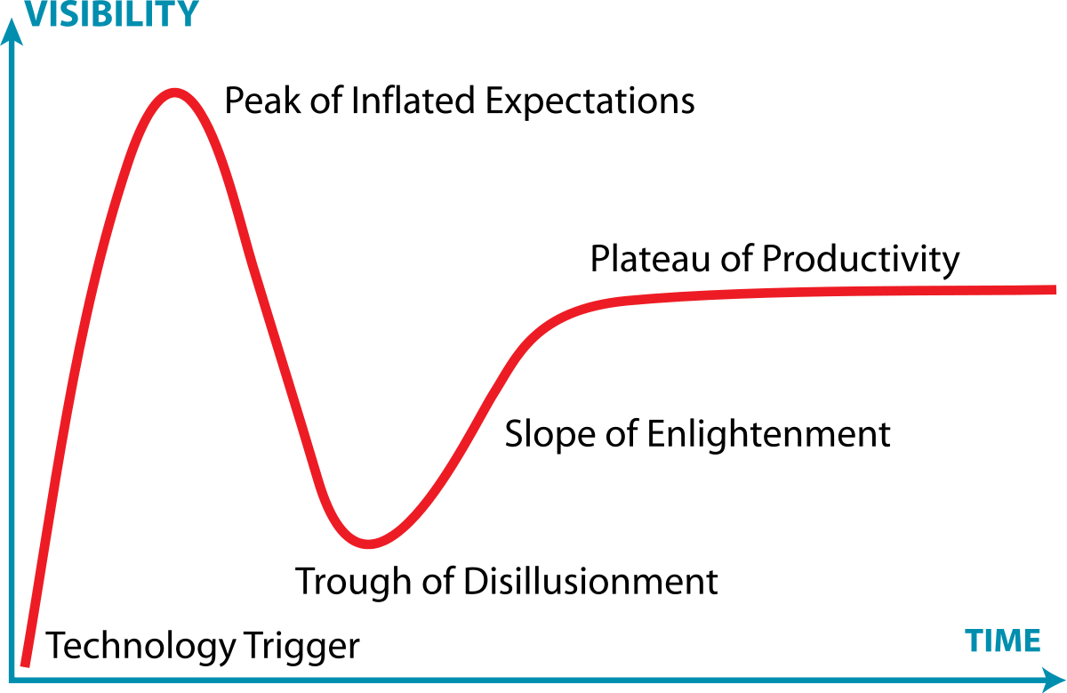
Artificial Intelligence
My definition: take something you think only humans can do and make something computational that does it
Moving Target!
Lots of things you take for granted were AI once.
Alexa/Siri/etc., google maps, biometrics, google search, automatic translation, natural language understanding, handwriting recognition, …
We’ll talk about the history of AI, but in short the trough of disillusionment is historic key
This Photo by Unknown Author is licensed under CC BY-SA

Slide 4
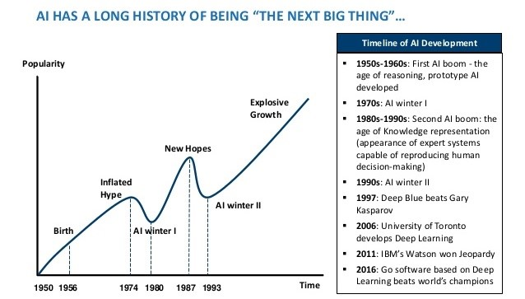
Artificial Intelligence (AI) in Computer Science
First attempt: Make ‘intelligent’ human-like machines.
Example: the GPS program (General Problem Solver) -> solve formal logic problems
Result: Complete failure and enormous negative reactions
First AI Winter
Problems: One knowledge representation scheme with one knowledge processing mechanism not enough + search spaces are enormous.
Second attempt: Take application area and make something that works
Example: Natural language, diagnosis, board game playing
Result: Worked within expectations but very specialized
From First AI Winter up until around ‘deep learning’
This Photo by Unknown Author is licensed under CC BY-NC-ND

Slide 5
What was that Turing Test at the start?
‘Does a machine exhibit behaviour which is indistinguishable from that of a human?’
Place a human interrogator is in a room with two computer terminals
One terminal is connected to another person
The other terminal is connected to an artificial intelligence
The interrogator asks questions by typing them into the terminals
If the interrogator cannot reliably determine which terminal connects to the human and which connects to the AI then the AI passes the test
The goal of the AI is not correct answers –it’s answers that resemble those of a person (Eugene Goostman!)
Based on work by Alan Turing in the 1940s and 1950s
‘The Imitation Game’, ‘Codebreaker’
Father of Computer Science (mathematician)

Slide 6
Connectionist vs Symbolic AI
Connectionist → Make something simple, like a digital brain cell, connect them together with some simple network structures, intelligence falls out? Profit
Symbolic AI → examine physical/animal/human world, find/create abstract structures and processes, apply to application problem that fits
Differences:
rely on emergence of capability (conn.) or bake it in (symb)
flexible to a degree (conn.) or often can’t think beyond what is baked in (symb)
great with learning patterns (conn.) or better at less common (symb.)

Slide 7
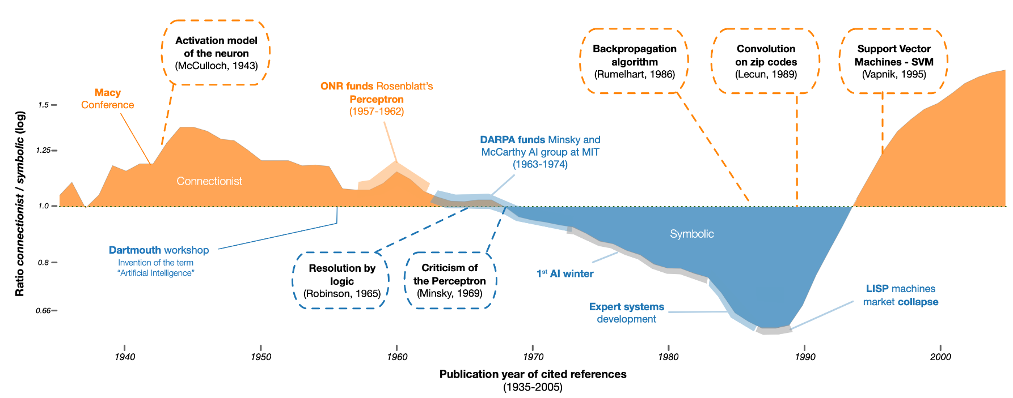
Connectionist vs Symbolic AI
Cardon, D., Cointet, J.-P. & Mazieres, A. (2018). Neurons spike back. The invention of inductive machines and the artificial intelligence controversy. Réseaux, 36(211), 173-220.

Slide 8
Current
After second AI Winter computer science made a lot of progress on taking the specialized system on the symbolic side and generalizing their ideas
On the other side our computing power reached the point that connectionist became powerful again

Slide 9
Current
Popular areas: Deep learning (neural networks), machine learning (AI for finding patterns), digital assistants (connect symbolic systems), service architectures, internet of things, self-automation, etc.
Things likely less close then you are sold: universal self-driving cars (visual identification has a lots of weaknesses), machine intelligence (?), true generic systems (we’ve generalized but there’s usually a lot more specificity under the hood than you think)
Machine Learning: In many ways just modern term for AI. Really just means machine changes/adds knowledge with less human influence.

Slide 10
Symbolic: Search
Brains?

Slide 11
What is Search?
The process of navigating from a start state to a goal state by transitioning through intermediate states
Determine states (knowledge representation can be really hard, ‘baked in’)
The transitions can be limited
It may not be possible to move directly from any state to any other state
A search model consists of
The set of states
The set of transitions between the states
Search control
Determines which transition is traversed to move to the next state
Simple types: breadth first search, depth first search, hill climbing, A*, alpha-beta pruning, minimax, branch and bound, …

Slide 12
Search Example
Define a problem clearly
Zombie Apocalypse! I’m looting an abandoned house.
I see five items $I$, each item $i∈I$has a weight $w_{i}$and a value $v_{i}$.
I have a backpack with a weight limit $W$
I can’t fit all the items in my backpack but I can select some $S⊆I$.
I want to maximize the value of the items I take without breaking my backpack!
That is pick an $S$ to maximize $\sum_{i∈S}{w_{i}}≤W.$
One way to view the problem is to think of all the possible solutions $S$.
I could pick items 1,2,3 or items 4,7.
How many of these solutions exist?

Slide 13
Search Example (cont’d)
One way to view the problem is to think of all the possible solutions $S$.
I could pick items 1,2,3 or items 4,5.
How many of these solutions exist?
Binary notation. Items 1,2,3 can be 11100 and 4,5 can be 00011.
We are using a 1 to indicate taken, and 0 to indicate not taken.
So there are $2×2×2×2×2=2^{5}$ different solutions.
This is known as our search space (set of all possible solutions).
Exponential!!! (doubles in size each item more we have to consider.)

Slide 14
Search Example (cont’d)
Binary notation. Items 1,2,3 can be 11100 and 4,5 can be 00011.
We are using a 1 to indicate taken, and 0 to indicate not taken.
So there are $2×2×2×2×2=2^{5}$ different solutions.
This is known as our search space (set of all possible solutions).
Exponential!!! (doubles in size each item more we have to consider.)
Brute force $O\left(2^{\left|I\right|}\right)$
Dynamic Programming $O\left(\left|I\right|×W\right)$
Even DP doesn’t scale great if W is large

Slide 15
What if we were happy with a pretty good solution?
(Zombies are breaking down the door!)

Slide 16
Heuristic Symbolic Search
Instead of guaranteed exploration there are a number of symbolic techniques that cannot guarantee us the best answer (ex. for that 0/1 knapsack problem example)
But, we generally get an rather good answer quickly
Lots of broadly used AI falls into here
Based on heuristics (rules that seem to work)
Specific rules like: If I want to go to Mountains from Calgary I likely want to choose roads that go West!
Or more abstract: using biological or physical inspirations for search algorithm design

Slide 17
Heuristic Symbolic Search
Physical Patterns examples:
Simulated Annealing : Cooling of metal slowly to find good state
Particle Swarm Optimization : gravity and energy like behaviour of particles
Biological Patterns examples:
Genetic Algorithms : DNA and Survival of the fittest
Ant Colony Optimization : colony exploratory properties

Slide 18
Symbolic: Hill-Climbing
Zombie brain?

Slide 19
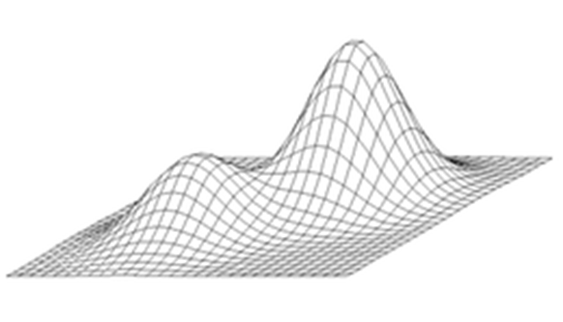
Hill-Climbing
Simple search
Greedy style algorithm (CPSC 413)
Have one solution
Make a simple change (if things get better, then keep change)
Put/swap something in backpack
Challenges with local optima

Slide 20
Symbolic: Simulated Annealing
Smarter brain?

Slide 21
Simulated Annealing
Have one solution through the whole process
Solution starts out random and you track a Temperature value
Each iteration
Propose a new solution
If it is better, then keep it
If it is worse, then keep it only if its loss of value is below temperature (sometimes)
In practice pick random probability
Calculate a difference in value term (that decreases with temp)
Only accept worse if first less than second
Temperature decreases (cools)
Idea, we know local optimum can trap us, so we get worse sometimes
Parameters touchy. How much to update? Not a ton of exploration.
This Photo by Unknown Author is licensed under CC BY-SA

Slide 22
Symbolic: Particle Swarm Optimization
Everyone go looking for brains?

Slide 23
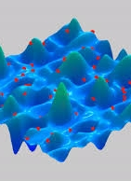
Particle Swarm Optimization
Design complexity grows.
Think of particles as having ‘gravity’. The better the solution the more ‘gravity’.
Particles also have momentum.
Have many particles.
Each step, particles follow their current direction of change with influence of the nearby local optima and global optima.
Less touchy to parameters and good at exploration. Often cooling principle included to help find best at end.
Challenges with discrete problems.

Slide 24
Symbolic: Genetic Algorithms
People brains?

Slide 25
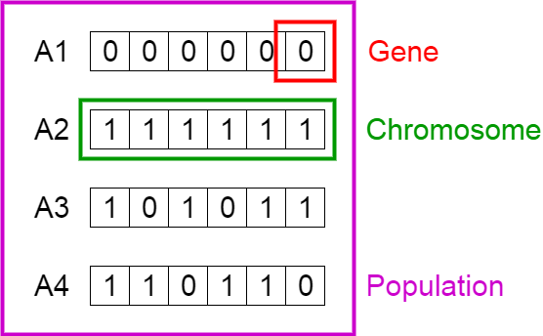
Genetic Algorithms
Designed around the concept of DNA, biological populations, and survival if the fittest.
Good for discrete as DNA is more discrete form.
Also the idea of adding, removing, swapping like DNA is a more natural operation.
Make a population of solutions.
Over iterations make more solutions by selecting ‘parents’ based on fitness (solution value).
Then make ‘children’ based on sharing chunks of DNA (crossover) or by change single DNA spots (mutation).

Slide 26
Connectionist: Neural Networks
Actually brains?

Slide 27
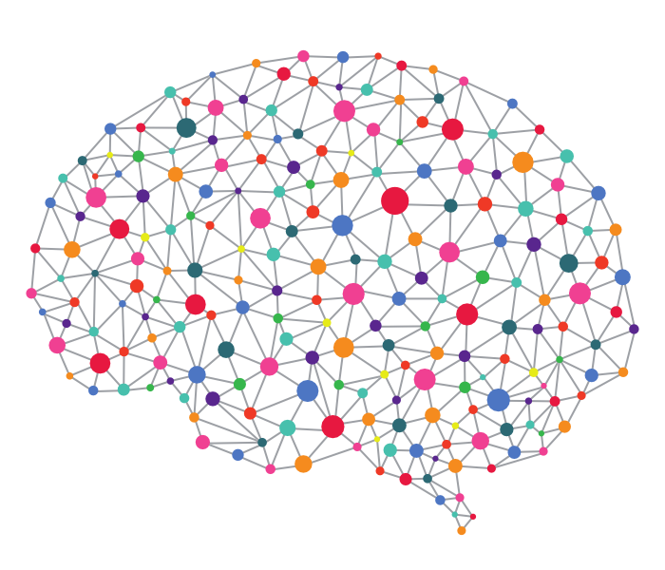
What are neural networks?
Inspired by the Human Brain.
The human brain has about 86 Billion neurons and requires 20% of your body’s energy to function.
These neurons are connected to between 100 Trillion to 1 Quadrillion synapses!
Deep learning neural networks really popular right now
Connectionist method
Make network, train, hope result is useful

Slide 28
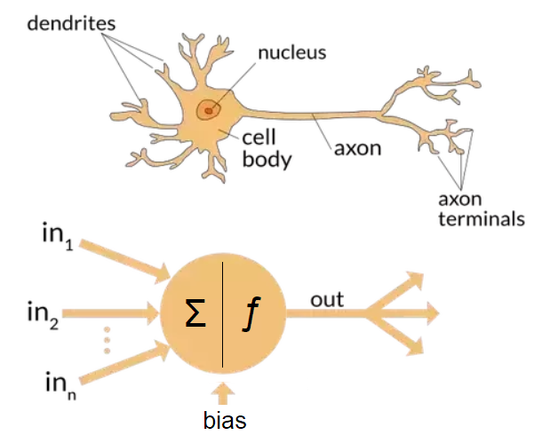
Neuron Model of Connections

Slide 29
Summary
AI is a moving target of making computer do previously thought to be human-like things.
Machine learning is mostly a modern term for AI, that means AI learns by itself.
Search spaces can get really big, so heuristic techniques are symbolic ways of exploring the space quicker but don’t guarantee best solution.
Connectionist AI like deep learning neural networks are currently really popular (although balance likely in the middle).
i.e. humans have brains but within our brains and between brains we’ve developed and communicated symbolic structures to help process the world

Slide 30
Onward to … neural networks.
Jonathan Hudson
jwhudson@ucalgary.ca
https://pages.cpsc.ucalgary.ca/~hudsonj/

