Slide 1
Digital Signal Processing: Convolution
CPSC 501: Advanced Programming Techniques
Fall 2020
Jonathan Hudson, Ph.D
Instructor
Department of Computer Science
University of Calgary
Tuesday, September 22, 2020

Slide 2
Convolution

Slide 3
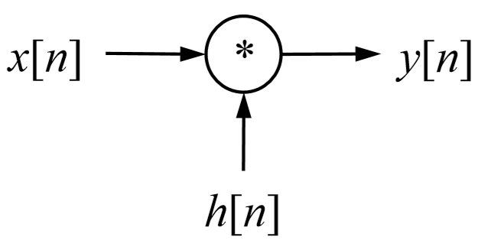
Time-Domain Convolution
Convolution is mathematical operation that takes 2 input signals, x[n] and h[n], to produce a third signal, y[n]
Represented mathematically as:
x[n] * h[n] = y[n]
Note: * means convolution, not multiplication
Represented graphically:

Slide 4
Time-Domain Convolution
Input Side Algorithm (array implementation):
void convolve(float x[], int N, float h[], int M, float y[], int P) {
int n, m;
/* Outer loop: process each input value x[n] in turn */
for (n = 0; n < N; n++) {
/* Inner loop: process x[n] with each sample of h[n] */
for (m = 0; m < M; m++)
y[n+m] += x[n] * h[m];
}
}

Slide 5
Time-Domain Convolution
Note:
N, M, and P are the number of elements in each array
P must equal N + M – 1
The signals x[n], h[n], and y[n] are f.p. numbers scaled to the range:
-1.0 to +1.0
You may need to convert to/from signed integers
This algorithm can be adapted to deal with samples stored in audio files

Slide 6
Examples

Slide 7
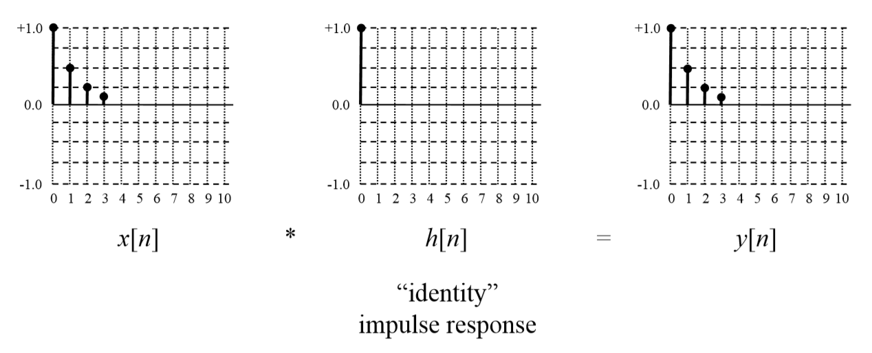
Example convolutions:

Slide 8
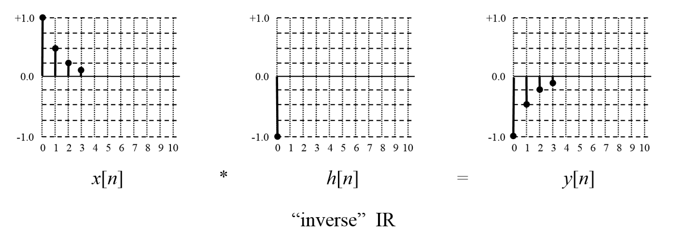
Example convolutions:

Slide 9
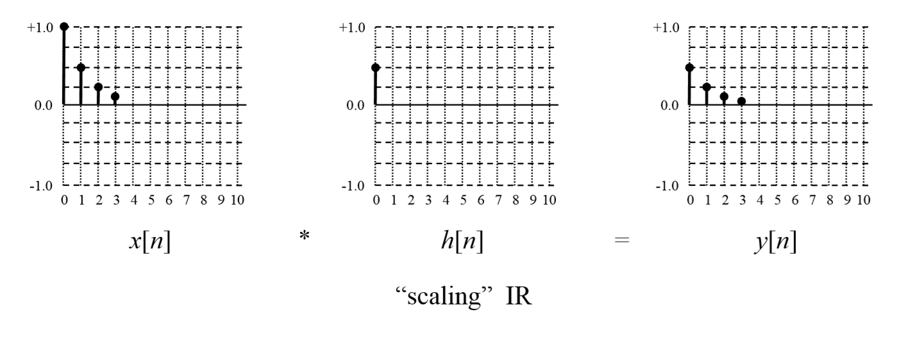
Example convolutions:

Slide 10
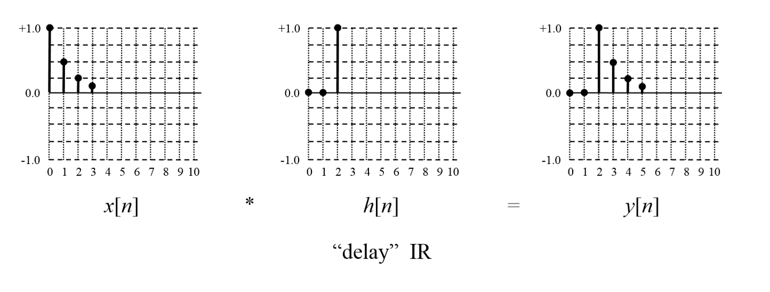
Example convolutions:

Slide 11
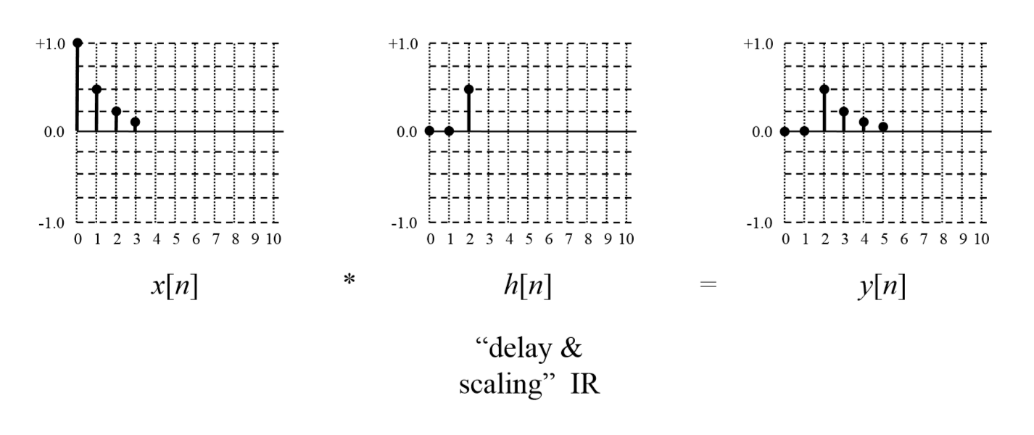
Example convolutions:

Slide 12
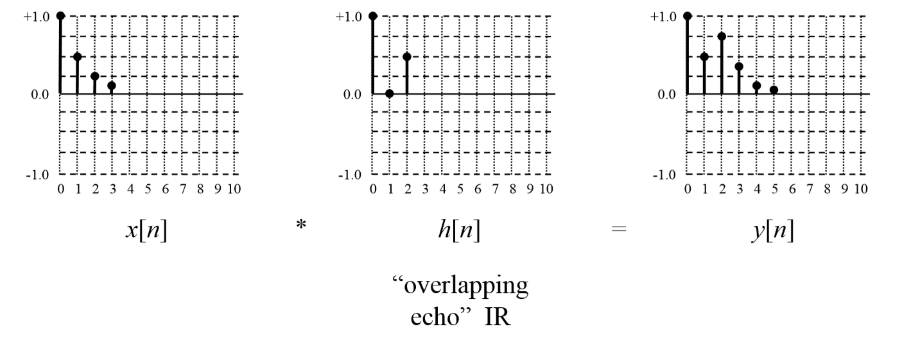
Example convolutions:

Slide 13
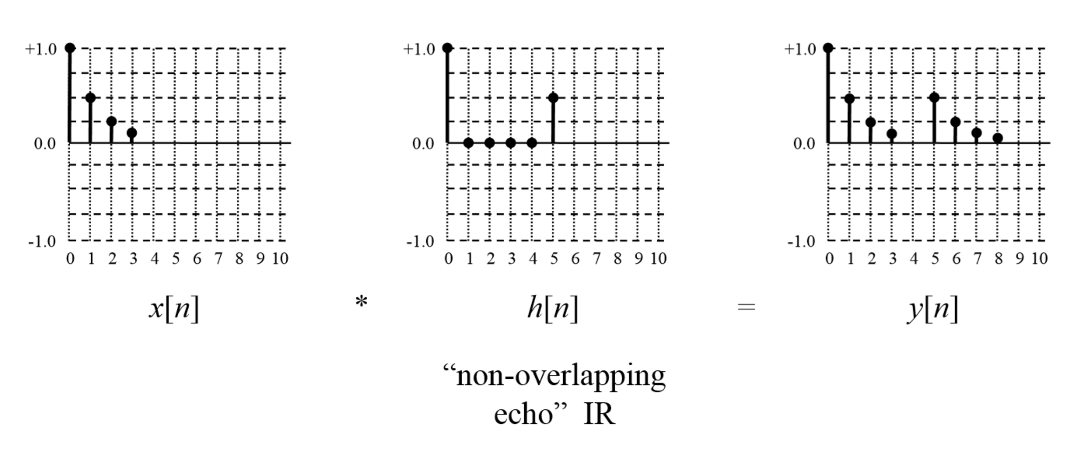
Example convolutions:

Slide 14
Example convolutions:
Convolution is a commutative operation
That is: x[n] * h[n] = h[n] * x[n] = y[n]

Slide 15
Time Domain Convolution

Slide 16
Time-Domain Convolution
The signals x[n] and h[n] can be any arbitrary kind of signal
However, x[n] is usually an input signal that you want to process
And, h[n] is the impulse response (IR) of a system you want mode

Slide 17
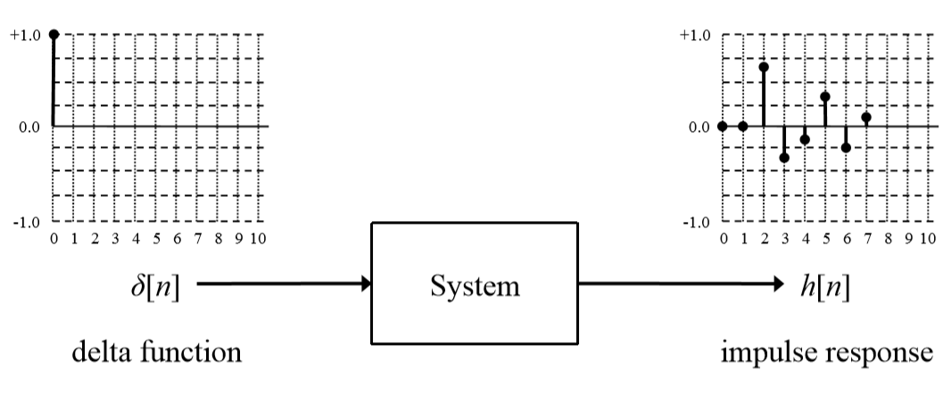
Impulse Response
The IR of a system is found by inputting a normalized impulse (delta function) into the system, and measuring or calculating the output

Slide 18
Model the System as it applied to signal change
If the system is linear and time-invariant (LTI), the impulse response perfectly characterizes the system
That is, we know how the system will respond to any input it receives

Slide 19
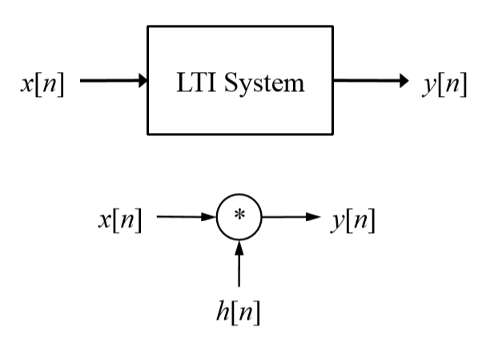
Simulate the system as convolution
We can thus simulate how a system would respond to an input signal by convolving the input signal with the system’s IR
That is, the following are equivalent:

Slide 20
Application: Concert Hall

Slide 21
Time-Domain Convolution
The IR of a concert hall can be found by firing a starting pistol (an approximate delta function), and using a microphone to record to the system’s response
Convolving a “dry” recording of an instrument with the IR results in an output signal where it sounds like the instrument is playing in the hall
This is the basis for a convolution reverb digital effect

Slide 22
Convolution using the FFT
Time-domain convolution can be very slow, especially if h[n] is large
Is O(N × M), where N and M are the sizes of x[n] and h[n]
High-speed or FFT convolution uses the principle that convolution in the time domain corresponds to multiplication of spectra in the frequency domain

Slide 23
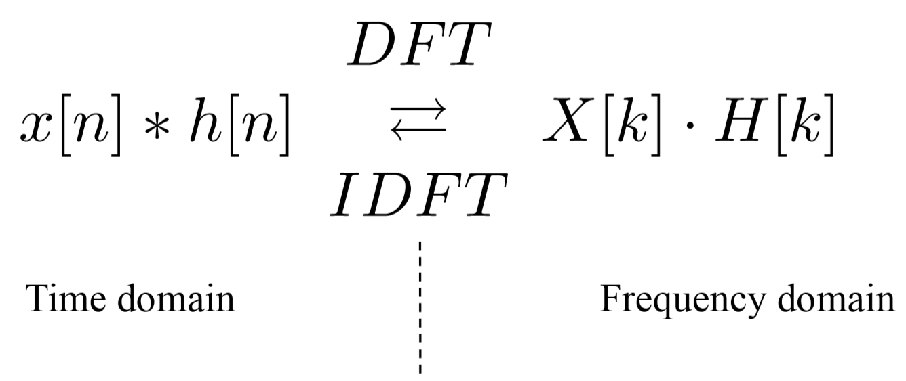
Convolution using the FFT
This is the convolution theorem, and is expressed mathematically as:
Where X[k] and H[k] are the spectra of x[n] and h[n]:
X[k] = DFT[x[n]]
H[k] = DFT[h[n]

Slide 24
Convolution using the FFT
We can calculate the convolution by:
Transforming both x[n] and h[n] to the frequency domain using the FFT
Note: zero-padding will have to be used so that x[n] and h[n] have the same length, the length is a power of 2 (needed for the FFT), and is long enough to avoid circular convolution (wrap around)
Multiplying X[k] by H[k] point by point
Note: this will be complex multiplication (imaginary/real)
Converting the result back to the time domain using the inverse FFT (IFFT)

Slide 25
Convolution using the FFT

Slide 26
Convolution using the FFT
Note: the output from either the FFTs or the IFFT (but NOT both) will have to be scaled by dividing by each data point by N, if the FFT/IFFT algorithm you are using doesn’t do scaling
E.g.
for (k = 0, i = 0; k < N; k++, i += 2) {
/* Scale the real and imaginary parts of a data point */
x[i] /= (double)N;
x[i+1] /= (double)N;
}

Slide 27
Onward to … next topic.
Jonathan Hudson
jwhudson@ucalgary.ca
https://pages.cpsc.ucalgary.ca/~hudsonj/

