Slide 1
Digital Signal Processing: Spectral Analysis
CPSC 501: Advanced Programming Techniques
Fall 2020
Jonathan Hudson, Ph.D
Instructor
Department of Computer Science
University of Calgary
Monday, August 24, 2020

Slide 2
Fourier Theorem

Slide 3
Fourier Theorem
Fourier Theorem:
Any continuous, periodic waveform can be expressed as the sum of a series of sine and cosine terms, each having speciﬁc amplitude and phase coefﬁcients
Any physical function that varies periodically with time with a frequency f can be expressed as a superposition of sinusoidal components of frequencies: $f, 2f, 3f, 4f, . . .$"

Slide 4
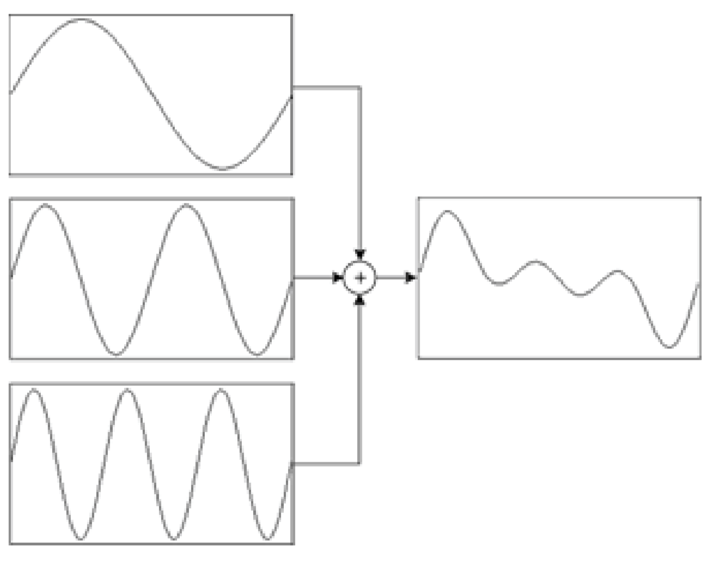
Additive synthesis
Pure tones can be added together to form a complex tone (additive synthesis):

Slide 5
Fourier decomposition
Fourier analysis decomposes a complex signal into its component parts
i.e. its spectrum
The Fourier transform calculates the spectrum of a continuous signal
Transforms from the time domain to the frequency domain

Slide 6
Discrete Fourier Transform

Slide 7
Discrete Fourier Transform
The discrete Fourier transform (DFT) calculates the spectrum of a digital signal
Deﬁnition:
$$DFT\left[x\left(n\right)\right]= X\left(k\right)$$
$= \sum_{n=0}^{N−1}{x\left(n\right)e^{−jωkn}} 0≤k≤N−1$
N is the number of samples per period of the waveform
k is the harmonic number
and ω = 2π/N

Slide 8
What frequencies are present
The discrete Fourier transform (DFT) calculates the spectrum of a digital signal
Spectrum -> Which frequencies are present
Harmonic Numbers -> we go up multiples of frequencies (this gives us regular components to break signal down into)

Slide 9
Breakdown
Since $e^{jx} = cos⁡(x) + j sin⁡(x)$, can be expressed as:
$$\sum_{n=0}^{N−1}{x\left(n\right)\cos\left(ωnk\right)−j\sum_{n=0}^{N−1}{x\left(n\right)\sin\left(ωnk\right)}} 0≤k≤N−1$$
We must calculate the real part $a_{k}$ and the imaginary part $b_{k}$ separately
Real part $a_{k}$
Imaginary part $b_{k}$

Slide 10
In code

Slide 11
Get initial summation values
C implementation:
#define PI 3.141592653589793
#define TWO_PI (2.0 * PI)
void dft(double x[], int N, double a[], double b[]){
int n, k;
double omega = TWO_PI / (double)N;
for (k = 0; k < N; k++) {
a[k] = b[k] = 0.0;
for (n = 0; n < N; n++) {
a[k] += (x[n] * cos(omega * n * k));
b[k] -= (x[n] * sin(omega * n * k));
} } }

Slide 12
Process result
The results must be further processed :
$a_{k}$ and $b_{k}$ must be scaled by N:
for (k = 0; k < N; k++) {
a[k] /= (double)N;
b[k] /= (double)N;
}
The magnitude or amplitude |X(k)| is given by:
$$\left|X\left(k\right)\right|=\sqrt{a_{k}^{2}+b_{k}^{2}}$$
for (k = 0; k < N; k++)
amplitude[k] = sqrt( (a[k] * a[k]) + (b[k] * b[k]) )

Slide 13
What we get?

Slide 14
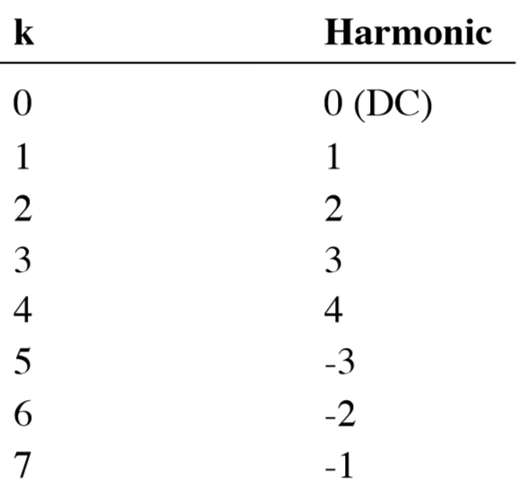
Harmonic numbers
The DFT gives amplitudes for both positive and negative frequencies (harmonics)
If N = 8:

Slide 15
Final amplitudes
Add these together to get the amplitude of a harmonic:
x[0] = amplitude[0];
x[N/2] = amplitude[N/2];
for (k = 1, j = N-1; k < N/2; k++, j--)
x[k] = amplitude[k] + amplitude[j];

Slide 16
Performance?

Slide 17
Performance
The DFT is $O(N^{2})$
Not practical for large data sets
Can be calculated more efﬁciently with the fast Fourier transform (FFT)
Is O(N log N)
There are many variants of the FFT
Most work by reordering the data, and then recursively subdividing it in half
Thus data size must be a power of 2
Most FFTs work with complex numbers
The signal is the real part
The imaginary part is set to 0
This data is packed into an array of size*2:

Slide 18
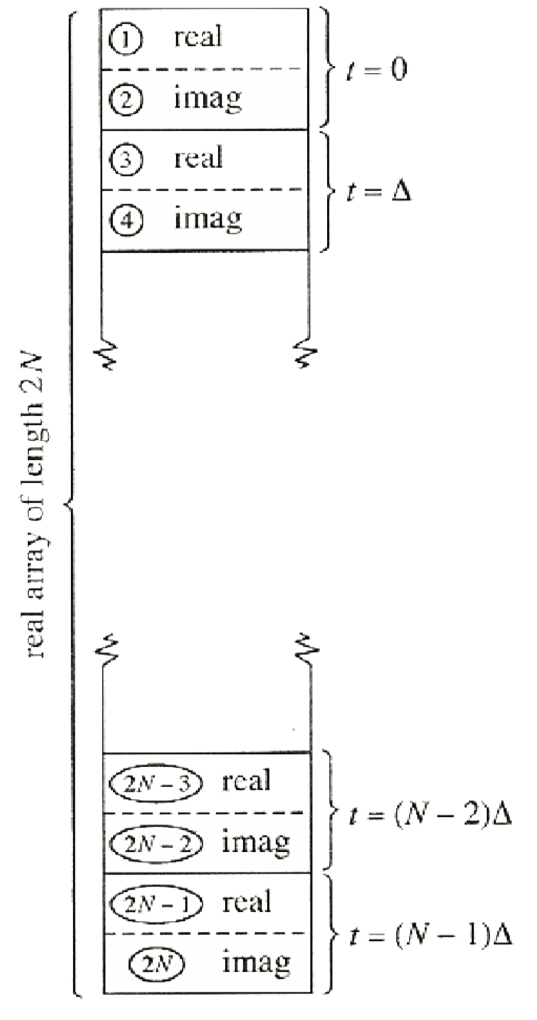
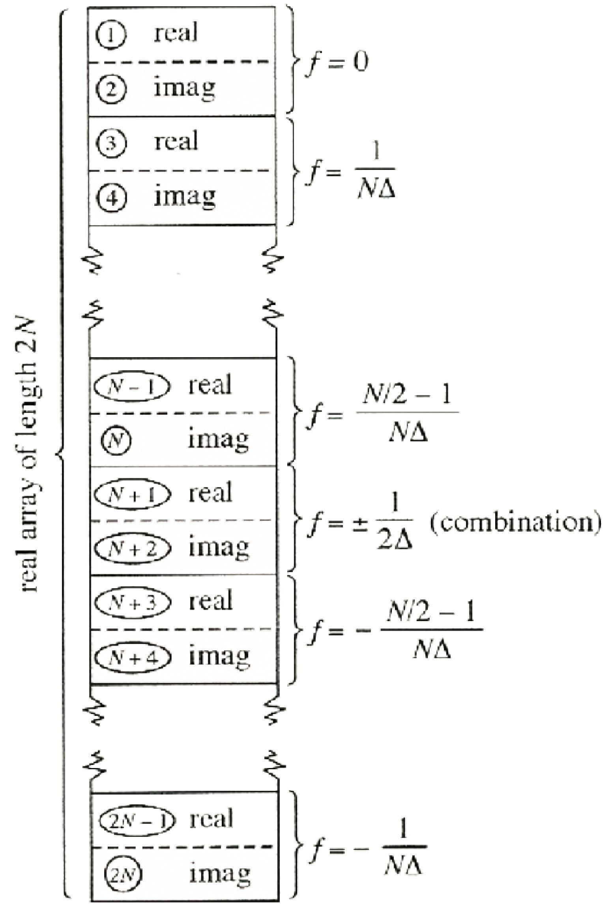
FFT

Slide 19
Spectral Analysis

Slide 20
Spectral Analysis
Like the DFT, the output of the FFT must be further processed to give meaningful results
The DFT calculates the spectrum for a single cycle of a waveform
Result can be displayed as a bar graph
Shows the relative amplitudes of the harmonics

Slide 21
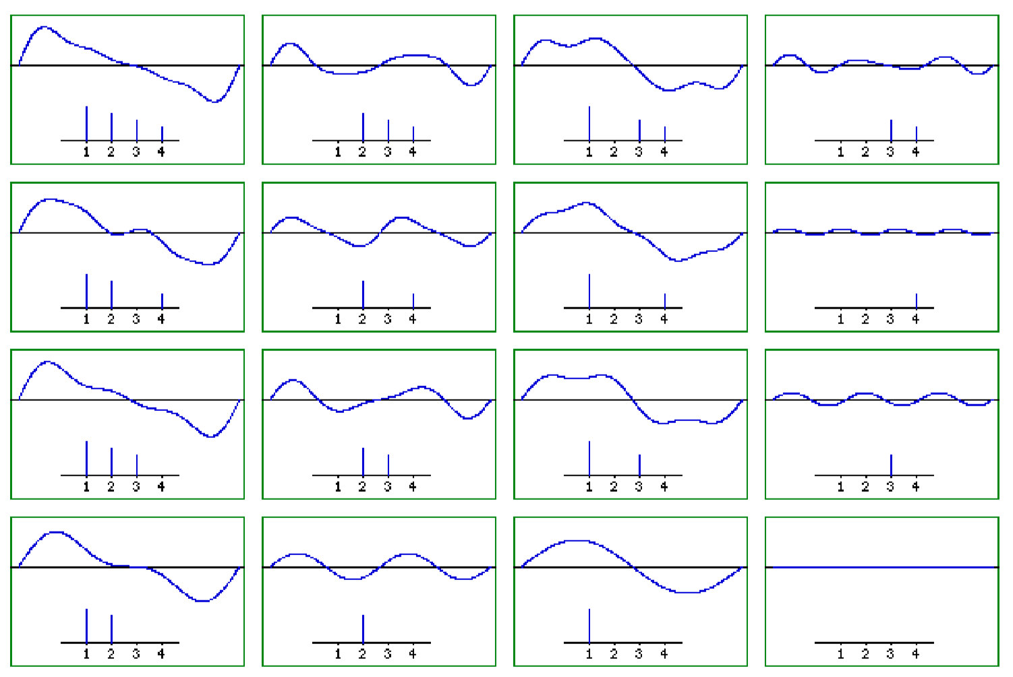
Signals as frequency bar graphs

Slide 22
DFT Window
The DFT can be applied to an arbitrary “window” of a longer waveform
Is a “snapshot” of the spectrum at a particular time
Window is typically 512 or 1024 samples long
Instead of harmonics, the output represents how much energy is present in particular “bins”
When graphed, the amplitudes are joined together to form a continuous line
E.g.

Slide 23
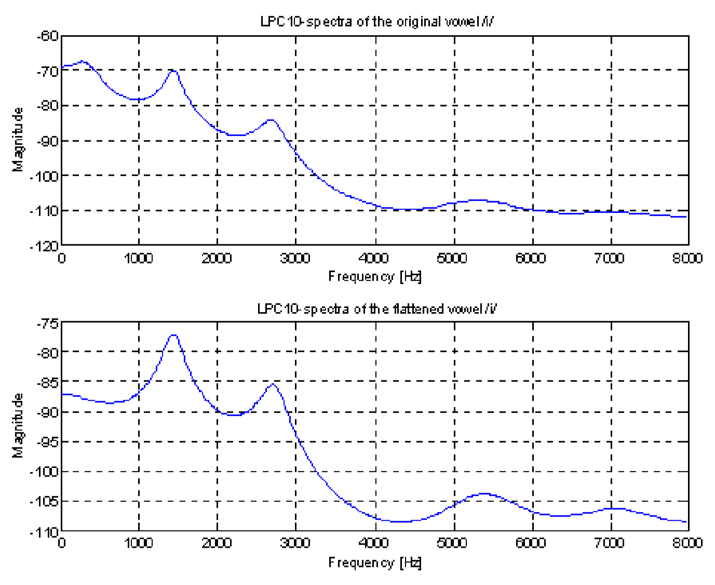
Example frequency outputs

Slide 24
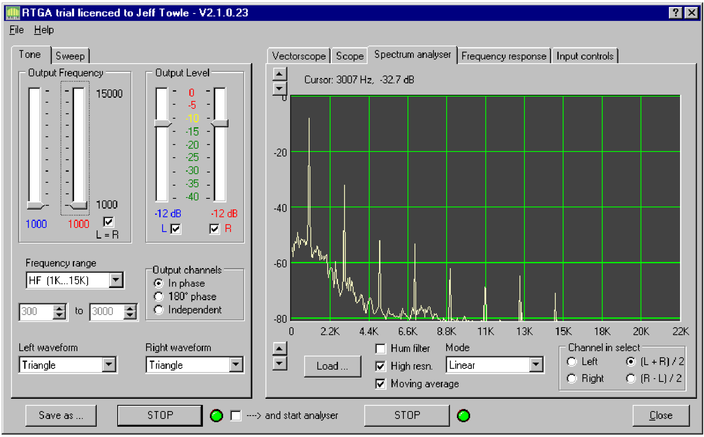
Within an application

Slide 25
Spectral Analysis
The spectrum can be plotted as it changes over time
The analysis window slides along the time axis
Can be end to end
Or overlapping
Can be graphed as a 3D “waterfall”
E.g.

Slide 26
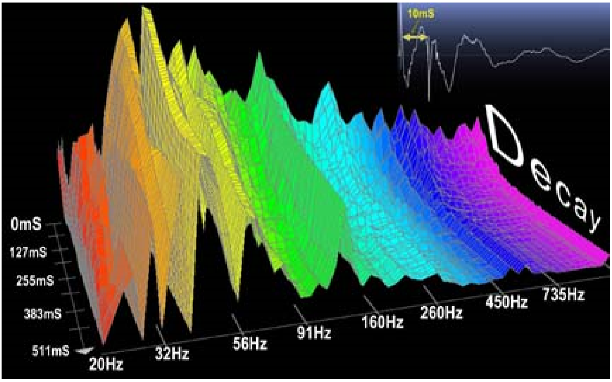
Spectral Analysis

Slide 27
Spectral Analysis
Can also be displayed as a spectrogram
X axis: time
Y axis: frequency
Darkness of pixel represents amplitude
White: 0 amplitude
Black: full amplitude
E.g.

Slide 28
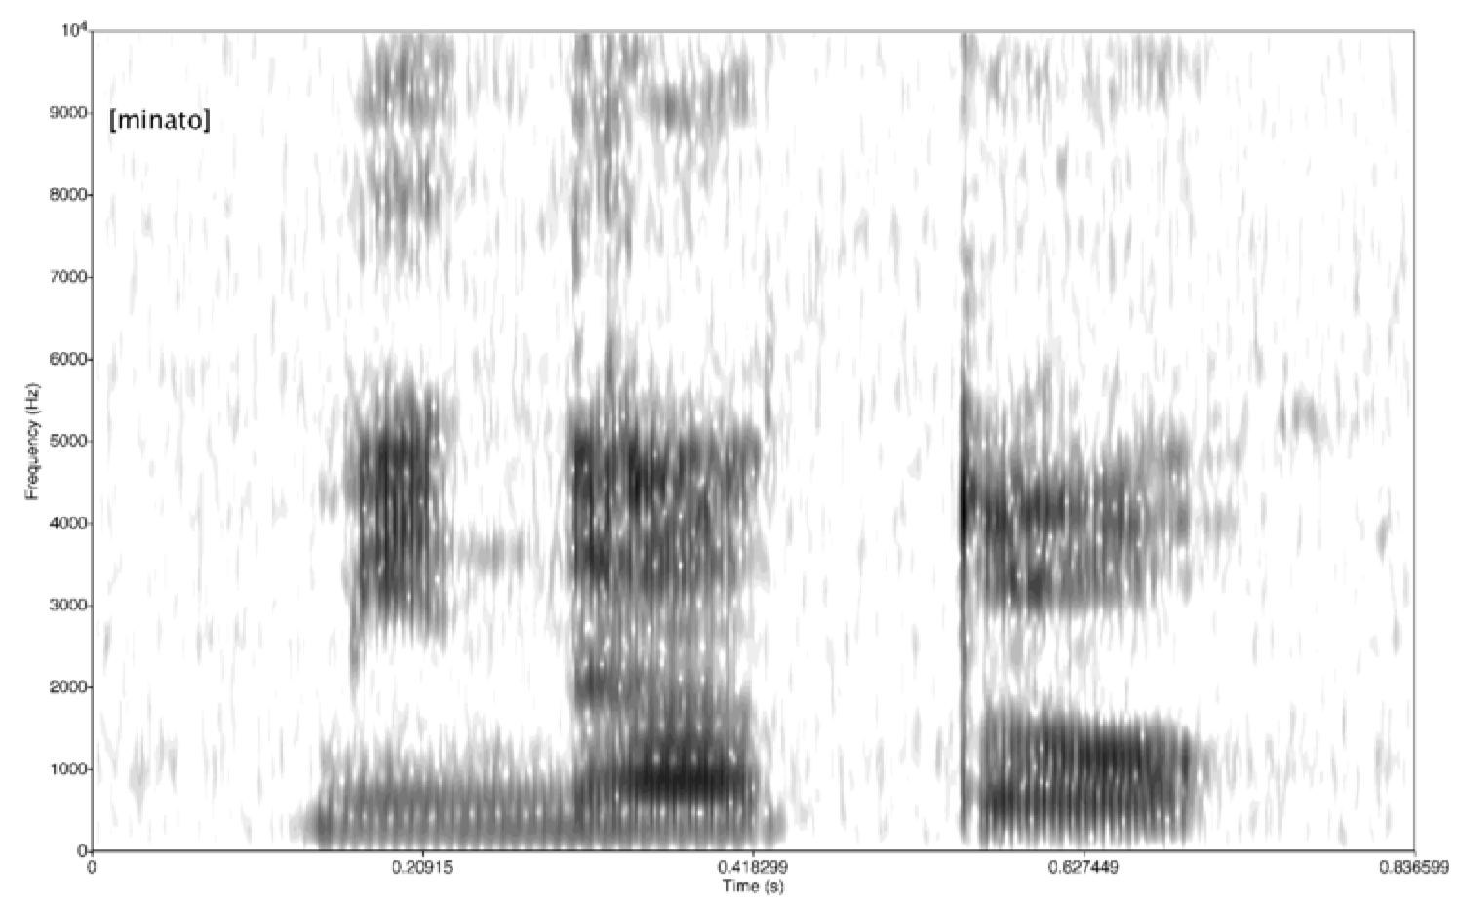
Spectral Analysis

Slide 29
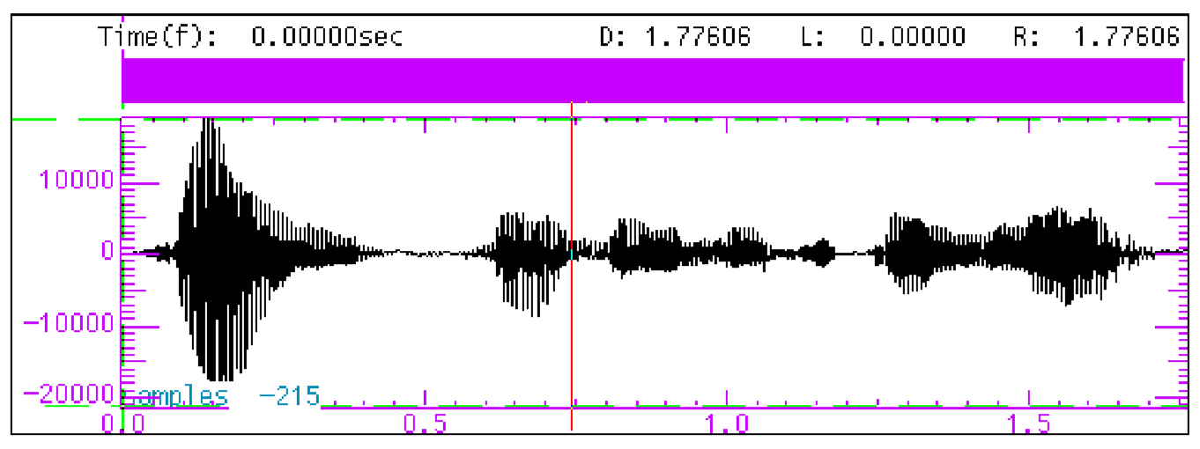
Spectral Analysis

Slide 30
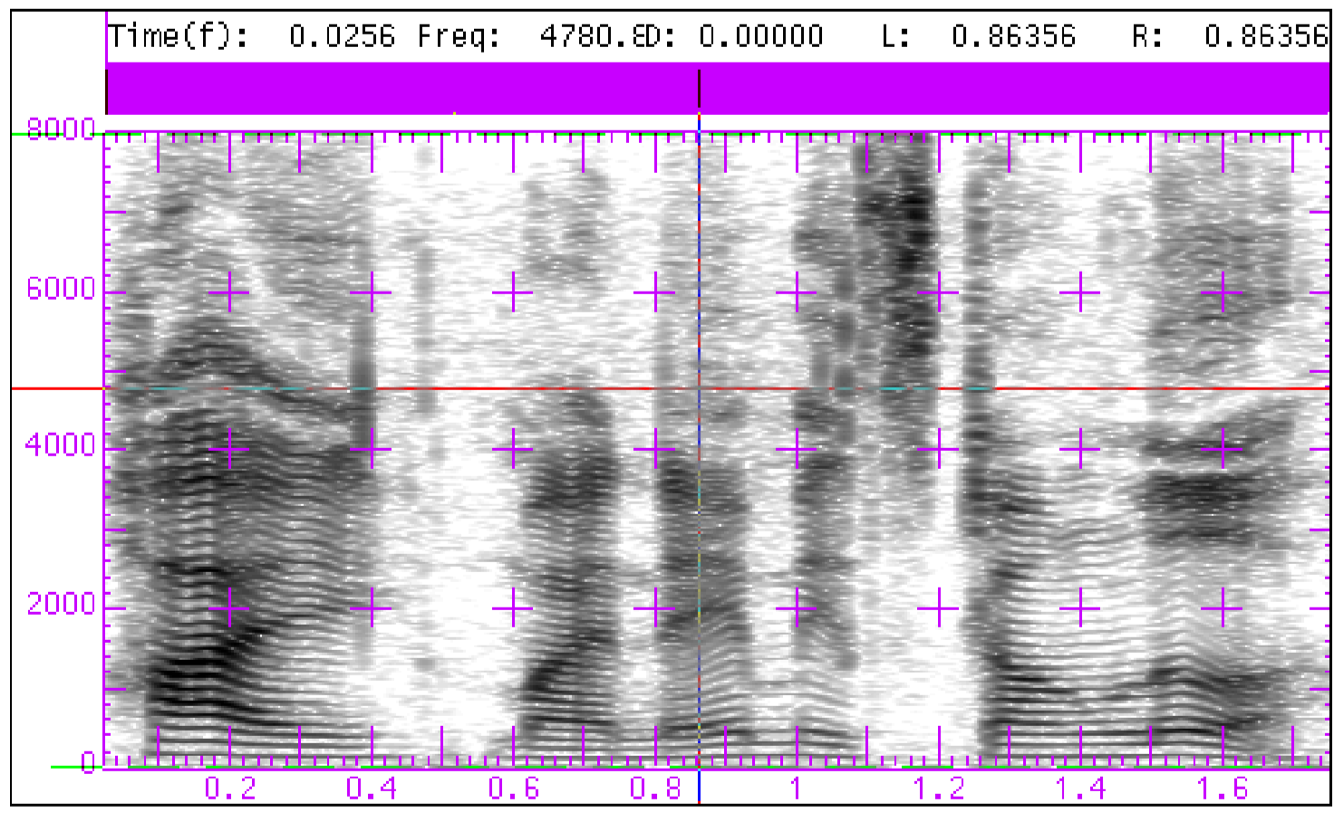
Spectral Analysis

Slide 31
Onward to … convolution.
Jonathan Hudson
jwhudson@ucalgary.ca
https://pages.cpsc.ucalgary.ca/~hudsonj/

