Slide 1
Digital Signal Processing Introduction
CPSC 501: Advanced Programming Techniques
Fall 2020
Jonathan Hudson, Ph.D
Instructor
Department of Computer Science
University of Calgary
Tuesday, September 22, 2020

Slide 2
Signals
How to we get a signal

Slide 3
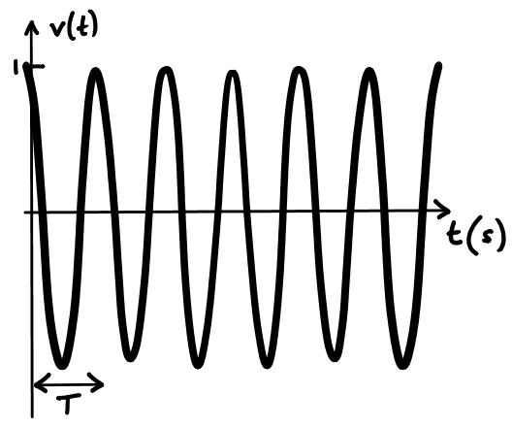
Analog Signal
Analog signal. This signal v(t)=cos(2πft) could be a perfect analog recording of a pure tone of frequency f=1 Hz.
The period T=1/f is the duration of one full oscillation.

Slide 4
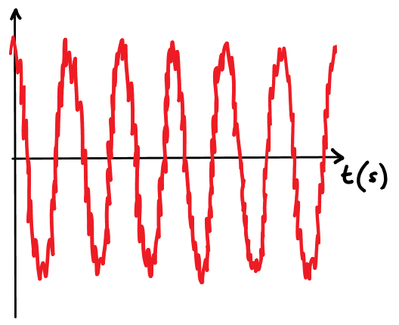
Noisy Signal
Noisy analog signal. Noise degrades the sinusoidal signal.
It is often impossible to recover the original signal exactly from the noisy version

Slide 5
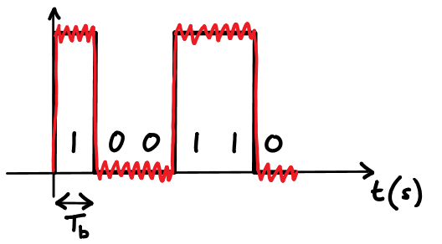
Digital Signal
Analog transmission of a digital signal.
Consider a digital signal 100110 converted to an analog signal for radio transmission.
The received signal suffers from noise, but given sufficient bit duration $T_{b}$, it is still easy to read off the original sequence 100110 perfectly.

Slide 6
Sampling
A continuous signal may be sampled
i.e. measured periodically at small intervals of time, and converted into a series of numbers (samples)
Such a series is a digital signal
An analog-to-digital converter does the sampling
E.g. Sampling an audio signal

Slide 7
From Voice to Bits
How to we get a signal

Slide 8
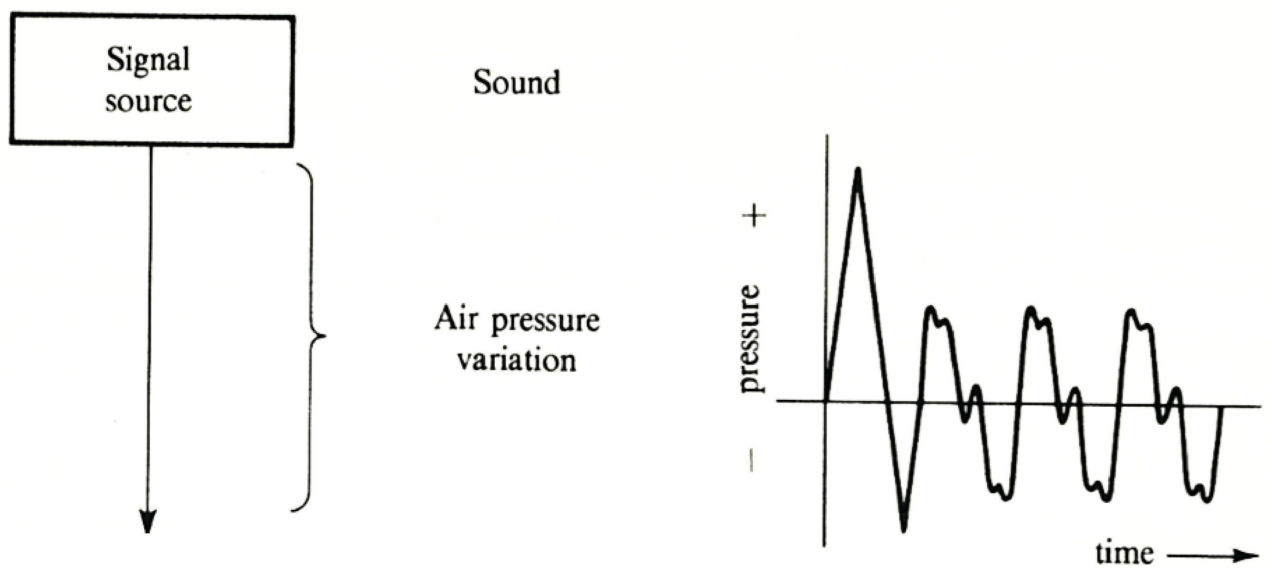
Original Signal

Slide 9
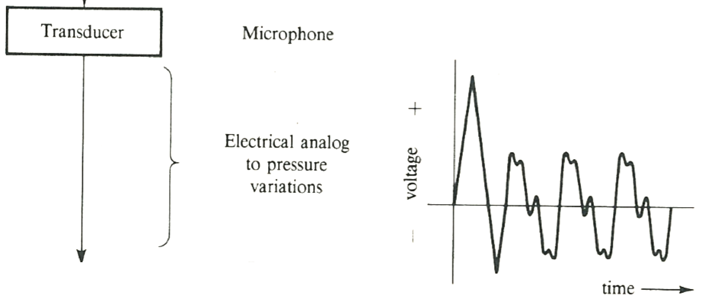
Analog Signal: Via Transducer

Slide 10
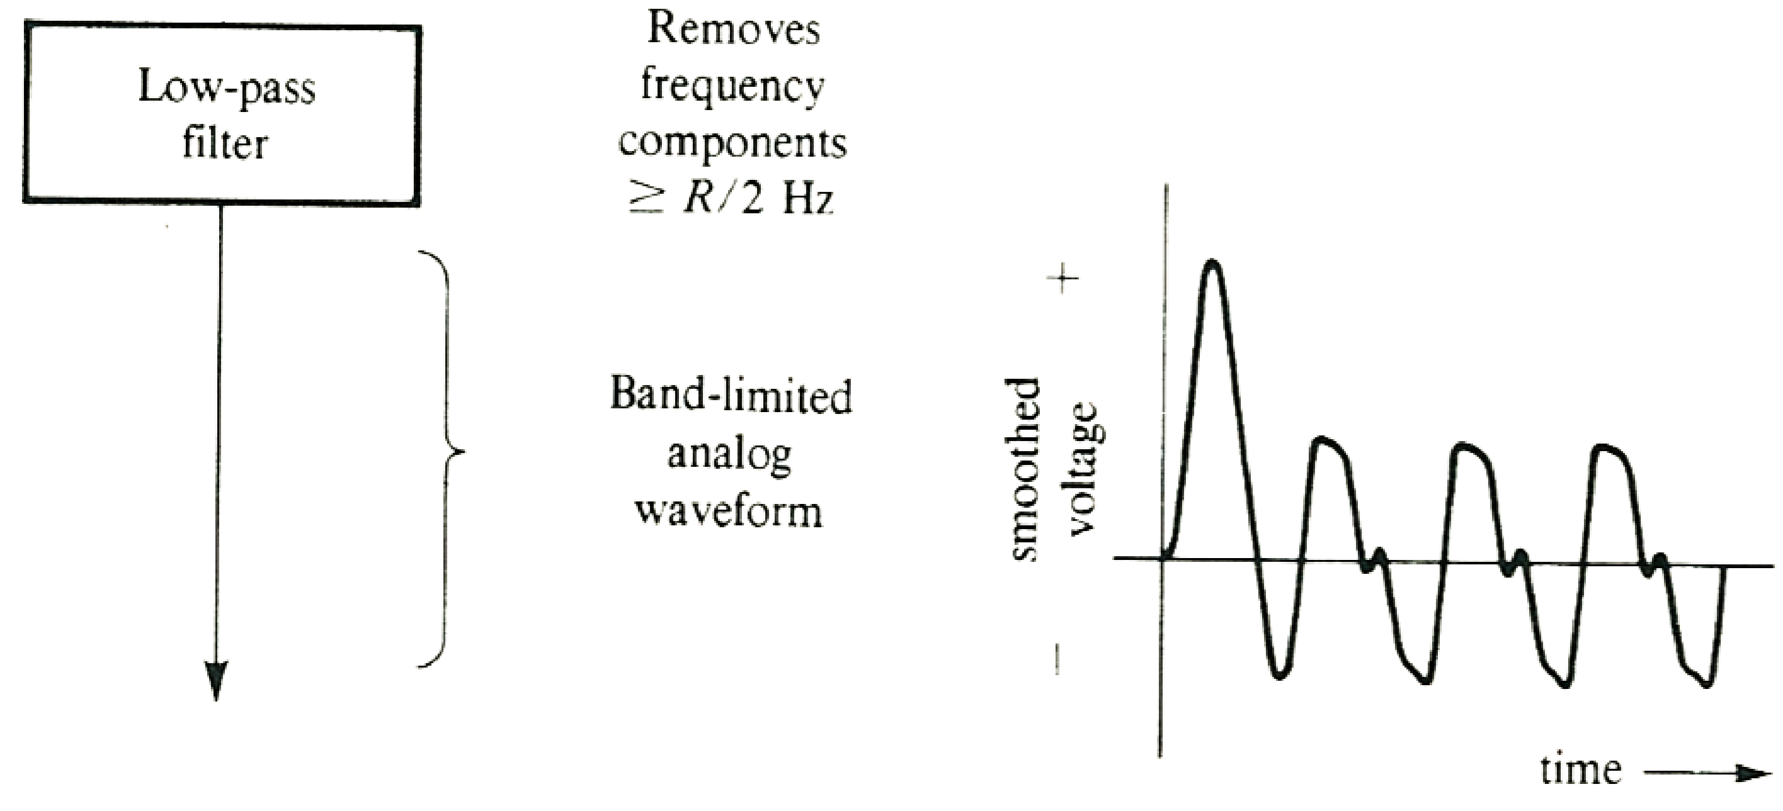
Analog Signal Cleaning

Slide 11
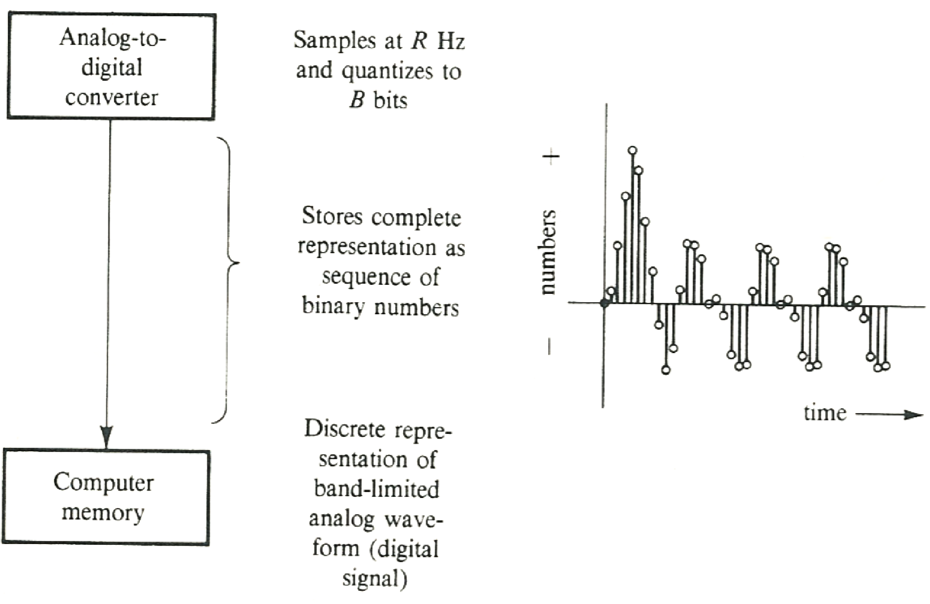
Analog to Digital

Slide 12
And back again

Slide 13
Sampling and Quantization
A digital-to-analog converter converts the digital signal back into an analog signal

Slide 14
Sampling

Slide 15
Sampling
Sampling is the process of recording an analog signal at regular discrete moments of time.
The sampling rate $f_{s}$ is the number of samples per second.
The time interval between samples is called the sampling interval $T_{s}=\frac{1}{f_{s}}$.

Slide 16
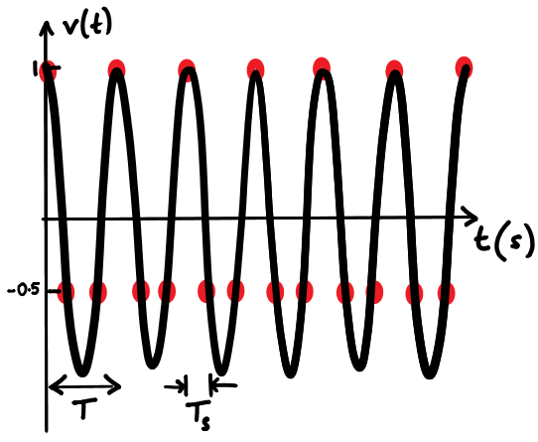
Original signal
The signal v(t)=cos(2πft) is sampled uniformly with 3 sampling intervals within each signal period T.
Therefore, the sampling interval T/3 and the sampling rate 3f.
Notice that there are three samples in every signal period T.

Slide 17
Sample points
To express the samples of the analog signal x$(t)$, we will use the notation x[n] for example
integer values of n index the samples
Typically, the n=0 sample is taken from t=0
Consequently, the n=1 sample must come from the $t=T_{s}$time point, exactly one sampling interval later; and so on.
sequence of samples can be written as
$$x[0]=x(0), x[1]=x(T_{s}), x[2]=x(2T_{s}),…$$

Slide 18
Store sample: extracted from formula
$x[n]=x(nT_{s})$ for integer n
Our signal was
$x\left(t\right)=cos⁡(2πft)$
$x\left[n\right]= cos⁡(2πfnT_{s})$
$x[n]=cos⁡(2πfn\frac{T}{3})\text{with} T_{s}=\frac{T}{3}$
$x[n]=cos⁡(\frac{2πn}{3})$as $T=\frac{1}{f}$

Slide 19
Stored sample: if measured
$x[n]=cos⁡(\frac{2πn}{3})$
$x\left[0\right]=\cos\left(0\right)=1$
$x\left[1\right]=\cos\left(\frac{2π}{3}\right)=$-0.5
$x\left[2\right]=\cos\left(\frac{4π}{3}\right)=$-0.5
$x\left[3\right]=\cos\left(2π\right)=1$

Slide 20
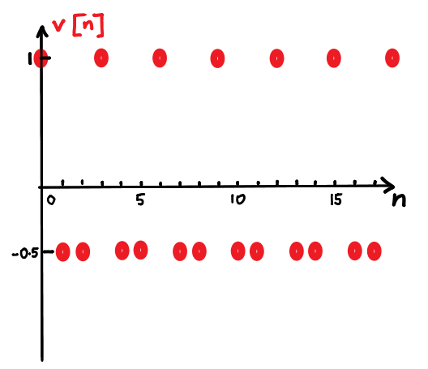
Can we rebuild it?
$x[n]=cos⁡(\frac{2πn}{3})$
$x\left[0\right]=\cos\left(0\right)=1$
$x\left[1\right]=\cos\left(\frac{2π}{3}\right)=$-0.5
$x\left[2\right]=\cos\left(\frac{4π}{3}\right)=$-0.5
$x\left[3\right]=\cos\left(2π\right)=1$

Slide 21
Sampling rate

Slide 22
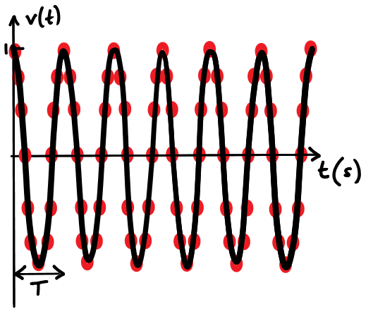
Higher rate sampling
Sampling at a high rate.
The signal v(t)=cos(2πft) is sampled uniformly with 12 sampling intervals within each signal period T.
The sampling interval $T_{s}=\frac{T}{12}$and the sampling rate $f_{s}=12f$.
The original signal x(t) can be recovered from the samples by connecting them together smoothly.

Slide 23
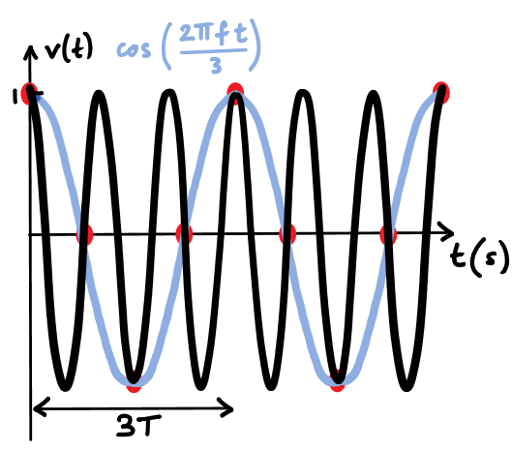
Lower rate sampling
In contrast, if a sinusoidal signal is sampled with a low sampling rate, the samples may be too infrequent to recover the original signal.

Slide 24
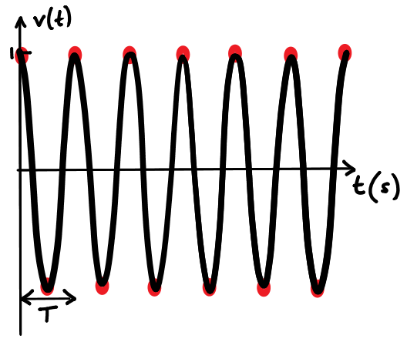
Best sample rate
Sampling a cosine at $f_{s}=2f$.
The signal v(t)=cos(2πft) is sampled uniformly with 2 sampling intervals within each signal period T.
sampling interval $T_{s}=\frac{T}{2}$and the sampling rate $f_{s}=2f$.
sample at every peak/trough of the sinusoid, there is no lower frequency sinusoid that fits these samples.
x(t) can be recovered exactly from the samples by ideal low pass filtering.

Slide 25
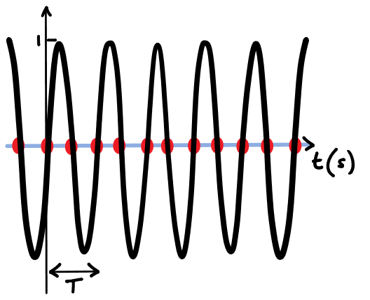
Worst case sample rate
The signal sin(2πft) is sampled uniformly with 2 sampling intervals within each signal period T.
Since all the samples are at the zero crossings, ideal low pass filtering produces a zero signal instead of recovering the sinusoid.

Slide 26
So how do we decide sample rate

Slide 27
Nyquist-Shannon theorem
The Nyquist-Shannon sampling theorem
The sampling rate for exact recovery of a signal composed of a sum of sinusoids is larger than twice the maximum frequency of the signal.
This rate is called the Nyquist sampling rate $f_{Nyquist}$

Slide 28
Terminology reminder
Sampling is the process of recording an analog signal at regular discrete moments of time.
The sampling rate $f_{s}$ is the number of samples per second.
The time interval between samples is called the sampling interval $T_{s}=\frac{1}{f_{s}}$.

Slide 29
Theroem basics
The sampling theorem:
The sampling frequency must be greater than twice the bandwidth of the signal in order to recreate it perfectly
f_{h} < R/2, where f_{h} is the frequency of the highest component of the signal, and R is the sampling rate
If you sample at too low a rate, aliasing or foldover distortion results

Slide 30
Details

Slide 31
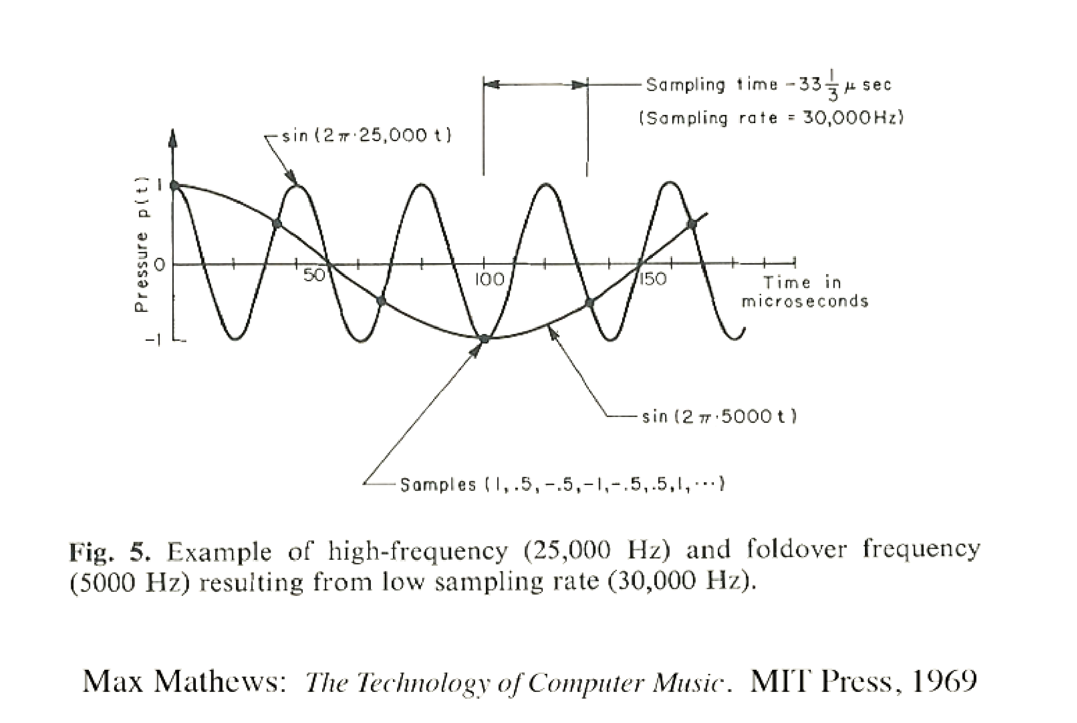
Sampling and Quantization

Slide 32
Sampling and Quantization
The frequency of the alias is calculated with:

Slide 33
Example
The frequency of the alias is calculated with:
If F = 25000 Hz, and R = 30000 Hz

Slide 34
Example (cont’d)
The frequency of the alias is calculated with:
If F = 25000 Hz, and R = 30000 Hz
$\frac{kR}{2}≤F≤\frac{\left(k+2\right)R}{2}$
$\frac{k∗30000}{2}≤25000≤\frac{\left(k+2\right)∗30000}{2}$
$k∗30000≤50000≤\left(k+2\right)∗30000$
$k≤5/3≤\left(k+2\right)$
$k≤5/3≤\left(k+2\right)$

Slide 35
Example (cont’d)
The frequency of the alias is calculated with:
If F = 25000 Hz, and R = 30000 Hz
$k≤5/3≤\left(k+2\right)$
$k≤1.6666…≤\left(k+2\right)$
$1≤1.6666…≤3$ when k =1

Slide 36
Example (cont’d)
The frequency of the alias is calculated with:
If F = 25000 Hz, and R = 30000 Hz, then k = 1
$1≤1.6666…≤3$ when k =1
$F_{a}=\left|F−\frac{(k+1)R}{2}\right|$
$F_{a}=\left|30000−\frac{\left(2\right)20000}{2}\right|$
$F_{a}=5000$

Slide 37
Low-pass filtering
To avoid aliasing, the signal is low-pass ﬁltered before A/D conversion, eliminating any frequency components above R/2

Slide 38
More information

Slide 39
Some rates used
Common audio sample rates:
CD: 44.1 kHz
Note: range of human hearing is 20 Hz to 20 kHz
Pro audio: 48 kHz, 96 kHz, 192 kHz
Speech codecs: 8000 Hz
Apple lossless (maximum 384 kHz)
Streaming music 44.1 kHz (some of this limit is contractual)

Slide 40
Digital form?
The A/D converter quantizes the instantaneous amplitude of each sample
i.e. represents it using N-bit binary number
Normally a signed integer
The more bits the better, to improve the signal-to-noise ratio
E.g. 16 bits gives SNR of about 96 dB

Slide 41
Commons sample bit sizes
Common sample sizes:
CD/Stream: 16-bit
Pro audio (subscriber streams): 20-bit, 24-bit
Speech codecs: 8-bit, 12-bit

Slide 42
Onward to … spectral analysis.
Jonathan Hudson
jwhudson@ucalgary.ca
https://pages.cpsc.ucalgary.ca/~hudsonj/

