Slide 1
Optimization: Java Optimization
CPSC 501: Advanced Programming Techniques
Fall 2020
Jonathan Hudson, Ph.D
Instructor
Department of Computer Science
University of Calgary
Monday, August 24, 2020

Slide 2
Java Specific Optimizations

Slide 3
Code Tuning – Java
Java is an object oriented language
That runs in a virtual machine
There are more inefficiencies that can be improved than we’ve covered for a language like c++

Slide 4
Strings

Slide 5
Code Tuning – Strings
Not null terminated
char[] and length are both stored
Immutable
Any change attempt (making new string)
char[] is better for secure data than String
Also UTF-16 (uses two bytes for all)
if you want UTF-32 there’s a lot of management steps

Slide 6
Code Tuning – Strings
String pool
Java has a special memory location (PermGen Space)
Usually for things like class desc, and metadata (exist longterm)
If a new String literal (“hello”) is made matching existing Java will attempt to point at same data
No NEW object
new String(“hello”) by-passes this
Also dynamic strings like one created at runtime from input won’t be associated

Slide 7
Code Tuning – Strings
String pool
Java has a special memory location (PermGen Space)
Usually for things like class desc, and metadata (exist longterm)
366712642
366712642
1829164700

Slide 8
Code Tuning – Strings
1442407170
1442407170
1028566121
hello
1118140819

Slide 9
Code Tuning – Strings
String pool
Java has a special memory location (PermGen Space)
Usually for things like class desc, and metadata (exist longterm)
USE .equals()
To get consistent String comparisons on .equals() compares contents, == will give you differing behaviour whether or not the String Pool has been used

Slide 10
Code Tuning – Strings
String pool
USE .equals()
To get consistent String comparisons on .equals() compares contents, == will give you differing behaviour whether or not the String Pool has been used
Example: Junit Testing
Setup will contain string literals String pool which re-use memory, thus == will work
however during operation == may fail
Strings during operation often collected via input steps

Slide 11
Code Tuning – Strings
StringBuilder and StringBuffer
StringBuilder not thread-safe
Let you compile a list of Strings which you can convert to a final String once
Much better than repetitive +, += operations
Can even set expected capacity needed (like ArrayList) so that hidden array doesn’t need to expand

Slide 12
Maps

Slide 13
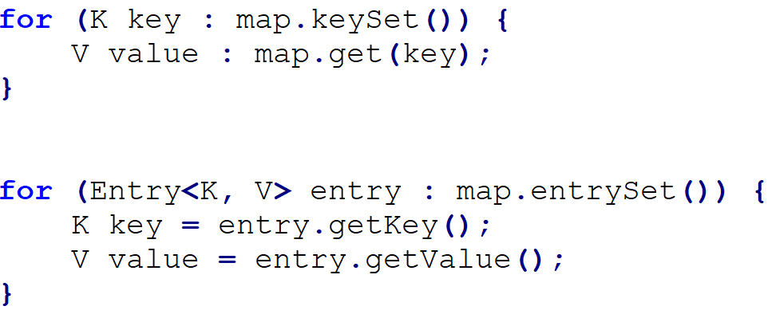
Code Tuning – Maps
When you want to iterate through a Map, and you need both keys and values, instead of the following:
.. To this:

Slide 14
Code Tuning – hashCode()/equals()
Optimise your hashCode() and equals() methods
A good hashCode() method is essential because it will prevent further calls to the much more expensive equals()
Can store a calculated hashCode once in object (only update on modified object, when sets are called)

Slide 15
Primitives

Slide 16
Code Tuning – Primitives
Reverse of refactoring
Sometimes code tuning is called ‘defactoring’
Use double instead of Double, int instead of Integer
Java can store values on stack, instead of heap
Try to avoid BigInteger and BigDecimal, similarly
Only if you really need to exceed long, or need precision

Slide 17
Logging

Slide 18
Code Tuning – Logging
Strings take a lot of time to create (program-wise)
Check the current log level first before making log string
// don’t do this
log.debug(“User [” + userName + “] called method X with [” + i + “]”);
// or this
log.debug(String.format(“User [%s] called method X with [%d]”, userName, i));
// do this if (log.isDebugEnabled()) { log.debug(“User [” + userName + “] called method X with [” + i + “]”); }

Slide 19
Libraries

Slide 20
Code Tuning – Libraries
Use Apache Commons StringUtils.replace instead of String.replace
Java 9 improved String replace but if on Java 8
// replace this
test.replace(“test”, “simple test”);
// with this
StringUtils.replace(test, “test”, “simple test”);

Slide 21
Code Tuning – Libraries
Avoid regular expressions and instead use Apache Commons Lang.

Slide 22
Simple Recursion

Slide 23
Code Tuning – Recursion
Recursion is great for design of algorithms but not great for optimization
Stay away from recursion.
Recursion is very resource intensive!
Very beneficial to code tune algorithms to be loops instead of recursive calls
Replace program stack with self-managed stack structure for data that would normally be passed in recursive call

Slide 24
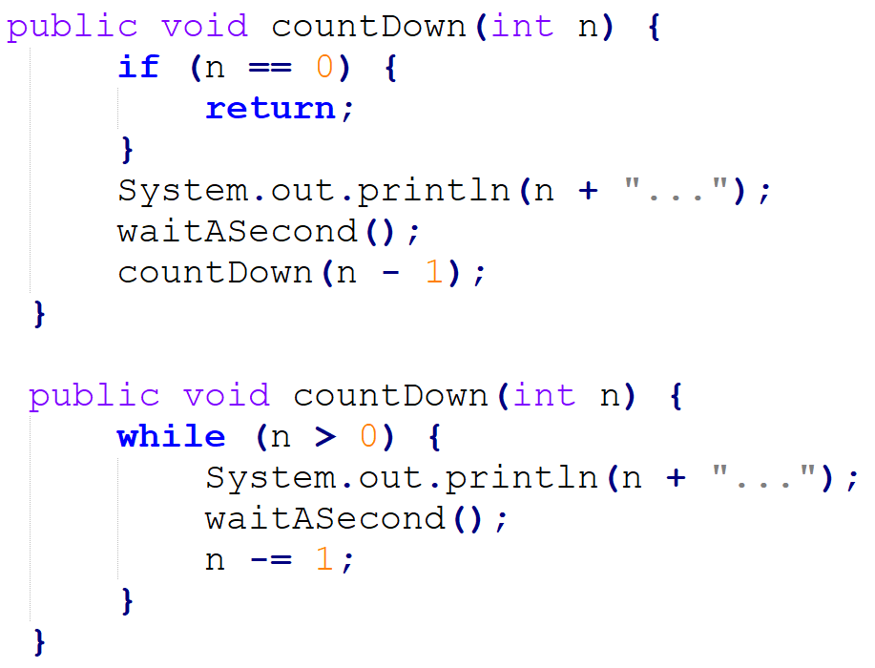
Code Tuning – Recursion

Slide 25
Code Tuning – Recursion

Slide 26
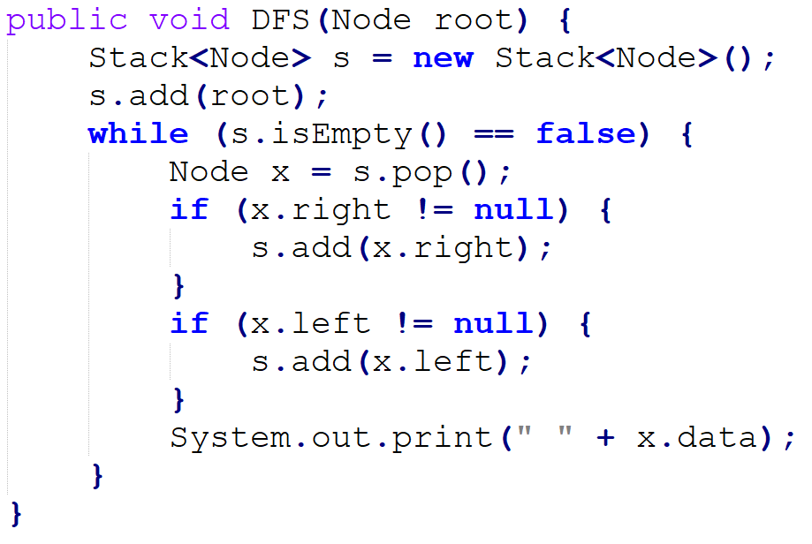
Code Tuning – Recursion

Slide 27
Caching

Slide 28
Code Tuning – Hidden Caching
A typical example is caching database connections in a pool.
The creation of a new connection takes time, which you can avoid if you reuse an existing connection.
You can also find other examples in the Java language itself.
The valueOf method of the Integer class, for example, caches the values between -128 and 127.

Slide 29
Iterators

Slide 30
Code Tuning – Iterators
Common now to use Java iterators
Is a good refactoring, but depending…
for (String value: strings) { // Do something useful here }
a new iterator instance will be created
int size = strings.size();
for (int i = 0; i < size; i++) {
String value: strings.get(i);
// Do something useful here
}

Slide 31
Memory

Slide 32
Code Tuning – Memory Leaks
Java is stuck with garbage collection
We can stop point at things but not delete them
If your program naively leaves created objects connected to current code (heap will continue to grow)
You can generally see this via Profiling and heap dumps

Slide 33
Code Tuning – Heap Structure
The young generation is actually garbage collected quicker than the older generation
Lots of new objects, or aggressive GC in young generation slows down program

Slide 34
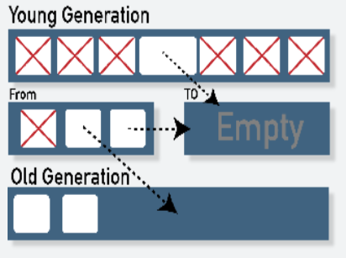
Code Tuning – Garbage Collectors
Serial Collector
Both Young and Old collections are done serially, using a single CPU and in a stop-the-world fashion.
Best client-side

Slide 35
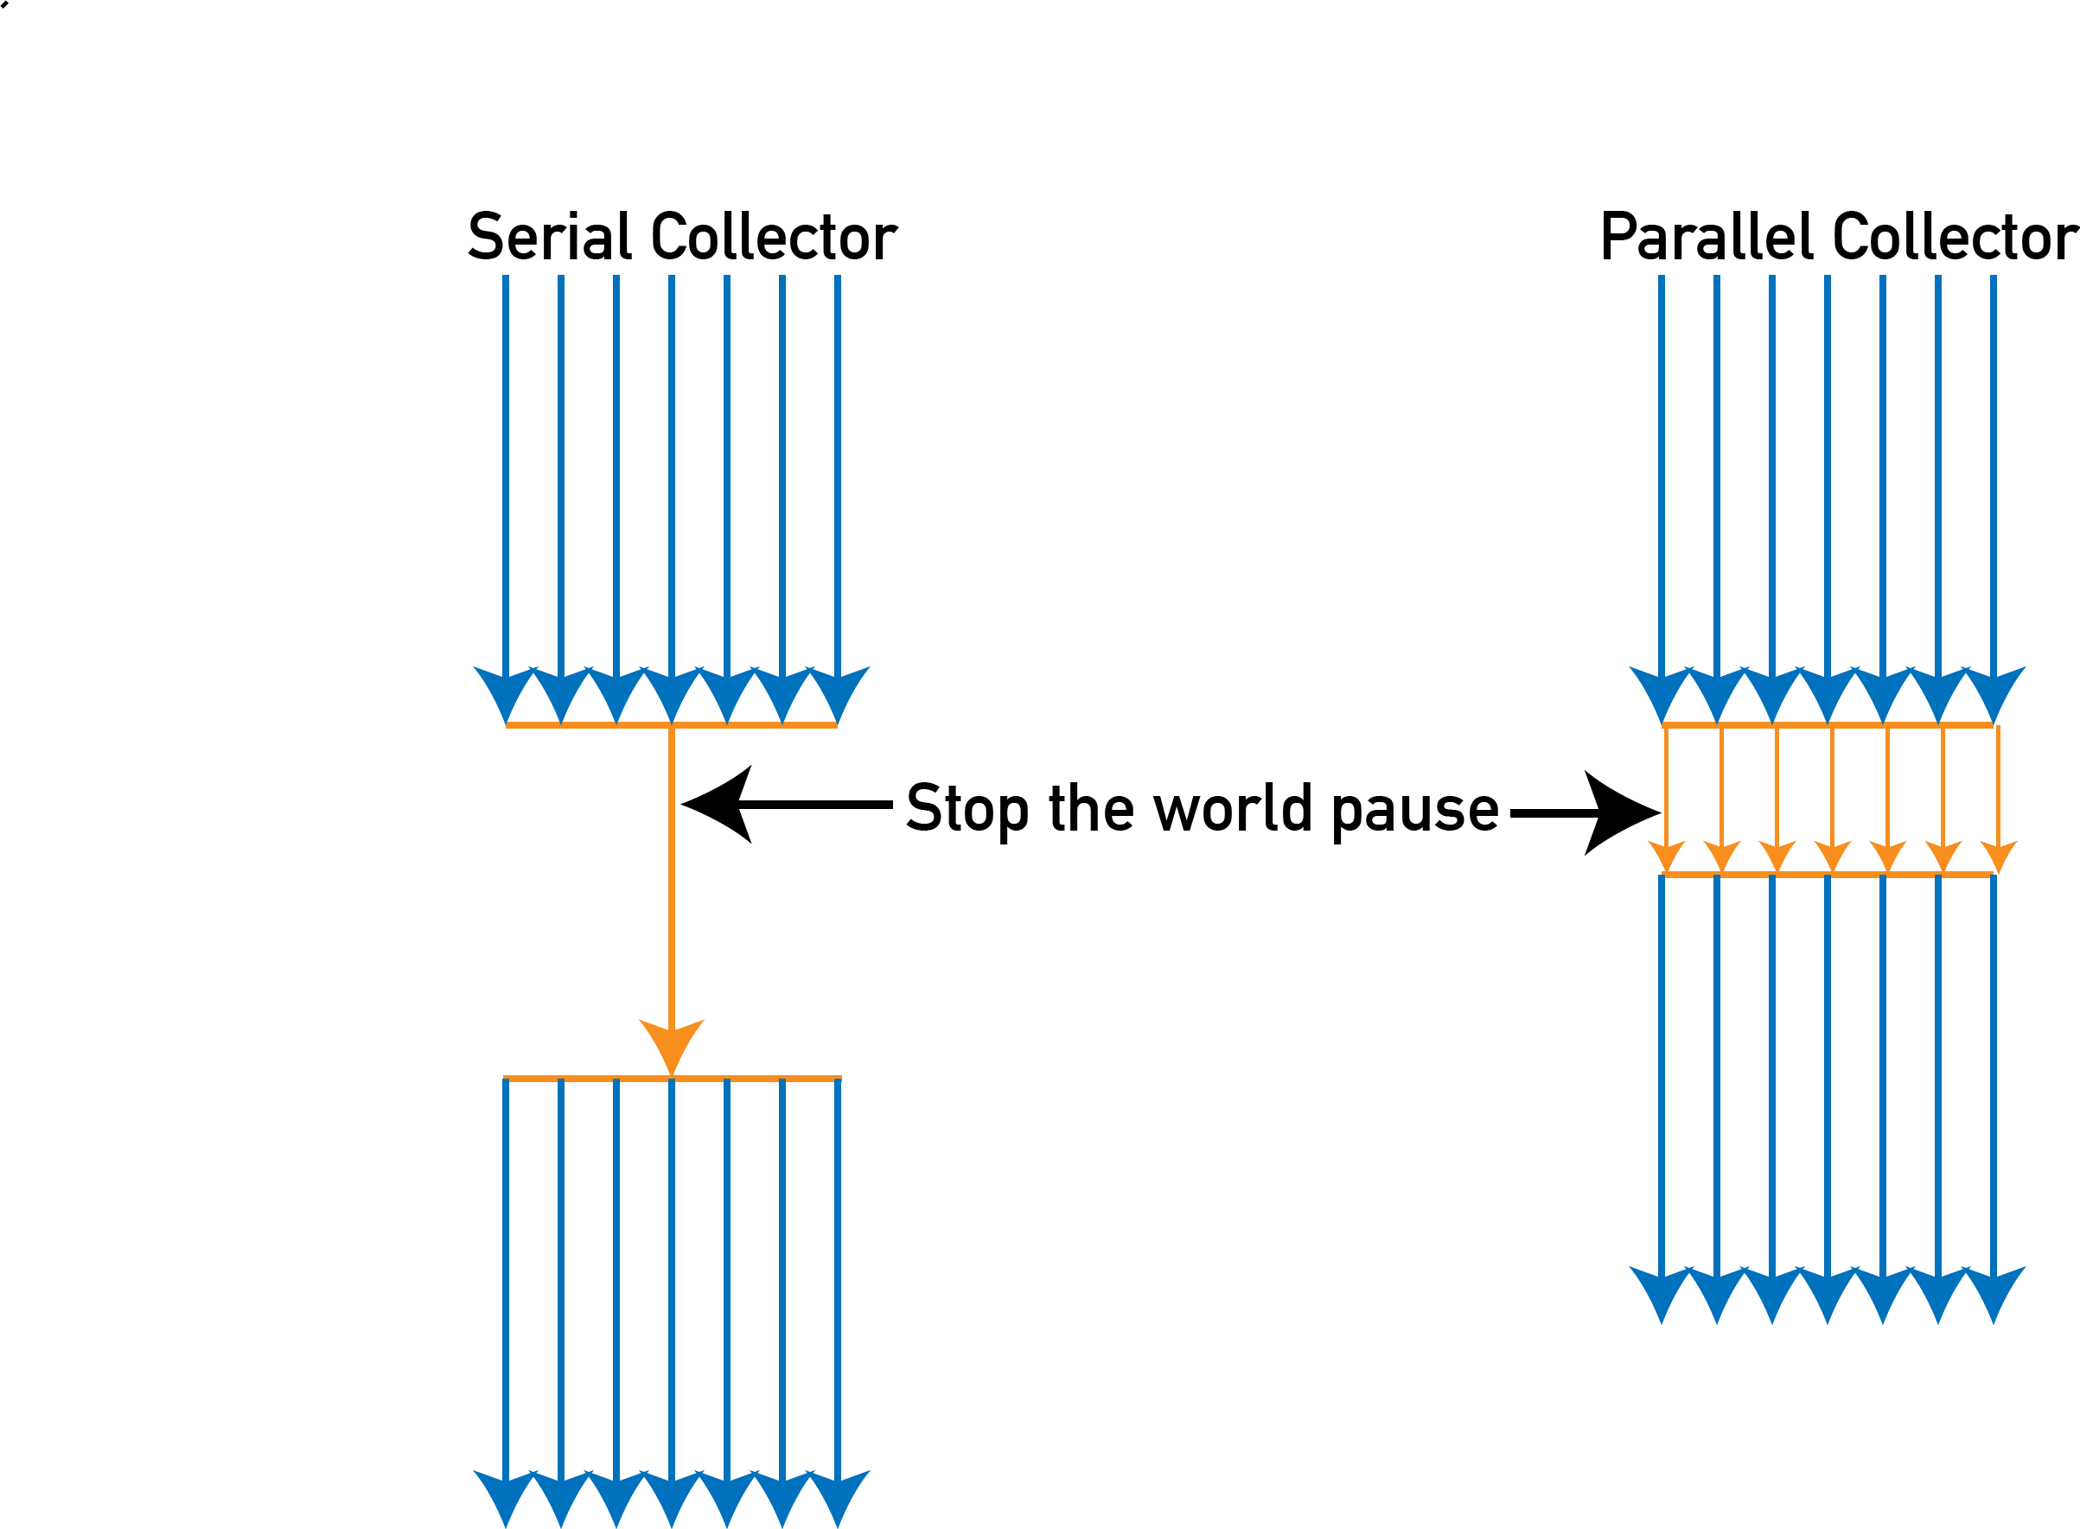
Code Tuning – Garbage Collectors
Serial Collector
Both Young and Old collections are done serially, using a single CPU and in a stop-the-world fashion.
Best client-side
Parallel Collector(throughput collector)
Designed to take advantage of available CPU cores. Both Young and Old collections are done using multiple Gcthreads.

Slide 36
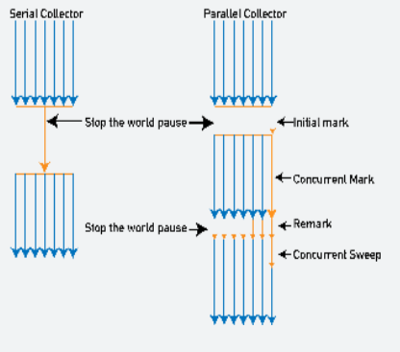
Code Tuning – Garbage Collectors
Mostly concurrent collectors (low-latency collectors)
Designed to minimize impact on application response time associated with Old generation stop-the-world collections.
Most of the collection of the old generation using the CMS collector is done concurrently with the execution of the application.

Slide 37
Code Tuning – Garbage Collectors
Choose wisely between 32-bit or 64-bit VMs
going from a 32-bit to a 64-bit machine increases heap requirement for an existing Java application by up to 1.5 times (bigger ordinary object pointers)
-XX:+UseCompressedOops in Java version prior to 1.7 (which is now default)
This tuning argument greatly alleviates the performance penalty associated with a 64-bit JVM.

Slide 38
Code Tuning – Garbage Collectors
Large heap not always better
Profile your application for possible memory leaks using tools such as Java VisualVM or Plumbr (Java memory leak detector).
Focus your analysis on the biggest Java object accumulation points
Reducing your application memory footprint will translate in improved performance due to reduced GC activity.

Slide 39
Threads

Slide 40
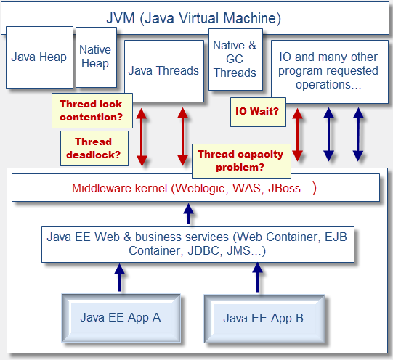
Code Tuning – Thread-Lock/Contention
Thread lock contention is by far the most common Java concurrency problem

Slide 41
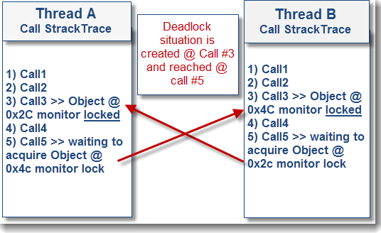
Code Tuning – Thread-Lock/Contention
True Java-level deadlocks, while less common, are triggered when two or more threads are blocked forever, waiting for each other.

Slide 42
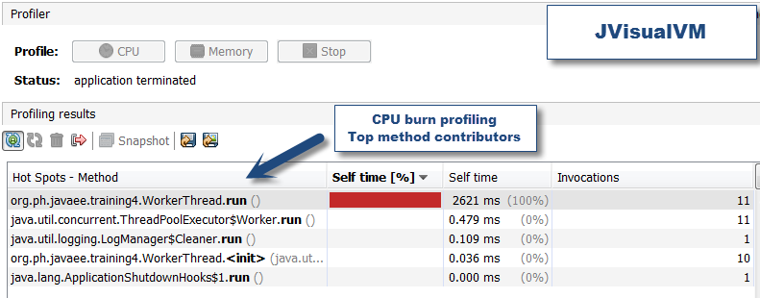
Code Tuning – Thread-Lock/Contention
Clock Time and CPU Burn
Ex. worker not doing anything, just spinning in a loop

Slide 43
Timeout Management

Slide 44
Code Tuning – Timeout Management
Lack of proper HTTP/HTTPS/TCP IP timeouts between your Java application and external systems
lead to severe performance degradation and outage due to middleware and JVM threads depletion (blocking IO calls).
Proper timeout implementation will prevent Java threads from waiting for too long in the event of major slowdown of your external service providers.

Slide 45
Onward to … next topic.
Jonathan Hudson
jwhudson@ucalgary.ca
https://pages.cpsc.ucalgary.ca/~hudsonj/

