Slide 1
Optimization: Assembly Optimization
CPSC 501: Advanced Programming Techniques
Fall 2020
Jonathan Hudson, Ph.D
Instructor
Department of Computer Science
University of Calgary
Monday, August 24, 2020

Slide 2
Code Tuning - Assembly
Assembly language techniques
Are speciﬁc to a CPU architecture
Thus are not generally portable
Goal is to minimize the number of clock cycles it takes to execute an algorithm
That is, code the algorithm using the fewest number of instructions possible
A clever programmer can usually beat the best optimizing compiler
We’re not always as clever as we think

Slide 3
Code Tuning – Assembly - Quantify
We can quantify execution time precisely, since each instruction takes a deﬁned number of clock cycles to complete
A ﬁxed number on a RISC CPU
E.g. 4 cycles per instruction on SPARC V8
A variable number on a CISC CPU
E.g. Intel Core 2
add: 1 cycle mul: 5 div: 40
Some assemblers produce output ﬁles showing this cycle count

Slide 4
Instructions

Slide 5
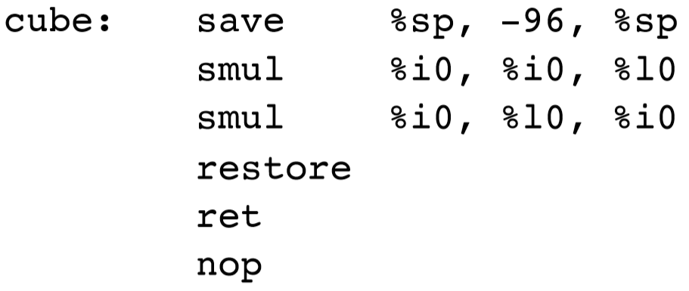
Code Tuning – Assembly - Instructions
Eliminate instructions where possible
Sparc example:
We save register window and create new
Restore after
Uses input registers (function inputs)

Slide 6
Code Tuning – Assembly - Instructions
Eliminate instructions where possible
Sparc example:
We save register window and create new
Restore after
Uses input registers (function inputs)
Eliminate 2 instructions by converting into a leaf subroutine:
We won’t call others (leaf)
Can only use output registers
Note: this also prevents the triggering of window overﬂow/underﬂow, which is expensive

Slide 7
Pipeline

Slide 8
Code Tuning – Assembly - Pipeline
Reorder instructions to keep the pipeline full or to avoid pipeline stalls

Slide 9
Code Tuning – Assembly - Pipeline
Reorder instructions to keep the pipeline full or to avoid pipeline stalls
E.g. Above code can be changed to:

Slide 10
Code Tuning – Assembly - Pipeline
Reorder instructions to keep the pipeline full or to avoid pipeline stalls
E.g. Above code can be changed to:
Eliminates 1 instruction
retl has to go through CPU 4 cycle (fetch, execute, memory, write) so we can slide in delay slot so cube is done by time retl gives reaches using it

Slide 11
Inline

Slide 12
Code Tuning – Assembly - Inline
Use macros to inline subroutines
Avoids call/return overhead
E.g. Calling code before optimization:
A macro such as:

Slide 13
SIMD

Slide 14
Code Tuning – Assembly – SIMD
Use SIMD instructions to move data while calculating
Single instruction, multiple data
Motorola DSP56001 example:
Multiply w/o Accumulate (MPY)
Multiple and Accumulate (MAC)
Move data (MOVE)

Slide 15
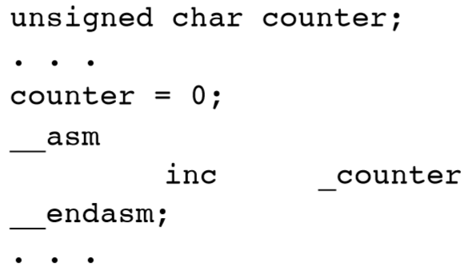
Code Tuning – Assembly – Inline (cont’d)
In extreme cases, one might inline every subroutine!
Usually results in a much bigger executable (i.e. more RAM is used)
We are trading memory for speed
Note that some compilers allow one to inline assembly code into C or C++ code
sdcc example:

Slide 16
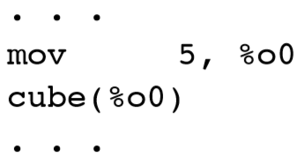
Code Tuning – Assembly – Inline (cont’d)
Can be used in calling code:
gets expanded to
Eliminates 3 more instructions

Slide 17
Code Tuning – Assembly – SIMD
Use SIMD instructions to move data while calculating
Single instruction, multiple data
Motorola DSP56001 example:
Can be improved to:

Slide 18
Code Tuning – Assembly – SIMD (cont’d)
There are libraries available that use SIMD instructions on vectors of data (and may exploit the parallelism of multi-core CPUs)
Intel Vector Math Library (VML)
Is a C/C++ API for Windows, Linux, OS X
Part of the Intel Math Kernel Library (MKL)
Accelerate framework
Is a C API for OS X

Slide 19
Onward to … Java optimization.
Jonathan Hudson
jwhudson@ucalgary.ca
https://pages.cpsc.ucalgary.ca/~hudsonj/

