Slide 1
Optimization: More Optimization
CPSC 501: Advanced Programming Techniques
Fall 2020
Jonathan Hudson, Ph.D
Instructor
Department of Computer Science
University of Calgary
Monday, August 24, 2020

Slide 2
Strength Reduction

Slide 3
Code Tuning – Strength Reduction
Strength Reduction
Is where you replace an expensive operation with a cheaper operation
E.g. Replace multiplication with addition
Remember: multiplication is repeated addition
E.g.

Slide 4
Code Tuning – Strength Reduction (cont’d)
After strength reduction:

Slide 5
Routines

Slide 6
Code Tuning – Routines - Inline
Routines
Rewrite routines inline
(looks like function but is code replacement)
C++ has the inline keyword
With other languages, use macros
E.g. in C
#define SQUARE(x) ((x) * (x))
. . .
int a = 5, b;
b = SQUARE(a);

Slide 7
Code Tuning – Routines – Re-Code
Recode in a low-level language
E.g. If in Java, use a native method written in C
E.g. If in C or C++, use assembly
Portability is lost
Best applied to small routines or sections of code
E.g. SPARC assembly
.global cube
cube: smul %o0, %o0, %o1
smul %o0, %o1, %o0
retl
nop

Slide 8
Code Tuning – Routine - Rewrite
Rewrite expensive system routines
E.g. double log2(double x) may give more precision than you need
Rounding integer version:
unsigned int log2(unsigned int x) {
if (x < 2) return 0;
if (x < 4) return 1;
if (x < 8) return 2;
. . .
if (x < 2147483648) return 30;
return 31;
}

Slide 9
Data Format

Slide 10
Code Tuning – Data Transformation – Float/Int
Data Transformation techniques
Replace f.p. numbers with integers
(in OO maybe also be able to replace object type with primitive type)
E.g. Visual Basic
Dim x As Single
For x = 0 to 99
a(x) = 0
Next
Is faster as:
Dim x As Integer
. . .

Slide 11
Code Tuning – Data Transformation – Array Dims
Reduce array dimensions where possible
E.g. C or C++ array
Is faster as a 1D array:

Slide 12
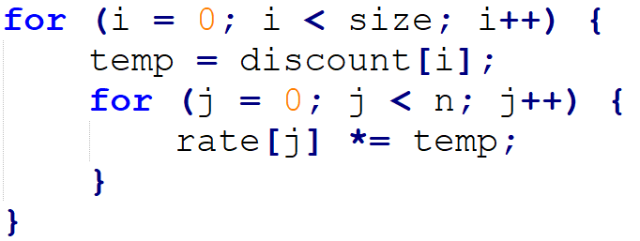
Code Tuning – Data Transformation – Array Refs
Minimize array references
E.g.
Is better as:

Slide 13
Code Tuning – Data Transformation – Supp
Use supplementary indices
Length index for arrays
E.g. Add a string-length ﬁeld to C strings
Faster than using strlen(), which loops until null found Parallel index structure
E.g. Often easier to sort an array of references to a data array, than the data array itself
Avoids swapping data that’s expensive to move (i.e. is large or on disk)

Slide 14
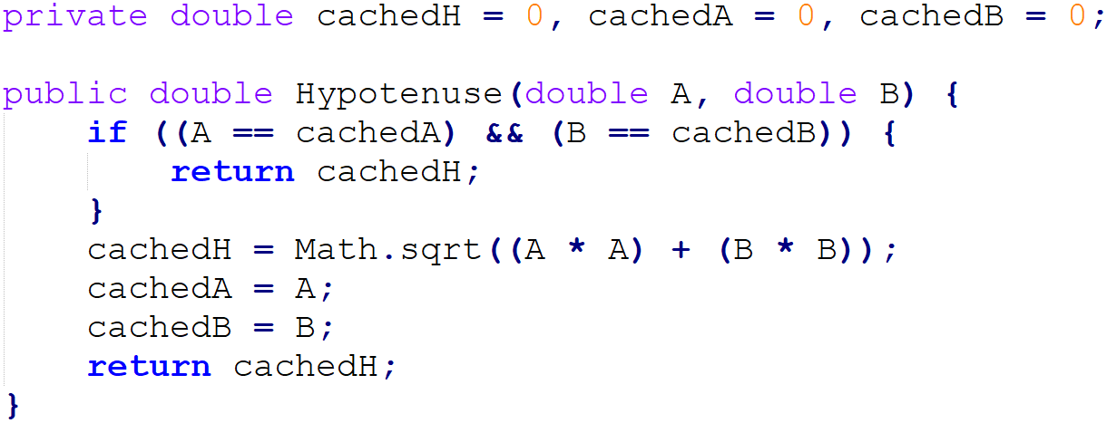
Code Tuning – Data Transformation – Caching
Use caching
Save commonly used values, instead of recomputing or rereading them
Java example:

Slide 15
Expressions

Slide 16
Code Tuning - Expressions
Expressions
Exploit algebraic identities
i.e. replace expensive expressions with cheaper ones
E.g. not a and not b
Better as: not (a or b)
E.g. if (sqrt(x) < sqrt(y))
Better as: if (x < y)

Slide 17
Code Tuning – Expressions – Strength Reduction
Use strength reduction
Replace expensive operations with cheaper ones
Some possibilities:
Original | Replacement
Multiplication | Addition
Exponentiation | Multiplication
Trig routines | Tri. Identities
Long ints | Ints
f.p. numbers | Fixed point numbers/ints
Doubles | Floats
Mult/div by power 2 | Left/right shift

Slide 18
Code Tuning – Expressions – Compile Time
Initialize at compile time
i.e. use constants where possible
E.g.
unsigned int Log2(unsigned int x) {
return (unsigned int)(log(x) / log(2));
}
Is better as:
const double LOG2 = 0.69314718;
unsigned int Log2(unsigned int x) {
return (unsigned int)(log(x) / LOG2);
}

Slide 19
Code Tuning – Expressions – Data Type
Use the proper data type for constants
i.e. avoid runtime type conversions
E.g.
double x;
. . .
x = 5;
Is better as:
x = 5.0;

Slide 20
Code Tuning – Expressions – Common Sub-Exp
Eliminate common subexpressions
Assign to a variable, and use it instead of recomputing
E.g.
p = (1.0 - (r / 12.0)) / (r / 12.0);
Is better as:
y = r / 12.0;
p = (1.0 - y) / y;

Slide 21
Code Tuning – Expressions – Precompute
Precompute results
Often better to look up values than to recompute them
Values could be stored in constants, arrays, or ﬁles

Slide 22
I/O

Slide 23
Code Tuning – I/O
I/O techniques
Minimize disk and network accesses
Use buffered I/O, instead of single reads/writes
Use RAM instead of disk whenever possible
Cache commonly used data
Localize memory accesses
Reading/writing registers is faster than cache memory, which is faster than DRAM
C and C++ provide the register keyword
Is a hint to the compiler to use a register instead of RAM
E.g. register int x;

Slide 24
Onward to … assembly optimization.
Jonathan Hudson
jwhudson@ucalgary.ca
https://pages.cpsc.ucalgary.ca/~hudsonj/

