Slide 1
Optimization: Loop Optimization
CPSC 501: Advanced Programming Techniques
Fall 2020
Jonathan Hudson, Ph.D
Instructor
Department of Computer Science
University of Calgary
Monday, August 24, 2020

Slide 2
Code Tuning Loops

Slide 3
Code Tuning
Loop techniques
Looping is often very important target for compiler and CPU optimizations (we can help it out)
Guidelines:
Save each version of your code using version control
Use the proﬁler to ﬁnd a bottleneck
Tune the bottleneck, using just one technique
Measure the improvement
If none, revert to the prior version
Repeat until desired performance is achieved

Slide 4
Unswitching

Slide 5
Loop Techniques - Unswitching
Un-switching
Switching is where a decision is made inside a loop on every iteration
If the decision doesn’t change while looping, unswitch it
i.e. turn the loop inside out

Slide 6
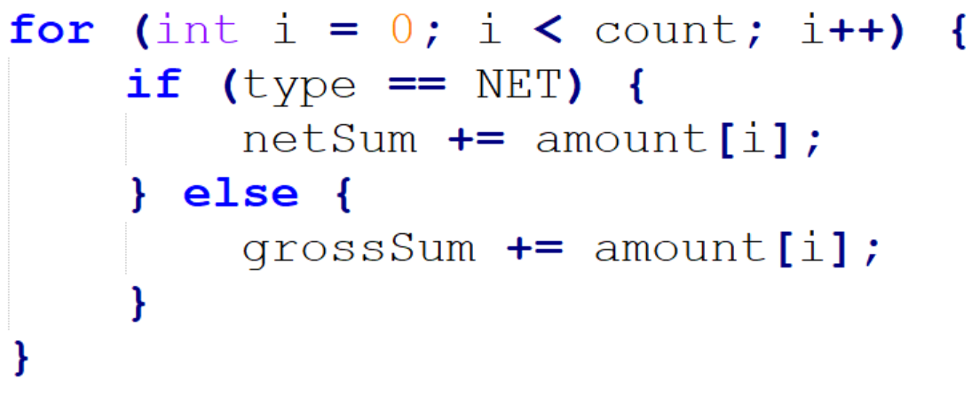
Loop Techniques – Unswitching (cont’d)
E.g.

Slide 7
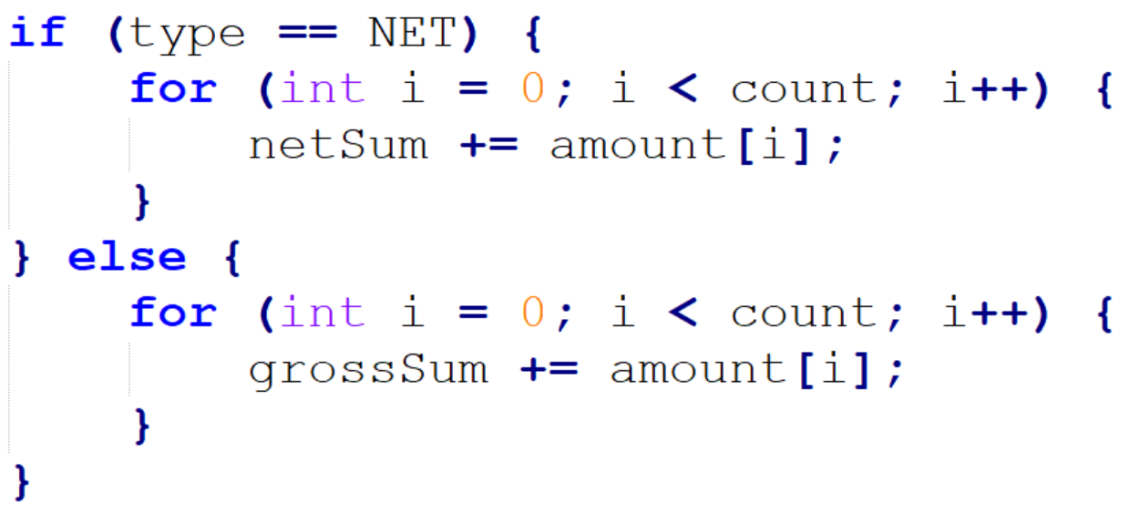
Loop Techniques – Unswitching (cont’d)
Note: two loops must now be maintained in parallel (design danger!!!)

Slide 8
Jamming

Slide 9
Loop Techniques – Jamming
Jamming (fusion)
Combines two or more loops into one
Their loop counters should be similar
Reduces loop overhead
E.g.

Slide 10
Loop Techniques – Jamming (cont’d)
Jammed version:

Slide 11
Unrolling

Slide 12
Loop Techniques - Unrolling
Unrolling
A complete unrolling replaces a loop with straight-line code
Practical only for short loops
E.g.

Slide 13
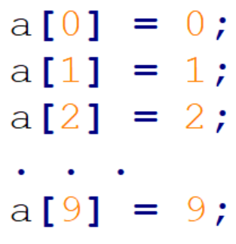
Loop Techniques – Unrolling (cont’d)
Is replaced with:
Maintenance!!!!

Slide 14
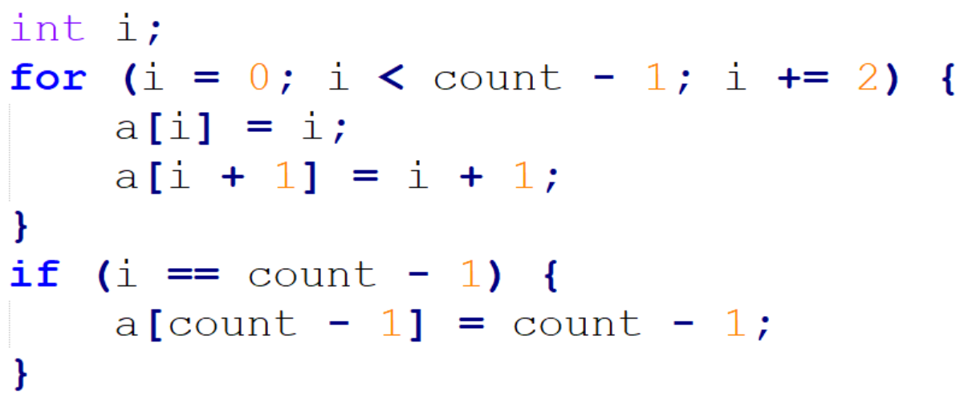
Loop Techniques – Partial Unrolling
With partial unrolling, two or more cases are handled inside the loop instead of just one
E.g.
Unrolled once, becomes:

Slide 15
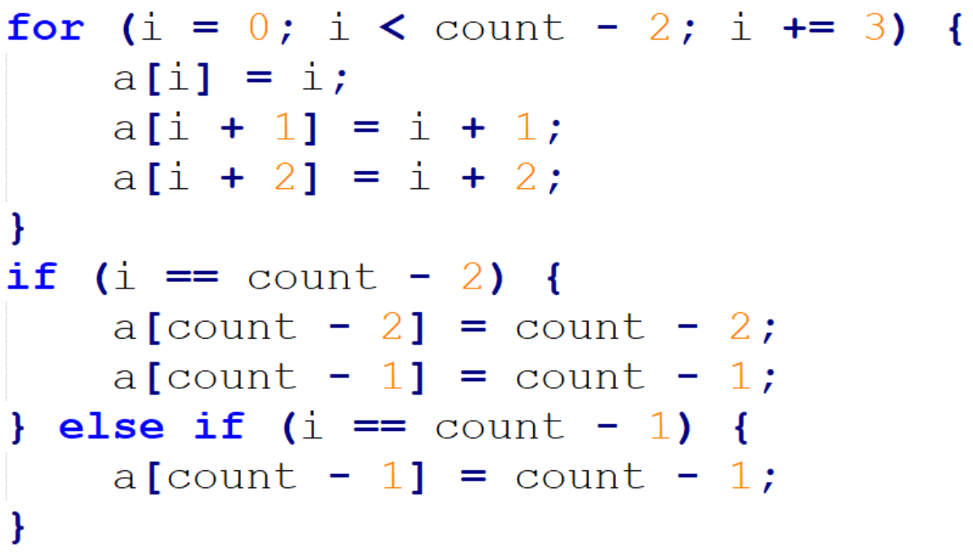
Loop Techniques – Partial Unrolling (cont’d)
Unrolled twice, becomes:

Slide 16
Minimize work

Slide 17
Loop Techniques – Minimize Work
Minimizing work inside loops
Put calculations that result in a constant before the loop
E.g.

Slide 18
Loop Techniques – Minimize Work (cont’d)
Is better as:

Slide 19
Sentinels

Slide 20
Loop Techniques - Sentinels
Sentinel Values
Are used to simplify loop control
Replaces expensive compound tests
A sentinel is a special value that marks the end of an array
Is guaranteed to terminate a search through the loop
Declare the array one element bigger so it can hold the sentinel

Slide 21
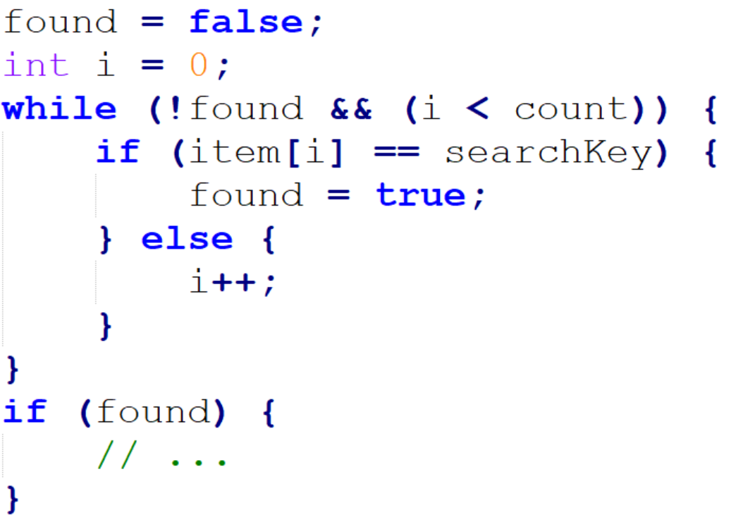
Loop Techniques – Sentinels (cont’d)
E.g.

Slide 22
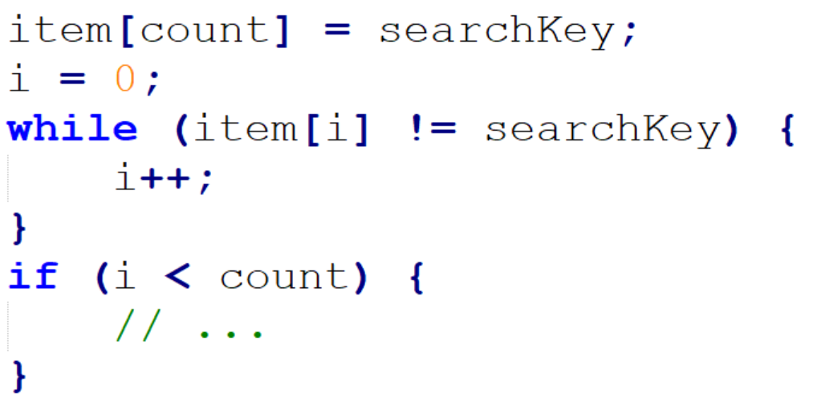
Loop Techniques – Sentinels (cont’d)
With a sentinel, becomes:
Put sentinel at end of the array (now bigger by one element)

Slide 23
Busy Loop Inside

Slide 24
Loop Techniques – Busy Loop Inside
Putting the busiest loop on the inside
E.g.
loop operations
Outer loop: 100
Inner loop: 100 * 5 = 500
Total: 600

Slide 25
Code Tuning
Switching inner and outer loops, gives:
loop operations
Outer loop: 5
Inner loop: 5 * 100 = 500
Total: 505

Slide 26
Onward to … more optimization.
Jonathan Hudson
jwhudson@ucalgary.ca
https://pages.cpsc.ucalgary.ca/~hudsonj/

