Slide 1
Optimization: Logic Optimization
CPSC 501: Advanced Programming Techniques
Fall 2020
Jonathan Hudson, Ph.D
Instructor
Department of Computer Science
University of Calgary
Tuesday, September 15, 2020

Slide 2
Code Tuning Logic

Slide 3
Code Tuning
Guidelines:
Save each version of your code using version control
Use the proﬁler to ﬁnd a bottleneck
Tune the bottleneck, using just one technique
Measure the improvement
If none, revert to the prior version
Repeat until desired performance is achieved

Slide 4
Stop when found

Slide 5
Logic Techniques - Found
Logic techniques
Stop testing when answer found
E.g.

Slide 6
Logic Techniques – Found (cont’d)
Is better as:

Slide 7
Frequency

Slide 8
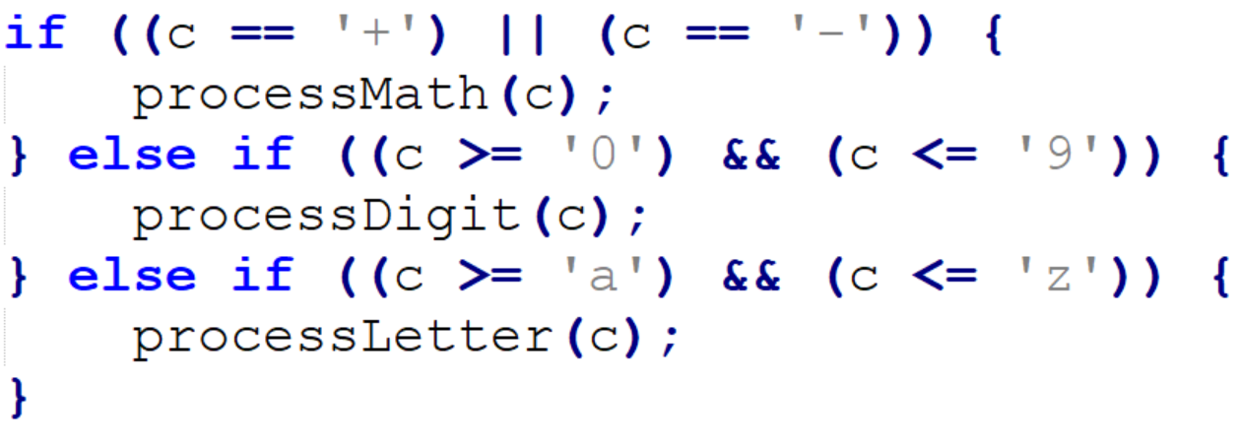
Logig Techniques - Frequency
Order tests by frequency in switch and if-else structures
E.g.

Slide 9
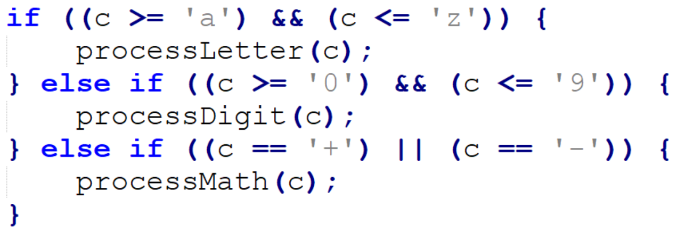
Logig Techniques – Frequency (cont’d)
Since letters are more common, is better as:

Slide 10
Switch

Slide 11
Logic Techniques - Switch
Substitute switch statement for if-else construct, or vice-versa
In Java, an if-else construct is about 6 times faster than a switch
Sometimes…
But in Visual Basic, is 4 times slower
Beware of assumptions (compiler optimizations, caching, predictive code execution mean this is variable sometimes)

Slide 12
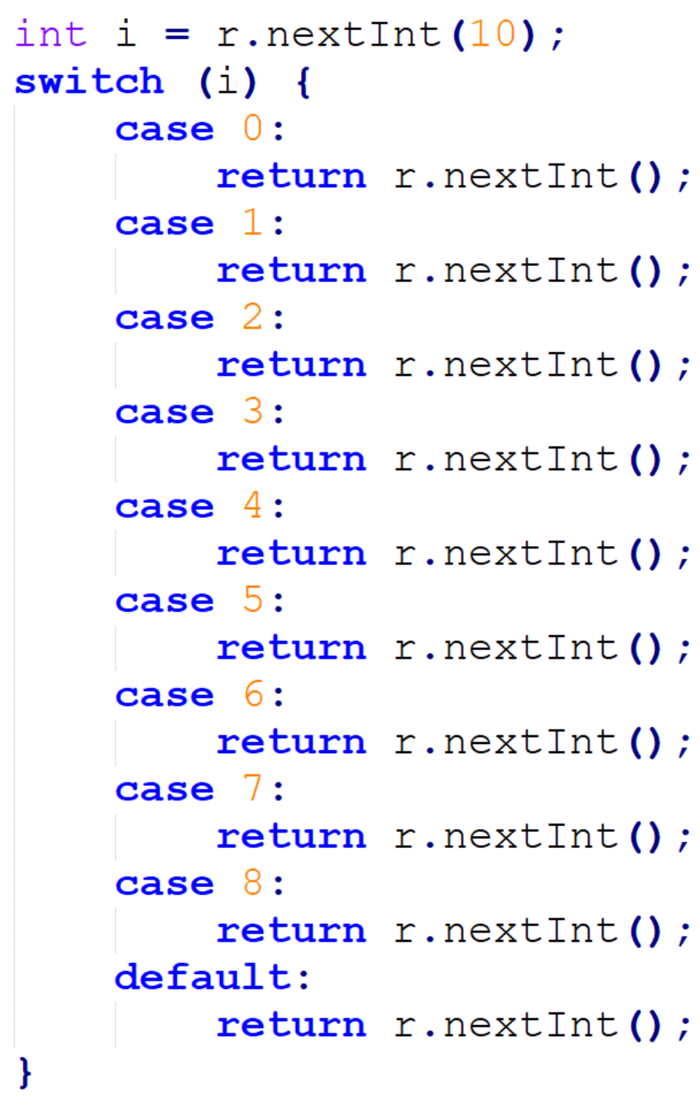
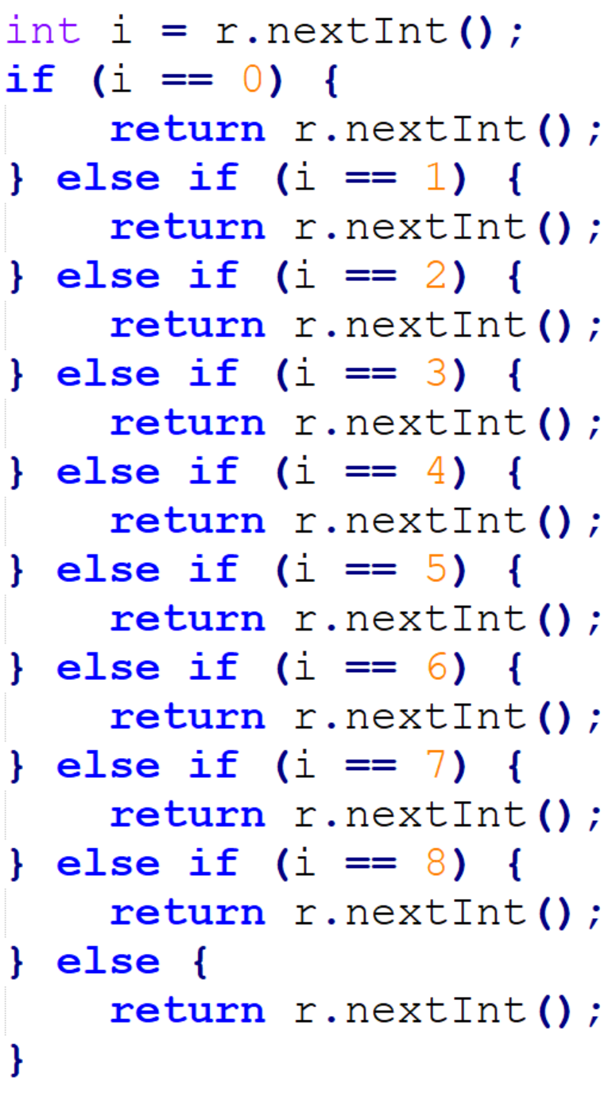
Logic Techniques – Switch (cont’d)

Slide 13
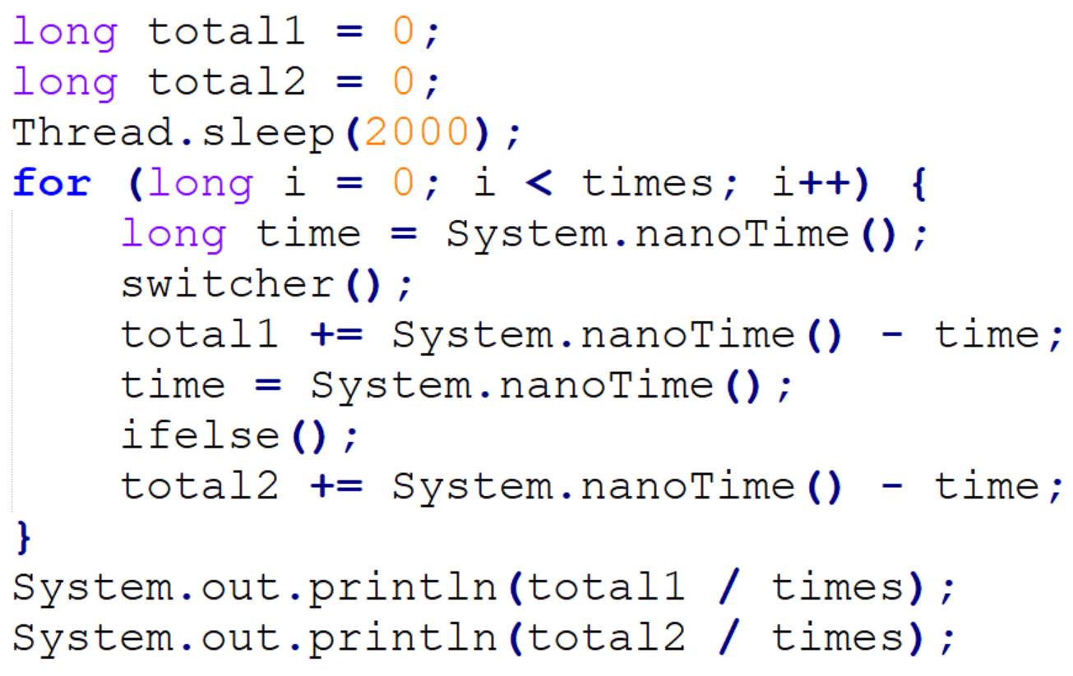
Logic Techniques – Switch (cont’d)

Slide 14
Logic Techniques – Switch (cont’d) [average]
Times | switcher | ifelse
1 | 3800 | 1800
10 | 2530 | 2420
100 | 1652 | 1919
1,000 | 526.4 | 552.6
10,000 | 209.99 | 204.86
100,000 | 88.525 | 94.928

Slide 15
Logic Techniques – Switch (cont’d) [median]
Times | switcher | ifelse
1 | 3800 | 1800
10 | 2250 | 2250
100 | 1200 | 1350
1,000 | 300 | 300
10,000 | 200 | 100
100,000 | 100 | 100

Slide 16
Lookup Table

Slide 17
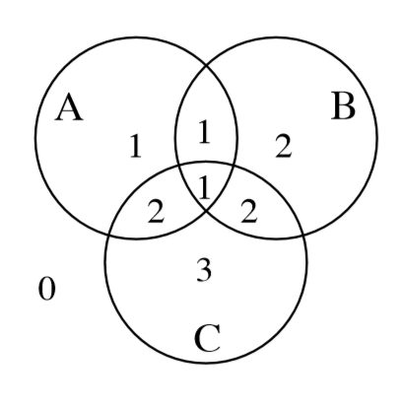
Logic Techniques – Lookup Table
Substitute table lookups for complicated expressions
E.g.

Slide 18
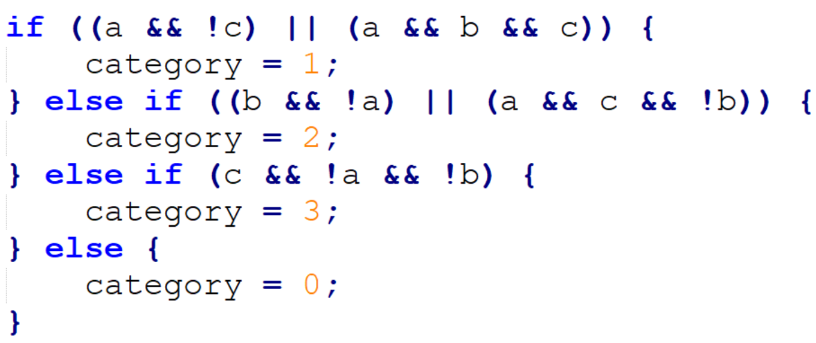
Logic Techniques – Lookup Table (cont’d)
Can be implemented using complicated logic:

Slide 19
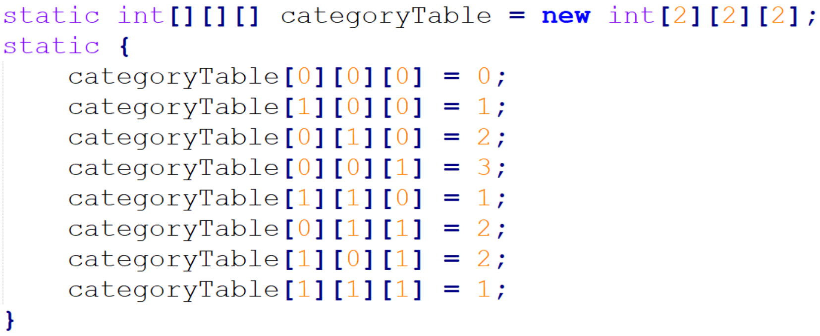
Logic Techniques – Lookup Table (cont’d)
But is faster with a lookup table:

Slide 20
Lazy evaluation

Slide 21
Logic Techniques – Lazy Evaluation
Use lazy evaluation
E.g. A 5000-entry table could be generated when the program starts
But if only a few entries are ever used, it may be better to compute values as needed, and then store them in the table
i.e. Cache them for further use

Slide 22
Onward to … loop optimization.
Jonathan Hudson
jwhudson@ucalgary.ca
https://pages.cpsc.ucalgary.ca/~hudsonj/

