Slide 1
Optimization: Introduction
CPSC 501: Advanced Programming Techniques
Fall 2020
Jonathan Hudson, Ph.D
Instructor
Department of Computer Science
University of Calgary
Monday, August 24, 2020

Slide 2
Definition

Slide 3
Optimization
Optimization is the process of modifying a program to improve its efﬁciency
Increase its speed
Reduce its size (memory usage)
Optimization can often be seen as de-factoring
Program gets faster but…
Harder to understand, upkeep, read

Slide 4
Efficiency
Efﬁciency can be viewed in terms of:
Program requirements
Does the program really need to run at a certain speed? Is it worth the extra effort
Program design
If performance is important, design a performance-oriented architecture
Set resource goals for individual subsystems and classes
Class and routine design
Choose efﬁcient algorithms and datatypes
E.g. Quicksort vs. bubble sort
E.g. Binary search vs. linear search

Slide 5
Efficiency (cont’d)
Operating system interactions
Working with ﬁles, dynamic memory, or I/O devices means using system calls
May be slow or fast
Code compilation
Good compilers produce optimized machine code
May have options for different optimization levels

Slide 6
Efficiency (cont’d)
Hardware
A hardware upgrade may be the cheapest way to improve a program’s performance
Not always possible
Code tuning
Small-scale changes made to code to make it run more efﬁciently
At the level of a single routine, or a few lines of code
Tends to produce hard-to-understand code
Obscures design

Slide 7
Guide to the galaxy of optimization

Slide 8
General Guidelines
Don’t optimize as you go
Focusing on optimization during initial development detracts from achieving correctness, readability, and design quality

Slide 9
General Guidelines (cont’d)
Jackson’s Rules of Optimization:
Rule 1. Don’t do it.
Rule 2 (for experts only). Don’t do it yet—that is, not until you have a perfectly clear and unoptimized solution.
Code tuning should be done only as a last step
Knuth: Pre-mature optimization is the root of all evil

Slide 10
General Guidelines (cont’d)
Optimize bottlenecks
The 80/20 rule: 20% of program’s routines consume 80% of its execution time
Knuth found 4% of a FORTRAN program accounted for over 50% of its run time
Spend your time ﬁxing these ‘bottlenecks’
Don’t waste effort on the other parts

Slide 11
General Guidelines (cont’d)
Measure performance when optimizing
Use a proﬁler to ﬁnd bottlenecks
Use timers to measure CPU time
Make sure a change actually improves speed
May actually make things worse when using a different compiler, OS, or processor
Run regression tests after each optimization
Make sure your program is still correct

Slide 12
Swipe right

Slide 13
Profiling
Proﬁling
Is used to ﬁnd how much time is spent in each function of a program
Helps ﬁnd bottlenecks
Helps you compare the performance of algorithms or programs

Slide 14
Profiling (cont’d)
Works by sampling the program counter (PC register)
Periodically queries the program, recording the function in which it is running
Is statistical in nature
i.e. is somewhat inexact, and will vary from run to run
Also the act of enabling profiling will generally slow down operation of code, this slowdown can be different for varying classes

Slide 15
C++ profiling

Slide 16
Profilers – gcc
Available UNIX proﬁlers for programs compiled with gcc:
prof (most commonly used)
gprof
pixie

Slide 17
Profilers – gcc (cont’d)
Using prof:
Compile the program with the -p option
E.g.
gcc -c myprog.c
gcc -o myprog -p myprog.o
Run the program
E.g.
./myprog
Produces the ﬁle mon.out
Print the proﬁle report to stdout
E.g. prof myprog mon.out

Slide 18
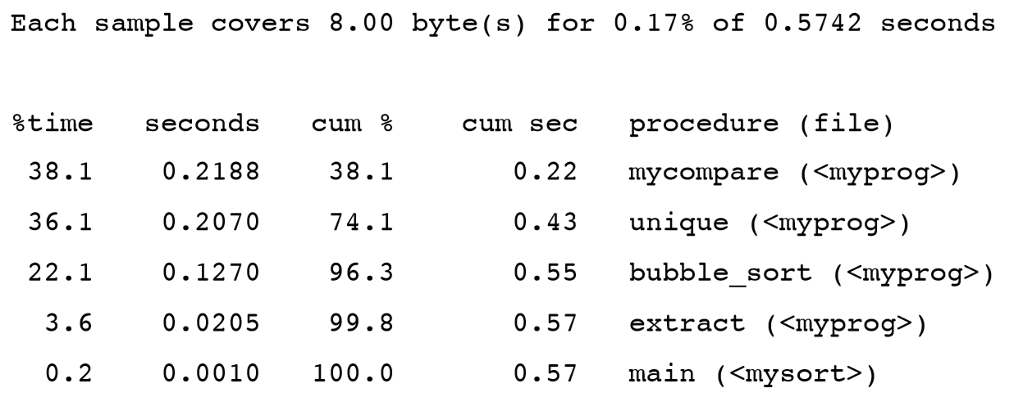
Profilers – gcc (cont’d)
Example output:

Slide 19
Timestamp profiling

Slide 20
Profilers - Timing
Timing measurements
In UNIX, can use the time command to time an entire program
E.g.
time java Test
1.09u 0.12s 0:01.27 95.2%
<user CPU time> <system CPU time> <real_time>

Slide 21
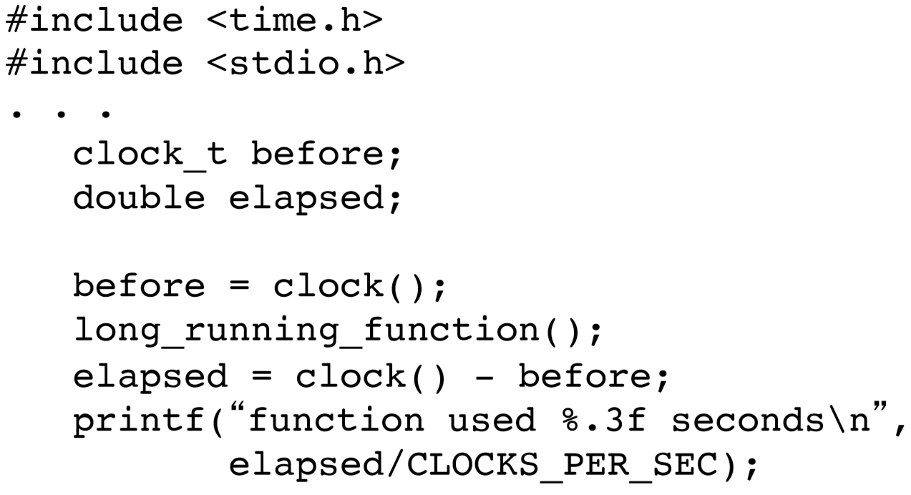
Profilers – C/C++ clock()
In C and C++, use the clock() function to measure the CPU time used by a function or section of code
E.g.

Slide 22
Profilers – C/C++ clock() (cont’d)
If the function takes a fraction of a second, run it in a loop to get a more accurate measurement
E.g.
before = clock();
for (i = 0; i < 1000; i++)
short_running_function();
elapsed = (clock() - before) / (double) i;

Slide 23
Profilers – nanoTime()
In Java, use the nanoTime() method
E.g.
long startTime = System.nanoTime();
longRunningMethod();
long elapsedTime = System.nanoTime() - startTime;
Note: result is in nanoseconds (10⁻⁹ s)

Slide 24
Java profiling

Slide 25
Profilers – Java
Standard JVM Profilers
VisualVM, JProfiler, YourKit and Java Mission Control
method calls and memory usage
Pros:
Great for tracking down memory leaks, standard profilers detail out all memory usage by the JVM and which classes/objects are responsible.
Good for tracking CPU usage and zero in on hot spots.

Slide 26
Profilers – Java
Standard JVM Profilers
VisualVM, JProfiler, YourKit and Java Mission Control
method calls and memory usage
Cons:
Requires a direct connection to the monitored JVM; this ends up limiting usage to development environments in most cases.
They slow down your application; a good deal of processing power is required for the high level of detail provided.

Slide 27
Profilers – Java
Lightweight Java Transaction Profilers
XRebel and Stackify Prefix
Aspect Profilers
use aspect-oriented programming (AOP) to inject code into the start and end of specified methods.
Java Agent profilers (ex. Netbeans built-in)
use the Java Instrumentation API to inject code into your application. This method has greater access to your application since the code is being rewritten at the bytecode level.

Slide 28
Profilers – Java
Lightweight Java Transaction Profilers
Aspect profilers are pretty easy to setup but are limited in what they can monitor and are encumbered by detailing out everything you want to be tracked.
Java Agents have a big advantage in their tracking depth but are much more complicated to write.

Slide 29
Profilers – Java
Low Overhead, Java JVM Profiling in Production (APM – APplication Monitoring)
New Relic, AppDynamics, Stackify Retrace, Dynatrace
how your system performs in production is critical
Java APM tools typically use the Java Agent profiler method
different instrumentation rules to allow them to run without affecting performance in productions.

Slide 30
Algorithm Based Optimization

Slide 31
Algorithm-Based Optimization
Choosing a more efﬁcient algorithm or data structure is often the best way to improve program efﬁciency
Look for algorithms that reduce the order of complexity
E.g. Binary search $O(log⁡n)$ vs. linear search $O(n)$
E.g. Merge sort $O(nlog⁡n)$vs. bubble sort $O(n^{2})$

Slide 32
Algorithm-Based Optimization
Do this ﬁrst before attempting other optimizations
Hand tuning an O(n²) algorithm won’t yield near the same gains as using an O(n log n) algorithm
Beware of worst-case performance
Some algorithms may not achieve their average Big-O performance under certain conditions
E.g. The quicksort degenerates to O(n²) with nearly-sorted inputs

Slide 33
Algorithm-Based Optimization
Sometimes an inefﬁcient algorithm is ﬁne for small inputs
The overhead of a complicated algorithm may make it slower than a simple one
And harder to debug and maintain!
Measure performance to make sure you’ve made the right choice

Slide 34
Algorithm-Based Optimization
Sometimes an inefﬁcient algorithm is ﬁne for small inputs
Java’s own internal Quick Sort uses an Insertion Sort below a specific array size

Slide 35
Compiler Based Optimization

Slide 36
Compiler-Level Optimization
Enabling compiler optimization can improve speed by as much as 2 times
Most compilers turn off optimization by default
Optimized code tends to confuse debuggers
Works best with straightforward code
Hand tuned code may actually be harder for the compiler to optimize

Slide 37
Compiler-Level Optimization
Some compilers optimize better than others
E.g.

Slide 38
Compiler-Level Optimization
Aggressive optimizers may introduce bugs
Rerun regression tests to ensure correctness
gcc optimization ﬂags:
Optimize: -O or -O1
Optimize even more: -O2
Optimize yet more: -O3
Don’t optimize (default): -O0

Slide 39
Compiler-Level Optimization
E.g. gcc -O2 -o myprog myfile.c

Slide 40
Onward to … logic optimization.
Jonathan Hudson
jwhudson@ucalgary.ca
https://pages.cpsc.ucalgary.ca/~hudsonj/

