Slide 1
Reflection: Aspects
CPSC 501: Advanced Programming Techniques
Fall 2020
Jonathan Hudson, Ph.D
Instructor
Department of Computer Science
University of Calgary
Monday, August 24, 2020

Slide 2
Intercession via aspects

Slide 3
Introduction
What is AspectJ?
Aspect oriented programming (AOP) extension to Java
What is an Aspect?
a particular part or feature of something.

Slide 4
History
Developed at Xerox PARC (Palo Alto RC)
Launched in 1998
PARC transferred AspectJ to an openly-developed eclipse.org project in December of 2002.
For more info: www.eclipse.org/aspectj

Slide 5
Introduction
What are goals of AOP?
Separation of concerns
Modularity
No more tangled code
Simplicity
Maintainability
Reusability
Aspects
encapsulate behaviors that affect multiple classes (OO) into reusable modules.

Slide 6
I’m concerned?

Slide 7
Cross-Cutting Concern
What is a cross-cutting concern?
Behavior that cuts across the typical divisions of responsibility, such as logging or debugging
A problem which a program tries to solve.
Aspects of a program that do not relate to the core concerns directly, but which proper program execution nevertheless requires.

Slide 8
Language: Dynamic VS Static crosscutting
Dynamic crosscutting
define additional behavior to run at certain well-defined points in the execution of the program
Static crosscutting
modify the static structure of a program (e.g., adding new methods, implementing new interfaces, modifying the class hierarchy)

Slide 9
We’ll build around this

Slide 10
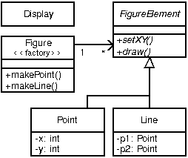
Reference Object Structured for Following

Slide 11
Join In

Slide 12
Language: Join Points
Join Points: well-defined points in the execution of a program
Method call, Method execution
Constructor call, Constructor execution
Static initializer execution
Object pre-initialization, Object initialization
Field reference, Field set
Handler execution
Advice execution

Slide 13
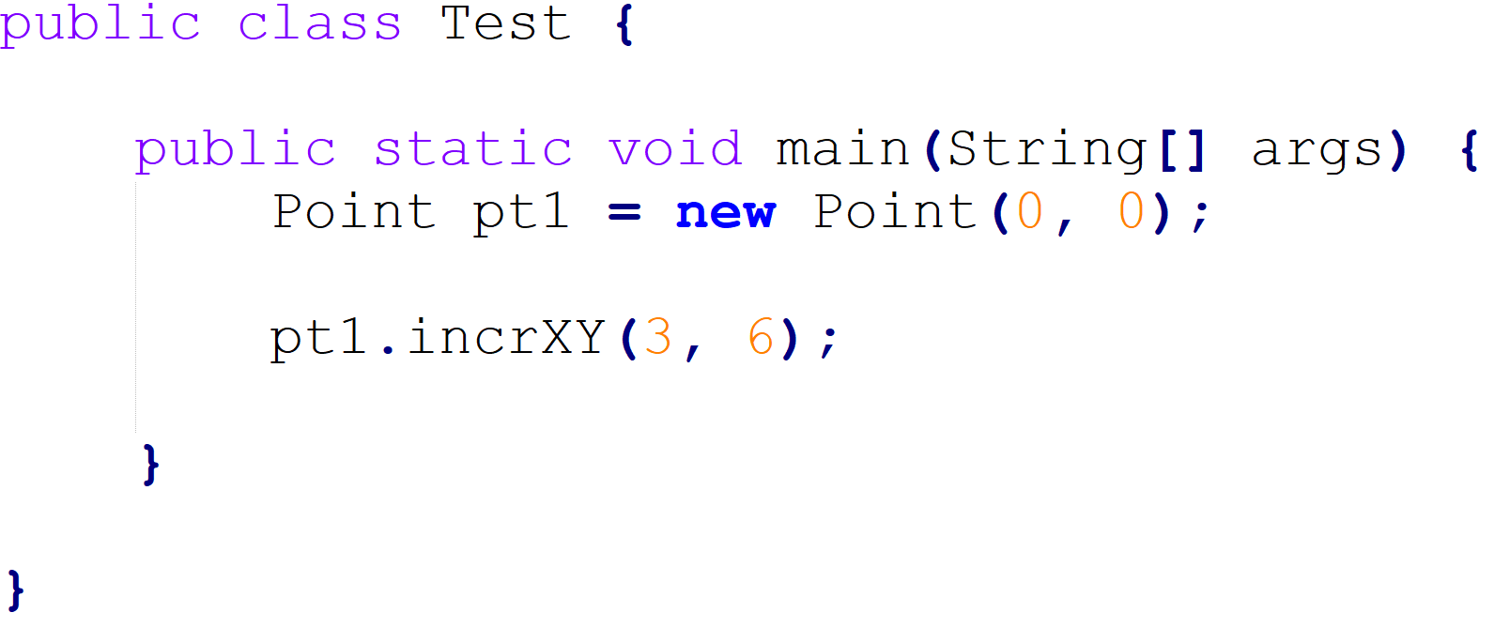
Language: Join Points
Method-execution
“Test.main(..)”
Constructor-call
“Point(..)”
Method-call
“Point.incrXY(..)”

Slide 14
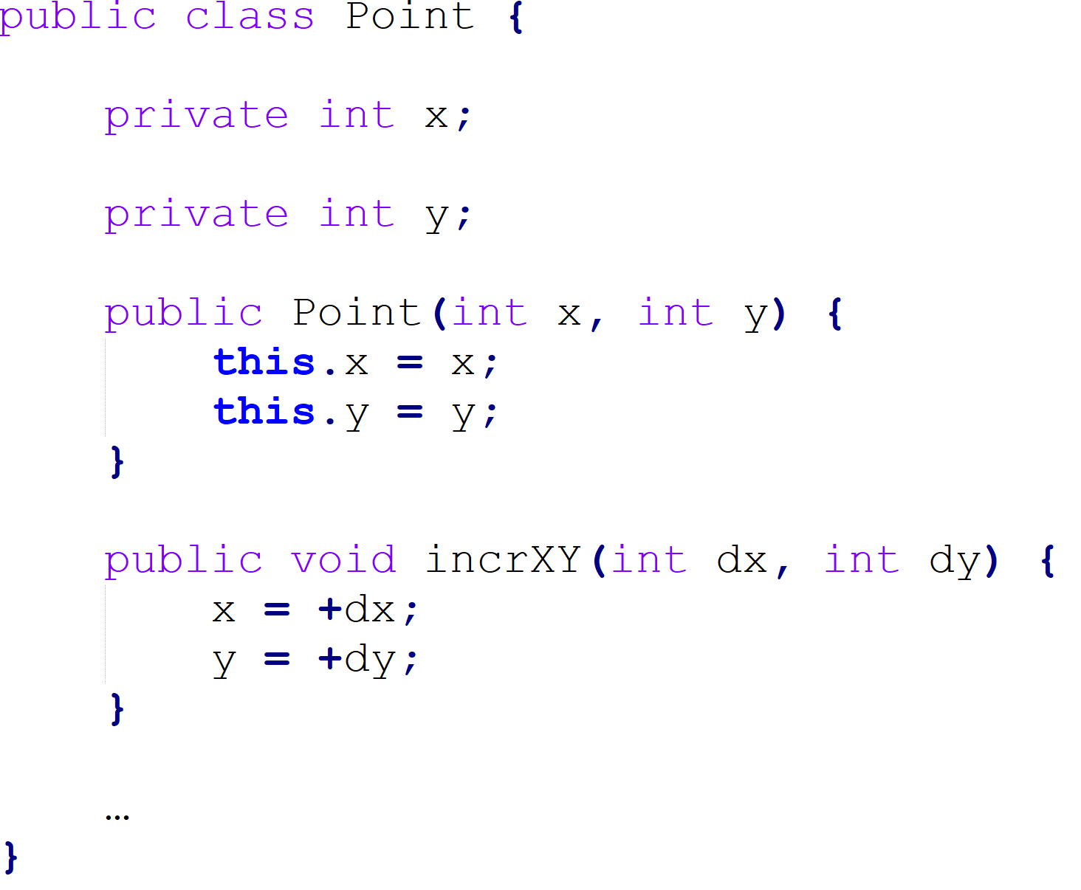
Language: Join Points
Static initialization
“Point._clinit_”
Pre-initialization
“Point(..)”
Constructor-execution
“Point(..)”
Field-set
“Point.x”
Initialization
“Point(..)”
Field-set
“Point.y”
Method-execution
“Point.incrXY(..)”
Field-set
“Point.x”
Field-set
“Point.y”

Slide 15
Cut in

Slide 16
Language: Pointcuts
A set of join point, plus, optionally, some of the values in the execution context of those join points.
Can be composed using boolean operators || , &&
Matched at runtime

Slide 17
Language Pointcut examples
Matches if the join point is a method call with this signature.
Matches if the join point is a method call to any kind of FigureElement.
Matches any call to setX OR setY

Slide 18
Language Pointcut examples
There is a cross-cutting concern here relating to moving
We can capture these in our own user defined pointcut

Slide 19
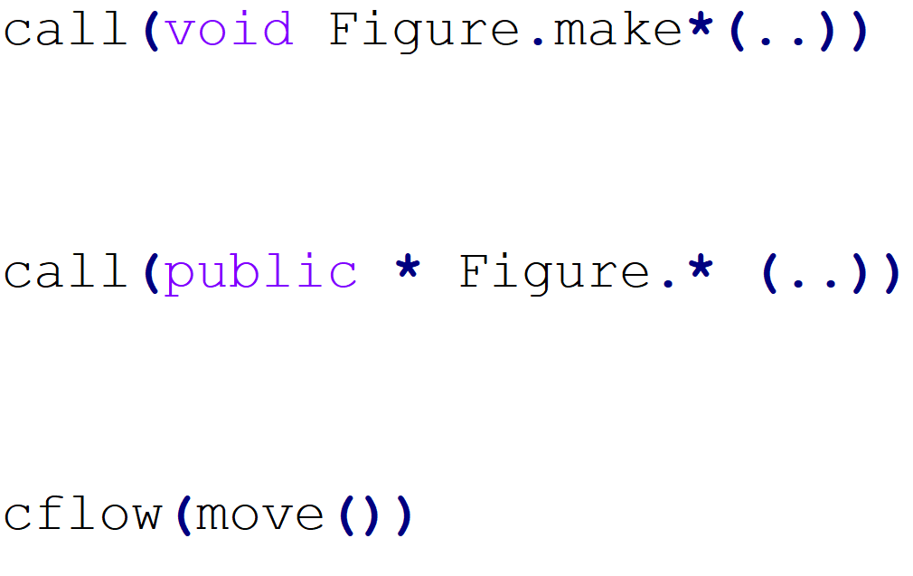
Language: Wildcards and cflow
A void method on Figure whose name begins with make regardless of parameters (both makePoint and makeLine)
Each call to all Figure’s public methods
Identify all join points that occur between when move() is called and it returns (in dynamic flow of move())

Slide 20
When to cut in?

Slide 21
Language: Advice
Method-like mechanism used to declare that certain code should execute at each of the join points in the pointcut.
Advice:
before
around
after
after
after returning
after throwing

Slide 22
Language: Advice

Slide 23
Language: Exposing context
We can also interact with parameters of pointcut
Filling in an applicable pointcut

Slide 24
Cut in all over the place

Slide 25
Language: Inter-type declarations
Suppose we want to have Screen objects observe changes to Point objects
where Point is an existing class.
We can implement this by writing an aspect
Each point has an instance field observers that keep track of the Screen objects that are observing Points.

Slide 26
Language: Inter-type declarations
Suppose we want to have Screen objects observe changes to Point objects
where Point is an existing class.
We can implement this by writing an aspect
Each point has an instance field observers that keep track of the Screen objects that are observing Points.

Slide 27
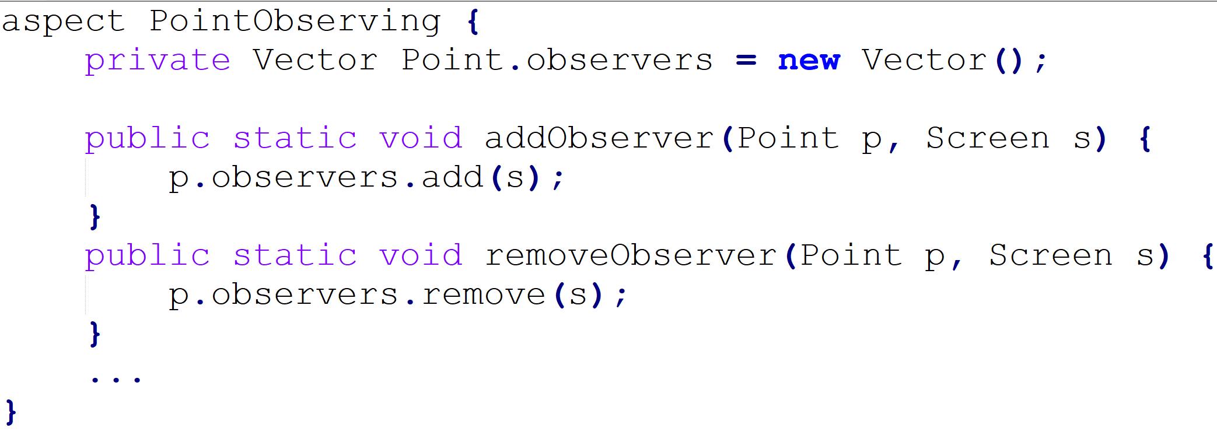
Language: Inter-type declarations

Slide 28
Language: Inter-type declarations

Slide 29
All together now

Slide 30
Language: Aspects
Mix everything we’ve seen up to now and put it one or more modular units called Aspects.
Looks a lot like a class!
Can contain pointcuts, advice declarations, methods, variables ….
Single instances (default behavior)

Slide 31
Log example

Slide 32
Language: Aspects

Slide 33
The methods we weave

Slide 34
Implementation
Aspect weaving: makes sure that applicable advice runs at the appropriate join points.
In AspectJ, almost all the weaving is done at compile-time to expose errors and avoid runtime overhead.
cflow (and maybe others) require dynamic dispatch.

Slide 35
Developmental Aspects

Slide 36
Developmental Aspects
What are some places Aspects can assist developmental processes
Exist in along-side but apart from existing coding
Tracing, profiling, logging, pre-post conditions, contract enforcement

Slide 37
Tracing
Enabling tracing as an ‘weaved’ in process that doesn’t exist in production

Slide 38
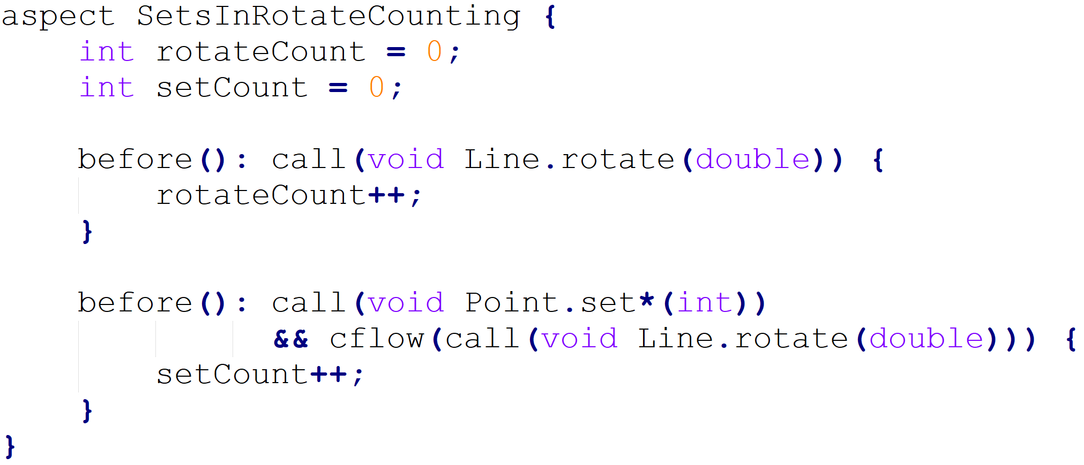
Profiling and Logging
Although many sophisticated profiling tools are available, and these can gather a variety of information and display the results in useful ways, you may sometimes want to profile or log some very specific behavior.

Slide 39
Pre-Post Condition Checking
"Design by Contract" style where explicit pre-conditions test that callers of a method call it properly and explicit post-conditions test that methods properly do the work they are supposed to.

Slide 40
Contract Enforcement
The property-based crosscutting mechanisms can be very useful in defining more sophisticated contract enforcement.
One very powerful use of these mechanisms is to identify method calls that, in a correct program, should not exist.

Slide 41
Production Aspects

Slide 42
Production Aspects
What are some places Aspects can assist production code
Expected to be enabled and in operation
Change monitoring, Context passing, Consistent Behaviour,

Slide 43
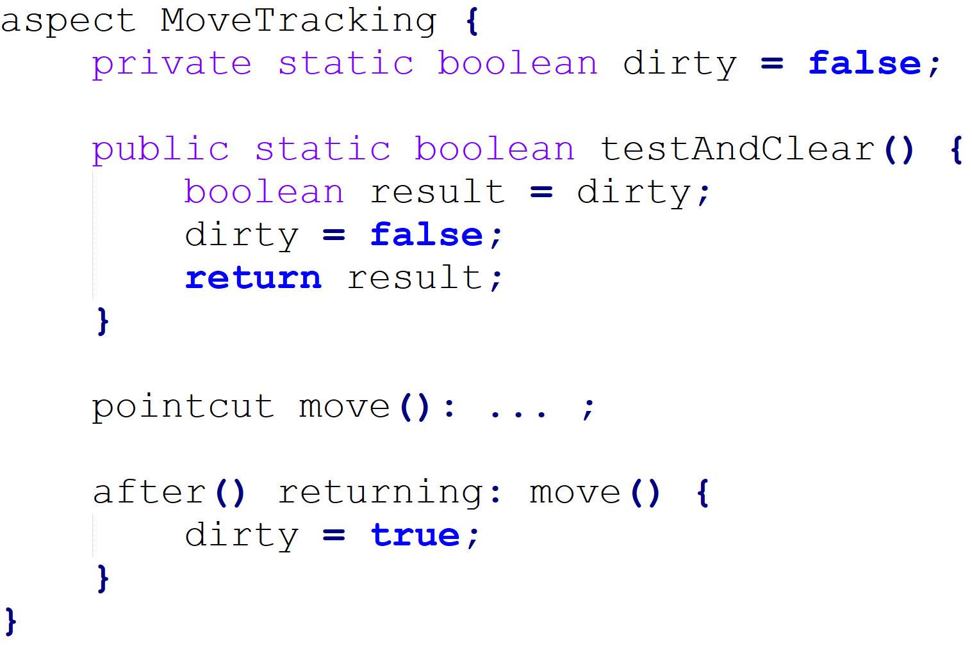
Change Monitoring
Sometimes simple functionality is hard to do explicitly.
Ex. maintain a dirty bit associated with object having moved since last display occurred

Slide 44
Change Monitoring: Cross-cutting concern
Consider implementing this functionality with ordinary Java:
there would likely be a helper class that contained the dirty flag, the testAndClear method, as well as a setFlag method.
Each of the methods that could move a figure element would include a call to the setFlag method.
Those calls, or rather the concept that those calls should happen at each move operation, are the crosscutting concern in this case.

Slide 45
AspectJ Advantages over Standard Implementation
The structure of the crosscutting concern is captured explicitly.
Evolution is easier
The functionality is easy to plug in and out.
The implementation is more stable.

Slide 46
Context Passing
Consider implementing functionality that would allow a client of the figure editor to set the color of any figure elements that are created.
Typically this requires passing a color, or a color factory, from the client, down through the calls that lead to the figure element factory.

Slide 47
Context Passing
The following code adds after advice that runs only when the factory methods of Figure are called in the control flow of a method on a ColorControllingClient.

Slide 48
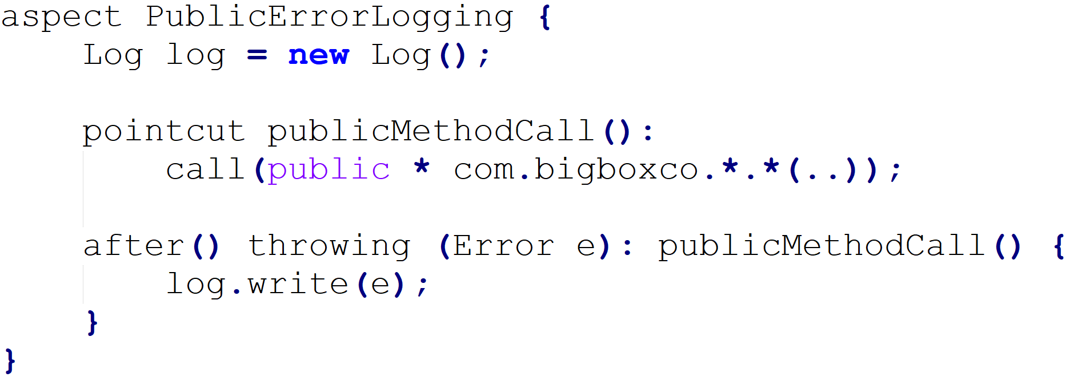
Providing Consistent Behavior
This aspect ensures that all public methods of the com.bigboxco package log any Errors they throw to their caller

Slide 49
Complex Example from Research

Slide 50
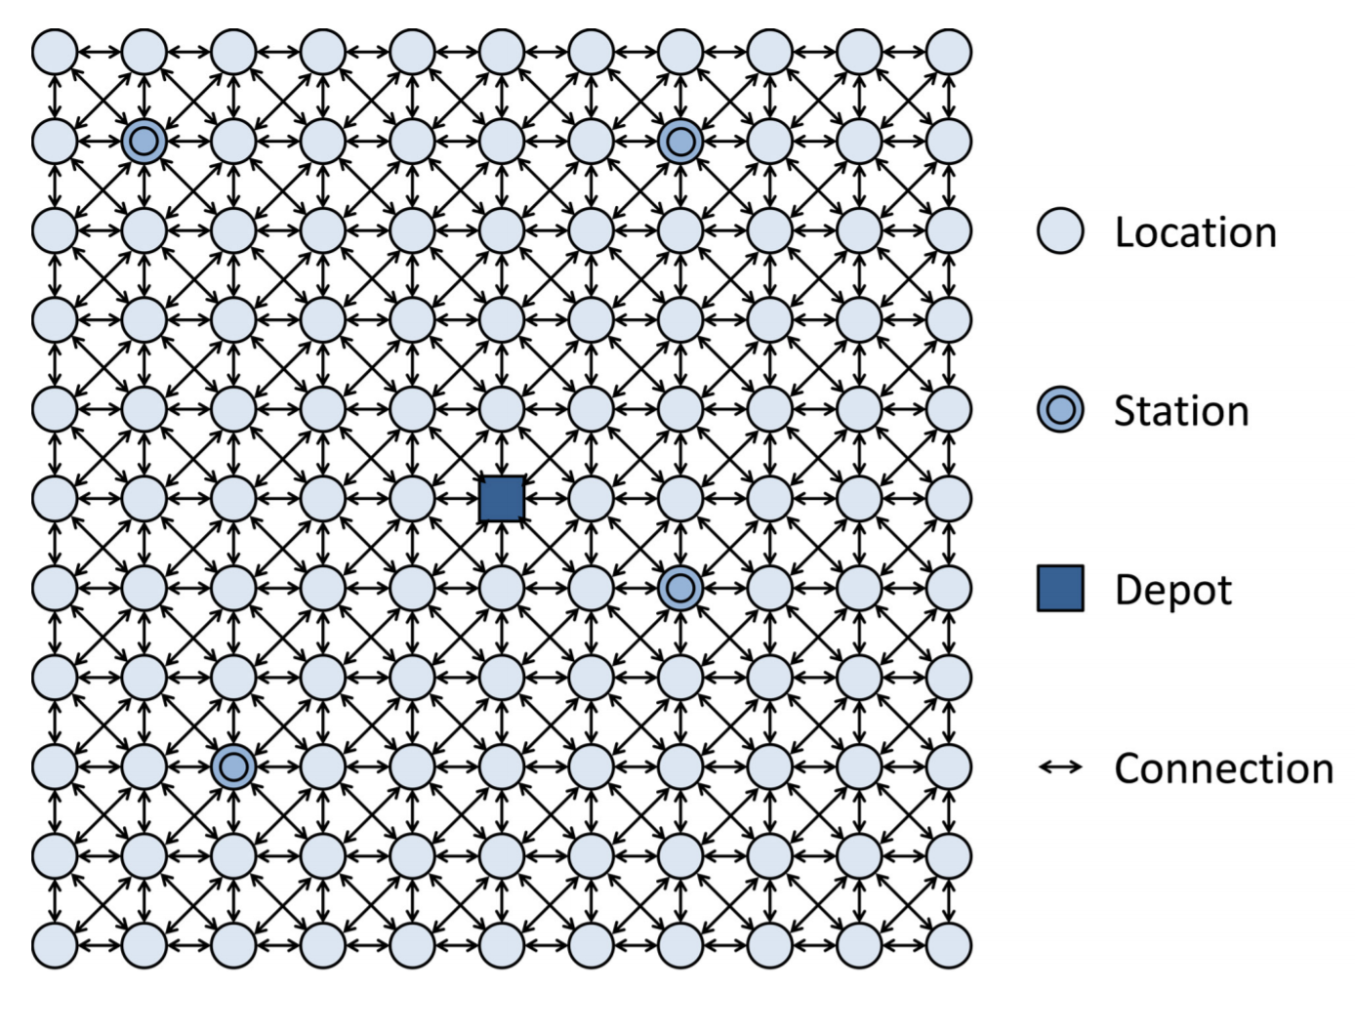
My Experience: Advised Multi-Agent System

Slide 51
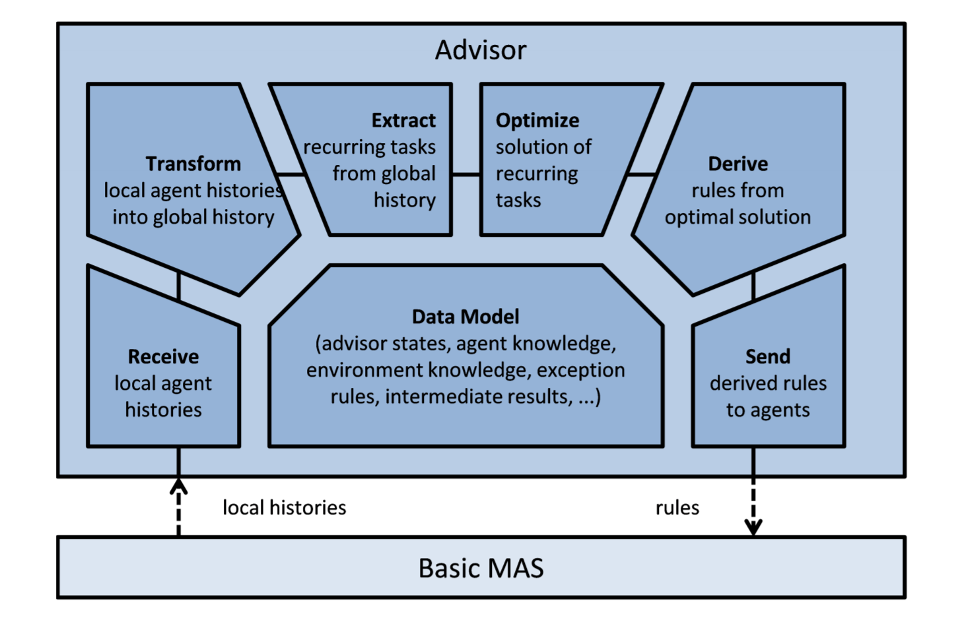
My Experience : Advised Multi-Agent System

Slide 52
My Experience: Advised Multi-Agent System
Advisor monitors each agent when actions happened (collecting histories)
From histories environment reconstructed, as well as agent behaviour
Agent behaviour compared to optimal (ish)
Rules to attempt to make agents act like optimal
Rules added to agent

Slide 53
My Experience: Advised Multi-Agent System
Aspects:
Advisor Aspect that hooks onto Agents when actions occur and records them (methods are called)
Also is able to notice when simulation runs have finished and do its number crunching to extract info, optimize, derive rules, and communicate them
Aspect around each agent to store advisor communicated rules and inter-cede in methods to change their behaviour decisions based on rules

Slide 54
My Experience: Advised Multi-Agent System
The MAS designer never had to change his code
The distributed aspect concerns related to the advisor were all centralized into very few classes, despite their interaction with code base being distributed
Could be flagged on and off at runtime
The negative was a negligible runtime cost of hooking in aspects (the optimization AI step was much longer)
Code always had to be run with additional configuration setup than basic Java code

Slide 55
Onward to … next topic.
Jonathan Hudson
jwhudson@ucalgary.ca
https://pages.cpsc.ucalgary.ca/~hudsonj/

