Slide 1
Reflection: Proxies
CPSC 501: Advanced Programming Techniques
Fall 2020
Jonathan Hudson, Ph.D
Instructor
Department of Computer Science
University of Calgary
Monday, August 24, 2020

Slide 2
Intercession via proxy

Slide 3
Dynamic Proxies
A proxy is “a person authorized to act on behalf of another”
In OO programming, a proxy is an object that substitutes for another object called the target
To work, the proxy must implement the target’s entire interface
i.e. support all the target’s methods

Slide 4
Dynamic Proxies
The proxy may
Implement its own versions of all the methods
Acts as a substitute for the target
Or delegate some or all calls it receives to the target
Acts as an intermediary between the caller and the target

Slide 5
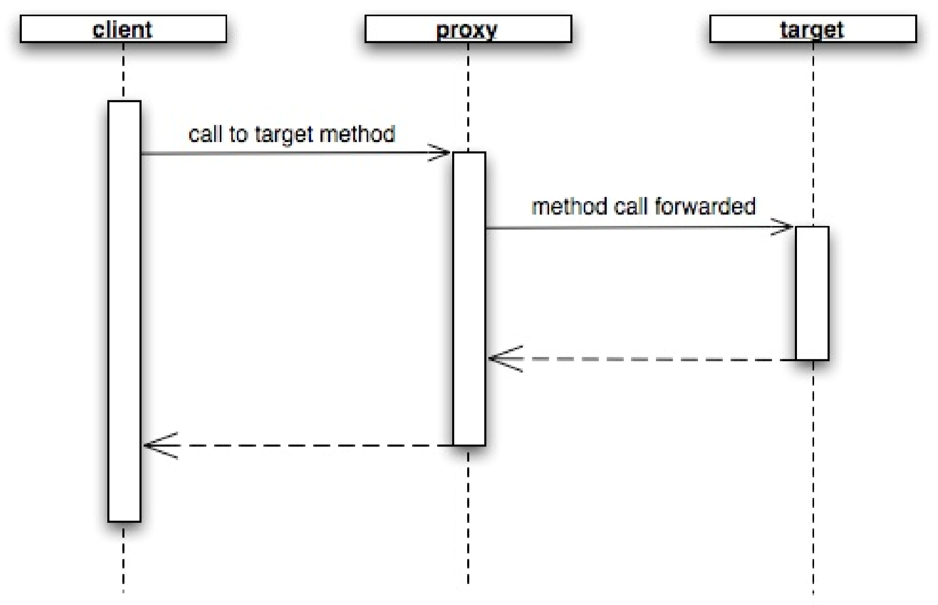
Dynamic Proxies

Slide 6
Dynamic Proxies
If an intermediary, a proxy may add functionality before and after forwarding the method to the target
Allows you to add behavior to objects

Slide 7
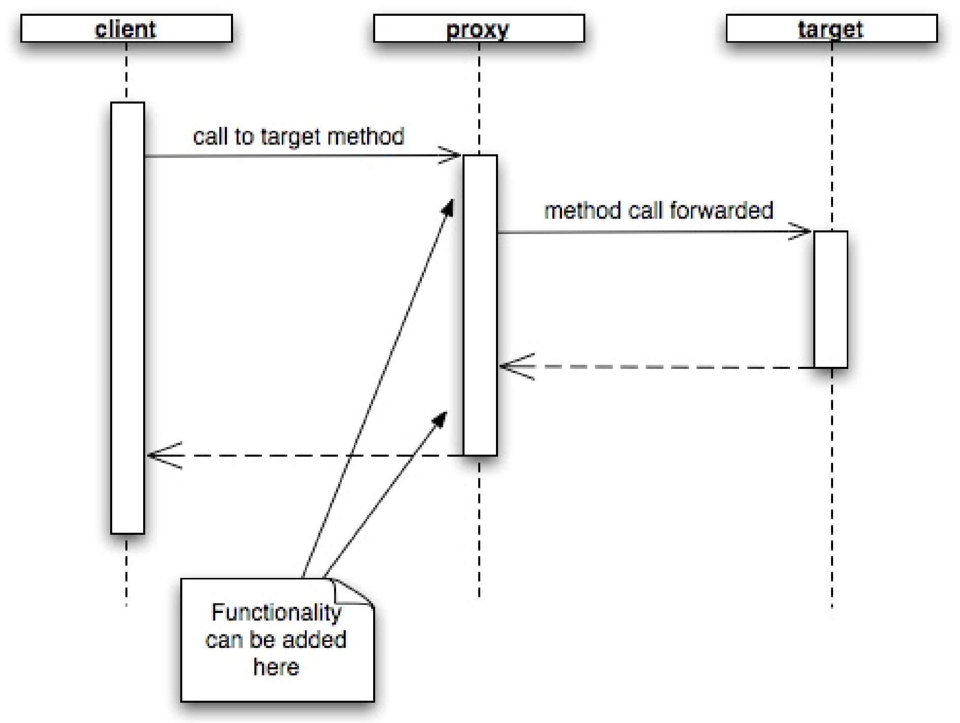
Dynamic Proxies

Slide 8
Dynamic Proxies
Method invocation intercession is the ability to intercept method calls reﬂectively
Not supported by Java directly
(Java Aspects one way of doing intercession)
But is approximated using dynamic proxies
Proxies can be created at runtime as needed

Slide 9
Dynamic Proxies
Proxies are useful when you need to add similar behavior to many different classes
E.g. Adding tracing code to all method calls
Without proxies, you could create non-tracing and tracing classes
Or subclasses of a common superclass
You arrange to instantiate the needed class at runtime

Slide 10
Dynamic Proxies
Without proxies, you could create non-tracing and tracing classes
Drawbacks:
Tedious: must be done for all methods of all classes
Error prone: may overlook a method
Fragile: if a method is added or changed, then the traced class must also be added/changed
Dynamic proxies allows the added behavior to be implemented in a single class

Slide 11
Intercession via Java proxy

Slide 12
Dynamic Proxies
java.lang.reﬂect.Proxy
Can create a proxy class (a class object) that implements a set of proxied interfaces with:
static Class getProxyClass(ClassLoader loader, Class[] interfaces)

Slide 13
Dynamic Proxies
Proxy classes have a constructor that takes an InvocationHandler parameter
You create a proxy instance with the constructor and newInstance()
E.g.

Slide 14
Dynamic Proxies
Or with a single call:
Use isProxyClass() to see if a class object represents a proxy class
E.g.
if (Proxy.isProxyClass(obj.getClass())
. . .

Slide 15
Dynamic Proxies
The proxy instance delegates handling of methods to its invocation handler
Is an object that implements the InvocationHandler interface
Must implement the invoke() method
Must also keep a reference to the target object
E.g.

Slide 16
Dynamic Proxies

Slide 17
Dynamic Proxies
The above invoke() method merely forwards the message to the target
Could add pre- and post-processing
E.g.

Slide 18
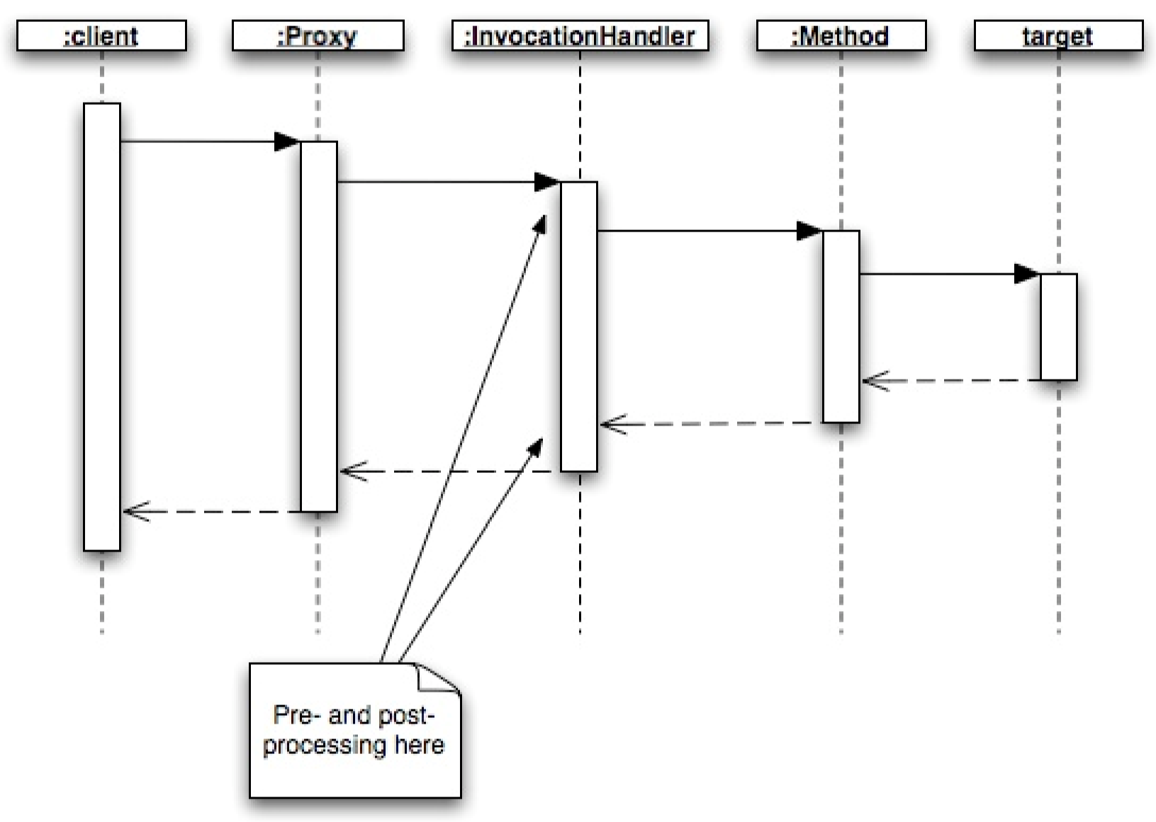
Dynamic Proxies

Slide 19
Example

Slide 20
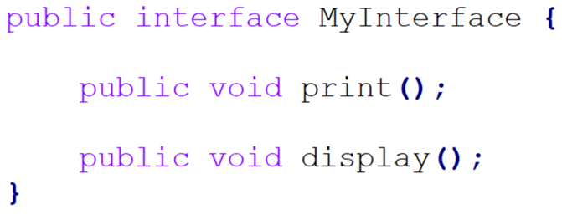
Example – MyInterface.java
Example: tracing proxy
Target interface

Slide 21
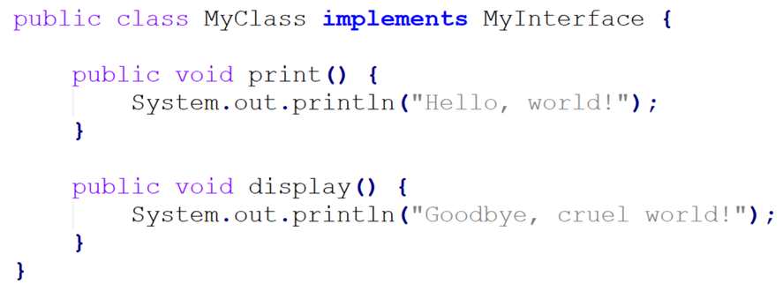
Example – MyClass.java
Target class

Slide 22
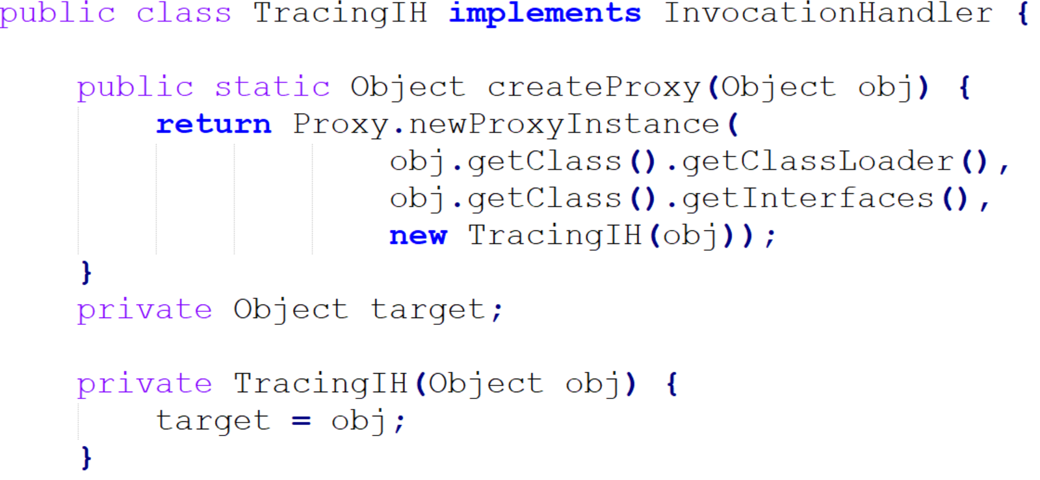
Example – TracingIH.java
Invocation handler

Slide 23
Example – TracingIH.java (cont’d)

Slide 24
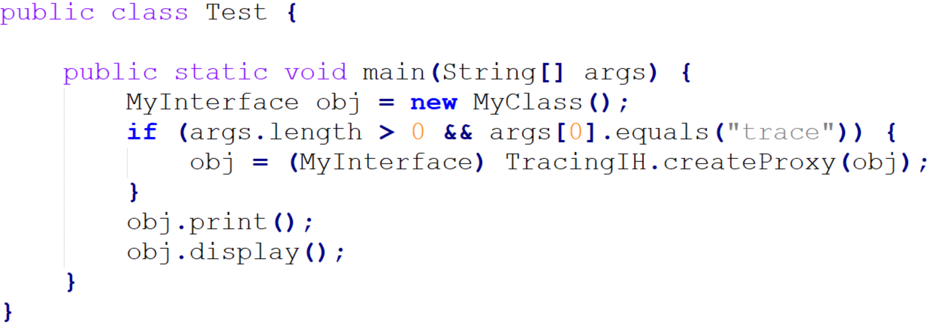
Example – Test.java
Client code

Slide 25
Example – no proxy
Sample run: java Test

Slide 26
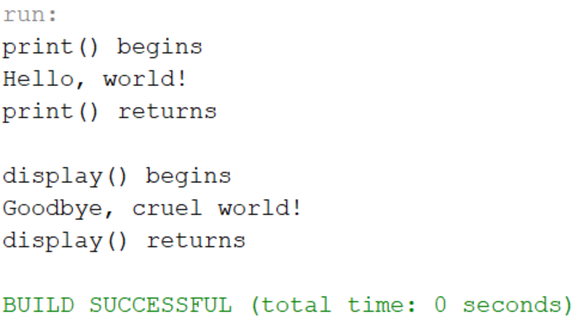
Example – proxy enabled
Sample run: java Test trace

Slide 27
Readings
Forman & Forman Chapter 4
Java API: java.lang.reﬂect.Proxy

Slide 28
Onward to … Java Aspects.
Jonathan Hudson
jwhudson@ucalgary.ca
https://pages.cpsc.ucalgary.ca/~hudsonj/

