Slide 1
Reflection: Introduction
CPSC 501: Advanced Programming Techniques
Fall 2020
Jonathan Hudson, Ph.D
Instructor
Department of Computer Science
University of Calgary
Monday, August 24, 2020

Slide 2
Just the basics

Slide 3
Definition: Two parter
Reﬂection is the ability of a running program to:
Examine itself and the run-time environment
Called introspection
Change its behavior, structure, or data depending on what it ﬁnds

Slide 4
Introspection via?
To do introspection, a program must have a representation of itself available at runtime
Called metadata
In an OO language, metadata is organized using metaobjects
In Java, these are typically instances of classes like Class, Method, and Field

Slide 5
You basic, you meta

Slide 6
You basic, you meta
The normal, non-reﬂective part of a program is called the base program
Consists of base-level objects
Each base-level object is an instance of some class
The class is represented at the metalevel as a class object (an example of a metaobject)

Slide 7
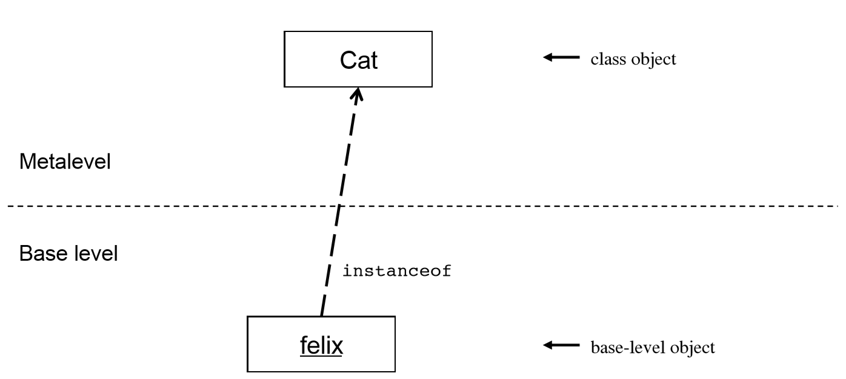
Basic Concepts

Slide 8
Basic Concepts
The ﬁelds and methods for a class are represented with Field and Method metaobjects
Are contained within the class object

Slide 9
Flip it, and reverse it

Slide 10
Basic Concepts
Once introspection is done, you can change a program’s structure, data, or behavior
Three general techniques:
Direct metaobject modiﬁcation
E.g. Add methods or ﬁelds to an existing class
Not possible in Java (avoids complications)
Operations using metadata
E.g. Dynamic method invocation, dynamic class loading, reﬂective construction
Exists in Java

Slide 11
Basic Concepts
Intercession
Where code intercedes modifies behavior as program runs
Typically involves intercepting method calls
In Java, limited to dynamic proxies

Slide 12
Work it

Slide 13
Basic Concepts
Growing number of languages support reflection
To some degree
This list is growing due to the power of it
Go, Java, Julia, Lisp, Logo, La, Mathematica, C#, Perl, PHP, Prolog, Python, R, Ruby, Scheme, Smalltalk, Wolfram language

Slide 14
Basic Concepts
Issues with reﬂection:
Since behavior can be changed dynamically, security could be compromised
Not a problem with Java
Has a strong security model
Limited intercession
Reﬂective techniques are indirect, thus making code more complex
Use reﬂection only where it makes sense

Slide 15
Basic Concepts
Reﬂective method calls are slower than normal calls
20x improvement from Java 1.3 to 1.4

Slide 16
Do it already

Slide 17
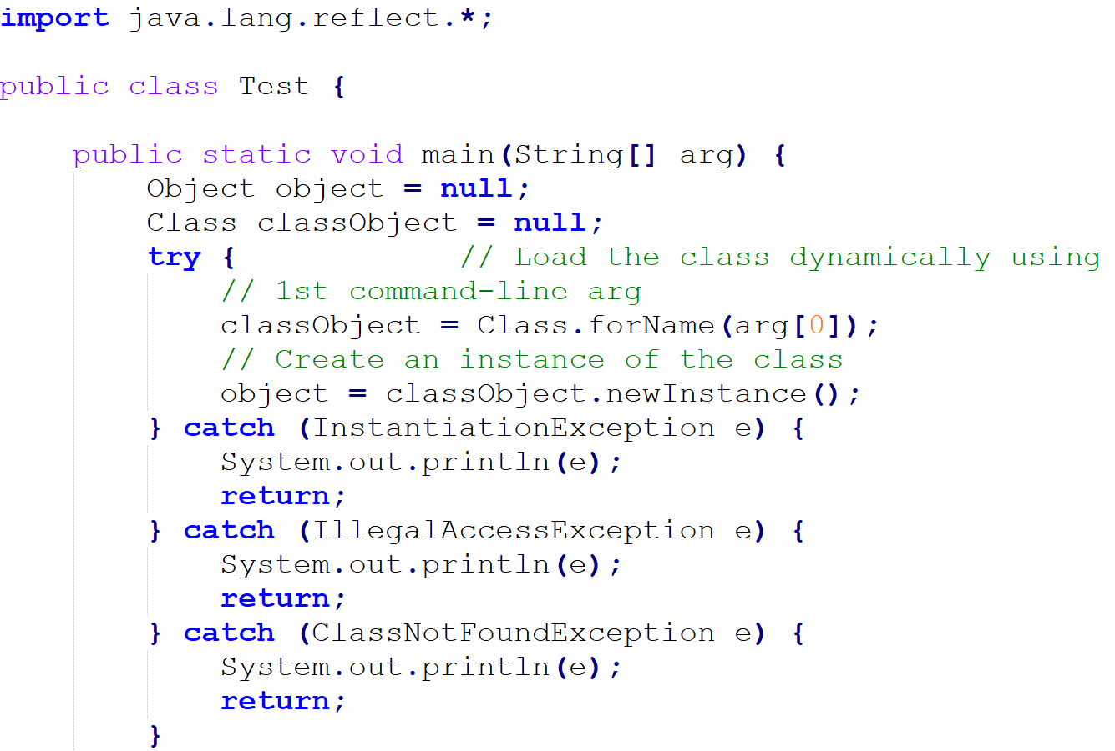
A Simple Example

Slide 18
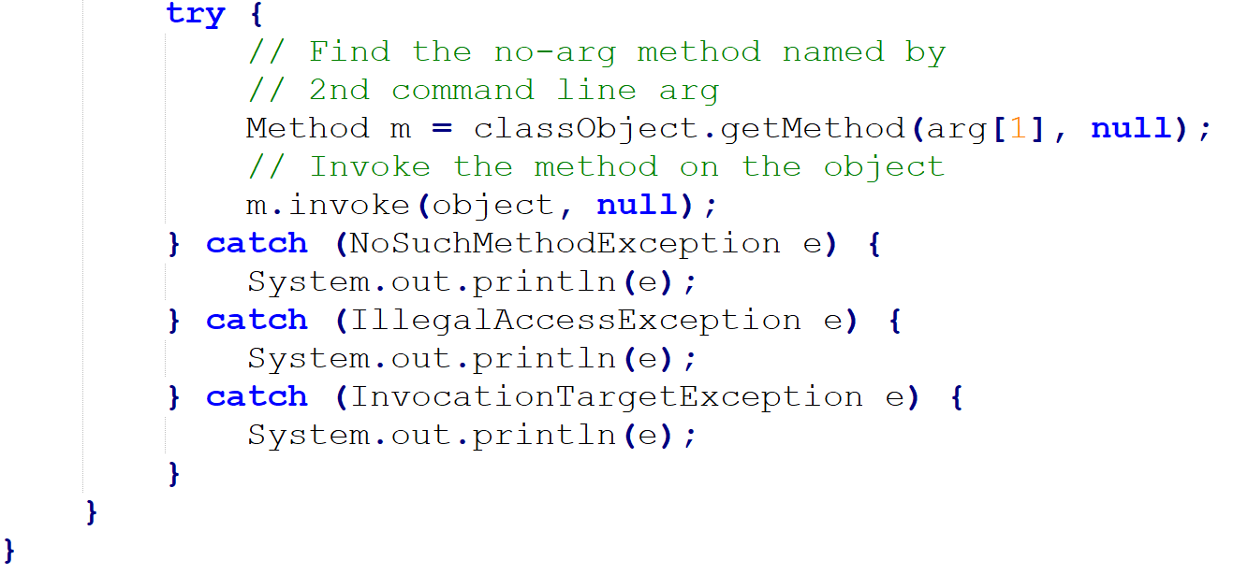
A Simple Example

Slide 19
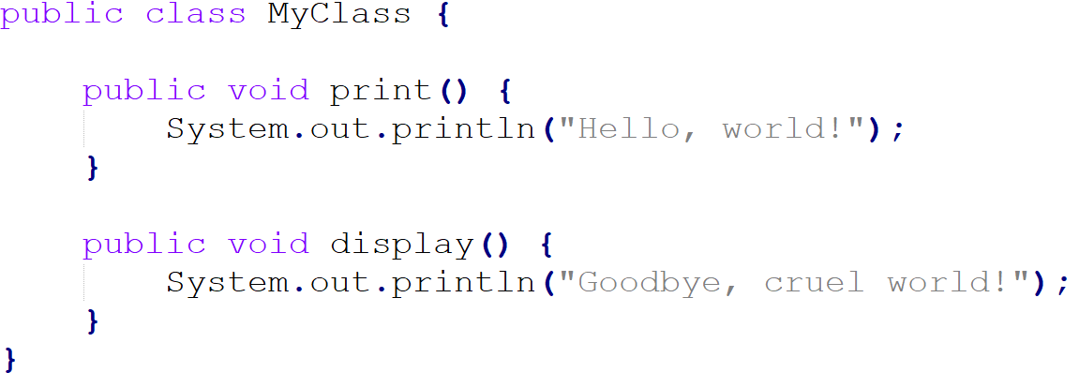
A Simple Example
Can be used on any class
Example:

Slide 20
A Simple Example
java Test MyClass print
outputs:Hello, world!
java Test MyClass display
outputs: Goodbye, cruel world!

Slide 21
Onward to … Java reflection.
Jonathan Hudson
jwhudson@ucalgary.ca
https://pages.cpsc.ucalgary.ca/~hudsonj/

