Slide 1
Refactoring: Example
CPSC 501: Advanced Programming Techniques
Fall 2020
Jonathan Hudson, Ph.D
Instructor
Department of Computer Science
University of Calgary
Monday, August 24, 2020

Slide 2
Lets do something with all that

Slide 3
Example 1
Form Template Method
Used when there is similar (but not identical) code in sibling classes
Their methods do similar steps in the same order
But the steps are different
Goal is Template Method design pattern
Identical code put into common superclass
Differing code put into subclasses

Slide 4
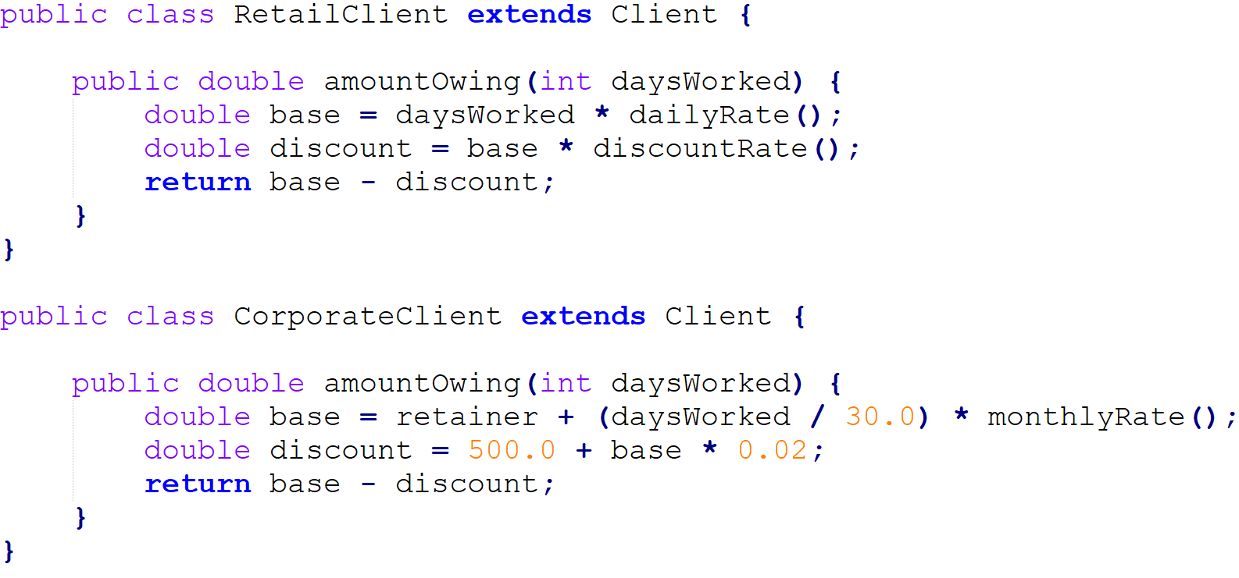
Example 1
Original code:

Slide 5
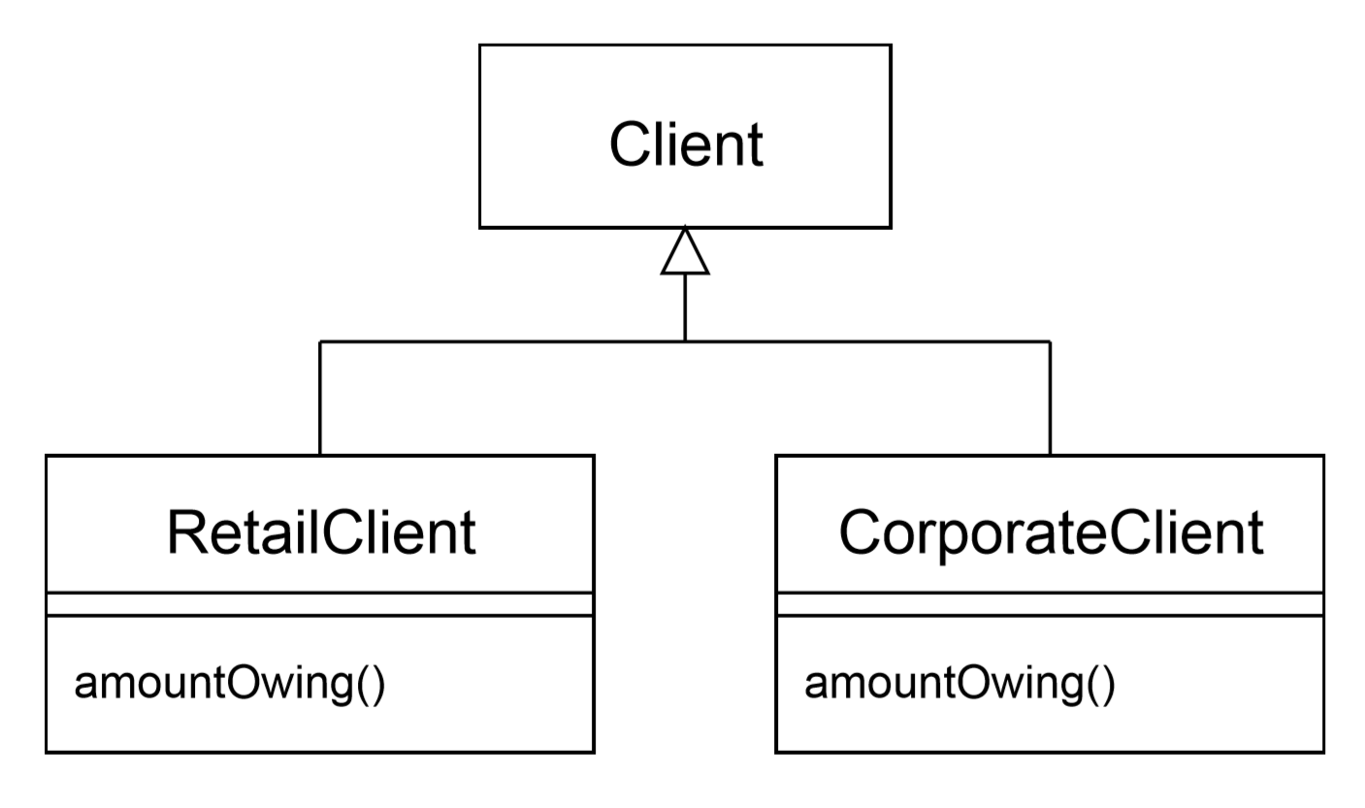
Example 1
Original code:

Slide 6
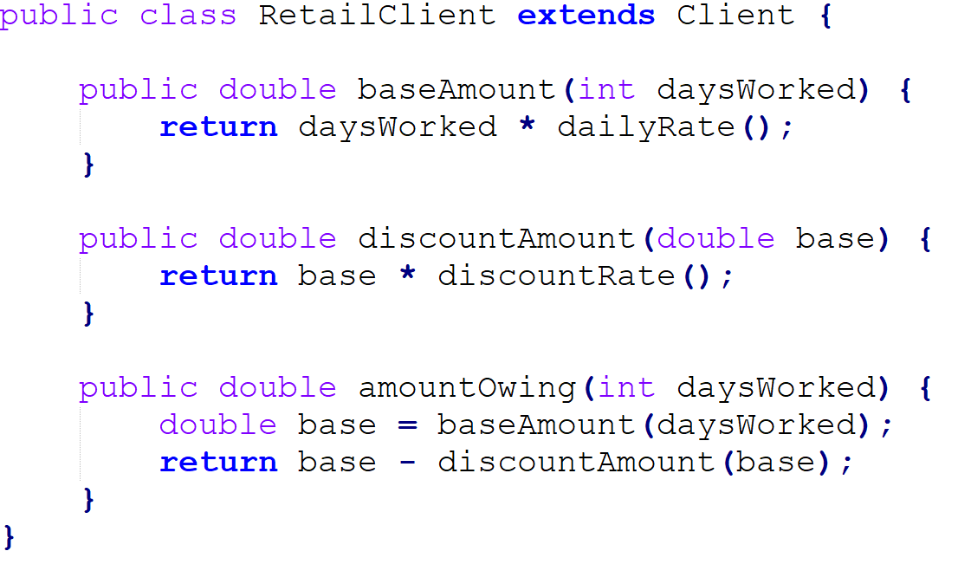
Example 1
Mechanics:
Extract methods that are either identical or completely different

Slide 7
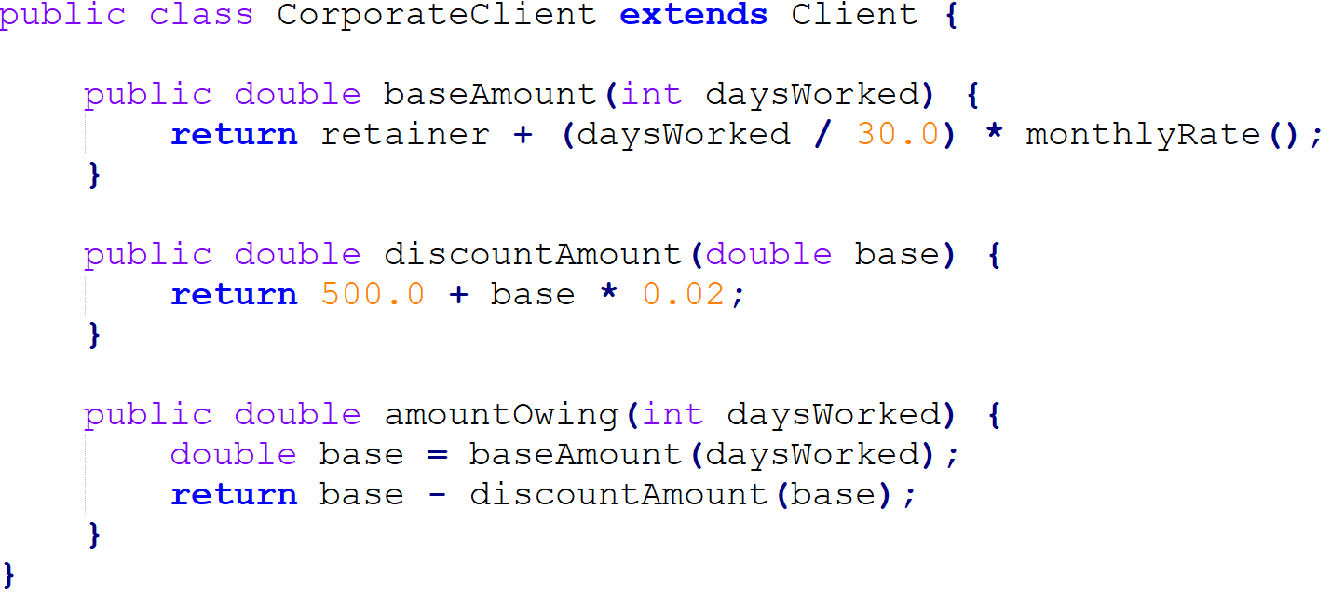
Example 1

Slide 8
Example 1
Original code:

Slide 9
Example 1
Pull up the common method into the superclass, and declare differing methods as abstract

Slide 10
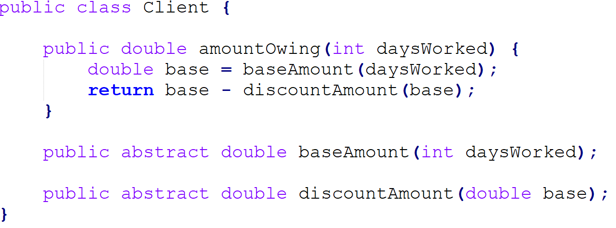
Example 1
Pull up the common method into the superclass, and declare differing methods as abstract

Slide 11
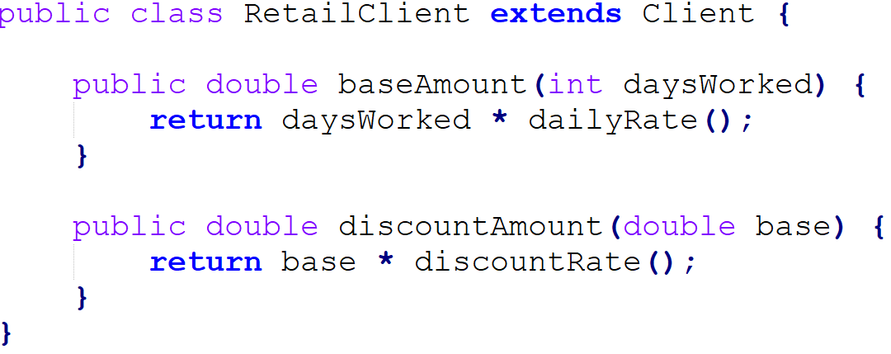
Example 1
Remove pulled up methods from subclasses

Slide 12
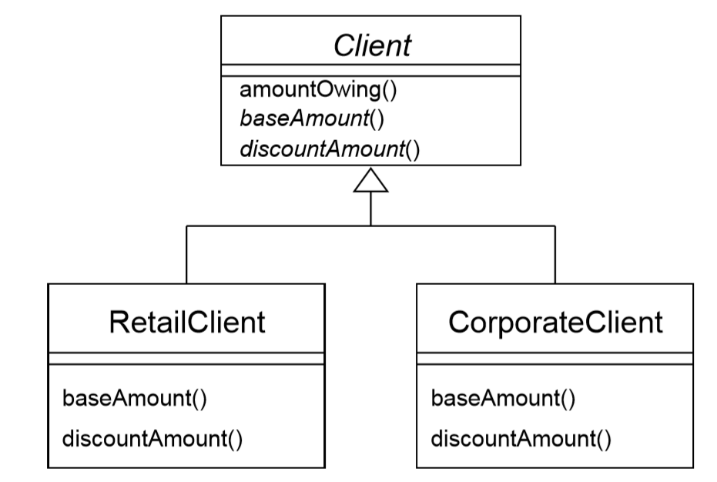
Example 1
Result

Slide 13
Example 1
Now easy to add new kinds of Clients
Create a new concrete subclass, overriding the abstract methods

Slide 14
How about something else

Slide 15
Example 2
Replace Type Code with Subclasses
Allows you to remove switch statements, if followed by Replace Conditional with Polymorphism

Slide 16
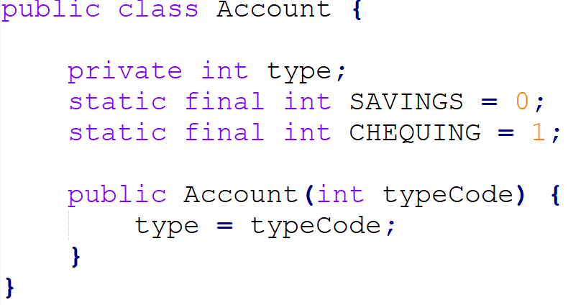
Example 2
Original code:

Slide 17
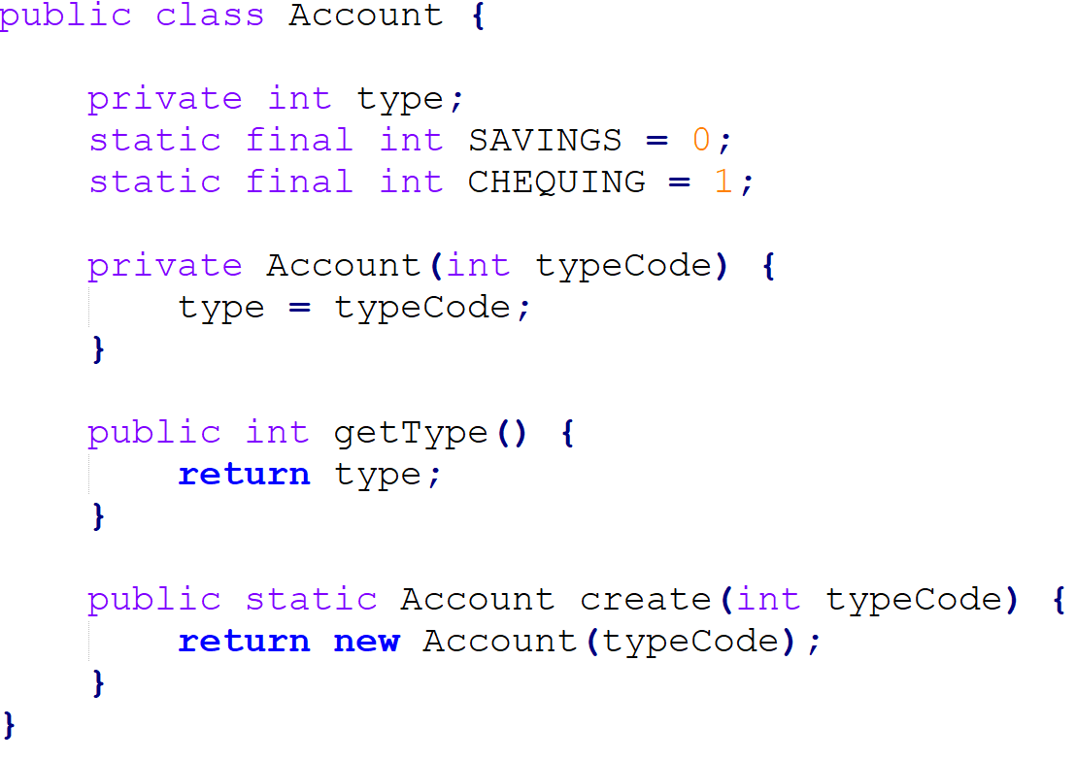
Example 2
Mechanics
Self-encapsulate the type code
If used by the constructor, replace constructor with factory method

Slide 18
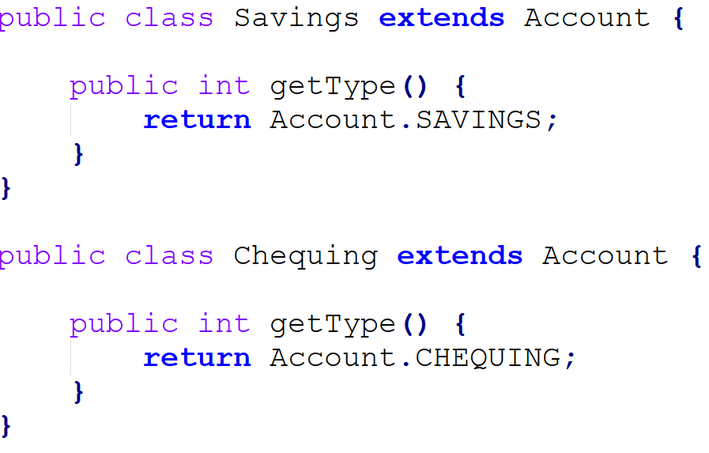
Example 2
For each type code, create a subclass
Override the getType() method
Change the factory method

Slide 19
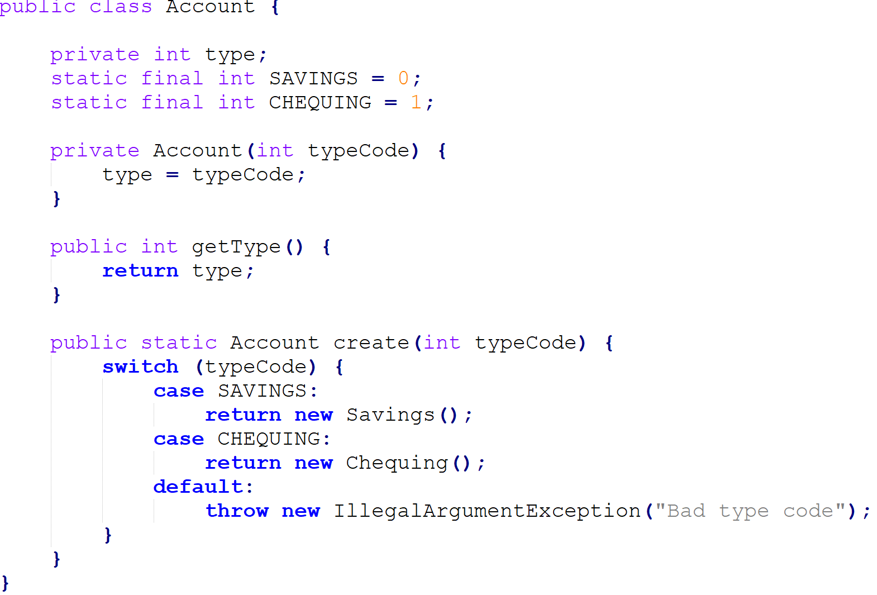
Example 2

Slide 20
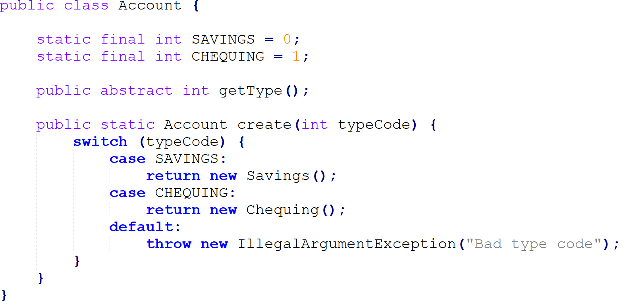
Example 2
Remove the type code ﬁeld
Declare accessors as abstract

Slide 21
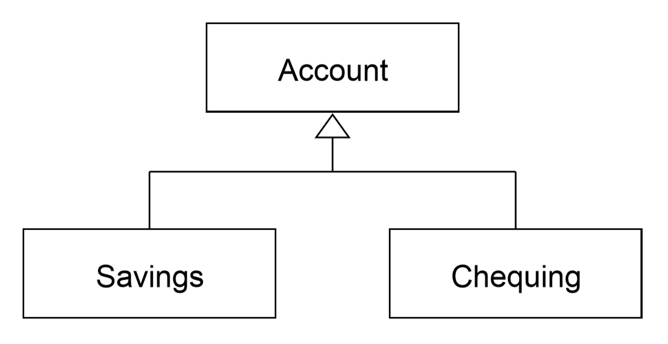
Example 2

Slide 22
Example 2
Use Push Down Method and Push Down Field for features speciﬁc to a subclass
If you have switch statements in methods other than the factory method, use Replace Conditional with Polymorphism

Slide 23
Onward to … the next topic.
Jonathan Hudson
jwhudson@ucalgary.ca
https://pages.cpsc.ucalgary.ca/~hudsonj/

