Slide 1
Refactoring
CPSC 501: Advanced Programming Techniques
Fall 2020
Jonathan Hudson, Ph.D
Instructor
Department of Computer Science
University of Calgary
Monday, August 24, 2020

Slide 2
We’re actually doing it?
We’re actually doing it!

Slide 3
Refactoring Tools
Automate the refactoring process
Restructures code while preserving behavior
Reduces the need to test
Are incorporated into some IDEs
Xcode supports 6 common refactorings:
Rename, Extract, Create Superclass, Move up, Move down, Encapsulate
Eclipse supports ~18 refactorings
But note that Fowler (text) lists ~72 refactorings
Manual refactoring will still often be necessary

Slide 4
Refactoring Principles
Refactoring: is the disciplined process of changing the internal structure of software to make it easier to understand and maintain, without changing its external observable behavior

Slide 5
Refactoring Principles
Why refactor?
Improves the design of software
Reverses the “decay” of cumulative ad hoc changes
Makes software more readable
A clear design is easier to understand and maintain
Use refactoring to learn about unfamiliar code
Helps you ﬁnd and eliminate bugs
Helps you program faster
A poor design prevents rapid development

Slide 6
Refactoring Principles
When should you refactor?
Continuously, as you develop or modify code
Whenever you duplicate code
When adding functionality to code
i.e. change the design to make adding features easy
As you ﬁnd and ﬁx bugs
It’s easier to spot bugs when the design is clear
As you do a code review

Slide 7
Not so fast

Slide 8
Refactoring Principles
Problems with Refactoring
Many refactorings change a class’s public interface
E.g. methods may be renamed or removed
Not a problem if you can edit all calling code
If the interface is published, you need a transition period where the old interface is kept until clients adopt the new interface
Mark an old method as deprecated and have it call the new method

Slide 9
Refactoring Principles
You may not be able to refactor your way out of a design mistake
May be necessary to do more upfront design
If software is tightly coupled to a database, changing the object model may cause changes to the database schema
Forces you to migrate data, which is difﬁcult and expensive
Isolate changes by putting a layer between the database and object model

Slide 10
Rule of thumb
Which thumb?

Slide 11
Refactoring Principles
Don’t refactor when:
Its easier to rewrite from scratch
You are close to a release deadline
Refactoring and design
Refactoring is not a replacement for upfront design
But it lets you create a simple, upfront design that does not build in unneeded ﬂexibility
i.e. you can always refactor later if necessary

Slide 12
Refactoring Principles
Refactoring and performance
Refactoring often makes software run more slowly
More function structure is complexity with runtime cost
But also more amenable to performance tuning
If well factored, “hot spots” will be isolated to a few short methods
Found using a proﬁler late in development
Tune the hot spots only
Tuning the other code is a waste

Slide 13
When to Refactor
No hard and fast rules
Best to use informed intuition
i.e. try to detect “Bad smells in code”

Slide 14
Ok lots of ‘rules’
Lots of thumbs?

Slide 15
Names may be slightly different between these edition 1 and 2018 edition 2

Slide 16
Duplicated Code

Slide 17
When to Refactor - Duplicated code
Duplicated code
If the same code in two or more places in the same class
Extract Method, and call it from each place
If the same code in two sibling classes
Extract Method, if necessary
Pull Up Method into common superclass

Slide 18
When to Refactor - Duplicated code
Duplicated code
If similar code in sibling classes
Extract Method, if necessary
Form Template Method to put common code in superclass, differing code in subclasses
If the same code in unrelated classes
Extract Class in one class, and use the new class in the other classes

Slide 19
Long Code

Slide 20
When to Refactor – Long Method
Long method
Decompose into small methods
Sometimes just one line long
Extract Method on blocks of code that can be separated out
Look for “clumps”
E.g. Commented blocks, loops, conditionals, etc.
May need to Replace Temp with Query to enable the extraction

Slide 21
Long Code – Replace temp with query

Slide 22
Replace Temp with Query
You have parameter initialization that is temporary
Replace this code with a function query that returns the result that was initialization

Slide 23
Replace Temp with Query
Change above into the following

Slide 24
Large Class

Slide 25
When to Refactor – Large Class
Large class
Tries to do too many different things (not cohesive)
Too many instance variables, and/or
Too much code
Extract Class or Extract Subclass to separate out “bundles” of data and responsibilities

Slide 26
Long Parameter List

Slide 27
When to Refactor - Long Parameter List
Long parameter list
Better to pass in an object, so the method can get the data it needs
Shorten list with Preserve Whole Object (pass in object instead of pulling of data as multiple parameters) or Introduce Parameter Object

Slide 28
Divergent Change

Slide 29
When to Refactor – Divergent Change
Divergent change
Occurs when a class changes in distinct ways for differing reasons
E.g. You change 3 methods together for one reason, and 5 other methods for another
Determine what changes for a single cause, and Extract Class to bundle these together

Slide 30
Shotgun Surgery

Slide 31
When to Refactor – Shotgun surgery
Shotgun surgery
A single change causes many little changes to several different classes
Use Move Method and Move Field to put changes into a single class
Sometimes best to Inline Class

Slide 32
Feature Envy

Slide 33
When to Refactor – Feature Envy
Feature Envy
A class does a calculation that belongs elsewhere
i.e. it uses too much data from another class
Put it into the proper class with Move Method

Slide 34
Data Clumps

Slide 35
When to Refactor – Data clumps
Data clumps
Data clusters together in ﬁelds or parameter lists
Extract Class to change clumps into an object
Shrink parameter lists with Introduce Parameter Object or Preserve Whole Object

Slide 36
Primitive Obsession

Slide 37
When to Refactor – Primitive Obsession
Primitive Obsession
Often better to use a class instead of a primitive type
Allows things like range checking, formatting, etc.
Done with Replace Data Value with Object
If the primitive is a type code, use
Replace Type Code with
Class, or
Subclasses, or
State/Strategy

Slide 38
Switch Statements

Slide 39
When to Refactor – Switch statements
Switch statements
Are rare in good OO code
If switching on a type code, Replace Conditional with Polymorphism
Easier to add subclasses than changing many switch statements

Slide 40
Parallel Inheritance

Slide 41
When to Refactor – Parallel inheritance
Parallel inheritance hierarchies
When you make a subclass of one class, you also make a subclass of another
Special case of shotgun surgery
Eliminate one hierarchy by shifting data and responsibilities to the other
Move Method and Move Field

Slide 42
Lazy Class

Slide 43
When to Refactor – Lazy class
Lazy class
A class doesn’t do enough to justify its existence
May result from other refactorings like Move Method
Eliminate it with Collapse Hierarchy or Inline Class

Slide 44
Speculative Generality

Slide 45
When to Refactor – Speculative generality
Speculative generality
You added code for future expansion that never occurred
Remove useless abstract classes with Collapse Hierarchy
Remove unneeded delegation with Inline Class
Remove unused parameters with Remove Parameter

Slide 46
Temporary Field

Slide 47
When to Refactor – Temporary Field
Temporary ﬁeld
An instance variable is set and used only part of the time
Extract Class, moving over the “orphan variables” and related methods

Slide 48
Message Chains

Slide 49
When to Refactor – Message chains
Message chains
A client follows a chain of referring objects, and sends a message to the last object
Any change to intermediate relationships causes client code to change
Hide Delegate on the ﬁrst object in the chain so it returns the last object

Slide 50
Message Chains – Hide delegate

Slide 51
Hide Delegate
Client talks to one object to get data, then talks to object in that data to do something
Maybe farther down chain
Put method in first object that is in charge of passing on message (detaches client from chain structure)

Slide 52
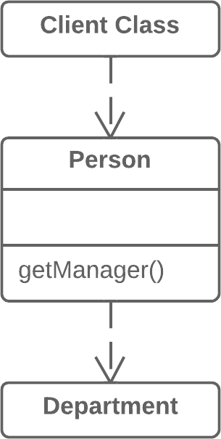
Hide Delegate

Slide 53
Middle Man

Slide 54
When to Refactor – Middle Man
Middle Man
Where most methods of a class delegate to another class
Remove Middle Man, so you talk to the delegated object directly

Slide 55
Inappropriate Intimacy

Slide 56
When to Refactor - Inappropriate intimacy
Inappropriate intimacy
A class knows too much about another class’s private parts
Move Method and Move Field to the ﬁrst class
Or Extract Class to put commonality in a safe place
Replace Inheritance with Delegation if a subclass knows too much about its parents

Slide 57
Inappropriate Intimacy – Replace Inheritance with Delegation

Slide 58
Replace Inheritance with Delegation
Inheritance structures can leave parts of a super-class exposed by a sub-class
Instead of a class extending a parent, the previous super-class can instead be initialized as a data object in the previous sub-class
This protects things exposed via regular inheritance

Slide 59
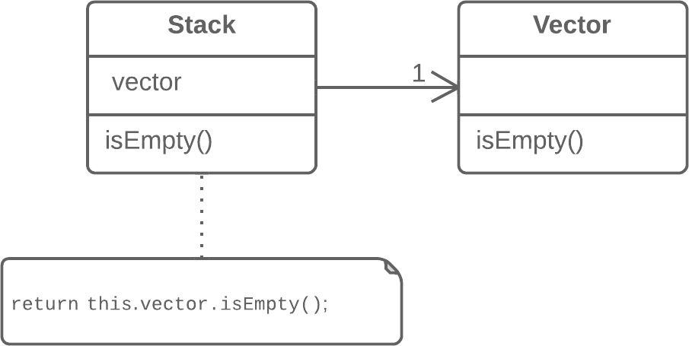
Replace Inheritance with Delegation

Slide 60
Alternative Classes

Slide 61
When to Refactor – Alternative classes
Alternative classes with different interfaces
Two or more classes do the same thing, but have inconsistent interfaces
Use Rename Method and Move Method to give the classes identical interfaces
If redundant, Extract Superclass

Slide 62
Incomplete Library Class

Slide 63
When to Refactor – Incomplete Library Class
Incomplete Library Class
You can’t use Move Method on code you can’t change
Introduce Foreign Method into a client class
Best for only one or two methods
Introduce Local Extension to create a subclass or wrapper of the original

Slide 64
Incomplete Library Class – Introduce Foreign Method

Slide 65
Introduce Foreign Method
A utility class doesn’t contain the method that you need and you can’t add the method to the class.
Add the method to a client class and pass an object of the utility class to it as an argument.

Slide 66
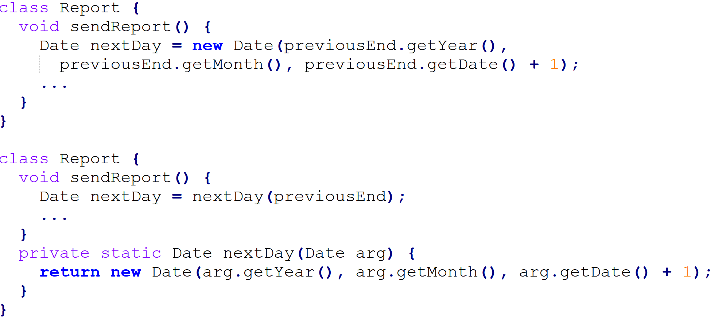
Introduce Foreign Method

Slide 67
Data Class

Slide 68
When to Refactor – Data Class
Data Class
Is a class with no behavior
i.e. has only get and set methods
Move Methods (that apply to that data) into the data class
May need to Extract Method ﬁrst

Slide 69
Refused Bequest

Slide 70
When to Refactor - Refused Bequest
Refused Bequest
A subclass doesn’t use all the methods and data that it inherits
Reorganize the class hierarchy
Push Down Method and Push Down Field to create a sibling for the unused behavior
If the subclass does not support the superclass interface, Replace Inheritance with Delegation

Slide 71
Worrisome Comments

Slide 72
When to Refactor - Worrisome comments
Comments that explain bad code
Extract Method on commented blocks of code
Rename Method to make purpose clearer

Slide 73
That was a lot of things
I don’t remember all the changes

Slide 74
Catalog of Refactorings
Format:
Name
Summary
Motivation
Mechanics
Examples

Slide 75
Catalog of Refactorings
Organized into chapters with related refactorings:
Composing Methods
Are refactorings that reorganize the methods of a class
And deal with troublesome local variables
Extract Method most commonly used

Slide 76
Catalog of Refactorings
Organized into chapters with related refactorings:
Composing Methods
Are refactorings that reorganize the methods of a class
And deal with troublesome local variables
Extract Method most commonly used
Moving Features Between Objects
Reassigns responsibilities to other classes
Move Method, Move Field, and Extract Class are commonly used

Slide 77
Catalog of Refactorings
Organized into chapters with related refactorings:
Organizing Data
Make working with data easier
Some refactorings promote better encapsulation
E.g. Encapsulate Field
Others eliminate type codes
Simplifying Conditional Expressions
Used to make logic within a method clearer
E.g. Decompose Conditional
Replace Conditional with Polymorphism changes the class structure

Slide 78
Catalog of Refactorings
Organized into chapters with related refactorings:
Making Method Calls Simpler
Use Rename Method to make intentions clearer
Some refactorings shorten parameter lists
E.g. Preserve Whole Object
Others simplify a class’s interface
E.g. Hide Method and Remove Setting Method

Slide 79
Catalog of Refactorings
Organized into chapters with related refactorings:
Dealing with Generalization
Some refactorings move responsibilities up/down the class hierarchy
E.g. Pull Up Field, Push Down Method
Other change the hierarchy by creating/destroying classes
E.g. Extract Subclass, Collapse Hierarchy

Slide 80
Catalog of Refactorings
Organized into chapters with related refactorings:
Big Refactorings
Are much lengthier and time consuming than the previous refactorings
Involves many small refactorings
Tease Apart Inheritance
Convert Procedural Design to Objects
Separate Domain from Presentation
Extract Hierarchy

Slide 81
If you are reading textbook
Fowler:
Read chapter 5 (Catalog of Refactorings)
Browse chapters 6 – 12 (individual methods)

Slide 82
Onward to … example.
Jonathan Hudson
jwhudson@ucalgary.ca
https://pages.cpsc.ucalgary.ca/~hudsonj/

