Slide 1
Refactoring: Continuous Integration / Development
CPSC 501: Advanced Programming Techniques
Fall 2020
Jonathan Hudson, Ph.D
Instructor
Department of Computer Science
University of Calgary
Monday, August 24, 2020

Slide 2
Makefiles
To make or not to make

Slide 3
Makefiles
make is an automation tool found in unix type operating system (and others) like Linux
Since 1976. Designed around c and not Java.
As software grew from single file programs to multiple files it became common that program could be compiled incorrectly (old compiled code vs newly fixed code)
Makefiles are a standardization of compile scripts into standardized text file containing series of commands
One key feature in a makefile is that it is designed to track dependencies of files so that one command can track by through source and compile and connect everything that is necessary in the right order

Slide 4
Makefile - example
all: helloworld
helloworld: helloworld.o
# Commands start with TAB not spaces
$(CC) $(LDFLAGS) -o $@ $^
helloworld.o: helloworld.c
$(CC) $(CFLAGS) -c -o $@ $<
clean:
rm -f helloworld helloworld.o
make all
Will follow all -> helloworld -> helloworld.o -> helloworld.c
Where it will compile it from .c to .o
Then it will link .o to make binary
Dependencies are dealt with before own command
make clean
Will remove binary and .o, then follow

Slide 5
Make
Basic idea of make commands in makefile is to be a one stop shop from someone downloading your codebase
The user downloads your source, looks at readme, picks target make command with options relevant to their desired compiled result
make target
Many unix tools/programs are distributed or accessible as source (and not as a binary). When you download them they expect you to make the binary yourself.
make is not in windows (cygwin will get you access to it)

Slide 6
First came ANT
What is this a build automation tool for ants!

Slide 7
Apache ANT
Another Neat Tool (ANT)
Originally Apache Tomacat project
Ant is not limited to Java but found its first big usage there as Makefiles didn’t really fit Java (c more naturally had .o dependencies that needed linking, Java compiles differently)
A lot similar to makefiles, such that simple build.xml configs were easy
From the era of structure files (xml), rather than relying on self managed structure like makefiles

Slide 8
Build.xml
Four different commands here
Setup clean (remove .class files)
Where to find src .java files and where to put .class files on compile command
Configuration of packing command to make a jar
Configuration for out to run the program

Slide 9
ANT
ANT is flexible (like makefiles)
But this means project coders can make really large and complex files which are hard to maintain
No original built in dependency support (was added later)
This original frustration drove Apache Maven

Slide 10
Then came Maven
What is this a build automation tool for mavens?

Slide 11
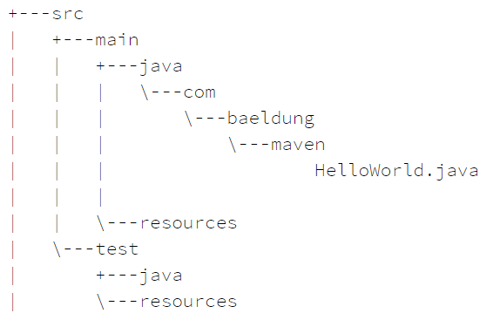
Apache Maven
Like ANT it uses XML files for structure
Added a lot of regularized structure seen in most project configurations so that certain commands could be automated
pom.xml
mvn compile
Unlike ANT a standard directory structure
developed
Rather inflexible than Ant
Great for quick projects
Insufficient for complex

Slide 12
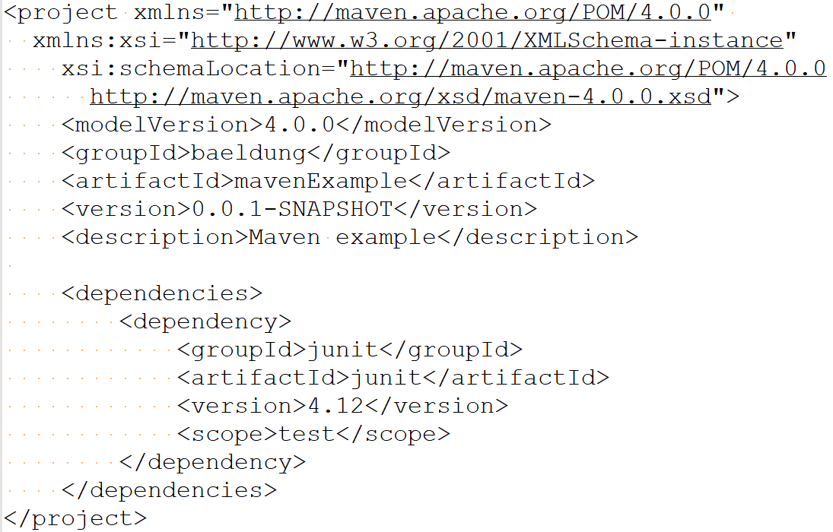
Apache Maven
A lot is direct encoded in xml
Junit config is expected parts
Name of jar and versioning
Etc.

Slide 13
Now Gradle
What is this a build automation tool for gradles?

Slide 14
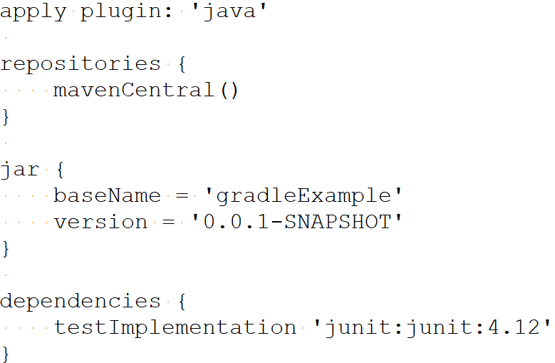
Gradle
No XML (follows a recent trend away from strict structured files)
Actually designed around specific language for
Gradle needs user to add plugins to gain most features, i.e. regular java actions need a Java plugin
Maven has most of market share but lots of growing support for Gradle (partially as it is less language specific)

Slide 15
Continuous Integration (CI)

Slide 16
Continuous Integration
JUnit testing enforces the idea that as a user makes changes to their changing part of codebase, that they run Unit Tests to ensure it stays correct
This leads to a development process where a change is made and then immediately tested against existing unit tests
The addition of version control leads to an environment where users are making changes on local repositories and/or branches (such as bugfixes) and desired to merge them back into a branch for the coming release
Continuous integration is this process where users are continuously pushing in code and we design automated tests to build and verify the code each time
Think of unit tests (and others) that run against codebase after a merge request is made

Slide 17
Continuous Integration
Continuous integration can be done on your own systems, but is also available through web hosting services (share with your worldwide git project)
Gitlab/Github: when project contributor push changes to remote, or commits to remote, a ‘pipeline’ can be triggered
Gitlab -> .gitlab-ci.yml file
Tells gitlab what commands to run (can also configure what triggers them)
Ex. On a commit, run static analysis, compile code, run unit tests, compile and package into a binary release file

Slide 18
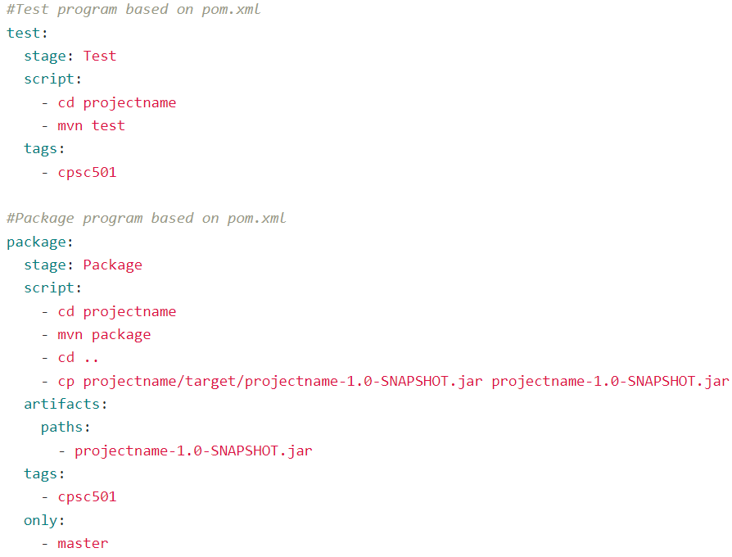
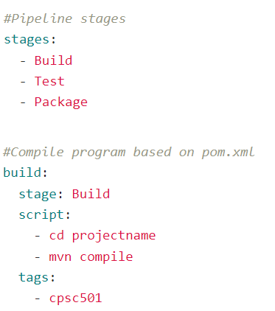
CI Maven

Slide 19
Leads to Continuous Deployment/Delivery (CD)

Slide 20
Continuous Deployment/Delivery
Gitlab -> .gitlab-ci.yml file
Tells gitlab what commands to run (can also configure what triggers them)
Ex. On a commit, run static analysis, compile code, run unit tests, compile and package into a binary release file
You can declare that certain finalized artifacts like a binary release file are created (or like a jar file)
Continuous deployment is to make these available to manually be installed into production setups (if you’ve seen a github project that you can download a file from after each commit)
Continuous delivery is to distribute these so that they are integrated into production systems

Slide 21
CI/CD

Slide 22
CI/CD by yourself
You need to connect the repository (passive storage) to an active system which will run your commands
In your regular dev environment you are used to running commands (like compile and unit testing yourself)
Now you want the repository (often remote) to do it by itself
Example for class: gitlab.ucalgary.ca
Gitlab uses program called gitlab-runner
Put it onto a machine, register it with repo, when repo has a commit it looks at .gitlab-ci.yml and pushes commands triggered to registered gitlab-runner
The gitlab-runner will received these jobs and execute
In general a job is a sequence of commands (ex. javac *.java to compile)

Slide 23
Docker
Docker is a service/tool that hosts and provides virtual machine configurations
Example a linux system with latest version of python 3 installed
You can make a CI file that will load a docker config, then run commands
Allows you to make compile setups for multiple environments (load docker for windows and compile, load docker for linux red hat and compile, load osx docker, etc.)
Challenge (docker files are vm files so they aren’t small files)
Docker often integrated into .gitlab-ci.yml files to indicate container environments used for pipeline steps.

Slide 24
Kubernetes
Open source automated tool for managing containers (like docker)
If you have an account you essentially request environments to be setup in their cloud environment to do your compile operations
Like most cloud services it claims to scale to your needs as you add compile environments, complexity of actions, or customizations to the process
Tools like gitlab will include ability that you can connect to your Kubernetes config so that you can install a gitlab-runner in their managed environment vs having to configure your own

Slide 25
Onward to … refactoring.
Jonathan Hudson
jwhudson@ucalgary.ca
https://pages.cpsc.ucalgary.ca/~hudsonj/

