Slide 1
Refactoring: JUnit
CPSC 501: Advanced Programming Techniques
Fall 2020
Jonathan Hudson, Ph.D
Instructor
Department of Computer Science
University of Calgary
Monday, August 24, 2020

Slide 2
Unit Testing

Slide 3
Unit Testing
A unit test is a technique for testing the correctness of a module of source code
You create separate test cases for every nontrivial method in the module
Unlike most other tests, is done by developers as they code
Is a form of “bottom-up” testing

Slide 4
Benefits of Unit Testing
Beneﬁts of unit testing:
Reduces the time spent on debugging
Catches bugs early
Eases integration
Bottom-up testing allows you to build a large system on a reliable “foundation” of working low-level code
Documents the intent of the code
Encourages refactoring
Tests are rerun to make sure no new bugs are introduced
Is a form of regression testing

Slide 5
Goal of Unit Testing
The goal of unit testing is to determine if the code:
Does what is intended
Works correctly under all conditions
Including exceptional conditions like bad input, full disks, dropped network connections, etc., etc.
Is dependable

Slide 6
Usage of Unit Testing
Your test code is for internal use only
Is separate from production code and is not shipped
Production code must be “unaware” of the test code that exercises it
However, you may have to refactor poorly structured code to make it testable

Slide 7
Unit Testing Frameworks
Unit testing frameworks make it easy to build and run tests
Open source frameworks include:
JUnit for Java
NUnit for C#
pytest for python

Slide 8
JUnit Example

Slide 9
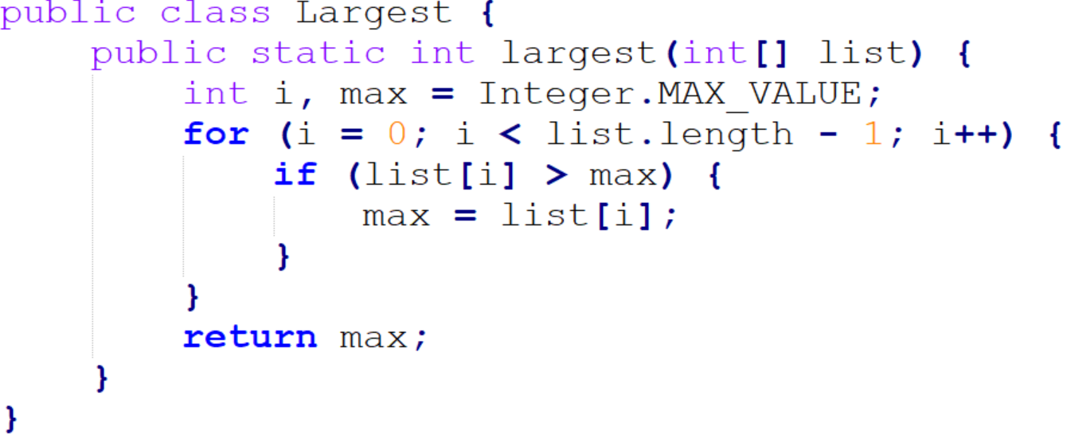
JUnit Example – Largest Integer Method
We will test the following method:
Note: contains some bugs

Slide 10
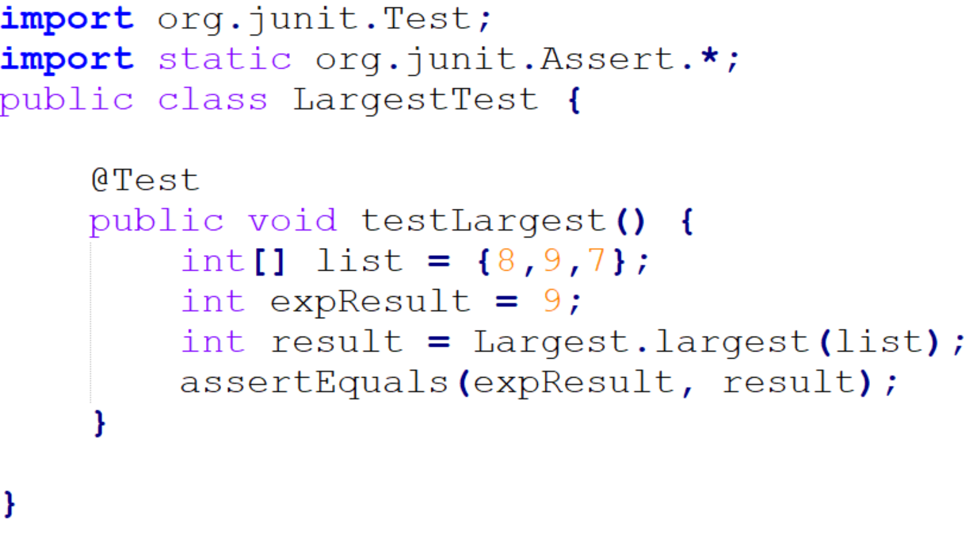
JUnit Example – JUnit Test
Create a test class with an initial test:

Slide 11
JUnit Example - Details
Your test class can be named anything
Test methods must be annotated with @Test
Will be invoked automatically by the test runner
The assertEquals() will abort if the largest() method does not return a 9
9 is the largest element in the list 8, 9, 7
Save the ﬁle
Compile using: javac *.java

Slide 12
JUnit Example - Running
Run the test
Use: java org.junit.runner.JUnitCore LargestTest
The classpath must be set correctly for this to work
Is a textual UI
Most IDEs can run tests within their GUI

Slide 13
JUnit Example – Failing Test

Slide 14
JUnit Example – Multiple Asserts
Create a new test testOrder():
Tests for the largest element in all 3 positions
Recompile and retest

Slide 15
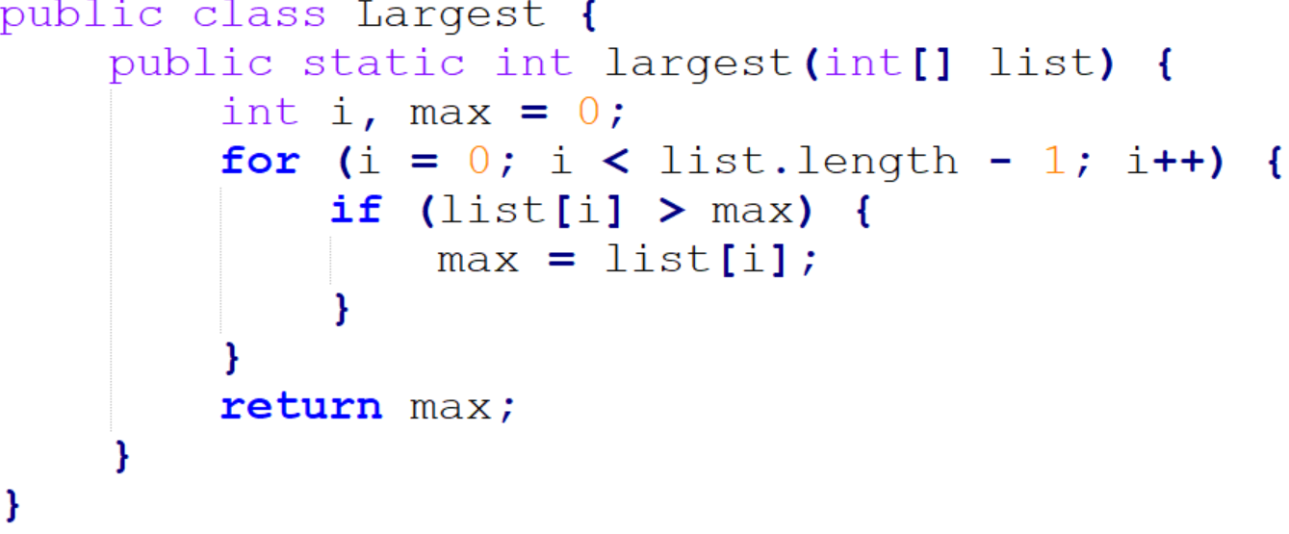
JUnit Example – Failing Again

Slide 16
JUnit Example – Fix Bug
We ﬁnd another error:
Is an “off by one” bug:
Change loop for correct termination
Recompile and retest
Should report: OK (2 tests)

Slide 17
JUnit Example – More Tests
Add methods to test for duplicates and a list of size one:
Recompile and retest
Should report: OK (4 tests)

Slide 18
JUnit Example – Negative Numbers
Add a method to test negative numbers:
Retesting reveals another bug:
Fix by initializing max = Integer.MIN_VALUE;
Retest

Slide 19
JUnit Example – Exceptions?
What should happen if the list is empty?
Throw an exception

Slide 20
JUnit Example – Exceptions Expected
Add a test for this:

Slide 21
JUnit Example – Null?
What if our function should crash on null input?

Slide 22
JUnit Versions

Slide 23
JUnit Versions
There are three main JUnit revisions active
JUnit 3 (offered as choice by eclipse)
JUnit 4 (default in eclipse? or was, might change soon if is)
JUnit 5 (AKA Jupiter, default in Netbeans)

Slide 24
JUnit Versions
There are three main JUnit revisions active
JUnit 3 (offered as step down choice by eclipse)
JDK 1.2+
JUnit 4
JDK 1.5+
JUnit 5
JDK 1.8+
Has JUnit Vintage for running Junit 3/4 Tests
Recommend using JUnit5 and an IDE environment like eclipse

Slide 25
JUnit 3
There are three main JUnit revisions active
JUnit 3 (offered as step down choice by eclipse)
Had to use testXXX pattern for methods
Had to catch exception manually
Had to comment out tests to ignore them
Can’t test timeouts
Can’t make methods that run once before test class executes

Slide 26
JUnit 4
There are three main JUnit revisions active
JUnit 4 (default in eclipse/netbeans)
Most common (JUnit 5 adds features that are nice but less of a big deal)
@Test to designate tests
@BeforeClass/@AfterClass for methods to run once for test class
@Before/@After for methods to run around each test
Can test for exceptions
Can @Ignore tests
Can test with timeouts @Test(timeout=1000)
@Category of tests
Can add fail messages to asserts

Slide 27
JUnit 5
There are three main JUnit revisions active
JUnit 5 (AKA JUnit Jupiter)
Tag name changes (same functionality)
Messages moved to end of assert (makes copy-paste code trickier b/w versions)
Can @Nested tests to only run if outer passes

Slide 28
JUnit Framework

Slide 29
JUnit Framework
The JUnit framework does the following:
Sets up conditions needed for testing
Creates objects, allocates resources, etc.
Calls the method
Veriﬁes the method worked as expected
Cleans up
Deallocates resources, etc.

Slide 30
JUnit Framework
All test methods must be annotated with @Test
Are invoked automatically by the framework
Each method uses various assert helper methods
Aborts the test method if the assertion fails
Reports failures to the user

Slide 31
JUnit Asserts
JUnit asserts: (JUnit4 and JUnit5 will swap message front/end of parameters)
assertEquals([String message], expected, actual)
message is optional
assertEquals([String message], expected, actual, tolerance)
Useful for imprecise f.p. numbers
assertNull([String message], Object object)
Asserts that the object is null
Also: assertNotNull()

Slide 32
JUnit Asserts
JUnit asserts: (JUnit4 and JUnit5 will swap message front/end of parameters)
assertSame([String message], expected, actual)
Asserts that expected and actual point to the same object
Also: assertNotSame()
assertTrue([String message], boolean condition)
Also: assertFalse()
fail([String message])
Fails the test immediately
Used to mark code that should not be reached

Slide 33
JUnit After/Before
Use @Before to mark a method used to initialize the testing environment before every test in test class
E.g. Allocate resources, initialize state
Use @After to mark a method used to clean up after every test in test class
E.g. Deallocate resources
Are invoked before and after every test method is run
Incredibly useful to make objects re-used across multiple tests
Tests should be designed to be run independently, and in any order
(JUnit doesn’t follow your source code order)

Slide 34
JUnit AfterClass/BeforeClass
Like @Before/@After, but once for the whole test class (instead of each function)
Good for static setups, like database connections
Use @BeforeClass to mark a method used to initialize the testing environment when test class is initialized
E.g. Allocate resources, initialize state
Use @AfterClass to mark a method used to clean up after every test in test class is complete
E.g. Deallocate resources

Slide 35
JUnit Before/After Examples

Slide 36
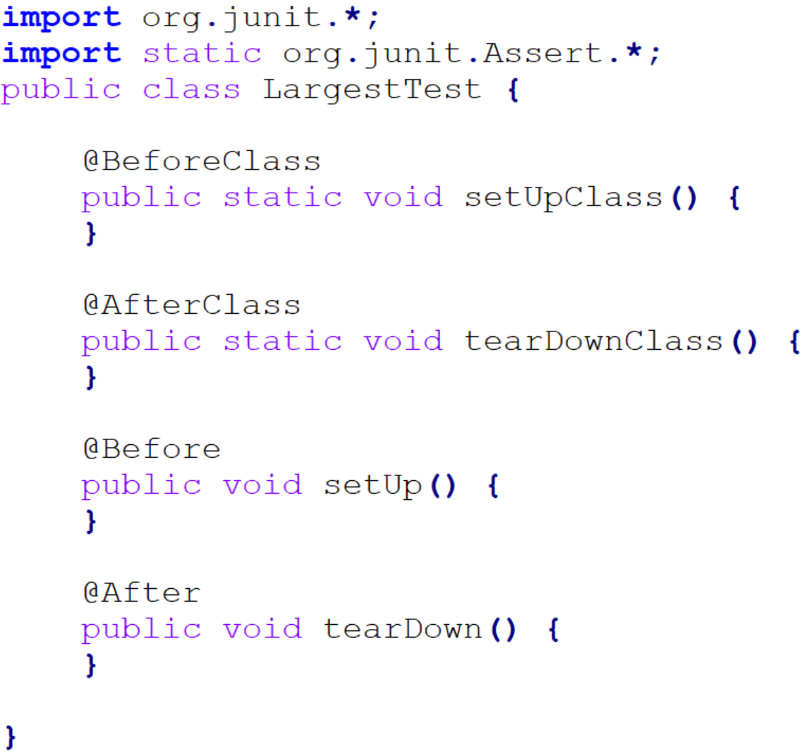
Junit: Before and after
BeforeClass – things you need for multiple tests (connections to resources, constants), shouldn’t be changed by tests
AfterClass – cleanup things related to BeforeClass
Before – things used for multiple tests, often changed by tests
After – clean up stuff related to Before

Slide 37
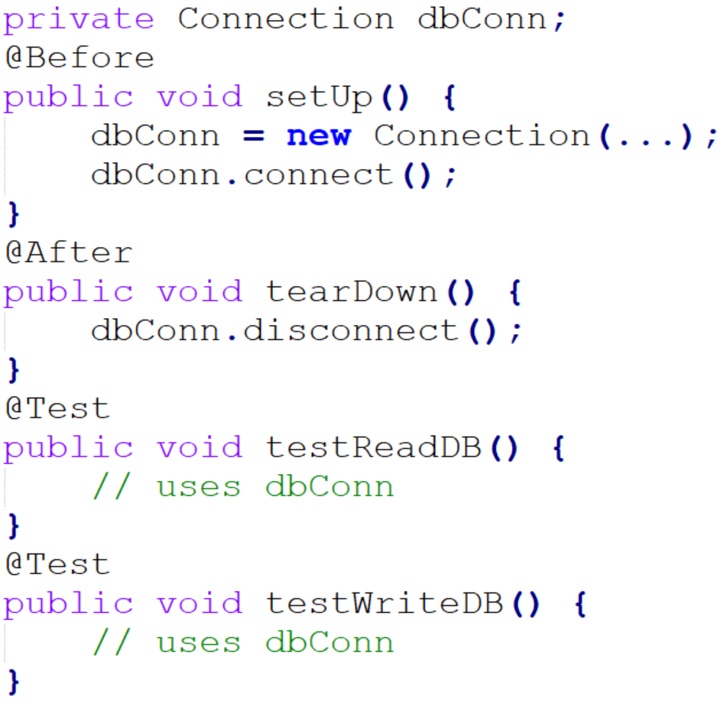
JUnit After/Before - Example

Slide 38
JUnit How Suite it Is

Slide 39
JUnit Suites
By default, the test runner uses all methods of a class annotated with @Test
A suite of tests is created for you automatically
You can combine tests from several classes into a suite using the @RunWith and @SuiteClasses annotations
E.g. Combine tests from TestLargest and TestSmallest classes

Slide 40
JUnit Suite - Example

Slide 41
JUnit Creating Tests

Slide 42
Testing
Use the mnemonic Right-BICEP
Are the results right?
i.e. Does the code do what is intended?
Check Boundary conditions
Most bugs live at the “edges”
Examples:
Beginnings and ends of lists, ﬁles, etc.
Badly formatted data
Empty or missing values
… (next page)

Slide 43
Testing
Out of range values
Duplicates in lists that should have unique data
Ordered lists that aren’t, and vice-versa
Things that arrive out of order
Etc.
Check Inverse relationships
E.g. Square the result of a square root method
Cross-check by other means
E.g. Use a proven sorting algorithm to check the results of a new sorting method

Slide 44
Testing
Force Error conditions
Incorrect input parameters
Problems in the environment like:
Running out of RAM
Running out of disk space
Dropped network connections
High system load
Etc.
Can be simulated using mock objects
i.e. objects that stand in for system resources

Slide 45
Testing
Check Performance characteristics
Make sure performance doesn’t degrade
With large inputs
When adding new functionality
Always ask yourself:
What else can go wrong?

Slide 46
Onward to … continuous integration & deployment.
Jonathan Hudson
jwhudson@ucalgary.ca
https://pages.cpsc.ucalgary.ca/~hudsonj/

