Slide 1
Refactoring: Compare GIT and SVN
CPSC 501: Advanced Programming Techniques
Fall 2020
Jonathan Hudson, Ph.D
Instructor
Department of Computer Science
University of Calgary
Monday, August 24, 2020

Slide 2
Quick comparison

Slide 3
Advantages of GIT
Git has a staging area.
100 new changes?
Break these 100 changes into 10 or 20 or more commits each with their own comments and their own detailed explanation of what just happened!
Developers can commit while disconnected. (Maintains good software developer practice)

Slide 4
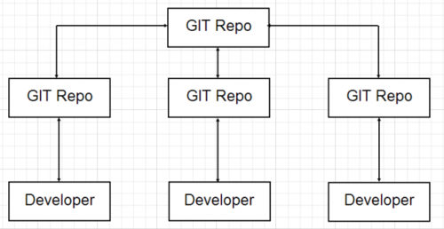
Distributed Version Control
REMOTE

Slide 5
Advantages of SVN
SVN has one central repository
easier for managers to have more of a top down approach to control, security, permissions, mirrors and dumps.
Additionally, some say SVN is easier to use than Git. (often b/c exp. in one vs other)
Others say that the way SVN is set up results in greater trunk stability, and having everything on a central server feels more controlled and secure for some. (managers?)

Slide 6
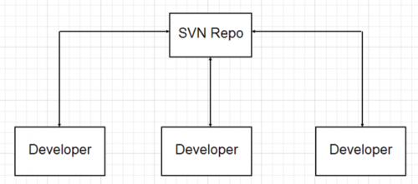
Centralized Version control

Slide 7
SVN vs GIT
SVN allows you to check out sub-trees (or branches) only whereas Git requires you to check out the entire repository as a unit.
This is because there is a .svn in each one of your folders while git only has one .git at the top level parent directory.
Great for big code bases (only need your part of code-base on laptop)

Slide 8
Is Git better than SVN?
Git and SVN are each viable version control systems
Git may have more difficulty compressing and storing binary files, while SVN doesn’t as much.
Some claim Git is better than SVN because it works well even for developers who aren’t always connected to the master repository, as it is available offline.
Branching and merging support are also thought to be superior with Git (partially due to being newly developed).
When it comes to disk space storage, it’s pretty close to equal between both SVN and Git repositories.

Slide 9
Command Comparison (same)
GIT | Operation | SVN
git commit | Record changes (local repo/repo) | svn commit
git status | Confirm status | svn status
git diff | Check differences | svn diff
git log | Check log | svn log
git add | Addition | svn add
git mv | Move | svn mv
git rm | Delete | svn rm
git merge | Merge | svn merge
gitignore | Ignore file list | .svnignore

Slide 10
Command Comparison (similar/different)
GIT | Operation | SVN
git init | Create repo | svnadmin create repo
git show | View commit details | svn cat
git checkout | Cancel change | svn checkout
git reset | Cancel change | svn revert
git branch | Make a branch | svn copy
git checkout | Switch branch | svn switch
git tag | Create a tag | svn copy

Slide 11
Command Comparison (remote)
GIT | Operation | SVN
git clone | Copy a remote repository | svn checkout*
git checkout | Get remote branch | svn switch*
git pull | Get/merge updates from remote | svn update*
git fetch | Get updates without merging | svn update*
git push | Push to remote | svn commit*
*There is no SVN version of a local repository, if you are interacting with a remote your operations of checkout/update/commit all are against the single centralized repository (that happens to be remote)

Slide 12
Onward to … junit.
Jonathan Hudson
jwhudson@ucalgary.ca
https://pages.cpsc.ucalgary.ca/~hudsonj/

