Slide 1
Refactoring: Git
CPSC 501: Advanced Programming Techniques
Fall 2020
Jonathan Hudson, Ph.D
Instructor
Department of Computer Science
University of Calgary
Monday, August 24, 2020

Slide 2
Not an acronym

Slide 3
Not an acronym
(from the source code read-me)
"git" can mean anything, depending on your mood.
random three-letter combination that is pronounceable, and not actually used by any common UNIX command. The fact that it is a mispronunciation of "get" may or may not be relevant.
stupid. contemptible and despicable. simple. Take your pick from the dictionary of slang.
"global information tracker": you're in a good mood, and it actually works for you. Angels sing, and a light suddenly fills the room.
"goddamn idiotic truckload of sh*t": when it breaks

Slide 4
The Rise of Git
Git is the most popular implementation of a distributed version control system.
Development started in 2005 by Linus Torvalds.
Linux kernel source host dispute with BitKeeper
Same reason resulted in another DVCS -> Mercurial
It is used by many popular open source projects as well as many commercial organizations.
Take Concurrent Versions System (CVS) as an example of what not to do; if in doubt, make the exact opposite decision.
Support a distributed, BitKeeper-like workflow. (‘He’s dead Jim’ -> BitKeeper)
Include very strong safeguards against corruption, either accidental or malicious.

Slide 5
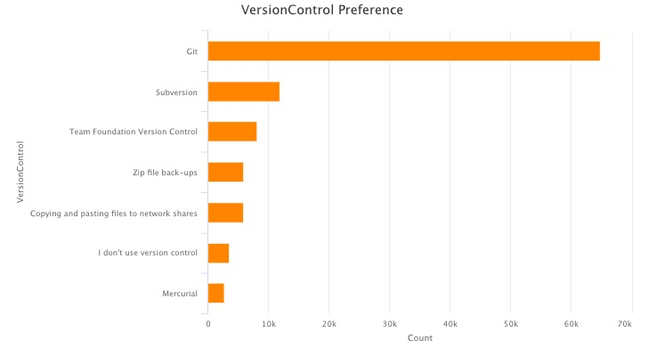
Why Git?
Git’s the most popular version control system in the industry.
Most popular VCS are similar to Git
Source: Stackoverflow 2018 survey

Slide 6
Why Git?
Git is distributed
i.e. there is generally are remote repo (like the single svn one) and a local repo on your own machine
SVN required repo to be only local, or only remote
GIT lets each developer have their own version of repo
Each developer can make changes and make commits to own repo and periodically push/pull from remote to bring together development
Frees programmer, code on a plane and still do multiple local commits
Source: Stackoverflow 2018 survey

Slide 7
This is how you do it

Slide 8
Git: *New* Version Control Terminology
SHA
Staging Area/Index

Slide 9
Git: *New* Version Control Terminology
SHA
Staging Area/Index
SHA
A SHA is basically an ID number for each commit.
Ex. E2adf8ae3e2e4ed40add75cc44cf9d0a869afeb6
Instead of version numbering (SVN)
Staging Area
You can think of the staging area as a prep table where Git will take the next commit.
Files on the Staging Index are ready to be added to the repository.

Slide 10
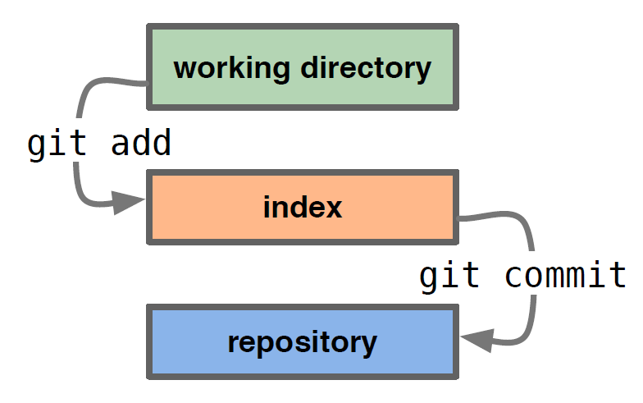
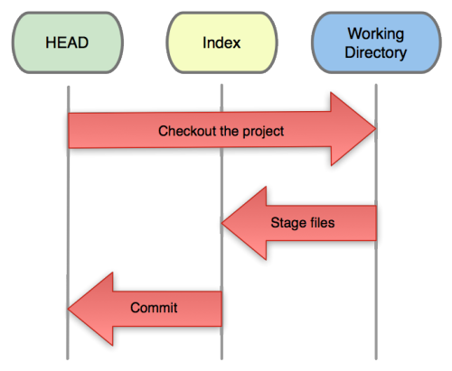
Git: Getting Started
Three trees of Git
The HEAD
last commit snapshot, next parent
Index
Proposed next commit snapshot
Working directory
Sandbox

Slide 11
Git: Basic Commands
git init – Initialize a Git repository/working directory
git init NAME
git status – Status of your working directory
git status
git add <filename> or git add . (for all files in your working directory)
git commit – Stash changes in your working directory
git log – View your commit history
git clone – Create an identical copy

Slide 12
Git: A Basic Workflow
A basic workflow
Init a repo (or clone an existing one)
Edit files
Stage the changes
Review your changes
Commit the changes

Slide 13
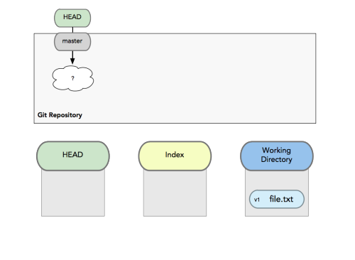
Git: A Basic Workflow
A basic workflow
Edit files
Stage the changes
Review your changes
Commit the changes

Slide 14
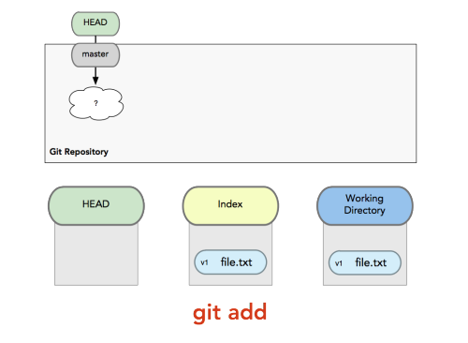
Git: A Basic Workflow
A basic workflow
Edit files
Stage the changes
Review your changes
Commit the changes
Git add filename

Slide 15
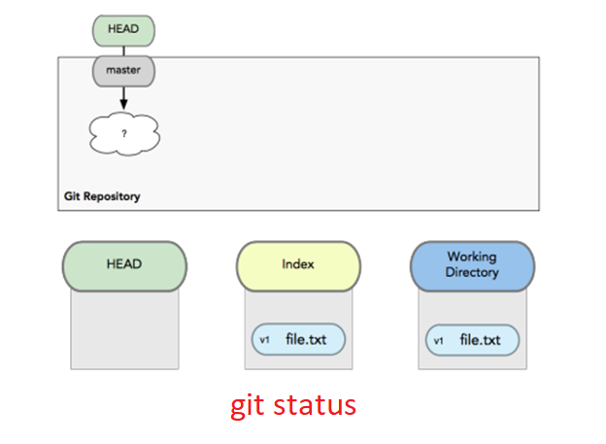
Git: A Basic Workflow
A basic workflow
Edit files
Stage the changes
Review your changes
Commit the changes
Git status

Slide 16
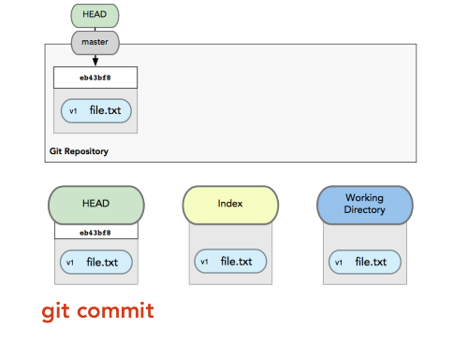
Git: A Basic Workflow
A basic workflow
Edit files
Stage the changes
Review your changes
Commit the changes
Git commit

Slide 17
Git: Informational
View changes
git diff
Show the difference between working directory and staged
git diff --cached
Show the difference between staged and the HEAD
View history
git log

Slide 18
Git: Revert
Revert changes (Get back to a previous version)
git checkout commit_hash

Slide 19
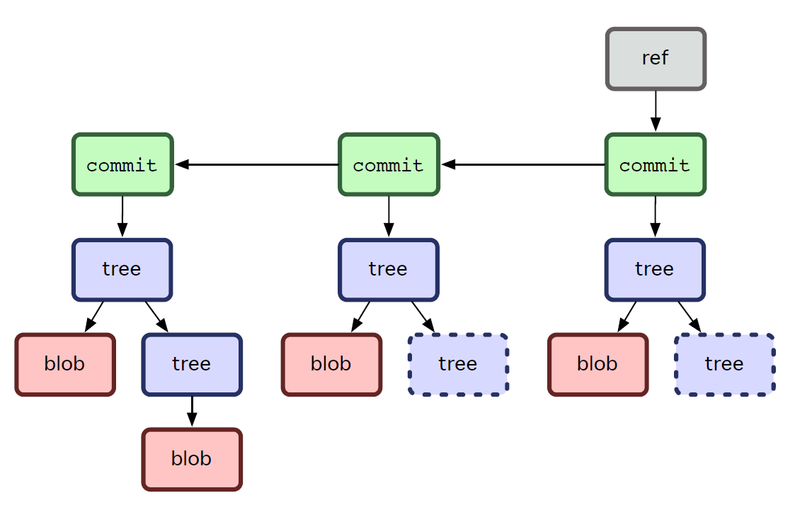
Git: Commit Tree
Git sees commit this way…
Branch annotates which commit we are working on

Slide 20
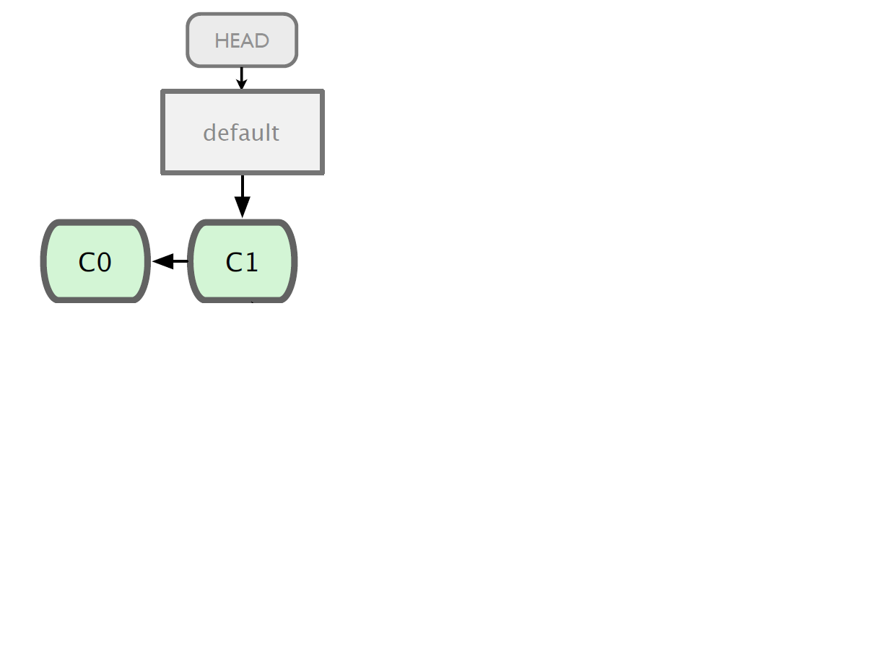
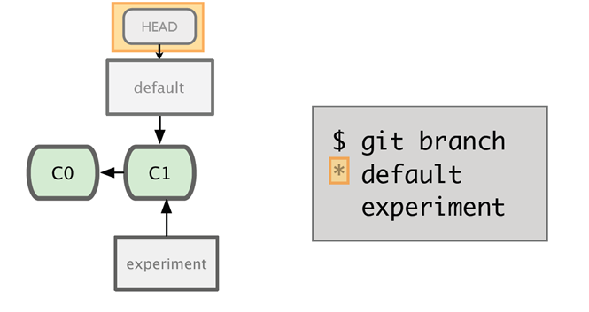
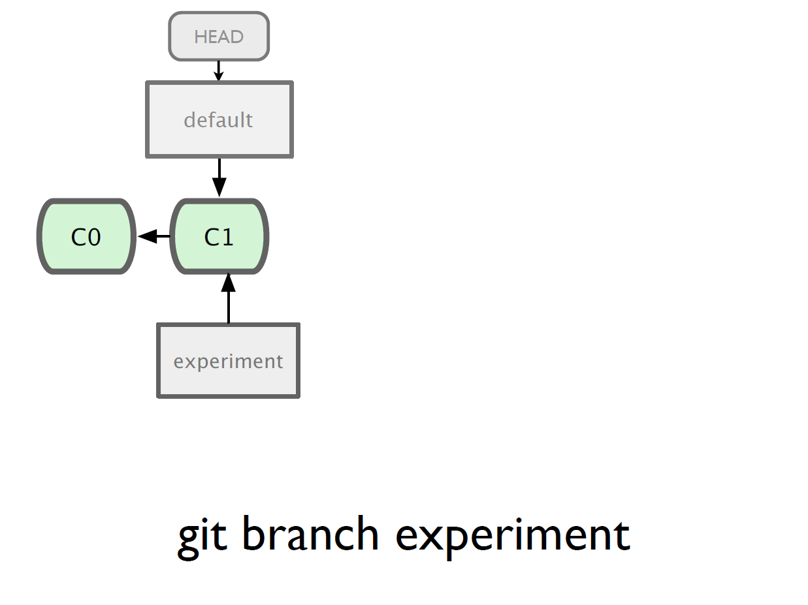
Git: Branching

Slide 21
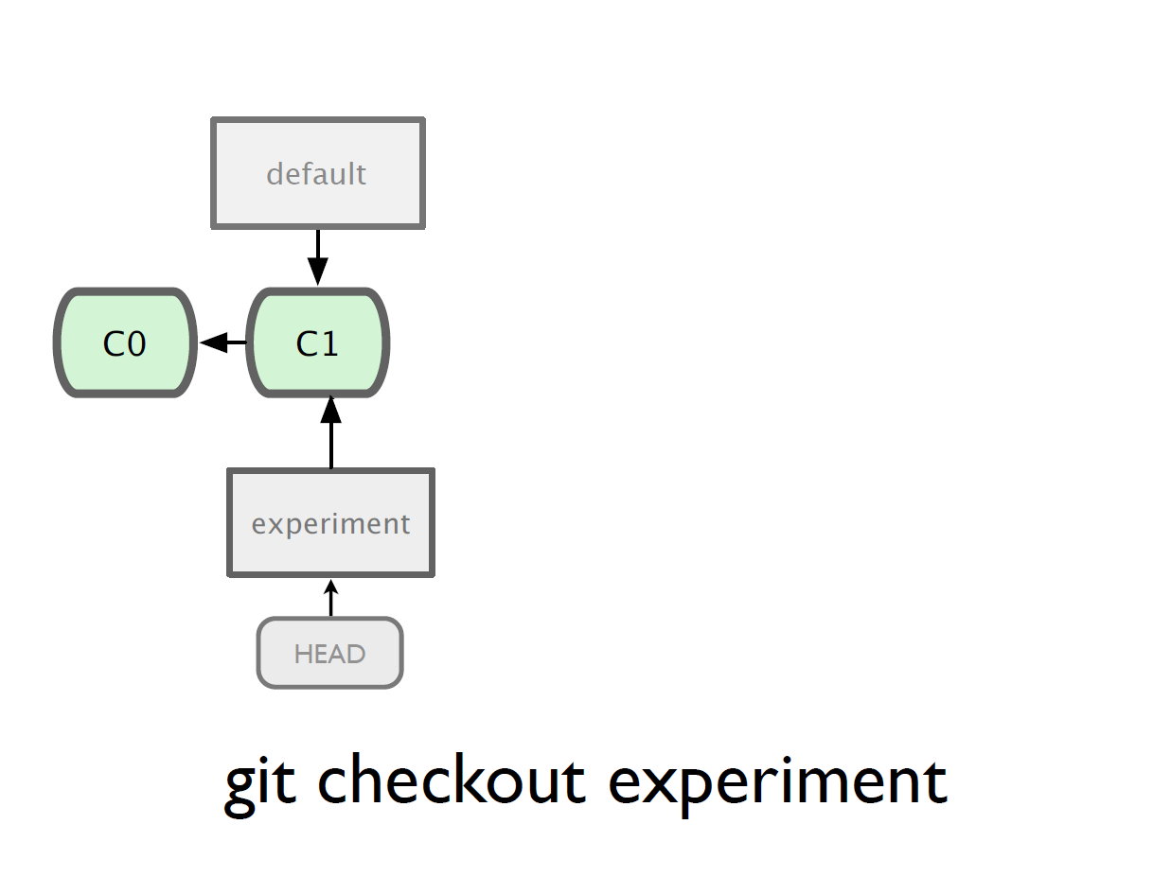
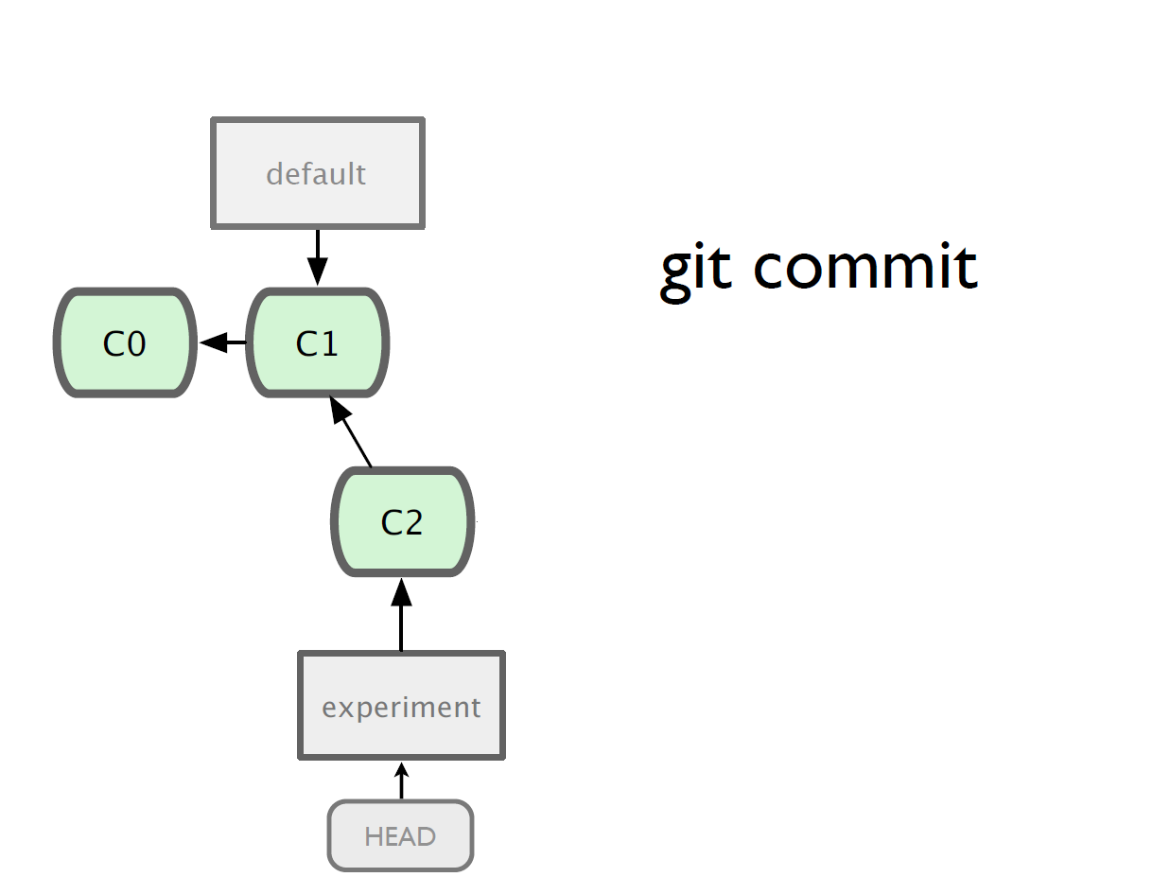
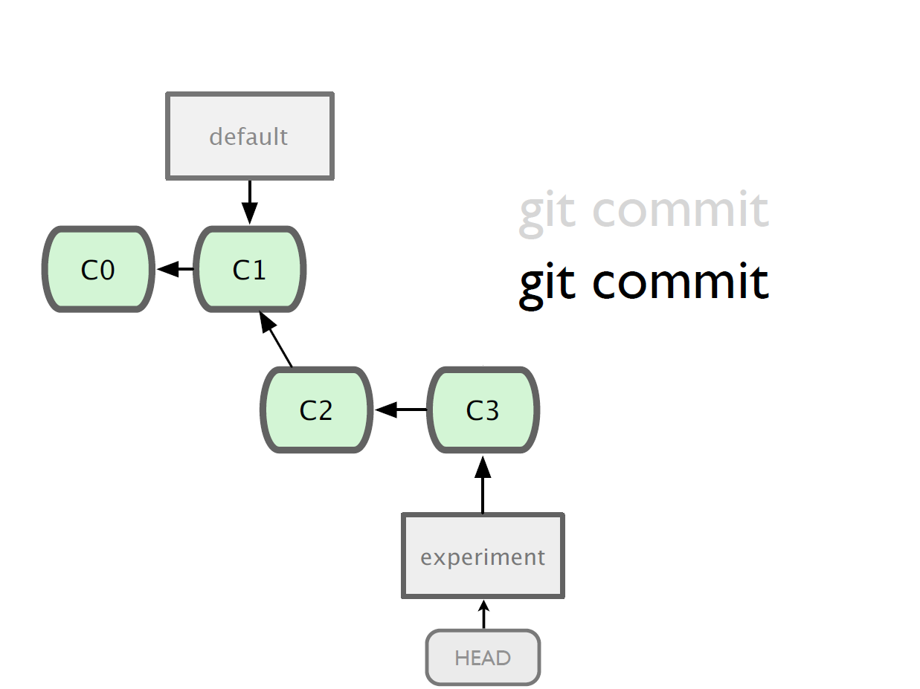
Git: Branching

Slide 22
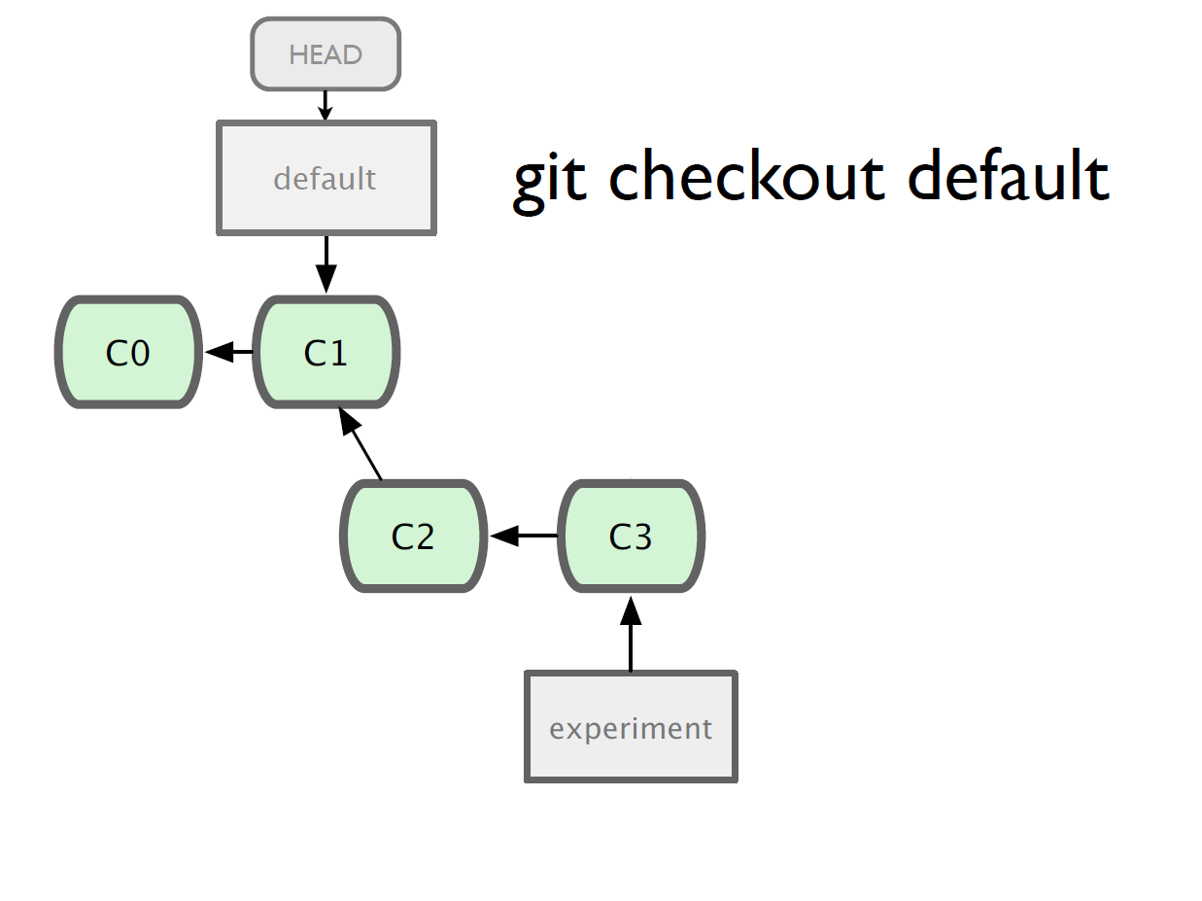
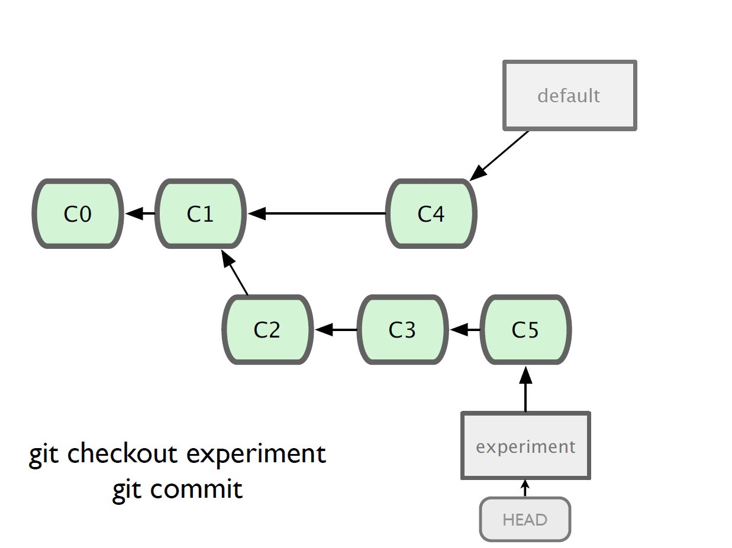
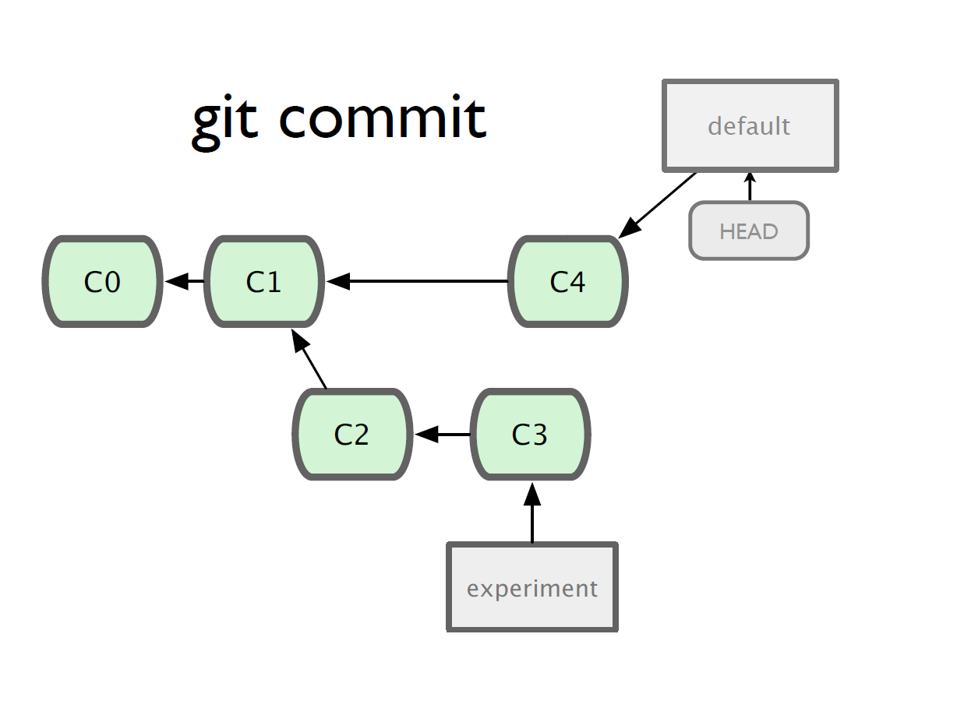
Git: Branching

Slide 23
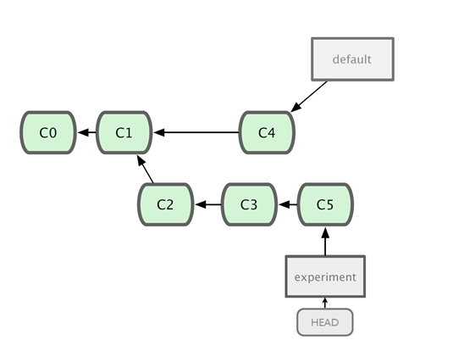
Git: Merging
What do we do with this mess?
Merge them

Slide 24
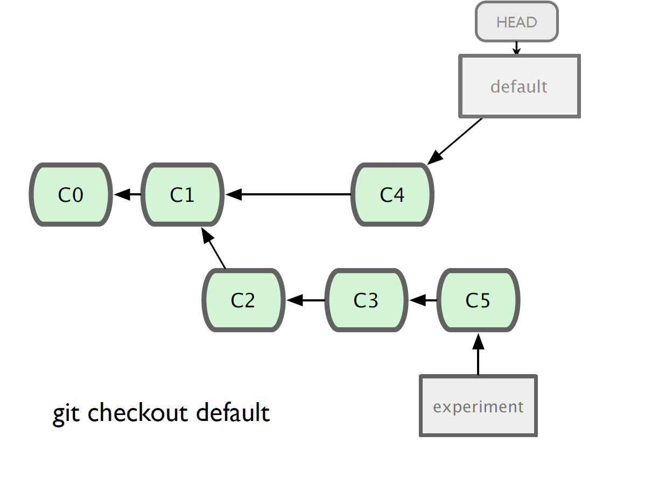
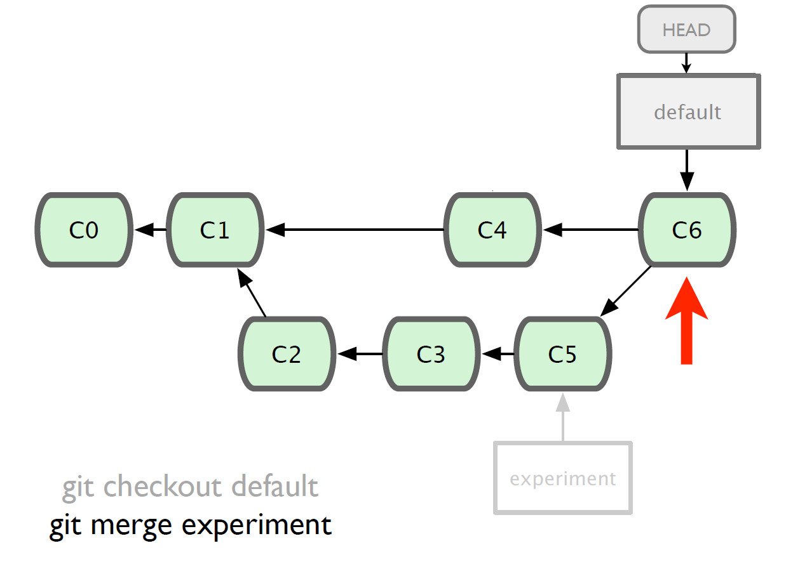
Git: Merging
Steps to merge two branch
Checkout the branch you want to merge onto
Merge the branch you want to merge

Slide 25
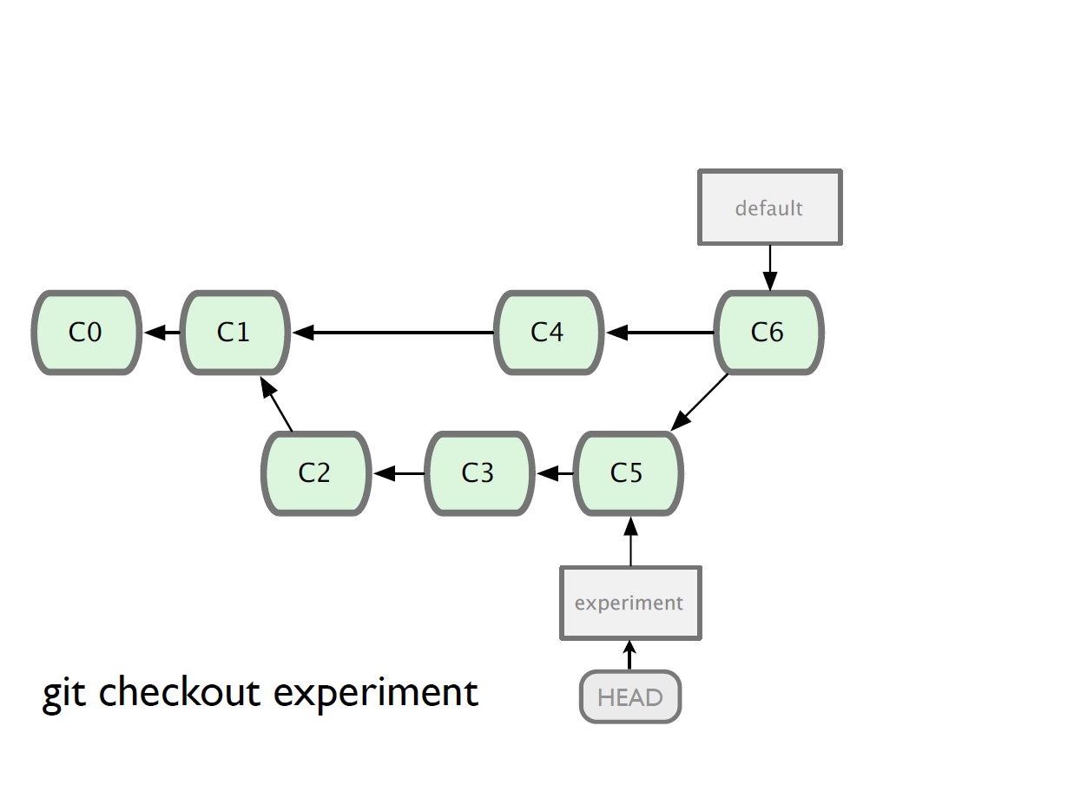
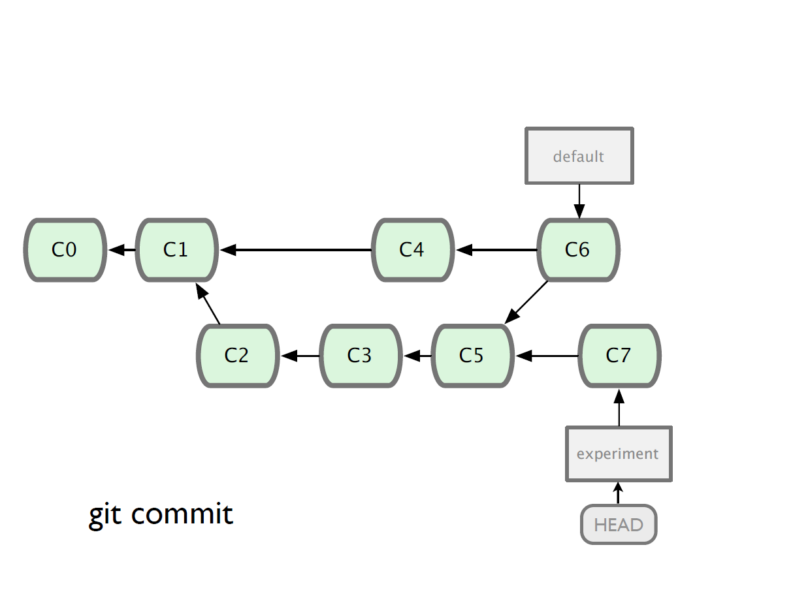
Git: Merging
We can continue working one whichever branch we want (the trunk default or on experiment)

Slide 26
Git: Branching and Merging
Why this is cool?
Non-linear development
clone the code that is in production
create a branch for issue #53 (iss53)
work for 10 minutes
someone asks for a hotfix for issue #102
checkout ‘production’
create a branch (iss102)
fix the issue
checkout ‘production’, merge ‘iss102’
push ‘production’
checkout ‘iss53’ and keep working

Slide 27
GitHub, UofC GitLab
It’s a hosting medium/website for your Git repositories
Offers powerful collaborative abilities
A good indicator of what you code/how much you code/quality of your code

Slide 28
Git: Working with a remote repository
Remote?
The common central repository
By default, remote name is origin and default branch is main (previously master).

Slide 29
How to access GitHub/UofC GitLab
Access on https://github.com/ or https://gitlab.cpsc.ucalgary.ca
Get a clone link
github.com/intley/Version_Control_Workshop

Slide 30
Git: Remote Commands
git push – push your changes into the remote repository
git pull – pull your latest changes from the remote repository

Slide 31
Git: Collaborate
Remote Repo
Master
C1
Alice
Bob
C2

Slide 32
Git: Collaborate
Remote Repo
git clone
git clone
Master
Master
Master
C1
C1
C1
Alice
Bob
C2
C2
C2

Slide 33
Git: Collaborate
Remote Repo
Master
Master
Master
C1
C1
C1
Alice
Bob
C2
C2
C2
CA
git add
git commit
CB
git add
git commit

Slide 34
Git: Collaborate
Remote Repo
Master
Master
Master
C1
git push
C1
C1
Alice
Bob
C2
C2
C2
CA
C3
CB

Slide 35
Git: Collaborate
Remote Repo
Master
Master
Master
C1
C1
git fetch
C1
Alice
Bob
C2
C2
C2
C3
CA
C3
CB

Slide 36
Git: Collaborate
Remote Repo
Master
Master
Master
C1
C1
git merge
C1
Alice
Bob
C2
C2
C2
CA
C3
C3
CB

Slide 37
Git: Collaborate
Remote Repo
Master
Master
Master
C1
C1
git push
C1
Alice
Bob
C2
C2
C2
CA
C3
C3
CB
CB

Slide 38
Git: Collaborate
Remote Repo
Master
Master
Master
C1
git pull
C1
C1
Alice
Bob
C2
C2
C2
CA
C3
C3
CB
CB
CB

Slide 39
Onward to … comparison.
Jonathan Hudson
jwhudson@ucalgary.ca
https://pages.cpsc.ucalgary.ca/~hudsonj/

