Slide 1
Refactoring: Subversion
CPSC 501: Advanced Programming Techniques
Fall 2020
Jonathan Hudson, Ph.D
Instructor
Department of Computer Science
University of Calgary
Monday, August 24, 2020

Slide 2
Subversion … rise and fall
(and why we’ll breeze through it)

Slide 3
Subversion … rise and fall
Initial release 2000 (still update - > 1.14 May 2020)
Open source (Apache Foundation)
Popular with sourceforge! (Basically what github now is)
2012 bought (along with Slashdot [RIP]) by Dice.com
Bundleware practices increased (some cases of malware)
Developers fled sit to others like Github
Some more popular tools included TortoiseSVN

Slide 4
Subversion … rise and fall
Initial release 2000 (still update - > 1.14 May 2020)
Open source (Apache Foundation)
Popular with sourceforge! (Basically what github now is)
2012 bought (along with Slashdot [RIP]) by Dice.com
Bundleware practices increased (some cases of malware)
Developers fled sit to others like Github
Some more popular tools included TortoiseSVN
Git (Blue) vs SVN (google trends)

Slide 5
Subversion … rise and fall
Initial release 2000 (still update - > 1.14 May 2020)
Open source (Apache Foundation)
Popular with sourceforge! (Basically what github now is)
2012 bought (along with Slashdot [RIP]) by Dice.com
Bundleware practices increased (some cases of malware)
Developers fled sit to others like Github
Some more popular tools included TortoiseSVN
Git (Blue) vs SVN (google trends)

Slide 6
This is how you do it

Slide 7
Working with SVN
Short for Subversion
Download and manuals available at: subversion.apache.org
Use svn --version at the command line to check if installed
Also: svnadmin --version
There are several GUI frontends to SVN
Many are not free
TortoiseSVN (will install SVN with it for you as well)
Generally integrated in many IDEs

Slide 8
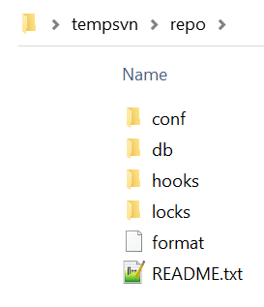
SVN: Creating a Repository
Initial set up:
Create a repository in your account on the local ﬁle system.
cd tempsvn
mkdir repo
svnadmin create repo
Do not directly change the ﬁles in this directory
These are all svn repository management files
Always use svn or svnadmin commands
Note the repository URL
C:/tempsvn/repo

Slide 9
SVN: Import some initial files
Create your project
Decide on a project name (e.g. “panther”)
Create some initial source code ﬁles in a temporary directory
mkdir temp
cd temp
echo public class Person{} > Person.java
echo public class Student extends Person{} > Student.java
Import the ﬁles into the repository
svn import . "file:///C:/tempsvn/repo/panther/trunk" –m "initial import"
We can remove the temp directory and files now
They are recorded in the repository

Slide 10
SVN: Import some initial files
svn import . "file:///C:/tempsvn/repo/panther/trunk" -m "initial import"
svn -> program that does subversion commands
import -> the import command
. -> everything in our temp directory (i.e. Student.java and Person.java)
"file:///C:/tempsvn/repo/panther/trunk" -> the repository directory
we’ll start a new trunk for a panther project with these two files
This often a url “https://svn.example.com/repos/repo/panther/trunk”
-m -> a flag to send in a message attached to the import
“initial import” -> an import message

Slide 11
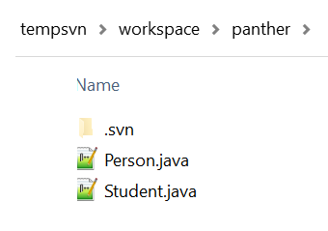
SVN: Workflow
Typical daily workﬂow:
Create a workspace directory
mkdir workspace
cd workspace
Check out the project to a folder called panther in workspace
svn co file:///tempsvn/repo/panther/trunk panther
Change into the project subdirectory
cd panther

Slide 12
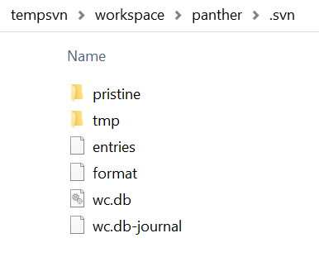
SVN: .svn
Hidden folder in file system
You may have to show hidden files to see it
Tracks info about repo locally
Do not delete/alter this directory if you plan to do anything after the checkout action that you want to affect the repo correctly
If you plan to archive your project in a zip file somewhere as a final item (remove the directory)

Slide 13
SVN: Status, Diff
Make changes to the ﬁles
Use status to give the current state of the ﬁles
svn status *.java
Should indicate they are “locally modiﬁed” (M) if any changes down
Use diff to show the differences between the local copy and repository version
svn diff Person.java

Slide 14
SVN: Commit, Log, Update
Commit the changes to the repository
svn commit -m “Did rename method refactoring”
Use log to see the history of a ﬁle
svn log Person.java
Use update to refresh the ﬁles and directories in the workspace
If there is a newer revision of your file in the repo you will not be allowed to commit until you update and self merge in your change to the file
Necessary if a multi-person project (or if you deleted local copies)
svn update

Slide 15
SVN: Add
Use add to add new directories to the repository
mkdir package
svn add package
Use add to add new ﬁles to the repository
cd package
# create and edit file Math.java
svn add Math.java
svn commit -m “new math stuff”

Slide 16
SVN: Delete and Move
Use delete to remove directories and/or ﬁles from the repository
svn delete package
svn commit -m “deleted package”
Use mv to move and/or rename ﬁles and directories
svn mv Person.java Main.java
svn commit -m “renamed file”
move, mv, and ren are aliases for rename

Slide 17
SVN: Revert changes before committed
Use revert to reverse unwanted changes done to working copy ﬁles and/or directories
# mistakenly edit Student.java
svn revert Student.java
Use -R to apply this to an entire directory or the entire project
svn revert -R mydirectory
# Or in current directory
svn revert -R .

Slide 18
SVN: Revert committed revisions
To revert a committed revision:
Do a reverse merge from the latest revision to an earlier revision
svn merge -r 5:4 .
Commit the change
svn commit -m “reverted to r4”
Note: this creates a revision 6, identical to 4
i.e. SVN never throws anything away

Slide 19
SVN: Release tagging
To create a release tag from a working copy:
Make sure the project is up to date
svn update
If not done already, create a “tags” subdirectory for the project in the repository
svn mkdir file:///C:/tempsvn/repo/panther/tags -m “Created tags subdirectory”
Use copy to create a tagged version in the newly created subdirectory in the repository
svn copy . file:///C:/tempsvn/repo/panther/tags/Rev1 -m “Created Rev1 tag”
Later, you can use this tag to checkout this set of ﬁles
svn co file:/// C:/tempsvn/repo/panther/tags/Rev1 panther

Slide 20
SVN: Notes
Many IDEs have support for subversion
Will be able to connect a project to a repository file/url and generally see in GUI if a file has been modified or not during coding
You can then commit a bunch of changed/added files through GUI with a message
Generally other behaviours such as rename, delete, tagging, reversion all supported
TortoiseSVN is a tool that integrates in file system explorer (adds right click svn menu)
svn is centralized version control, if you aren’t in contact with repo you can’t version control changes.
Leads to big commits in communication challenged situations

Slide 21
Onward to … git.
Jonathan Hudson
jwhudson@ucalgary.ca
https://pages.cpsc.ucalgary.ca/~hudsonj/

