Slide 1
Refactoring: Version Control
CPSC 501: Advanced Programming Techniques
Fall 2020
Jonathan Hudson, Ph.D
Instructor
Department of Computer Science
University of Calgary
Monday, August 24, 2020

Slide 2
Version control … quick history

Slide 3
Version control … quick history
Three generations
Concurrency though lock operations on one file at a time (1972 antiquated)
Centralized repository - CVCS (SVN, Team Foundation Server)
Merge your change in case someone else made changes to central repo, then you can commit a change.
Managers like the control
Distributed repositories – DVCS (Git [by far market leader], Mercurial, more)
Can do work on a local repo
Developers like flexibility (managers can adapt)

Slide 4
First up some definitions
Contrast and compare … later

Slide 5
Version Control
Version control:
Stores source code ﬁles for a project in a central place
Allows multiple developers to work on the same code base in a controlled way
Keeps a record of changes made to source code ﬁles over time
You can recall any version of a ﬁle based on a date or version number
Allows you to maintain multiple, concurrent releases of your software
i.e. the mainline (or trunk) plus one or more branch releases

Slide 6
Version Control: Repository
Repository: the place where source code ﬁles for projects are stored
Will contain all versions of the ﬁles
Actually stored as differences
much smaller than full copies
but means you need to history to recreate a full file
Can be local but often network accessible

Slide 7
Version Control: Repository
Repository: the place where source code ﬁles for projects are stored
Will contain all versions of the ﬁles
Actually stored as differences
much smaller than full copies
But means you need to history to recreate a full file
Can be local but often network accessible
Often stores non-code project artifacts such as:
Ant/Maven files, Makeﬁles, etc.
External documentation (analysis, design, etc.)
Generally does not to store generated artifacts
E.g. Object code, .class files, linking files, executables, temp files, etc

Slide 8
Version Control: Basic Terms
Workspace: the place where you work on a copy of a project’s ﬁles
Files in the repository are not changed by you directly
Checking out: populates your workspace with up-to-date copies of ﬁles and directories from the repository
Committing: saves your changes back into the repository
Sometimes called checking in
The repository keeps track of changes using revision numbers
Updating/pulling: repopulates your workspace with the latest versions of ﬁles
Useful when other developers are also working concurrently on the same project

Slide 9
Version Control: Versioning
Revision: Each version of a ﬁle (or a set of ﬁles) is given a unique identifier
Is time stamped and should be commented to describe the change made
In SVN:
1 for the initial version
2, 3, etc. for subsequent committed versions
In GIT
no revision numbers, generated hash values
You have to name revisions for context with tagging

Slide 10
Version Control: Versioning
Revisions
Retrieve a speciﬁc revision of a ﬁle or set of ﬁles (i.e. a directory or a project)
List the differences between revisions
Retrieve all source code as it appeared at some date in the past

Slide 11
Version Control: Tagging
A tag allows you to name a particular revision of your project (or particular directories or subsets of ﬁles)
E.g. “PreRelease1” might tag revision 34 of ﬁle1.java, revision 27 of ﬁle2.java, etc.
Checking out using the tag retrieves the same set of ﬁles despite subsequent revisions

Slide 12
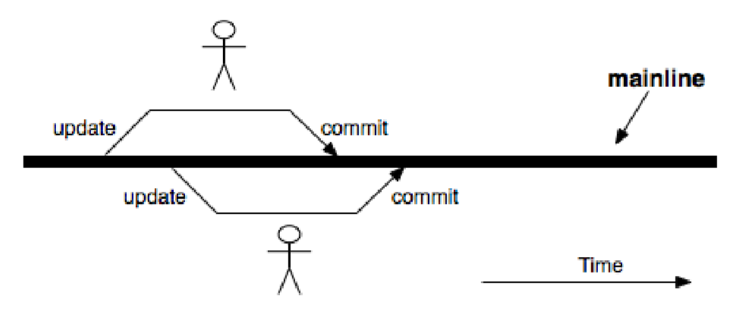
Version Control: Trunk/Mainline
Normally, developers work on the same shared code base for a project
Called the mainline (or trunk)

Slide 13
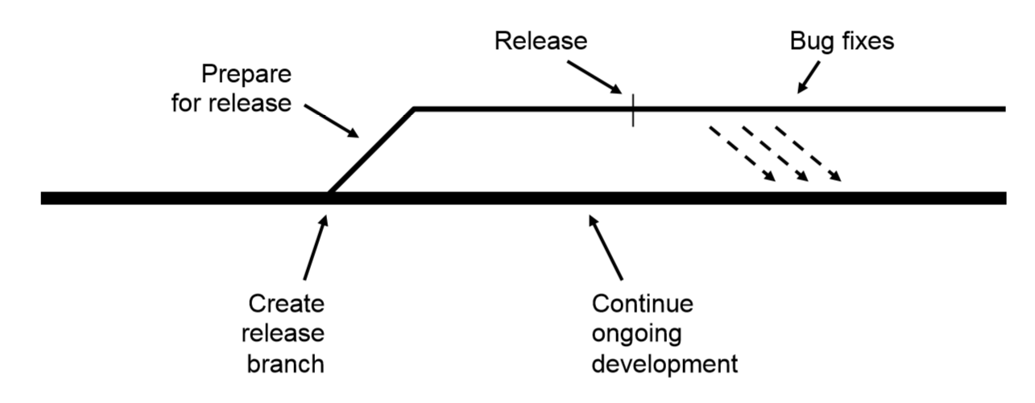
Version Control: Branching
A branch is a separate, independent line of development
Is like a separate repository for the same project
Allows parallel development on the same code base
Useful for creating a release branch

Slide 14
Basic Concepts: Merging
Merging allows you to apply changes made in a release branch back into the mainline
E.g. Bug ﬁxes, Refactorings!!!

Slide 15
Basic Concepts : Conflicts
Two or more developers editing the same ﬁle can lead to conﬂicts
Strict locking allows only one person at a time to have write access to the ﬁle (gen 1)
SVN (normally) uses optimistic locking
If you try to commit a shared ﬁle, you are forced to update the ﬁle ﬁrst
SVN merges changes from other developers into the working copy
If no conﬂicts, you simply commit the ﬁle
Else, you must manually resolve the conﬂicts
GIT
Will attempt to do merge itself, even within files
Will have ‘conflict’ if file is gone, or same line is edited
Will produce file with both lines and you’ll have to pick (or to make more changes)

Slide 16
Onward to … svn.
Jonathan Hudson
jwhudson@ucalgary.ca
https://pages.cpsc.ucalgary.ca/~hudsonj/

