Slide 1
Refactoring: Introduction
CPSC 501: Advanced Programming Techniques
Fall 2020
Jonathan Hudson, Ph.D
Instructor
Department of Computer Science
University of Calgary
Monday, August 24, 2020

Slide 2
Once upon a time …

Slide 3
Once upon a time …
A consultant visited a development project.
There was a class hierarchy at the centre of the system.
The consultant saw that it was rather messy.
The higher-level classes made certain assumptions
Super class code didn't suit all the subclasses.
If superclasses were modified, then less overriding would be necessary.
In other places the intention of the superclass had been misunderstood.
In yet other places several subclasses did the same thing.

Slide 4
I have some ideas!

Slide 5
I have some ideas!
This code can be looked at and cleaned up!
BUT the project management didn't seem enthusiastic.
The code seemed to work and there were considerable schedule pressures.
The managers said they would get around to it at some later point.
The programmers initially agreed.

Slide 6
I have some ideas!
The programmers initially agreed.
A second set of eyes revealed unconsidered issues.
It wasn’t really their fault.
They spent some time to clean it up.
They removed half the code but the functionality remained.
It was now quicker and easier to make future changes.

Slide 7
What are you thinking?

Slide 8
What are you thinking?
The project management was displeased.
Schedules were tight and there was a lot of work to do.
These two programmers had spent two days doing work that had done nothing to add the many features the system had to deliver in a few months time.
The old code had worked just ‘fine’.

Slide 9
What are you thinking?
The old code had worked just ‘fine’.
So the design was a bit more ‘pure’ a bit more ‘clean’.
The project had to ship code that worked, not please an academic.
The consultant suggested that this cleaning up be done elsewhere.
Such an activity might halt the project for a week or two.
All this activity was devoted to making the code ‘look’ better, not to making it do anything new.

Slide 10
Thoughts?

Slide 11
Thoughts?
How do you feel about this story?
Do you think the consultant was right to suggest further clean up?
Or do you follow that old engineering adage, "if it works, don't fix it"?

Slide 12
Thoughts?
How do you feel about this story?
Do you think the consultant was right to suggest further clean up?
Or do you follow that old engineering adage, "if it works, don't fix it"?
Maybe the issue here wasn’t the concept but the timing?

Slide 13
Refactoring
What is it?

Slide 14
Refactoring: Basic Concepts
Even a well designed software system ‘decays’ as it is modiﬁed over time
Loses its design integrity as new features and ﬁxes are added in an ad hoc way
i.e. as changes are ‘hacked’ in
Refactoring reverses this decay
A bad/chaotic design can be improved with series of small simple changes
Refactoring should be done during software maintenance:
When ﬁxing bugs
When adding new feature
Waiting until we reach the point in the story is actually bad practice.

Slide 15
Refactoring: Basic Concepts
Definition: disciplined process of changing the internal structure of software to make it easier to understand and maintain, without changing its external observable behavior

Slide 16
Refactoring: Basic Concepts
Definition: disciplined process of changing the internal structure of software to make it easier to understand and maintain, without changing its external observable behavior
Disciplined process: simple steps, defined start and end points, unambiguous
Internal structure: we change the internal code but don’t impact the connection layer to outer components or human user.
If you are changing the connection to externalities this is more than ‘refactoring’ it is a design change.
Understand and maintain: goal is code clarity for other readers of code, and ease of future changes
External observable behaviour: refactoring’s result should not require anything external to code to be affected.

Slide 17
Refactoring: Basic Concepts
Definition: disciplined process of changing the internal structure of software to make it easier to understand and maintain, without changing its external observable behavior
Goal is to improve the design of the code after it is written and already functional.
Done in an orderly way to avoid introducing bugs .
Changes are made in small steps (branch and merge).
Every step is tested (usually with unit tests).
Version control allows us to undo a step.

Slide 18
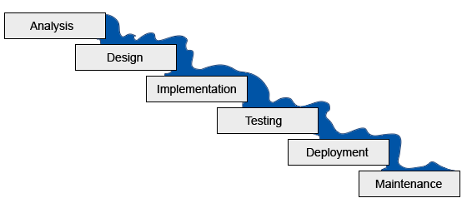
Refactoring: Non-iterative code lifecycles?
Refactoring doesn’t function well with non-iterative development techniques.
In the traditional “waterfall” lifecycle, design precedes coding, and is never revisited:
This Photo by Unknown Author is licensed under CC BY-SA

Slide 19
Refactoring: Iterative code lifecycles?
With iterative development, design occurs continuously:
Analysis
Design
Coding
Testing

Slide 20
Refactoring: Iterative code lifecycles?
Refactoring is a form of redesign that can be superimposed on the iterative lifecycle:
Analysis
Design
Coding
Testing
Refactoring

Slide 21
Jumping in
The simplest of examples … you’ve refactored before!

Slide 22
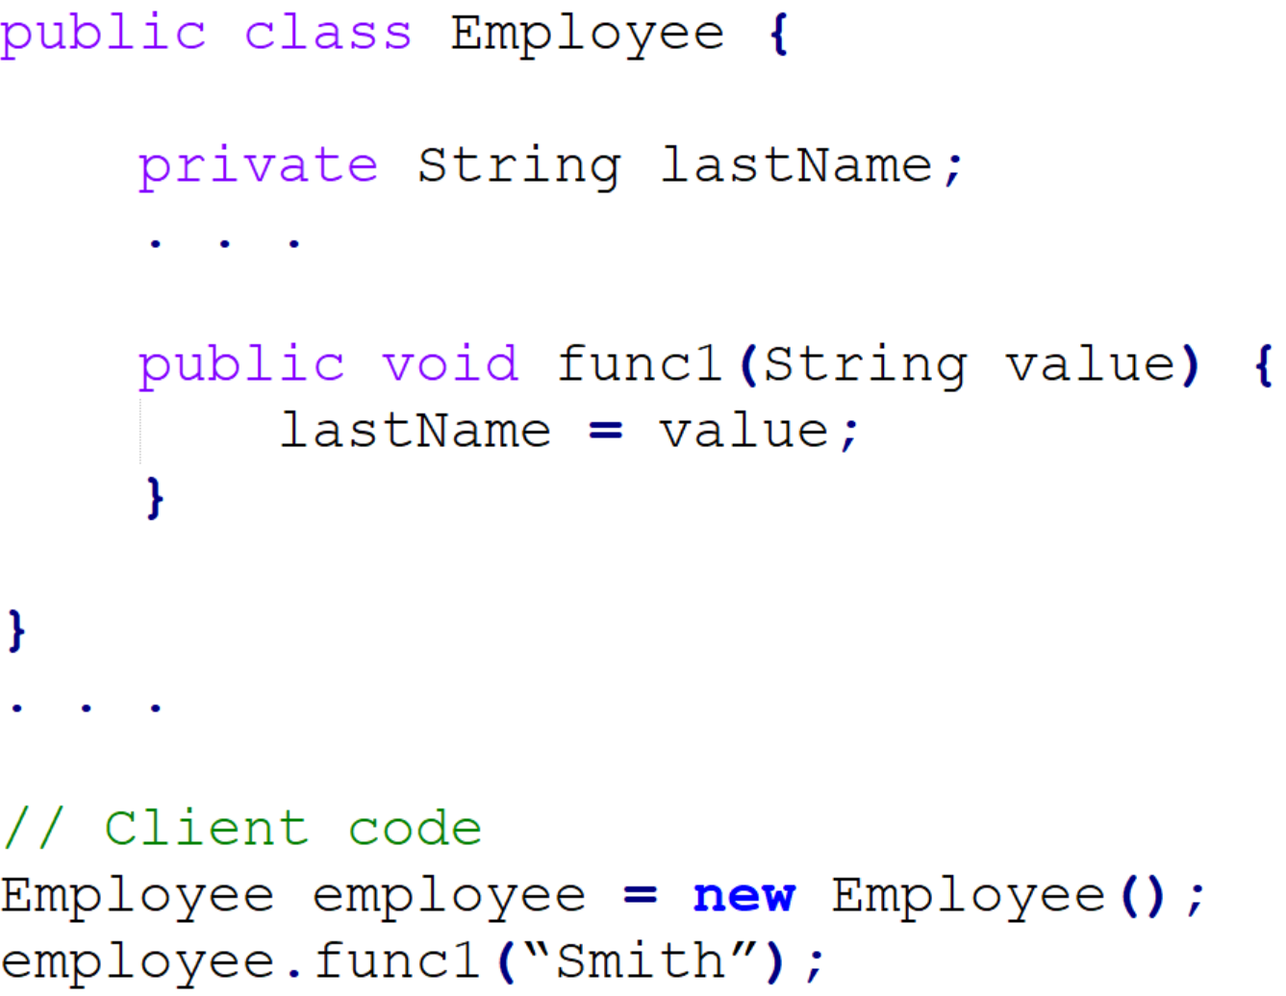
Refactoring: The simplest of examples
How could this code be improved?

Slide 23
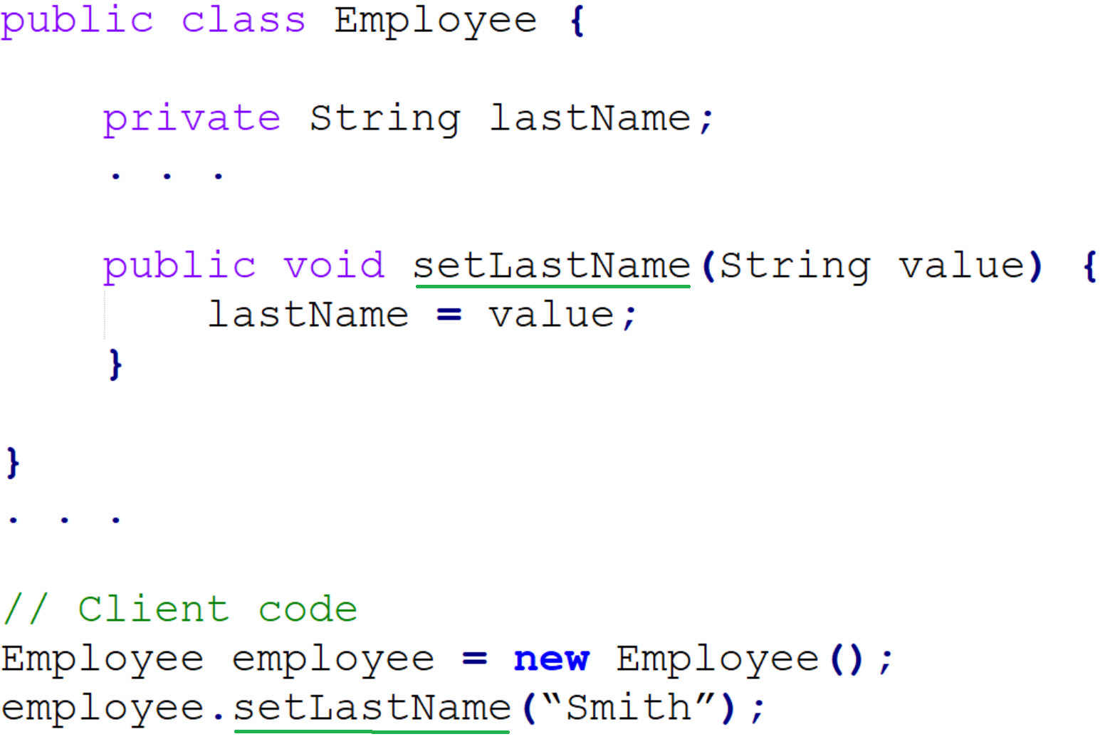
Refactoring: The simplest of examples
Rename the method to better describe what it does:

Slide 24
Refactoring: The simplest of examples
Rename the method to better describe what it does:
This is the Rename Method (Change Function Declaration) refactoring (Fowler)
“The name of the method does not reveal its purpose”
Rename the violating method appropriately
Most IDEs have a shortcut to do this through-out codebase at once
Danger in choosing a name already in use!
Compiled and tested after change
Version control process: make branch, make change, make merge request, pass unit testing pipeline, merge request approved into main branch

Slide 25
Jumping in
Structural example … ok maybe a bit more

Slide 26
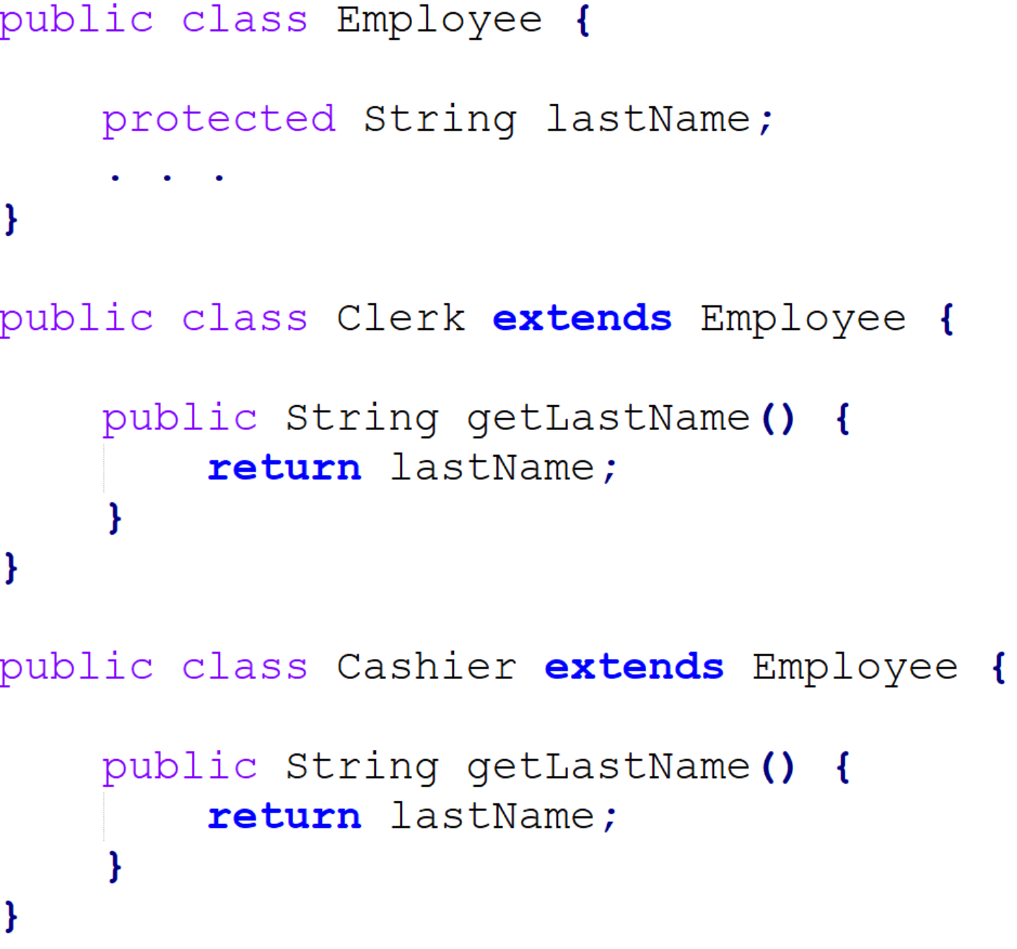
Refactoring: A structural example
How could this code be improved?

Slide 27
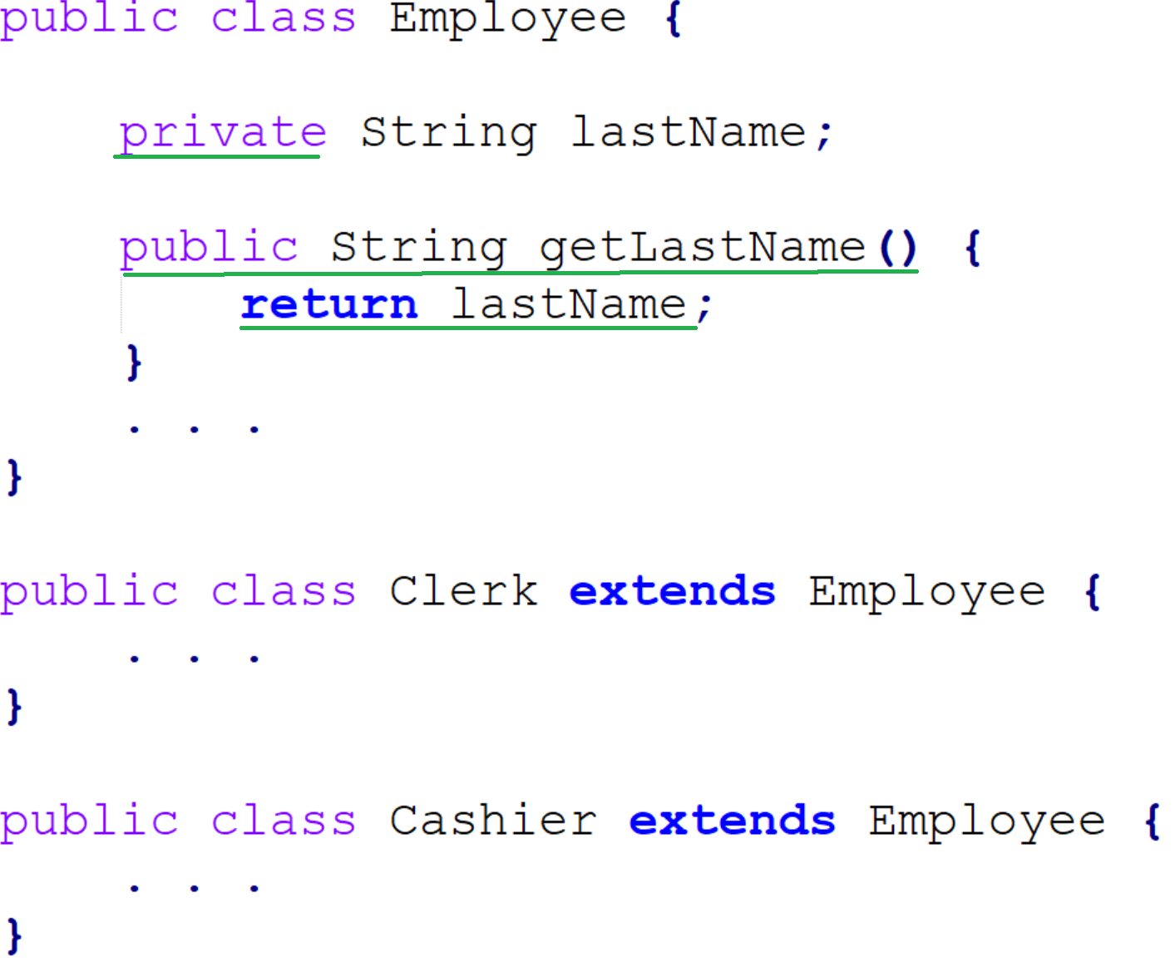
Refactoring: A structural example
Move functionality from subclass to superclass.

Slide 28
Refactoring: A structural example
Move functionality from subclass to superclass.
This is the Pull Up Method refactoring
“You have methods with identical results on subclasses”
Move them to superclass
Eliminates redundant code that is hard to maintain
Again test post change and generally done within version control iterative life cycle.

Slide 29
Well that’s easy?

Slide 30
This Photo by Unknown Author is licensed under CC BY-SA

Slide 31
Refactoring: Risks
Refactoring is risky
“The butterfly effect”
Changes can create subtle bugs and changes often cascade
Done improperly it can be like digging a hole you can’t escape from
Refactor ‘Systematically’
Old style: make a backup, make a change, unit test, iterate
Version control: make a branch instead of backup, after pass tests then merge
This Photo by Unknown Author is licensed under CC BY-NC-ND

Slide 32
Onward to … version control.
Jonathan Hudson
jwhudson@ucalgary.ca
https://pages.cpsc.ucalgary.ca/~hudsonj/

