Slide 1
Course Organization
CPSC 501: Advanced Programming Techniques
Fall 2020
Jonathan Hudson, Ph.D
Instructor
Department of Computer Science
University of Calgary
Tuesday, September 8, 2020

Slide 2
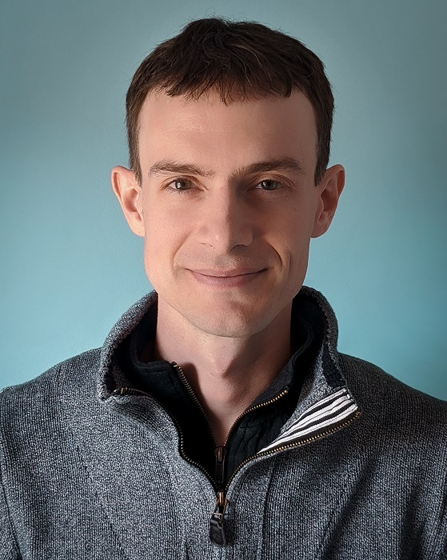
Welcome!
Jonathan Hudson, Ph.D
Lectures: Asynchronous (Zoom -> Content->Video, pre-recorded and available via Yuja)
Office: ICT 712 (I will not be in it!)
Office hours: 11:00-12:50 PM Mondays and Wednesdays (Zoom, link in D2L) or by email-scheduled appointments. (in between L01/L02, using waiting room, not recorded)
jwhudson@ucalgary.ca
https://pages.cpsc.ucalgary.ca/~hudsonj/CPSC501F20/

Slide 3
Tutorials
Start next week Monday.
Also through D2L, will be recorded, however point is active interaction with TA for material and assignment help.
Use link to your tutorial only.
Your enrollment tutorial TA will mark your assignment material and they are only responsible for the students enrolled in their tutorial.

Slide 4
Why CPSC 501?
This course is full of things other courses likely never got to BUT are often encountered during more advanced programming and very useful to know.

Slide 5
Course Goal
From the calendar:
“Theory and application of advanced programming methods and tools. Recent issues as well as those of an enduring nature will be discussed.
Topics may include the Fourier transform; wavelets; functional programming; genetic algorithms, simulated annealing and neural networks; parallel and distributed programming; images and graphics user interface programming.”

Slide 6
Course Outcomes
From the outline:
Code refactoring, including how refactoring improves the design of software systems.
Refactor object-oriented code using a disciplined process that uses version control and unit testing.
Concepts of reflection as embodied in modern programming languages.
Object introspection using the reflective capabilities of the Java programming language.
Reflection serialization and deserialization using the reflection API of the Java programming language.
Techniques used to optimize software performance, including how to measure performance gains.
Optimize a computationally expensive digital signal processing program and create a report that describes the process they went through to accomplish this.

Slide 7
Lectures
We will be using Java/Python in this course
We will cover:
Refactoring
Reflection
Serialization
Optimization
Selected topics (AI methods, Digital Signal Processing)

Slide 8
Out of lecture?
There is no attendance at tutorials but they are highly recommended
Start Monday/Tuesday next week
TAs will use classes to cover coding material in hands-on environment
Material will be covered and there will also be assignment work/help
There is an D2L managed midterm scheduled
Friday, November 6th, 2020 (24 hour period)

Slide 9
Grading
Each of the above components will be given a letter grade using the official University grading system. The final grade will be calculated using the grade point equivalents weighted by the percentages given above and then converted to a final letter grade using the official University grade point equivalents. (A+ are 4.3 for in-class component weighting)
Component | Weighting %
Assignments (4) | 50%
Midterm | 25%
Final | 25%

Slide 10
Example
A1: A+
A2: B
A3: C
A4: D
Midterm: B+
Final: A-

Slide 11
Example
A1: 4.3
A2: 3
A3: 2
A4: 1
Midterm: 3.3
Final: 3.7

Slide 12
Example
A1: 0.5375
A2: 0.375
A3: 0.25
A4: 0.125
Midterm: 0.825
Final: 0.925

Slide 13
Example
A1: 0.5375
A2: 0.375
A3: 0.25
A4: 0.125
Midterm: 0.825
Final: 0.925
Sum: 3.0375 (which is a B)

Slide 14
Assignments
Four individual assignments (50%)
Refactoring, Reflection, Serialization, and TensorFlow Machine Learning
Assignment deadlines will be 11:59 pm on Friday due dates.

Slide 15
Exams (each 25%)
Midterm
D2L – asynchronous (24-hour period)
Written (long answer)
Refactoring/reflection
Final
Registrar scheduled via D2L (synchronous)
Written (long answer)
Cumulative
Light on selected topics
Focus on optimization and then midterm topics second

Slide 16
Course Policies
When you email include your first name, and last name.
Please use “CPSC501F20” as the prefix in the subject line
Make-up examinations and deferred examinations will not be provided except in cases of extreme personal emergencies.
There are no late submissions. Submit early and double check after submitting. You can submit multiple times on D2L with no issue, so excuses will not be accepted.

Slide 17
Academic Dishonesty
“A single offence of cheating, plagiarism, or other academic misconduct, on term work, tests, or final examinations, etc., may lead to disciplinary probation or a student's suspension or expulsion from the faculty by the Dean, if it is determined that the offence warrants such action. ”
We have tools that let me quickly see if assignments appear to be highly similar and techniques like changing names, comments, and other details will not trick them.
Please refer to the University Calendar for more details.
This course is fundamental and is essential for CS studies.

Slide 18
Academic Dishonesty
All the work you submit must be your own.
When you take algorithms or segments of code from somewhere else you must cite where you obtained them from.
You need to understand all of the code in your work because the midterm and final are evaluating your understanding, not if you were able to make it work

Slide 19
Be Computer Science ‘Lazy’
Search internet for answers.
If you find something, read and understand it.
Then develop your own solution using what you’ve learned.
Do not copy and paste the answer! It is considered plagiarism!
Being computer science lazy is an important skill and we will return to it.

Slide 20
Getting Help
Do your part: Attend the lectures and tutorials
Act early!
First try it yourself→
Study the material carefully
Break the problem down
Try to narrow down the question
Search on google for your answer
Still unclear?
Ask your TA
Come to my office ☺

Slide 21
Crisis line!
If you think:
You suck at programming!
You suck at python!
You are not sure about this course!
You are OK with only a passing mark!!!
You tried but you didn’t understand!
Come to my office → I’ll prove to you that you are wrong!
Come early before things piled up!

Slide 22
Textbooks
Recommended Textbook(s):
Martin Fowler, Refactoring: Addison-Wesley.
Forman and Forman, Java Reflection in Action: Manning Publications.

Slide 23
Access to CPSC
The Java 8/Python 3 are your primary work environment for this course.
Assignments & exercises are acceptable if they run on Java 8 (1.8) and Python 3.6.8+
You can access the CPSC lab remotely. (no need to do this)
SSH (Secure Shell) allows you to establish a remote connection with the CPSC lab.
https://ucalgary.service-now.com/it?id=kb_article&sys_id=29aedd1bdb3e63c0d1b63ccb7c961963
Please do not use any non-Linux-based CPSC server for this course.

Slide 24
Onward to … Refactoring.
Jonathan Hudson
jwhudson@ucalgary.ca
https://pages.cpsc.ucalgary.ca/~hudsonj/

