Slide 1
Brief History of Computer Science
CPSC 231: Introduction to Computer Science for Computer Science Majors I
Spring 2021
Jonathan Hudson, Ph.D.
Instructor
Department of Computer Science
University of Calgary
Friday, 30 April 2021
Copyright © 2021

Slide 2
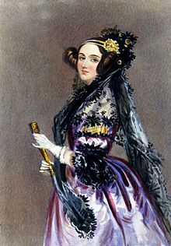
Ada Lovelace
Mathematician and writer
Daughter of Lord Byron (*interesting fellow*)
Worked with Charles Babbage
Maybe the first programmer
(At least first evidence of)
Early philosophy of computer science (The effects of technology on people)

Slide 3
Difference Engine (Charles Babbage)
A difference engine is an automatic mechanical calculator designed to tabulate polynomial functions. (~1822)
A mathematician, philosopher, inventor and mechanical engineer, Babbage originated the concept of a digital programmable computer.
“father of the computer“
In 1991, a functioning difference engine was constructed from Babbage's original plans.

Slide 4
Claude Shannon
Electrical application of Boolean algebra could be used for digital calculation (Master’s thesis)
Field of information theory (1948) all information can be in bits, in this paper.
Together theses things are consider the fundamentals of modern computers
Sending digital information (instead of analog which was everyone else was doing)
Data compression

Slide 5
Bombe (WWII Bletchley Park)
A machine to reverse engineer rotator selection for enemy messages

Slide 6
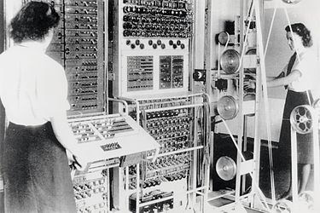
Collosus (WWII Bletchley Park)
Find patterns in cipher text

Slide 7
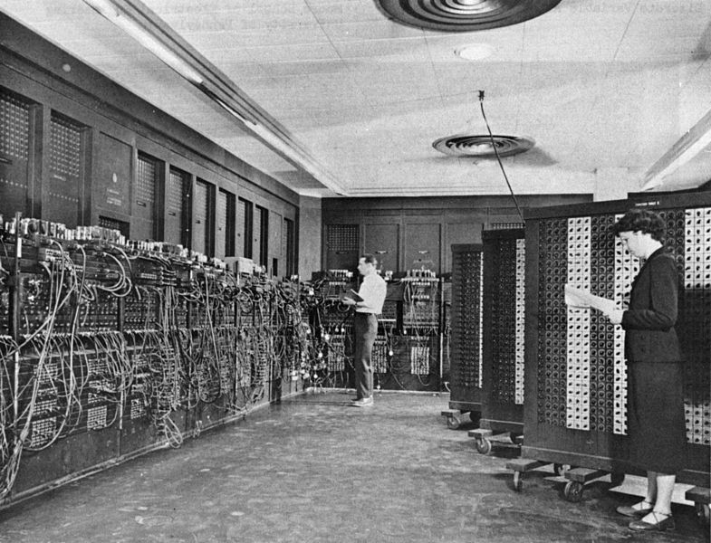
ENIAC
Artillery firing tables (1946)
20 hours down to 30 seconds
$7 million
Calculations needed for thermonuclear weapons
20,000 vacuum tube
1500 relays
70,000 resistors
10,000 capacitors
7200 crystal diodes

Slide 8
Alan Turing
Father of Computer Science and Artificial Intelligence
Worked at Bletchley Park
Mathematician, logician, computer scientist, philosopher, cryptanalyst
Turing Machine

Slide 9
Halting Problem

Slide 10
Turing Test

Slide 11
P=NP or P =/= NP
The theory of NP-completeness has its roots in computability theory, which originated in the work of Turing, Church, Godel, and others in the 1930s
2002 poll, 61 mathematicians and computer scientists said that they thought P probably didn’t equal NP, to only nine who thought it did — and of those nine, several told the pollster that they took the position just to be contrary.
The equivalency of P and NP is one of the seven problems that the Clay Mathematics Institute will give you a million dollars for proving

Slide 12
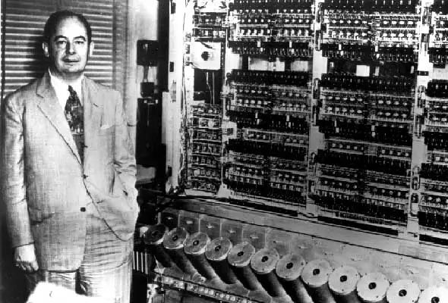
1944 Harvard Mark I
Electromechanical Computer
Von Neumann
We should store programs in memory with the data the program operates on
Before we always setup the program as an external encoding

Slide 13
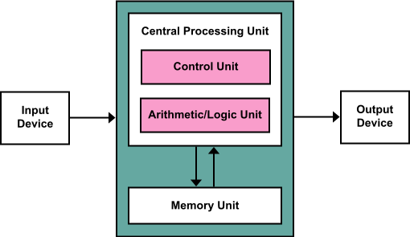
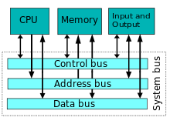
Von Neumann
Mathematician and Physicist
Modern CPUs are based off of Von Neumann Architectures (1945)

Slide 14
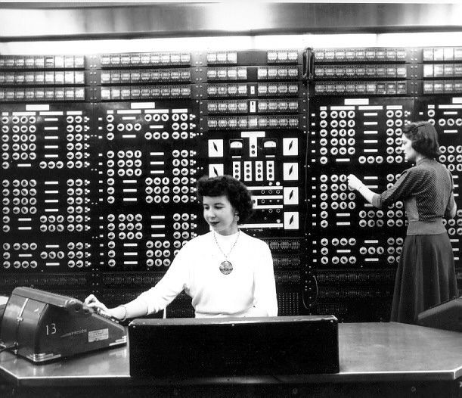
Grace Hopper
US Navy Rear Admiral
Programmer on Von Neumann’s Harvard Mark I
Compiler -> Write high level code which is changed into something the computer understands (1952)
COBOL (still around for mainframes)
Bug - often (but erroneously) credited to Grace Hopper. In 1946, she traced an error in the Harvard Mark II to a moth trapped in a relay.
Popularized term of debugging

Slide 15
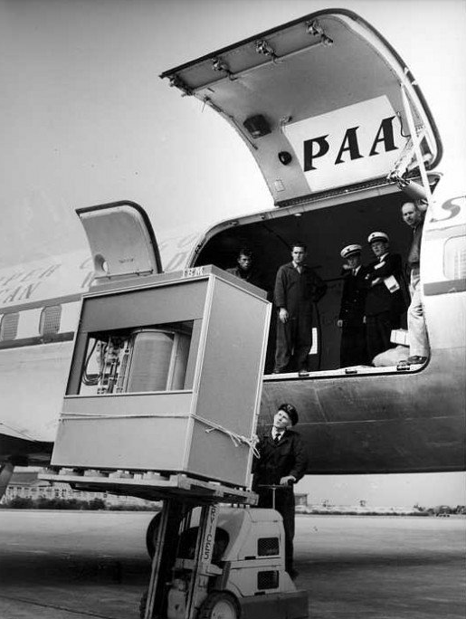
First Hard Drive (1953)
5 MB 5 * 1024 bytes
People take single pictures that take up more space than this
byte — coined by Werner Buchholz in June 1956 during the early design phase for the IBM Stretch computer.[11][12][13][14]

Slide 16
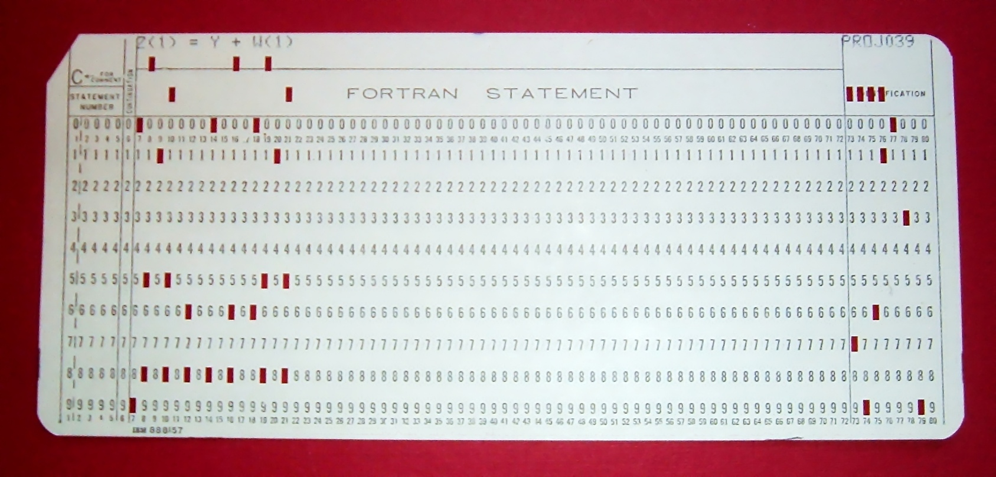
Punch Cards
Concept goes back before computers for tabulating data
Early form of interacting with computers without having to switch a whole bunch of switches into an initial state
Where the word ‘patch’ comes from (putting something over a misplaced hole)
Into mid-80s until hard drives became of reasonable cost
Learning to program you learned to punch out your program and then carry to machine to run

Slide 17
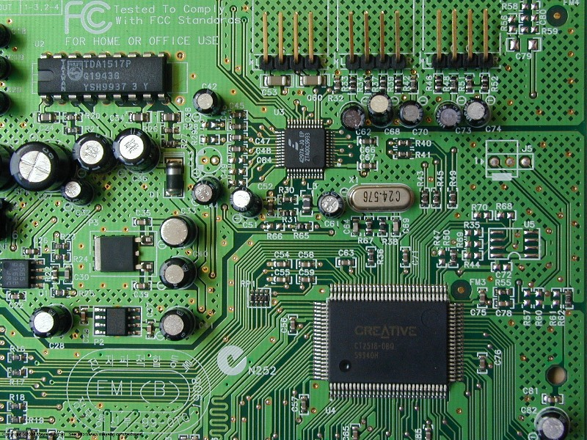
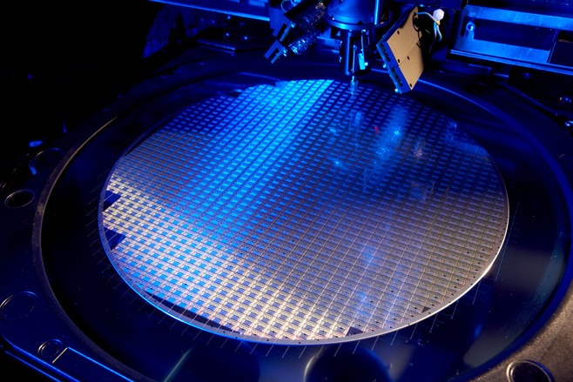
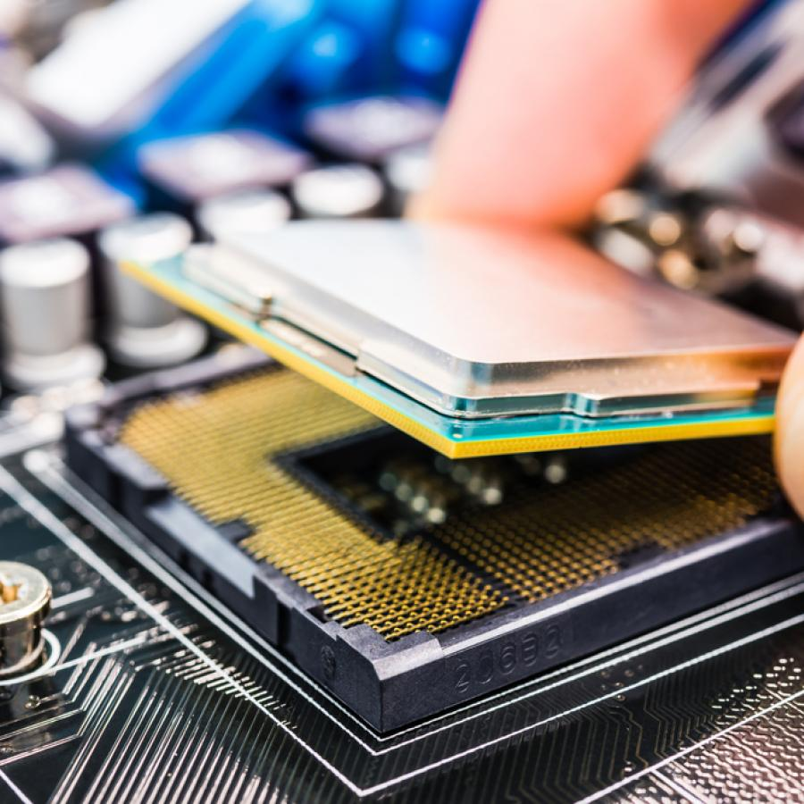
Modern Computers
Integrated Circuits (1959) patent by Robert Noyce. Co-inventor of integrated circuit.
William Shockley was the manager of a research group at Bell Labs that included John Bardeen and Walter Brattain. The three scientists were jointly awarded the 1956 Nobel Prize in Physics for "their researches on semiconductors and their discovery of the transistor effect.“
Considered founder of silicon valley, his company spawned Intel/AMD/National Semi conductors

Slide 18
Mother of all Demos
Douglas Engelbart
Human-computer interactions
Live demo with a computer mouse, video conferencing, teleconferencing, hypertext, word processing, real time editing (1968)

Slide 19
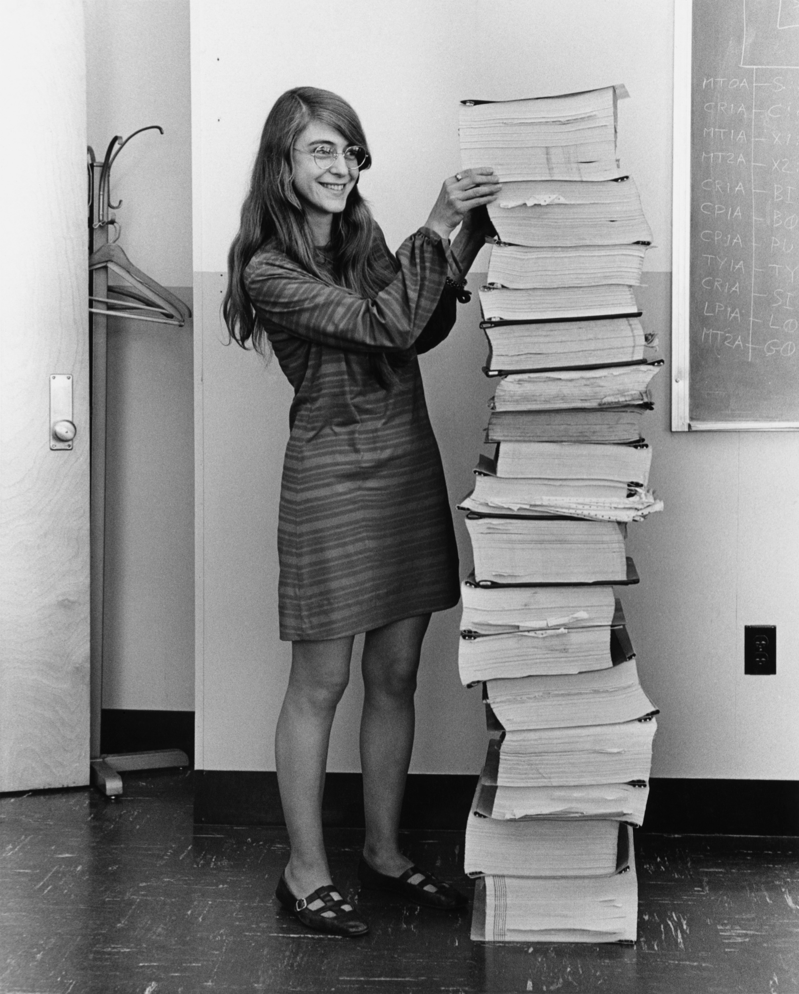
Margaret Hamilton
Director of MIT software engineering group that made on-board software for the Apollo Space Program (Seen here, 1969)
Coined term software engineer
Lots of software engineering developments, modelling, design, languages, robust systems

Slide 20
Fourier Transform
1822 Joseph Fourier
-some functions written as sum of infinite harmonics (sin and cos waves)
Guess what often falls into this, digital signals such as wireless/wired network signals.
Fast-Fourier Transform -> 1965 basic ideas popularized (top 10 algorithms of 20th century)
(Two others included Fortran compiler and quicksort)

Slide 21
RSA Algorithm
Ron Rivest, Adi Shamir, Leonard Adelman (1976) public discovery
1970 GCHQ (from Bletchley) discovered the idea but couldn’t publish (announced in 1997)
Popularized when implemented in ARPANET

Slide 22
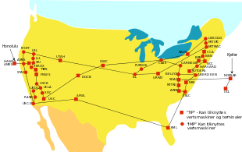
ARPANET
Advanced Research Projects Agency Network (ARPANET) was an early packet switching network and the first network to implement the protocol suite TCP/IP. (1969)
TCP/IP layers of protocols to handle different levels of communications. (Vint Cerf, father of internet)
Where internet came from.
Was not invented by one person. Many different people over many years.

Slide 23
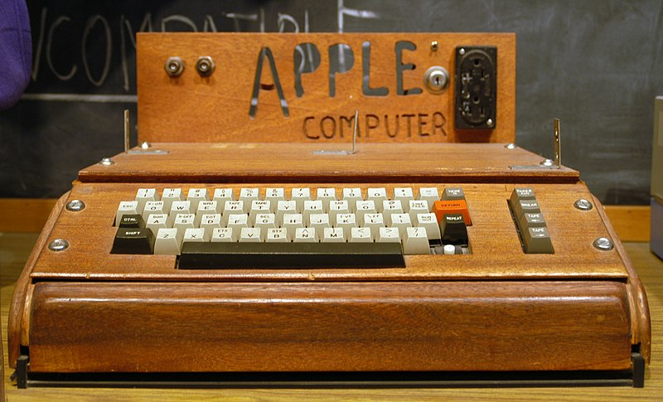
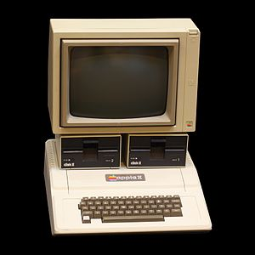
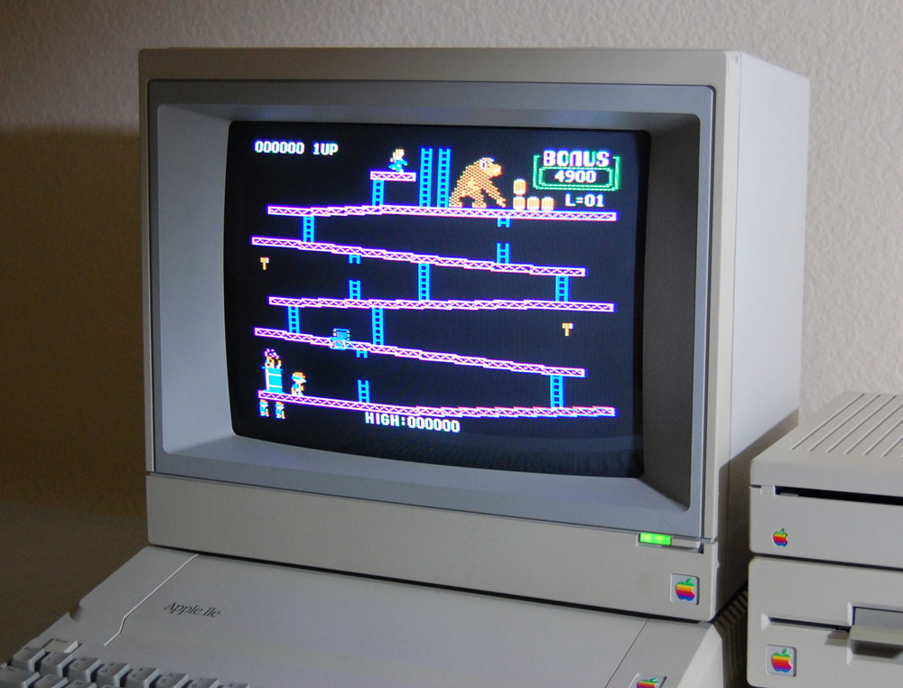
Steve Wozniak
Wozniak was the computer scientist
Steve Jobs was more of the businessman.
Pioneer of personal computer, many were doing it. HP where he worked passed on Apple I design.
Apple I (1976)
Apple II (1977)
Apple I like ALTAIR which worked in BASIC (first home micro computer) but Apple I was hobbyist machine
Apple II first colour PC

Slide 24
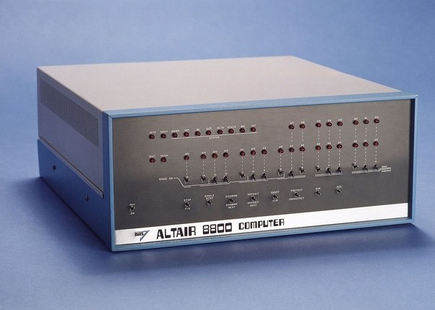
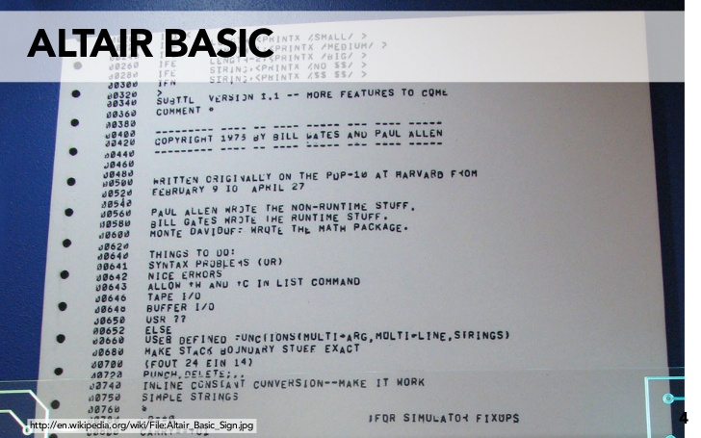
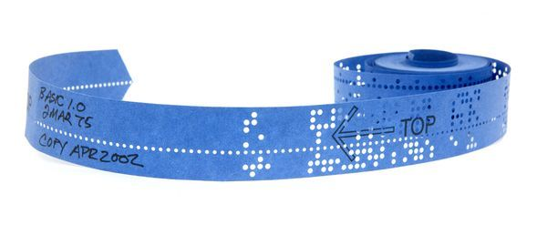
Bill Gates
Businessman
Bill Gates and Paul Allen founded Microsoft in 1975
ALTAIR was first big popular microcomputer made by MITS
They made Altair BASIC
BASIC (1964) – high level programming language, that let your write programs, popular on microcomputers, many many different versions, let homebrewers write their own code easier
Then Microsoft worked with IBM on a version of DOS (an OS program that could launch other programs within it)
Key to Windows after was understanding people wanted to be sold a solution that worked across platforms (standardization)

Slide 25
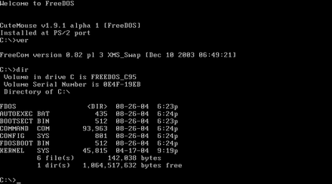
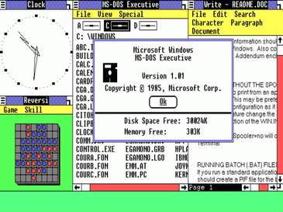
Bill Gates
Businessman
Bill Gates and Paul Allen founded Microsoft in 1975
ALTAIR was first big popular microcomputer made by MITS
They made Altair BASIC
BASIC (1964) – high level programming language, that let your write programs, popular on microcomputers, many many different versions, let homebrewers write their own code easier
Then Microsoft worked with IBM on a version of DOS (an OS program that could launch other programs within it) [MS-DOS 1981]
Windows 1.0 (1985)
Key to Windows after was understanding people wanted to be sold a solution that worked across platforms (standardization)

Slide 26
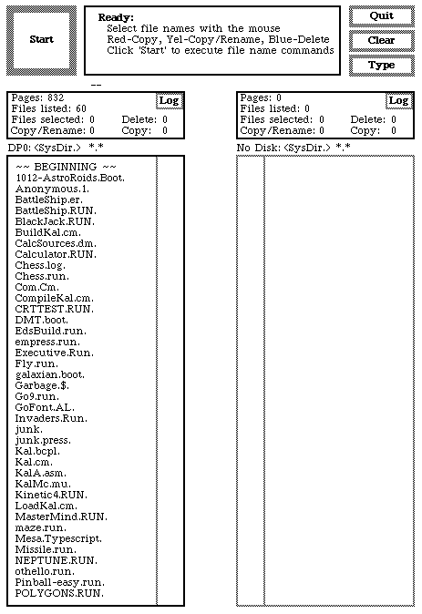
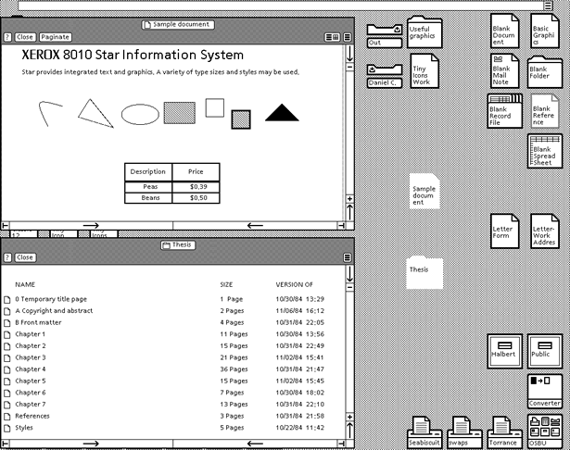
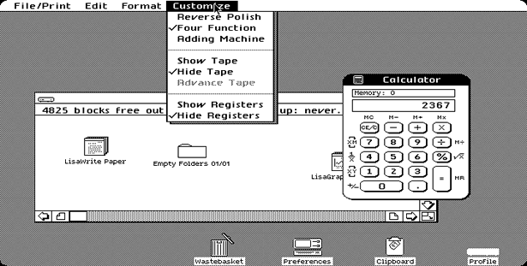
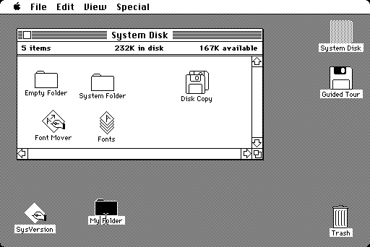
Brief History of OS
The first personal computer which used a modern graphical user interface was the Xerox Alto, developed in 1973.
XEROX 8010 Star (1981)
Apple Lisa (1983)
Mac OS 1.0 (1984)

Slide 27
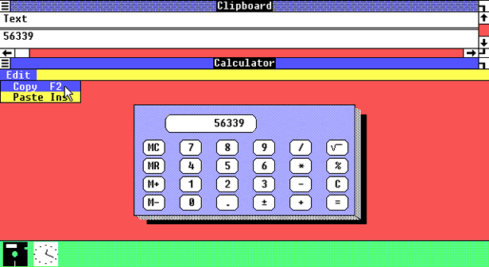
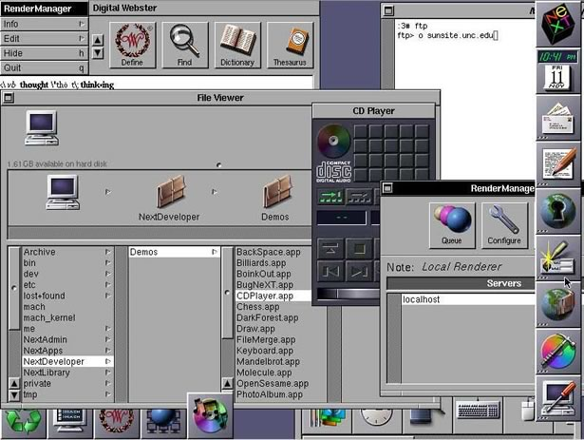
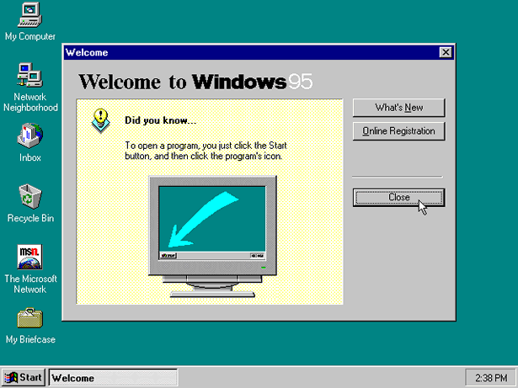
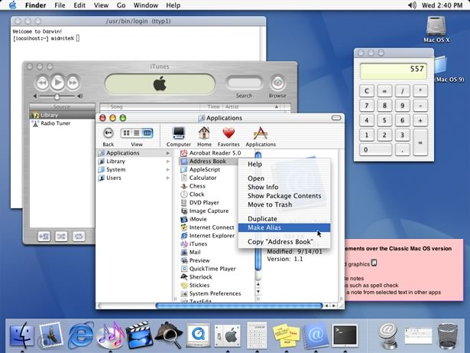
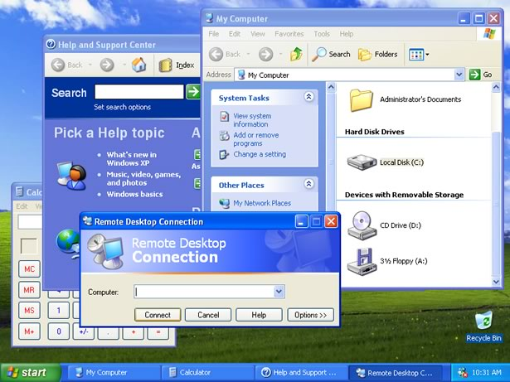
Brief History of OS
Windows 1.0 (1985)
NeXTStep 1.0 (1989)
Windows 95 (1995)
Mac OS X (2001) -> High unix, Jobs returns with NeXT ideas
Windows XP (2001)

Slide 28
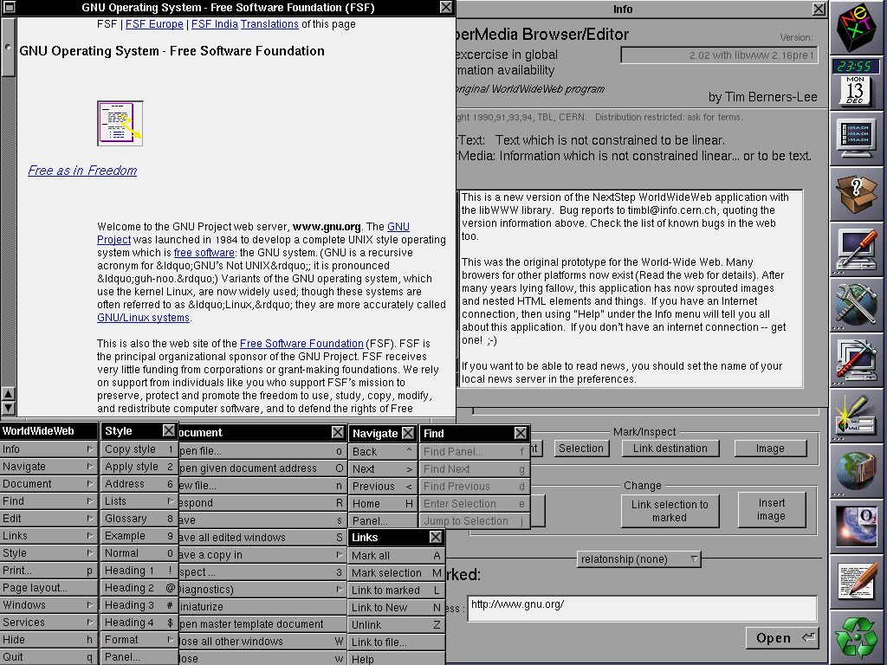
First Browser
Tim Berners-Lee (1990)

Slide 29
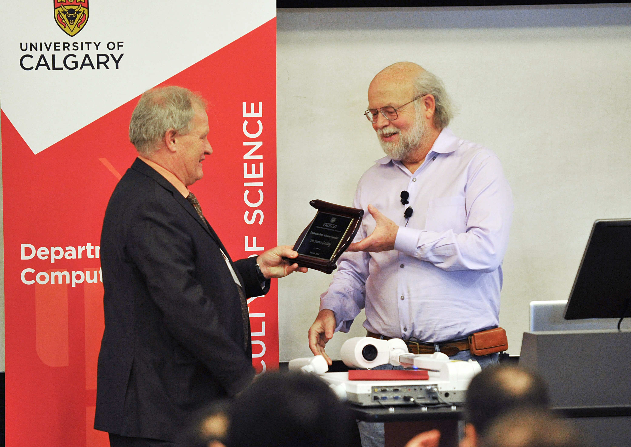
James Gosling
Snuck into CPSC labs at UofC while in high school at William Aberhart (1973)
Bachelor of Science UofC
MA, PhD Carnegie Mellon
Created Java (1995) while with Sun Mcirosystems
Key idea is the Java VM (virtual machine) write code once and run it anywhere (don’t compile to machine code, compile to a midform byte code and make specific vm for each specific hardware)

Slide 30
Steve Jobs
Originally involved with Wozniak with Apple I
With Apple until 1985
1986 helped fund the LucasFilm spinoff Pixar
With NeXT until 1997, people like graphics
User friendly became selling point
Two main targets, creatives and non business
Popularization of iPod, found success with minimalization (less of a computer)
Popularization of modern smartphone, tablet
All concepts existed in computer science, just addition of single minded HCI focus

Slide 31
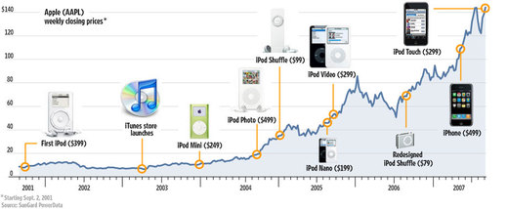
Steve Jobs

Slide 32
Shor’s Algorithm

Slide 33
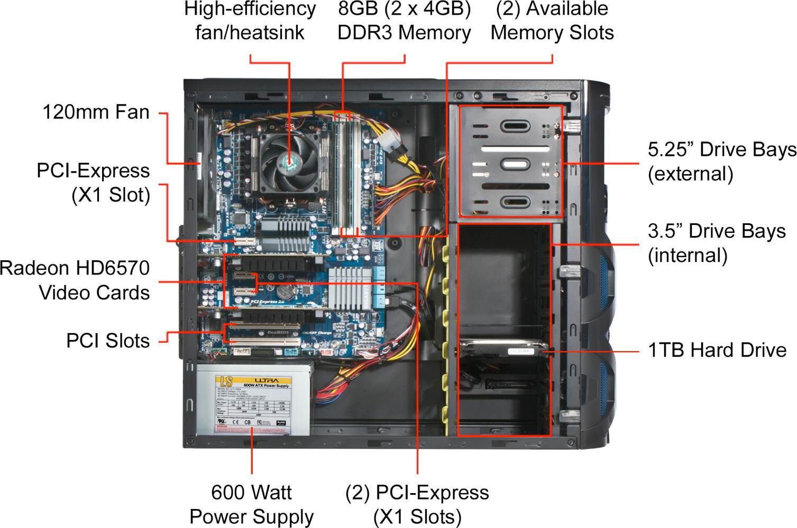
Modern Computers

Slide 34
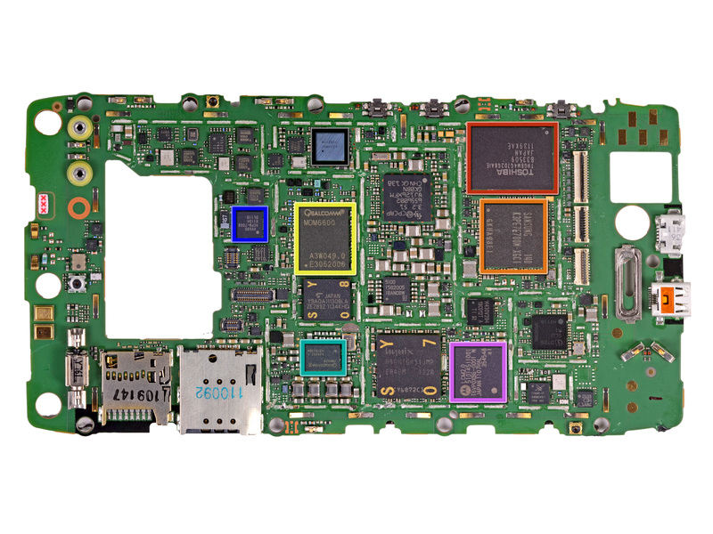
Modern Computers

Slide 35
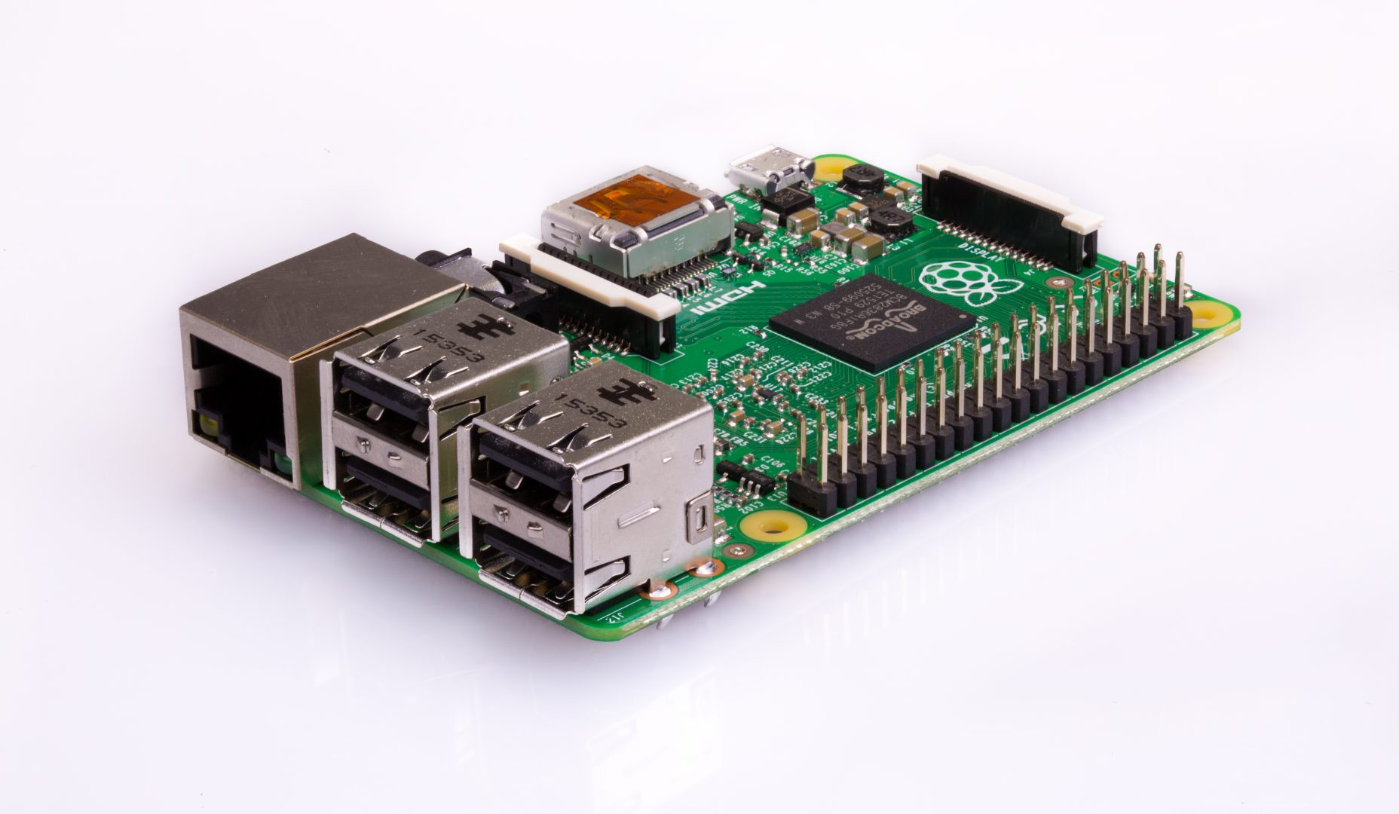
Modern Computers

Slide 36
Onward to … CPSC 233.
Jonathan Hudson
jwhudson@ucalgary.ca
https://pages.cpsc.ucalgary.ca/~hudsonj/

