Slide 1
Structures: Strings
CPSC 217: Introduction to Computer Science for Multidisciplinary Studies I
Fall 2020
Jonathan Hudson, Ph.D
Instructor
Department of Computer Science
University of Calgary
Tuesday, September 8, 2020

Slide 2
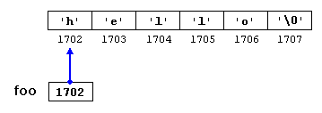
Strings
Strings are a class (type) of objects that is represented as a sequence of characters in member
Ex. foo = “hello”

Slide 3
String creation

Slide 4
Strings
Strings are immutable. Meaning, their values cannot change after it has been created.
Ex.
greeting = "Hello, world!"
greeting[0] = 'J' # ERROR!
print(greeting)
Do this instead
greeting = "Hello, world!"
newGreeting = 'J' + greeting[1:]
print(newGreeting)
print(greeting)
Jello, world!
Hello, world!

Slide 5
Creating String Variables
Form: var = “”
The string object must be enclosed with either a single quote (') or double quote (").
Single quote and double quote are interchangeable: “Hello World!” == ‘Hello World!’
If your string object contains single quotes, then enclose it with double quotes, or vice versa:
myStr1 = “Jonathan’s lecture ROCKS!”
myStr2 = ‘The students agreed: “Yes, it does!”’

Slide 6
Creating String Variables
Use triple single quote (''') or double quote (""") to create a string that spans multiple lines.
myStr3 = '''hello
my name is Jonathan'''

Slide 7
Accessing characters

Slide 8
Accessing Single String Characters
Using indexing operator you can access a single character from a string.
Python uses square brackets to enclose the index
Course = "CPSC 231"
m = Course[2]
print(m)
lastchar = Course[-1]
print(lastchar)
Index
S
1

Slide 9
Escaping

Slide 10
Escaping Characters
\\ → Backslash (keeps \)
\’ → Single quote (keeps ’)
\” → Double quote (keeps ”)
\n → Newline, end of line
\t → Horizontal tab
…
When Python sees the backslash (\), it treats the following character as a part of string

Slide 11
Escaping Characters
Sometimes, you need to include special characters in your string, such as backslash (\), single quote, double quote, newline (\n), tab (\t), etc.
Ex. I want to print the string She said, "It’s a beautiful morning!" and a newline afterwards.
>>>print("She said, "It’s a beautiful morning! "\n")
SyntaxError: invalid character in identifier
backslash \ is used to indicate that the character is part of the string and to indicate the special character newline (\n)
>>>print("She said, \"It’s a beautiful morning!\"\n")
She said, "It’s a beautiful morning!"

Slide 12
Concatenation

Slide 13
String Concatenation
Combine two or more strings together
Example appending the last name “Smith” to the first name “John”
print('John', 'Smith')
print('John'+'Smith')
What is the difference between these calls?
>>> print ('John', 'Smith')
John Smith
>>> print ('John'+'Smith')
JohnSmith

Slide 14
Formatting

Slide 15
String Formatting – Old-old-school way
This original way of formatting strings:
>>>name = input(“What is your name hooman?”)
Jonathan
>>>print(”Hello %s!” % (name))
‘Hello Jonathan!’
%s a place holder of string type
% marks the start of
the format specifier

Slide 16
String Formatting – Float Formatting
You can format floats to have specific width (padding) and precision.
width is 10
precision is 3
someValue = 12.12345
print("someValue = %10.3f“ % (someValue))
outputs
Precision = 3
someValue = 12.123
width = 10

Slide 17
* Works for Strings

Slide 18
String Operations - Illegal
message - 1
"Hello" / 123
"15" + 2
Illegal

Slide 19
String Operations - Concatenation
message - 1
"Hello" / 123
"15" + 2
fruit = "banana"
bakedGood = " nut bread"
print(fruit + bakedGood)
Illegal
concatenation

Slide 20
String Operations
message - 1
"Hello" / 123
"15" + 2
fruit = "banana"
bakedGood = " nut bread"
print(fruit + bakedGood)
Illegal
concatenation
print("Go" * 6)
name = “Dinos"
print(name * 3)
print(name + "Go" * 3)
print((name + "Go") * 3)
GoGoGoGoGoGo
DinosDinosDinos
DinosGoGoGo
DinosGoDinosGoDinosGo
Repetition

Slide 21
Methods

Slide 22
String Methods
NOTE: A method is a function that is associated with a specific object/class.
Other functions include:
capitalize, join, strip, count, center, replace, ljust, rjust, find, rfind, …
For more details, refer to: https://docs.python.org/3/library/stdtypes.html
ss = "Hello, World"
print(ss.upper())
print(ss.lower())
HELLO, WORLD
hello, world
Outputs

Slide 23
String Methods - count(), strip(), and replace() Examples
ss = " Hello, World "
els = ss.count("l")
print(els)
print("***" + ss.strip() + "***")
print("***" + ss.lstrip() + "***")
print("***" + ss.rstrip() + "***")
news = ss.replace("o", "***")
print(news)
3
***Hello, World***
***Hello, World ***
*** Hello, World***
Hell***, W***rld
Outputs

Slide 24
String Methods - format() Example
person = input('Your name: ')
greeting = 'Hello {}!'.format(person)
print(greeting)
Hello Jonathan!

Slide 25
Slicing

Slide 26
String Methods - The Slice Operator
A substring of a string is called a slice.
The slice operator [n:m] returns the part of the string from the n’th character to the m’th character.
Including the first but excluding the last.
singers = "Peter, Paul, and Mary"
print(singers[0:5])
print(singers[7:11])
print(singers[17:21])
Peter
Paul
Mary

Slide 27
String Methods - The Slice Operator
n and m are optional, their default values are 0 and len(str)-1, respectively
name = "CPSC 231"
print(name[:])
print(name[3:])
print(name[:6])
CPSC 231
C 231
CPSC 2
If n or m have values larger than the length of the string, no error is returned
name = "CPSC 231"
print(name[100:200])
print(name[:200])
print(name[100:])
'‘
‘CPSC 231‘
''

Slide 28
String Methods - The Slice Operator
name = "CPSC 231"
print(name[-1:])
print(name[:-1])
print(name[-8:-1])
1
CPSC 23
CPSC 23
n and m can be negative values

Slide 29
split()

Slide 30
String Methods - split()
The split() function takes a string argument (delimiter) returns a list of words of the original string split on this delimiter.
a = "this is a string"
a = a.split(" ")
print(a)
['this', 'is', 'a', 'string']

Slide 31
len()

Slide 32
The len() function
len(str) returns the number of characters in a given string.
fruit = "Banana"
print(len(fruit))
6
fruit = "Banana"
sz = len(fruit)
last = fruit[sz] # ERROR!
print(last)
Error! Starts from zero
fruit = "Banana"
sz = len(fruit)
last = fruit[sz-1]
print(last)
a

Slide 33
Examples

Slide 34
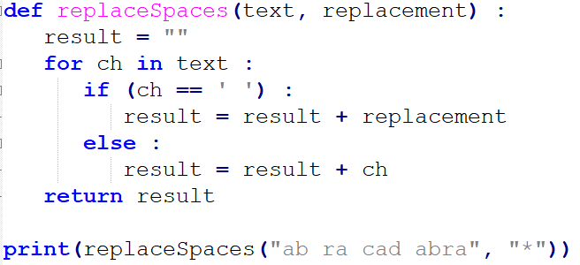
Example
ab*ra*cad*abra

Slide 35
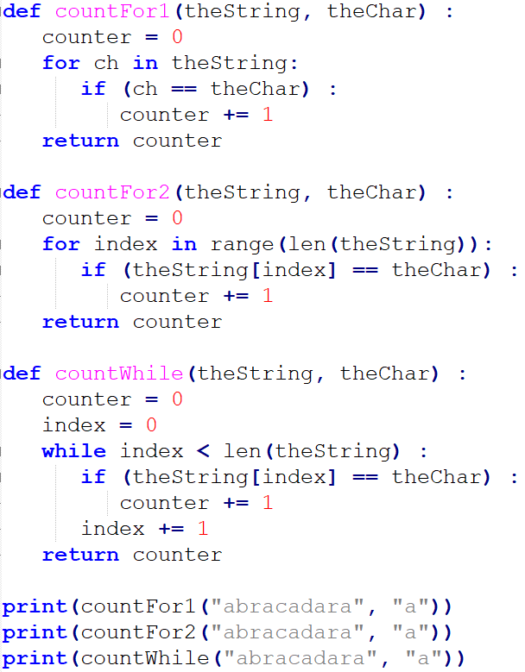
5
5
5

Slide 36
Onward to … files and exceptions.
Jonathan Hudson
jwhudson@ucalgary.ca
https://pages.cpsc.ucalgary.ca/~hudsonj/

