Slide 1
Structures: Dictionaries
CPSC 217: Introduction to Computer Science for Multidisciplinary Studies I
Fall 2020
Jonathan Hudson, Ph.D
Instructor
Department of Computer Science
University of Calgary
Tuesday, September 8, 2020

Slide 2
Dictionary
A mutable data structure that maps unique keys to values
Dictionaries support many of the same operations as lists
They can contain mutable types, such as lists.
They are unordered (insertion order is not preserved)
Keys are unique, values can be duplicates, using same key overwrites previous value

Slide 3
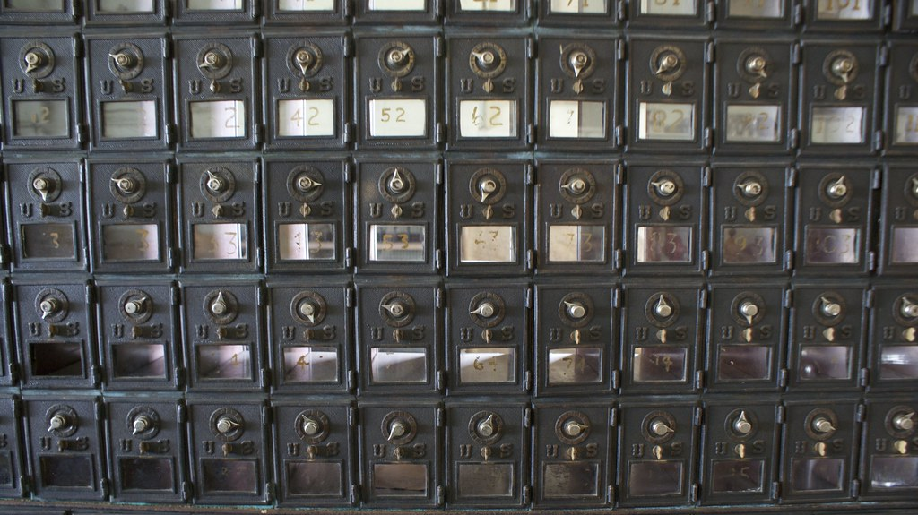
Dictionary
Think of a dictionary like a post office where your mailbox can hold one item
Your address is a unique location (key) where mail (value) can be put
In Python to store multiple letters we need to store a list in our mailbox (otherwise previous mail falls out)
This Photo by Unknown Author is licensed under CC BY

Slide 4
Creating a Dictionary
Keys must be unique
Keys should be of an immutable type: int, bool, string, float (since floats are approximated, then it is unwise to use them).
They could of any type, but you must do some extra work to make it work.
Hardcoding:
<dict name> = {key1:value,... , keyn:value}
Examples:
students = {123:'Alice',124:'Bob',125:'Charles'}

Slide 5
Adding Elements to Dictionary
Keys must be unique, but not values. If a duplicate key is found, then its value is overwritten:
myDictionary = {}
myDictionary[123] = 'Alice'
myDictionary[124] = 'Bob'
myDictionary[125] = ‘Alice'
print(myDictionary)
myDictionary[123] = ‘Charles‘
print(myDictionary)
{123: 'Alice', 124: 'Bob', 125: ‘Alice'}
{123: 'Charles', 124: 'Bob', 125: ‘Alice'}

Slide 6
Dictionary Operations

Slide 7
Dictionary operations

Slide 8
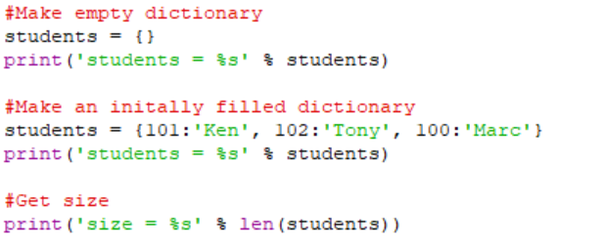
Create and size

Slide 9
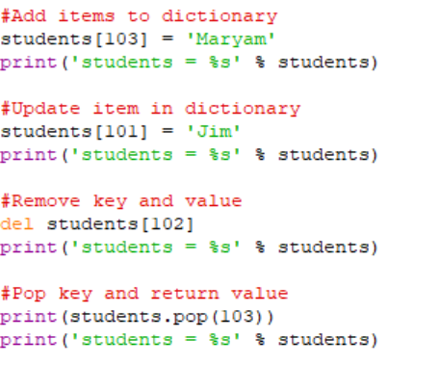
Add, update, remove, get and remove

Slide 10
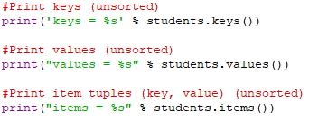
Keys, values, items

Slide 11
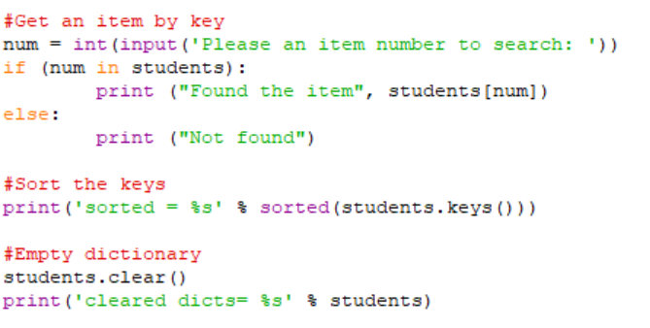
Get item, sort, empty

Slide 12
Usage

Slide 13
What are dictionaries for?
Sometimes having an order does not apply for certain data.
Sometimes we don’t care if something is stored in ordered structure or not.
Sometimes an unordered structure makes things faster/easier.
If data is unsorted how long does it take to find something in list of length n?
If data is sorted how long does it take to find something?

Slide 14
What are dictionaries for?
In lists the only way to find things fast, was to keep a list sorted.
Sorting has a cost of efficiency. (and even then there are delays)
Dictionaries use a mathematical trick called hashing which applies mathematical function to key and changes it to a hidden index. The math works the same way every time. Essentially a constant lookup time.
There is a cost every time we store too many things and are hash table has to grow, but once we stop adding. Lookup is fast.

Slide 15
Onward to … strings.
Jonathan Hudson
jwhudson@ucalgary.ca
https://pages.cpsc.ucalgary.ca/~hudsonj/

