Slide 1
Structures: Lists: Complex
CPSC 217: Introduction to Computer Science for Multidisciplinary Studies I
Fall 2020
Jonathan Hudson, Ph.D
Instructor
Department of Computer Science
University of Calgary
Tuesday, September 8, 2020

Slide 2
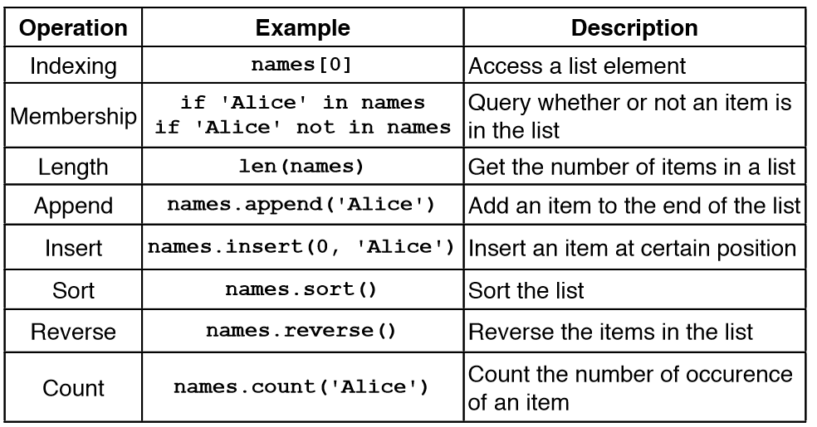
List Operations and Methods

Slide 3
Search/Remove List

Slide 4
Searching For Elements
Use in to check if an item is present in a list
data = [1,2,3,4,5]
2 in data evaluates to True
8 in data evaluates to False
Use index to determine where it is in the list
data = [11,12,13,14]
data.index(12) evaluates to 1
data.index(8) results in a ValueError

Slide 5
Removing Elements
How can we remove an item from a list?
Use the remove method
Removes the first occurrence of the item
Subsequent identical items remain in the list
Item must exist or a ValueError will occur
x = [1,2,1,3,4,2,1]
x.remove(1)
print(x)

Slide 6
Removing Elements
What if we want to remove all occurrences of an item from a list?
Use a while loop:
while x in myList:
myList.remove(x)

Slide 7
Removing Elements
What if we know the index of the item we want to remove?
Use pop(index)
With no parameters: Removes last item
With one parameter: Removes item at the index specified
Returns the item that is removed
myList = [1,2,3,4]
myList.pop()
print(myList)
myList.pop(0)
print(myList)
myList.pop(myList.index(2))
print(myList)
[1, 2, 3]
[2, 3]
[3]

Slide 8
Sorting a List

Slide 9
Sorting
Sorting is the process of ordering elements of a list in ascending or descending order.
[4, 2, 1, 3, 0]
[0, 1, 2, 3, 4]
[4, 3, 2, 1, 0]
How do we sort the list?
Unordered list
Ordered list in ascending order
Ordered list in descending order

Slide 10
Sorting
Sorting is an important task
Needed when working with large data sets
Frequently occurs as part of other algorithms
Sorting has been studied extensively
Many algorithms, some of which are quite complex

Slide 11
Sorting - Selection Sort
General idea (ascending order): The list is initially considered entirely unordered.
Select the smallest element in the unordered portion of list
Remove the element from unordered portion of the list and place it at the end of the ordered portion of the list.
Repeat until no elements remain in the unordered portion of the list.
https://www.youtube.com/watch?v=xWBP4lzkoyM
Lets implement this!
You can download another solution from D2L: 21_Selection.py

Slide 12
Sorting - Bubble Sort
General idea (ascending order)
go through list from beginning to end
compare adjacent elements
swap if previous element is larger than current element
repeat until no swaps are performed
https://www.youtube.com/watch?v=nmhjrI-aW5o
You can download a solution from D2L: 23_Bubble.py

Slide 13
Sorting in Python
Python makes sorting a list easy
Use the sorted function
Takes one parameter which is an unsorted list
Returns a new list sorted into increasing order
Use the sort(order) method
Order is a Boolean parameter. Default is True for ascending order. False sorts in descending order.
Invoked on a list using dot notation
Modifies the list
list=[0,1,6,2,10]
list.sort()
print(list)
[0, 1, 2, 6, 10]

Slide 14
List Example

Slide 15
Practice Example
Compute the median of a list of values entered by the user
User will enter an unknown number of values
A blank line will be used to indicate that no additional values will be entered
If the list has an odd number of elements
Median is the middle value
If the list has an even number of elements
Median is average of the two middle values

Slide 16
Practice Example Design
read values from user and store in a list (using append)
sort list (put numbers in ascending order)
if list length is odd, display middle value (index = len(list)/2)
if list length is even, display the average of two middle values (index len(list)/2 and len(list)/2 – 1)
Lets code this!

Slide 17
2D Lists

Slide 18
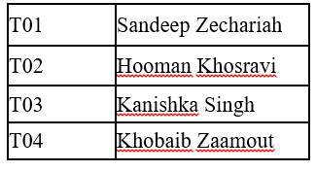
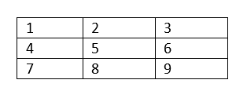
2D Lists
A list of lists (images,movies,tables,matrices -> all 2D data)
[does not have to be rectangular]
Format:
<list name> = [[<value 1>, <value 2>, ... , <value n>],
[<value 1>, <value 2>, ... , <value n>],
…
[<value 1>, <value 2>, ... , <value n>]]
A table
A matrix
rows
columns

Slide 19
Accessing 2D Lists
matrix1 = [[1, 2, 3], [4, 5, 6], [7, 8, 9]]
print(matrix1)
print(matrix1[0])
print(matrix1[1])
print(matrix1[2])
row = matrix1[0]
print(row[0])
print(row[1])
print(row[2])
[[1, 2, 3], [4, 5, 6], [7, 8, 9]]
[1, 2, 3]
[4, 5, 6]
[7, 8, 9]
1
2
3

Slide 20
Accessing 2D Lists
matrix1 = [[1, 2, 3], [4, 5, 6], [7, 8, 9]]
print(matrix1[0][0])
print(matrix1[0][1])
print(matrix1[0][2])
1
2
3

Slide 21
2D-List Creation
Creating the following matrix programmatically:
matrix1 = [[1, 2, 3], [4, 5, 6], [7, 8, 9]]

Slide 22
2D-List Creation
Creating the following matrix programmatically:
matrix1 = [[1, 2, 3], [4, 5, 6], [7, 8, 9]]
matrix1 = []
for i in range (1, 10, 3):
row = [i , i + 1, i + 2]
matrix1.append(row)
print(matrix1)
matrix3=[]
ROWS=3
COLS=3
counter = 1
for row in range(ROWS):
matrix3.append([])
for col in range(COLS):
matrix3[row].append(counter)
counter+=1
print(matrix3)
matrix2 = []
for i in range (0, 9, 3):
matrix2.append([])
for j in range (i, i + 3, 1):
matrix2[i//3].append(j+1)
print(matrix2)

Slide 23
2D-List Printing
Using print (matrix)
Using loops:
Print one row per iteration
for row in matrix:
print(row)
for row in matrix:
output = ''
for num in row:
output += str(num) + ' '
print (output)
[1, 2, 3]
[4, 5, 6]
[7, 8, 9]
Print one row per iteration
1 2 3
4 5 6
7 8 9

Slide 24
2D List: Example

Slide 25
Example: Boggle
Generate a random board for Boggle
4x4 board
Store the board in a 2D list
Each space on the board contains one randomly selected letter
Display the board
Sample Board:
S
N
K
O
V
R
E
R
I
D
I
N
N
E
G
U

Slide 26
Example: Boggle
from pprint import pprint
from random import choice
NUM_ROWS = 4
NUM_COLS = 4
board = [] # Create a new, empty board
for row in range(NUM_ROWS): # Add the correct number of rows to the board
board.append([""]* NUM_COLS) # Append a row of size NUM_COLS
pprint(board) #pretty print the board
# Set each element in the board to a random letter
for row in range(NUM_ROWS):
for col in range(NUM_COLS):
board[row][col] = choice("ABCDEFGHIJKLMNOPQRSTUVWXYZ")
pprint(board) # Pretty print the board

Slide 27
Tracing

Slide 28
Trace The Code 1:
def f1(list1) :
list2 = list1
for index in range(len(list1)):
list2[index] = list1[index]+1
print(list1)
print(list2)
f1([1,2,3])
[2, 3, 4]
[2, 3, 4]

Slide 29
Trace The Code 2:
def f2(list1) :
list2 = list1[:]
for index in range(len(list1)):
list2[index] = list1[index]+1
print(list1)
print(list2)
f2([1,2,3])
[1, 2, 3]
[2, 3, 4]

Slide 30
Trace The Code 3:
def f3(list1) :
list2 = list1*2
for index in range(len(list2)):
list2[index] += 1
print(list1)
print(list2)
f3([1,2,3])
[1, 2, 3]
[2, 3, 4, 2, 3, 4]

Slide 31
Trace The Code 4:
List 1
List 2
def f4(list1) :
list2 = [list1]*3
for index in range(len(list2)):
innerList = list2[index]
for innerIndex in range(len(innerList)) :
innerList[innerIndex] += 1
print(list1)
print(list2)
f4([1,2,3])
[4, 5, 6]
[[4, 5, 6], [4, 5, 6],[4, 5, 6]]

Slide 32
Trace The Code 5:
def f5(list1) :
list2 = [list1]*2
for index in range(len(list2)):
innerList = list2[index]
innerList = innerList[:]
for innerIndex in range(len(innerList)) :
innerList[innerIndex] += 1
list2[index] = innerList
print(list1)
print(list2)
f5([1,2,3])
[1, 2, 3]
[[2, 3, 4], [2, 3, 4]]

Slide 33
Onward to … dictionaries.
Jonathan Hudson
jwhudson@ucalgary.ca
https://pages.cpsc.ucalgary.ca/~hudsonj/

