Slide 1
Functions: Usage
CPSC 217: Introduction to Computer Science for Multidisciplinary Studies I
Fall 2020
Jonathan Hudson, Ph.D
Instructor
Department of Computer Science
University of Calgary
Tuesday, September 8, 2020

Slide 2
Function calling review
Select a descriptive name for your function
Use brackets when calling functions even if you are not passing any arguments
At least one statement needs to be in a function.
Functions must be defined before they are called!

Slide 3
How to use a function?
Call function
Pass valid inputs
Store the result in a variable
If function returns a value:
returnedValue = functionName(values/variables)
If no value is returned
functionName(values/variables)

Slide 4
Functions that do nothing
Functions have to have one line of code in them
Only way to make pythons syntax parsing that is looking for indentation happy
(Once you put something indented in function the rest of indentation has to match)
This is also true for conditionals and loop indentation
Can use pass keyword to do nothing

Slide 5
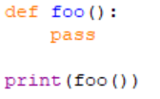
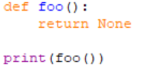
Functions return None by default
Functions in python always return something
That something is by default nothing or None
None is a special keyword
(We often use None in other places in our code to show nothing has been stored in a variable yet)

Slide 6
Return multiple things

Slide 7
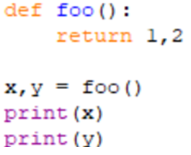
Functions can return multiple things

Slide 8
Return values
Format
The results can be stored into variables for later use
def <function name> (param1, param2, ...): body
return var1, var2, ...
var1, var2, ... = <function name> (arg1, arg2, ...)

Slide 9
Namespace
Must define functions before use

Slide 10
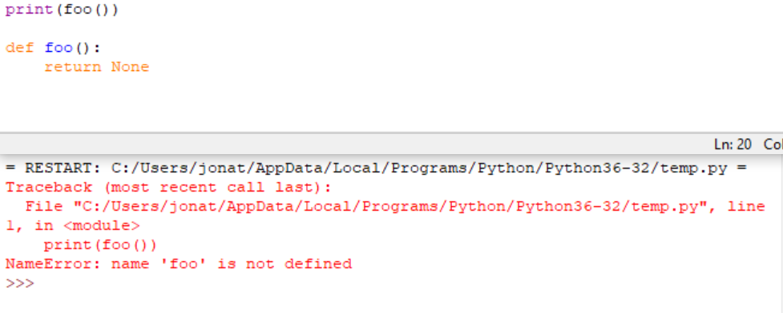
Functions must be declared before use

Slide 11
Examples

Slide 12
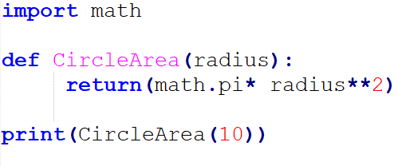
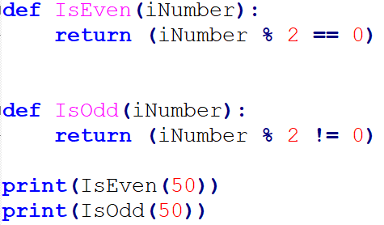
Some simple functions

Slide 13
Design

Slide 14
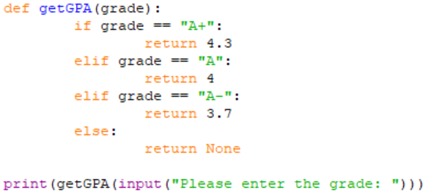
There are challenges in defining a function

Slide 15
User-Defined Functions - Commenting
A good function always contains explicit comments that describe the purpose of the function, the parameters, and returned values.
See: https://docs.python.org/3/library/functions.html

Slide 16
Namespace
Re-defining functions

Slide 17
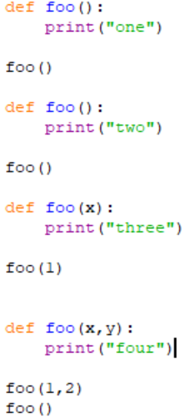
Dangers of functions (re-use name)
Python only lets you have one function per name, but you can override previous usage (ignores parameters unlike other languages)

Slide 18
Parameter order

Slide 19
Calling Functions - Order of Parameters
Function parameters are position sensitive.
When calling a function that accepts parameters, make sure your arguments are in the same order of the parameters.
WARNING: Not following the order of the parameters will result in parameters having wrong values, which may lead to semantic and runtime errors.
def printbar(char, num = 10):
bar = ''
for i in range(num + 1):
bar = bar + char
print(bar)
printbar(20, '=')

Slide 20
Keyword parameters
Keyword parameters allow us to match arguments with parameters by name, instead of positions
def payroll (rate, hours):
bounus = 5
salary = rate * (hours + bounus)
return (salary)
payment = payroll (hours = 40, rate = 15)
print ("$%d has been paid." % (payment))
$675 has been paid.

Slide 21
We can do this with functions you already use

Slide 22
Scope

Slide 23
Scope of Variables
Variables are memory locations that are used for the temporary storage of data
The scope of a variable is the section of code in which it is accessible
var1 = …
The global scope: Accessible by both functions
def fee():
var2 = …
Local scopes: Two different memory spaces,
Accessible only within their functions
def foo():
var2 = …

Slide 24
Scope of Variables - Local Variables
Local variables are only accessible to the function where they are defined.
The memory for local variables is only allocated (reserve the memory) when the function is running and deallocated (free up the memory) when the function reaches the end.
Local variables are defined (memory allocated and value stored) each time the function is called.

Slide 25
Scope of Variables - Local Variables
string
“Hello World”
Function body is executed
Function is done
string is a local variable
Memory deallocated
string

Slide 26
Scope of Variables - Global Variables
Variables that are declared within the body of a function have a local scope → Accessible from inside the function only
This includes the parameters
Variables that are declared outside the body of a function have a global scope → Accessible from anywhere in the program
In Python, global variables can only be modified in global scope.
They cannot be modified in local scope unless the global keyword is used:
global variableName

Slide 27
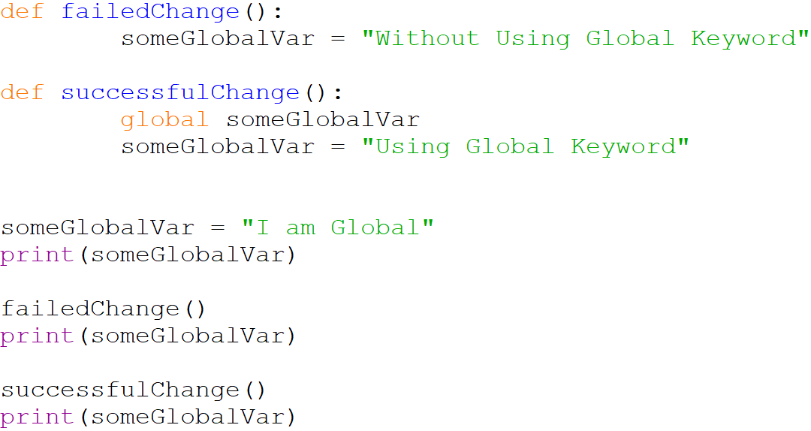
Scope of Variables - Global Variables
I am Global
I am Global
Using Global Keyword

Slide 28
Scope of Variables - Variable lifetime
The lifetime of a variable is the time that a variable is allocated a memory space.
The memory is allocated at the time of variable declaration
Global variables exist until the program terminates
Local variables exist until the function containing it finishes

Slide 29
Program Structure – Functions

Slide 30
Structure
def func1():
def func2():
def func3():
…
The main function
def main():
func1()
func2()
…
The only code outside functions
main()

Slide 31
Function Tracing

Slide 32
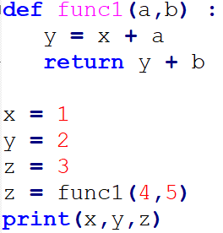
Scope
1 2 10

Slide 33
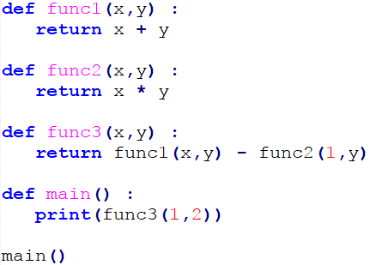
Scope
1

Slide 34
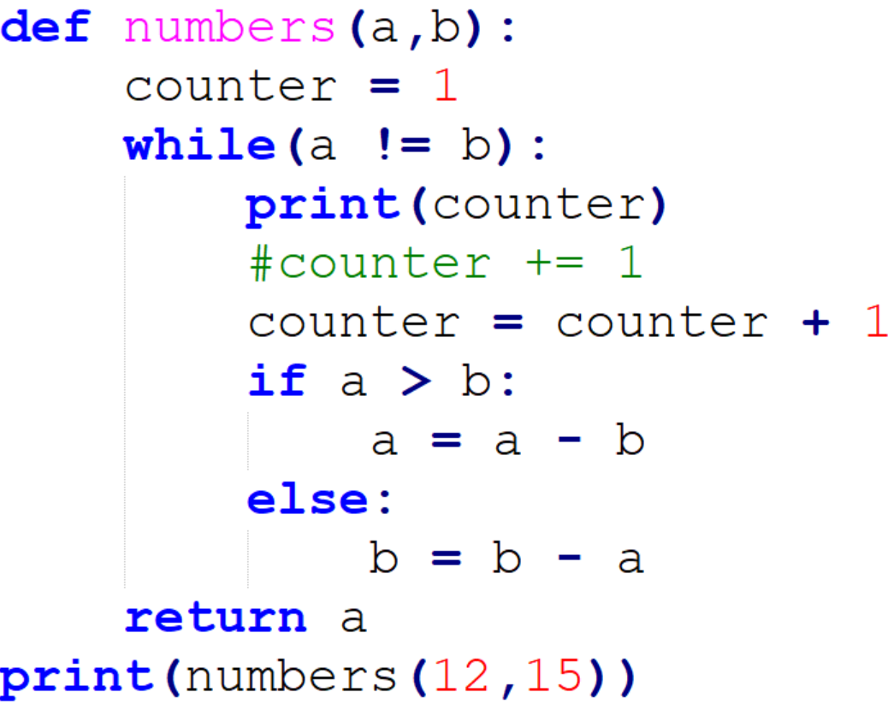
Trace the code
1
2
3
4
3

Slide 35
Onward to … lists, dictionaries, and strings.
Jonathan Hudson
jwhudson@ucalgary.ca
https://pages.cpsc.ucalgary.ca/~hudsonj/

