Slide 1
Repetition: Loop Types
CPSC 217: Introduction to Computer Science for Multidisciplinary Studies I
Fall 2020
Jonathan Hudson, Ph.D
Instructor
Department of Computer Science
University of Calgary
Tuesday, September 8, 2020

Slide 2
Review
So far, we have learned…
How to use variables
Read values from the user
Make decisions
Compute a result
Output a result
What if we want to perform a task several times?

Slide 3
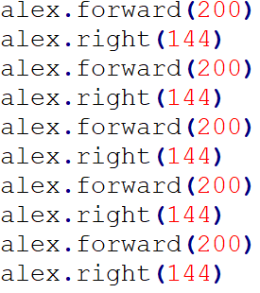
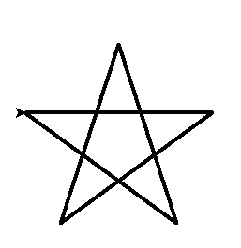
Loops
Computer programs are very good at performing tasks over and over
If part of the code is repeated it probably should be a loop

Slide 4
Loop Terminology
Body of the Loop:
simple or compound statement that is repeated
Loop Condition:
a Boolean expression
tested to determine if the loop will continue executing

Slide 5
Loop types
Post-test loops
Checking the looping condition after executing the body of the loop.
The loop body executes at least one time.
Pre-test loops
Checking the looping condition before executing the body of the loop.
The loop body executes zero or more times.

Slide 6
Post-Test Loop
Not in Python

Slide 7
Post-test loops
Initialization
Body of the loop
Initialize the loop control
Execute the body of the loop
(the part to be repeated)
Update the loop control
Check the condition
False → stop the loop and go to the rest of program
True → repeat from step 2
Update Condition
Condition
true
false
Remainder of
the code

Slide 8
Post-test loops
The looping condition is checked after the body is executed
The loop body will be executed at least once.
Python does not provide post-test loop, common in Java and C/C++

Slide 9
Pre-Test Loop
In Python!

Slide 10
Pre-test loops
Initialization
Condition
1. Initialize loop control
2. Check the condition
False→ stop the loop, skip the body,
go to the rest of program
True → Execute the body of the loop
4. Update the loop control
5. Repeat from step 2
false
true
Body of the loop
Update Condition
Remainder of
the code

Slide 11
Loop control
A loop control is a variable used in the loop control statement
Loop control statement is a condition for loop execution
Python stops the loop execution when a condition is no longer true
What happens if a loop control is not updated?
(Pre-emptive instructor comment)
Using “break” is not a good practice!

Slide 12
Pre-test loops in Python
Condition is checked before the body is executed
The loop body will be executed for zero or more times
Available loops in Python
for loops
while loops

Slide 13
While loops

Slide 14
While loop (indeterminate)
Executes as long as some condition is true
A pre-tested loop
loop condition is tested before the loop executes the first time
General form:
while condition:
body

Slide 15
While loop
When it is not known how many times to repeat → consider a while loop
Here 0 is a sentinel value (a value that indicates loop completion)
Example:
userinput = int(input(‘Please enter number to add to sum’))
sum = 0
while (userinput != 0):
sum = sum + int(userinput)
userinput = input(‘Plz enter a number, ‘0’ to end')

Slide 16
While loop
When it is not known how many times to repeat → consider a while loop
Here 0 is a sentinel value (a value that indicates loop completion)
Example:
userinput = int(input(‘Please enter number to add to sum'))
sum = 0
while (userinput != 0):
sum = sum + int(userinput)
userinput = input(‘Plz enter a number, ‘0’ to end')
Initialization
indentation
Body of the loop

Slide 17
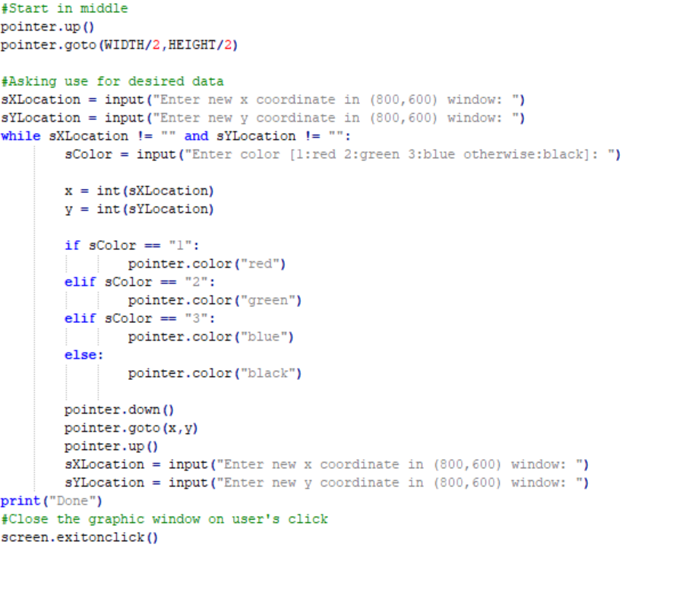
Example while

Slide 18
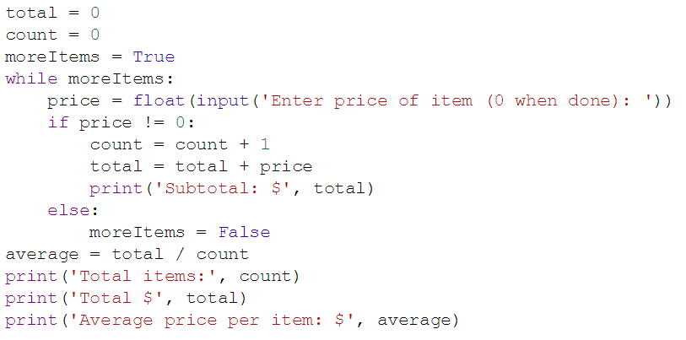
While example

Slide 19
For loops

Slide 20
For loop (determinate)
A counting loop
Typically used when we know how many times we need to perform a task in advance
A pre-tested loop
General form:
for variable_name in list:
body

Slide 21
For loop
When it is known how many times to repeat → consider a for loop
Example:
last = int(input(‘Please enter number of iterations'))
total = 0
for i in range (1, last + 1, 1):
total = total + i

Slide 22
For loop
When it is known how many times to repeat → consider a for loop
Example:
last = int(input(‘Please enter number of iterations'))
total = 0
for i in range (1, last + 1, 1):
total = total + i
Initialization
i in (1, 2, 3)
indentation
Body of the loop

Slide 23
What was range()?
Python specific integer loop function

Slide 24
Loops in Python - for Loop – range()
range(start, end, step) is a function that can take up to 3 parameters and returns a range of integer values.
start: is an optional parameter (default is 0).
It represents the start of the range.
end: is a required parameter, which represents the end of the range.
The end value itself is excluded from the range.
step: is an optional parameter (default is 1).
It represents the increment value.

Slide 25
Step Values
Range is flexible
With one parameter
Counts from 0 up to (but not including) the number provided
With two parameters
Counts from the first number to the second number (exclusive), increasing by one each time
Generates the empty list if the second number is less than or equal to the first
With three parameters
Counts from the first number to the second (exclusive), increasing by the third

Slide 26
Loops in Python - for Loop – range()
What does the range(5) return?
What does range(1, 6) return?
What does range(0, 5, 2) return?

Slide 27
Loops in Python - for Loop – range()
What does the range(5) return?
start = 0, end = 5, step = 1
What does range(1, 6) return?
start = 1, end = 6, step =1
What does range(0, 5, 2) return?
start = 0, end = 5, step = 2

Slide 28
Loops in Python - for Loop – range()
What does the range(5) return?
A range object representing 0, 1, 2, 3, 4
What does range(1, 6) return?
A range object representing 1, 2, 3, 4, 5
What does range(0, 5, 2) return?
A range object representing 0, 2, 4

Slide 29
Example range() for loops

Slide 30
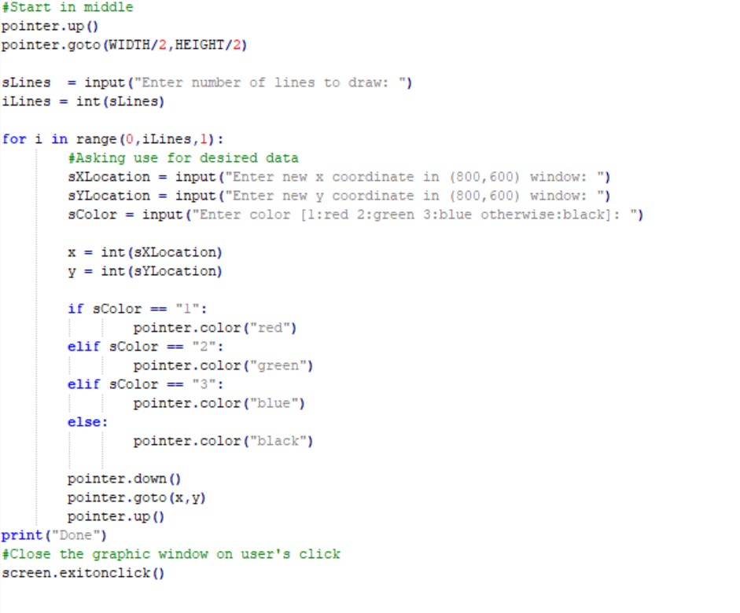
Example for

Slide 31
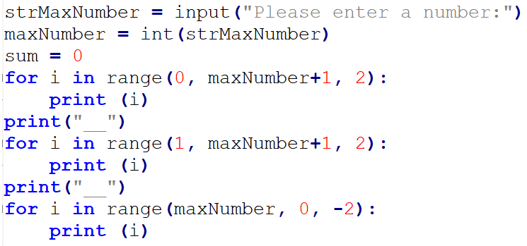
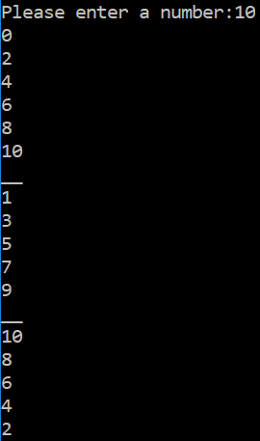
Range

Slide 32
Example for list loops

Slide 33
For each character in string
A string is a list of characters we can loop through
for c in “Hello World”:
print(c)

Slide 34
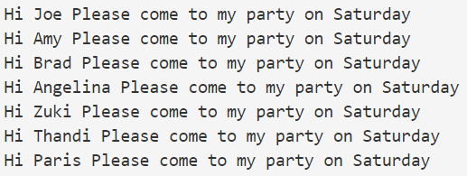
For in list of strings

Slide 35
Onward to … loop usage.
Jonathan Hudson
jwhudson@ucalgary.ca
https://pages.cpsc.ucalgary.ca/~hudsonj/

