Slide 1
Decisions: If Else Statements
CPSC 217: Introduction to Computer Science for Multidisciplinary Studies I
Fall 2020
Jonathan Hudson, Ph.D
Instructor
Department of Computer Science
University of Calgary
Tuesday, September 8, 2020

Slide 2
Conditions in Python
Decision making/branching constructs in Python:
If
If-else
If-elif-else

Slide 3
if

Slide 4
Condition flowchart
if
True
Execute a statement(s)
Question?
False
Remainder of
the program

Slide 5
“if” statement format
The logical expression is evaluated
If True, the indented statements that follow are executed
If False, the indented statements that follow will not be executed
The program continues
if (logical expression):
Body
if (age<= 17):
print ('You are underage!')
Note: Indenting the
body is required!

Slide 6
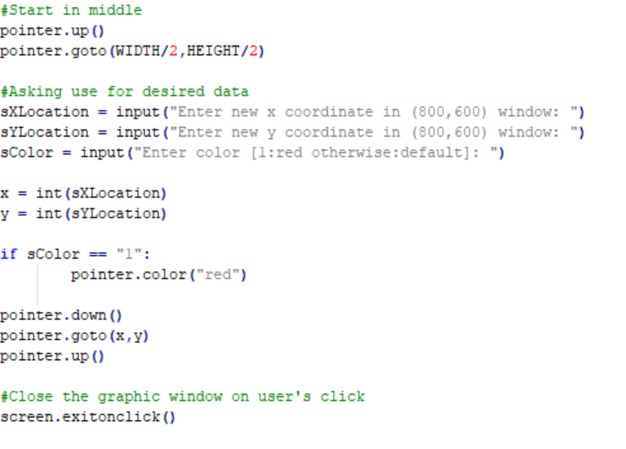
Using if

Slide 7
else

Slide 8
If-Else statement
if
else: Execute other statement(s)
False
True
Execute a statement(s)
Question?
Remainder of
the program

Slide 9
if-else format
if (logical expression):
body of ‘if’
else:
body of ‘else’
remainder of the program

Slide 10
Example for if-else
if (grade >= 50):
letterGrade = 'P'
print ('You pass!')
else:
letterGrade = 'F'
print ('Try Harder!')
print ('Thank You!')
Indentation

Slide 11
Using if-else

Slide 12
elif
else if

Slide 13
if-elif-else format
if (logical expression):
body of ‘if’
elif:
body of ‘elif’
else:
body of ‘else’
remainder of the program

Slide 14
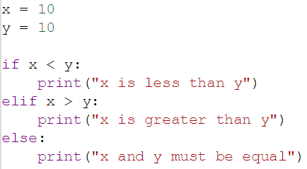
if –elif-else
if
True
Execute a statement(s)
Question?
False
elif
True
Execute a statement(s)
Question?
False
else: Execute other statement(s)
Remainder of
the program

Slide 15
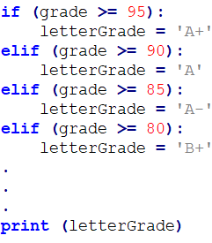
Using elif
What is the output if grade is 97?
Multiple ‘ifs’ may not work for
some problems.
if-elif-else provides the result.

Slide 16
Using elif
What is the output if grade is 97?
Multiple ‘ifs’ may not work for
some problems.

Slide 17
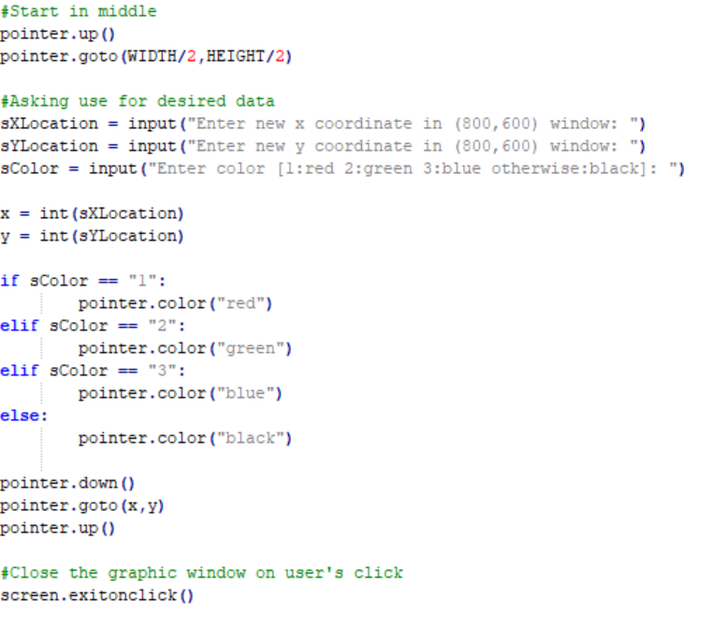
Using if elif else

Slide 18
if-elif-else
You can always have an ‘if’ without ‘elif’ or ‘else’
You can’t have ‘elif’ without ‘if’ first
You can’t have ‘else’ with ‘if’ or ‘elif’ ahead
You can only have one ‘if’ (in a chain)
You can only have one ‘else’ (in a chain)
You can have as many ‘elif’ as you desire (in middle of chain)

Slide 19
Nesting

Slide 20
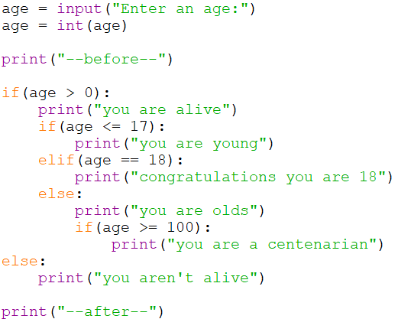
Nesting

Slide 21
Scope

Slide 22
Scope
Namespace - is a declarative region that provides a scope to the identifiers (the names of types, functions, variables, etc) inside it.
Whenever you declare a variable it exists within a namespace
Whenever python sees you use a variable is looks with this storage area for the variable name you use and finds out what it is attached to
dir() returns to use all the things in the current namespace

Slide 23
Scope
The variables of
a = 2 , b = 3 , B = 4 , this = 10 , avacodo = 42
Would create variables of name a,b,B,this,avocado in the namespace (all of these will have the type int)
Python decides types for us (implicitly) based on what we put in
We can delete things from it using del <name>

Slide 24
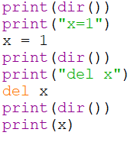
Scope
If we use a variable name that doesn’t exist

Slide 25
Scope
If we use a variable name that doesn’t exist

Slide 26
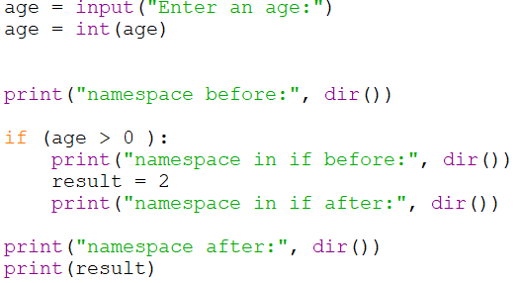
Scope
When we enter an indented block
This namespace can be changed
But we have to be careful to not create a variable SOMETIMES
That our code uses ALL the time

Slide 27
Testing

Slide 28
Testing
Black-box testing
Test the program without looking at the source code
Test are generally functional / behavioural
White-box testing
Design test cases for the program by looking at its source code
Tests are generally structural

Slide 29
White Box Test Coverage
How thoroughly do the cases test the code?
Condition Coverage: Every decision point in the program is executed
Statement Coverage: Every statement in the program is executed
Path Coverage: Every possible path through the program is executed

Slide 30
Onward to … repetition.
Jonathan Hudson
jwhudson@ucalgary.ca
https://pages.cpsc.ucalgary.ca/~hudsonj/

