Slide 1
Decisions: Boolean Logic
CPSC 217: Introduction to Computer Science for Multidisciplinary Studies I
Fall 2020
Jonathan Hudson, Ph.D
Instructor
Department of Computer Science
University of Calgary
Wednesday, September 30, 2020

Slide 2
Review
What kinds of statements have we seen so far?
Assignment statements
Input statements
Output statements
These are generally necessary, but not sufficient, to solve “interesting” problems

Slide 3
Decision making
Decisions are questions with answers that are either true or false (Boolean)
e.g., Is it true that the variable ʻnumʼ is positive?
A program can branch one way or another depending upon the answer to the question (the result of the Boolean expression).
x = True
y = False

Slide 4
Relational Operators

Slide 5
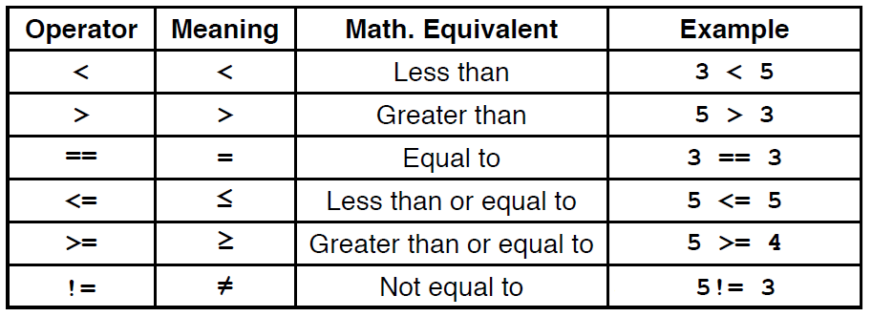
Relational operators
Allow us to compare other data types to produce booleans

Slide 6
Boolean expression
(operand) relational operator (operand)
The result of the relational operator (comparison) is of type bool (short for boolean)
Boolean: a binary variable, having two possible values: “True” and “False”
True → 1 or T and False → 0 or F
x = 1.0
y = 2.0
c = (x <= y)
print (type(c))
<class 'bool'>

Slide 7
Boolean Operators

Slide 8
Logical (Boolean) operators
For bool variables a and b
a and b (True only when a and b are both True)
a or b (False only when a and b are both False)
not a (True only when a is False and vice versa)

Slide 9
Precendence
With relational and boolean operators

Slide 10
Update on precedence
Order | Operations | Precedence
1 | () | Highest
2 | x ** y
3 | -x, +x
4 | x * y, x / y, x % y, x // y
5 | x + y, x - y
6 | <, <=, >, >=
7 | <>, !=, ==
8 | not
9 | and
10 | or
11 | = | Lowest

Slide 11
Truth Tables

Slide 12
Truth Table for OR
A | B | A or B

Slide 13
Truth Table for OR
A | B | A or B
T | T | T

Slide 14
Truth Table for OR
A | B | A or B
T | T | T
T | F | T

Slide 15
Truth Table for OR
A | B | A or B
T | T | T
T | F | T
F | T | T

Slide 16
Truth Table for OR
A | B | A or B
T | T | T
T | F | T
F | T | T
F | F | F

Slide 17
Logical expression
(boolean expression) logical operator (boolean expression)
Logical operators → and, or, and not (more later)
A | B | A or B
T | T | T
T | F | T
F | T | T
F | F | F
A | B | A and B
T | T | T
T | F | F
F | T | F
F | F | F
B | not B
T | F
F | T

Slide 18
Truth Tables
Example

Slide 19
Boolean Logic
Example:
Construct a truth table for A and (B or not C):

Slide 20
Boolean Logic
Example:
Construct a truth table for A and (B or not C):
A | B | C
0 | 0 | 0
0 | 0 | 1
0 | 1 | 0
0 | 1 | 1
1 | 0 | 0
1 | 0 | 1
1 | 1 | 0
1 | 1 | 1

Slide 21
Boolean Logic
Example:
Construct a truth table for A and (B or not C):
A | B | C | not C
0 | 0 | 0 | 1
0 | 0 | 1 | 0
0 | 1 | 0 | 1
0 | 1 | 1 | 0
1 | 0 | 0 | 1
1 | 0 | 1 | 0
1 | 1 | 0 | 1
1 | 1 | 1 | 0

Slide 22
Boolean Logic
Example:
Construct a truth table for A and (B or not C):
A | B | C | not C | B or not C
0 | 0 | 0 | 1 | 1
0 | 0 | 1 | 0 | 0
0 | 1 | 0 | 1 | 1
0 | 1 | 1 | 0 | 1
1 | 0 | 0 | 1 | 1
1 | 0 | 1 | 0 | 0
1 | 1 | 0 | 1 | 1
1 | 1 | 1 | 0 | 1

Slide 23
Boolean Logic
Example:
Construct a truth table for A and (B or not C):
A | B | C | not C | B or not C | A and (B or not C)
0 | 0 | 0 | 1 | 1 | 0
0 | 0 | 1 | 0 | 0 | 0
0 | 1 | 0 | 1 | 1 | 0
0 | 1 | 1 | 0 | 1 | 0
1 | 0 | 0 | 1 | 1 | 1
1 | 0 | 1 | 0 | 0 | 0
1 | 1 | 0 | 1 | 1 | 1
1 | 1 | 1 | 0 | 1 | 1

Slide 24
Onward to … if else statements.
Jonathan Hudson
jwhudson@ucalgary.ca
https://pages.cpsc.ucalgary.ca/~hudsonj/

