Slide 1
Information and Data
CPSC 217: Introduction to Computer Science for Multidisciplinary Studies I
Fall 2020
Jonathan Hudson, Ph.D
Instructor
Department of Computer Science
University of Calgary
Tuesday, September 8, 2020

Slide 2
What is Information?
Etymology: Latin, “to give form to” or “to form an idea of”
Definition: The state of being of an object or system of interest

Slide 3
What is Data?
Data: raw facts, representation of information, no context
Encoding: The translation of information into data
(Decoding the other direction
Data represents information

Slide 4
Information Processing
A change of information in any manner detectable by an observer
Using a computer?
Encode information into data
Process the data
Translate data back into information
Moral: computers process data, not information – it is our responsibility to interpret the data correctly.

Slide 5
Storing Data
All data in a computer is either a 0 or 1
Called a bit (binary digit)
Electrically, this is a switch that is either open or closed
Encoding schemes translate integers, real numbers, letters, pictures, … into bits

Slide 6
Boolean Data
Has two possible values
False
True
Easily encoded using a single bit
0: False
1: True

Slide 7
Integer Data
How do we represent the numbers 5, 24, or 367 using only ones and zeros?
Simplest idea:
11111 = 5
11111 11111 11111 11111 1111 = 24
Not practical for large integers!
Other ideas?

Slide 8
Number Systems
Decimal (Base 10)
10 distinct symbols (0,1,2,3,4,5,6,7,8,9)
Each digit is a factor of 10 larger than the digit to its right
Examples:
5 = 5 x 1
24 = 2 x 10 + 4 x 1
367 = 3 x 100 + 6 x 10 + 7 x 1

Slide 9
Number Systems
Decimal (Base 10)
10 distinct symbols (0,1,2,3,4,5,6,7,8,9)
Each digit is a factor of 10 larger than the digit to its right
Examples:
5 = 5 x 10⁰
24 = 2 x 10¹ + 4 x 10⁰
367 = 3 x 10² + 6 x 10¹ + 7 x 10⁰

Slide 10
Number Systems
This is a positional system – the position within the number impacts the factor by which the digit is multiplied.
Choice of base 10 is (somewhat) arbitrary – can use any integer base >= 1
Note: there is nothing special about base 10 – it’s just what we are used to!

Slide 11
Binary Data

Slide 12
Number Systems
Binary (Base 2)
2 distinct symbols (0,1)
Each digit is a factor of 2 larger than the digit to its right
Base 10: hundreds, tens, ones
Base 2: eights, fours, twos, ones

Slide 13
Counting in Binary
0 == 0
1 == 1
10 == 2
11 == 3
100 == 4
101 == 5
110 == 6
111 == 7
1000 == 8
You can see how when we have a single 1 in a column (ones, two, fours, eights) that it’s equivalent to that number in decimal (base 10)

Slide 14
Binary Numbers
Consider the base 2 number 1001101₂
1: ones (2⁰)
0: twos (2¹)
1: fours (2²)
1: eights (2³)
0: sixteens (2⁴)
0: thirty-twos (2⁵)
1: sixty-fours (2⁶)

Slide 15
Binary Numbers
Consider the base 2 number 1001101₂
1: ones (2⁰)
0: twos (2¹)
1: fours (2²)
1: eights (2³)
0: sixteens (2⁴)
0: thirty-twos (2⁵)
1: sixty-fours (2⁶)
1 x 2⁰ + 1 x 2² + 1 x 2³ + 1 x 2⁶ = 1 + 4 + 8 + 64 = 77₁₀ (base specified as a subscript)

Slide 16
Binary <-> Decimal

Slide 17
Binary to Decimal
Convert 1111₂ to base 10:
Convert 100010₂ to base 10:
Convert 0₂ to base 10:

Slide 18
Binary to Decimal
Convert 1111₂ to base 10:
1 x 2⁰ + 1 x 2¹ + 1 x 2² + 1 x 2³ = 1 + 2 + 4 + 8 = 15₁₀
Convert 100010₂ to base 10:
1 x 2¹ + 1 x 2⁵ = 2 + 32 = 34₁₀
Convert 0₂ to base 10:
0₁₀

Slide 19
The Division Algorithm
Allows us to convert from Decimal to Binary
Let Q represent the number to convert
Repeat
Divide Q by 2, recording the Quotient, Q, and the remainder, R
Until Q is 0
Read the remainders from bottom to top
Divide by the base to which we want to convert (algorithm works for conversion from decimal to any base)

Slide 20
Decimal to Binary
Convert 191₁₀ to Binary:
191 / 2 = 95, remainder 1
95 / 2 = 47, remainder 1
47 / 2 = 23, remainder 1
23 / 2 = 11, remainder 1
11 / 2 = 5, remainder 1
5 / 2 = 2, remainder 1
2 / 2 = 1, remainder 0
1 / 2 = 0, remainder 1

Slide 21
Decimal to Binary
Convert 191₁₀ to Binary:
191 / 2 = 95, remainder 1
95 / 2 = 47, remainder 1
47 / 2 = 23, remainder 1
23 / 2 = 11, remainder 1
11 / 2 = 5, remainder 1
5 / 2 = 2, remainder 1
2 / 2 = 1, remainder 0
1 / 2 = 0, remainder 1
Reading from bottom to top: 1011 1111₂
Check: 1 + 2¹ + 2² + 2³ + 2⁴ + 2⁵ + 2⁷ = 1 + 2 + 4 + 8 + 16 + 32 + 128 = 191₁₀

Slide 22
Integer Data

Slide 23
Integer Data
Base 10 integers can be represented using sequences of bits
Common sizes:
8 bits (referred to as a byte)
32 bits (referred to as a word)
64 bits (referred to as a double word / long)
16 bits (referred to as a half word / short)

Slide 24
Integer Data
Base 10 integers can be represented using sequences of bits
Byte [8 bits]: 0000 0000 – 1111 1111 (0 to 2⁸ – 1)
Word [32 bits]: 0 to 2³² – 1
Double word (long) [64 bits]: 0 to 2⁶⁴ – 1
Half word (short) [16 bits]; 0 to 2¹⁶ - 1

Slide 25
Negative Numbers
Simple idea is called “Signed Magnitude”.
Idea (SM byte): right-most 7 bits represent the magnitude, 8th bit represents the sign.
Example:
65₁₀ = 100 0001₂
+65 as a byte: 0100 0001
-65 as a SM byte: 1100 0001

Slide 26
Other Bases

Slide 27
Other Bases
A number system can have any base
Decimal: Base 10 (0,1,2,3,4,5,6,7,8,9)
Binary: Base 2 (0,1)
Octal: Base 8 (0,1,2,3,4,5,6,7)
Hexadecimal: Base 16 (0,1,2,3,4,5,6,7,8,9,a,b,c,d,e,f)
Vigesimal: Base 20 (0,1,2,3,4,5,6,7,8,9,a,b,c,d,e,f,g,h,I,j)
Base 6 (0,1,2,3,4,5)
Any other number we choose…

Slide 28
Hexadecimal
Convert 0xA1 to decimal:
Convert 44 base 16 to decimal:
Convert CAFE₁₆ to base 10:

Slide 29
Hexadecimal
Convert 0xA1 to decimal:
A x 16¹ + 1 x 16⁰ =
10 x 16¹ + 1 x 16⁰ =
160 + 1 =
161₁₀
Convert 44 base 16 to decimal:
4 x 16¹ + 4 x 16⁰ =
64 + 4 =
68₁₀
Convert CAFE₁₆ to base 10:
C x 16³ + A x 16² + F x 16¹ + E x 16⁰ =
12 x 16³ + 10 x 16² + 15 x 16¹ + 14 x 16⁰ =
12 x 4095 + 10 x 256 + 15 x 16 + 14 x 1 =
51966₁₀

Slide 30
Hexadecimal
Convert 507₁₀ to base 16:
Use division method with 16 instead of 2:

Slide 31
Hexadecimal
Convert 507₁₀ to base 16:
Use division method with 16 instead of 2:
507/16 = 31, remainder 11 = B
31/16 = 1, remainder 15 = F
1/16 = 0, remainder 1

Slide 32
Hexadecimal
Convert 507₁₀ to base 16:
Use division method with 16 instead of 2:
507/16 = 31, remainder 11 = B
31/16 = 1, remainder 15 = F
1/16 = 0, remainder 1
Reading from bottom to top: 1FB₁₆
Check your work:
1 x 16² + F x 16¹ + B x 16⁰ = 1 x 16² + 15 x 16¹ + 11 x 16⁰ = 256 + 240 + 11 = 507₁₀

Slide 33
Utility of Hexadecimal
Common to have groups of 32 bits
32 bits is cumbersome to write
easy to make mistakes
Use hexadecimal as a shorthand
8 hex digits instead of 32 bits
Group bits from the right
Memorize mapping from binary to hex for values between 0 and F

Slide 34
Utility of Hexadecimal
Convert 0xF51A to binary
Convert 1001001010101011010100 from binary to hex

Slide 35
Utility of Hexadecimal
Convert 0xF51A to binary
F=1111₂, 5 = 0101₂, 1 =0001₂, A=1010₂
1111 0101 0001 1010₂
Convert 1001001010101011010100 from binary to hex
10 0100 1010 1010 1101 0100
0010=2 0100=4 1010=10 1010=10 1101=13 0100=4
0010=2 0100=4 1010=a 1010=a 1101=d 0100=4
0x24aad4

Slide 36
Character Data

Slide 37
Representing Characters
Standard encoding scheme called ASCII
American Standard Code for Information Interchange
7 bits per character (2⁷ = 128 possible characters)
Includes printable characters
Includes “control characters” that impact formatting (tab, newline), data transmission (mostly obsolete)
Layout seems arbitrary, but actually contains some interesting patterns

Slide 38
This Photo by Unknown Author is licensed under CC BY-SA

Slide 39
Representing More Characters
Limitation of ASCII?
Only supports Latin character set
No support for accents, additional character sets
Solutions?

Slide 40
Representing More Characters
UTF-8
Another encoding scheme for characters
Variable length – 1, 2, 3 or 4 bytes per character
Compatible with ASCII
Consider each byte
Left most bit is 0? Usual ASCII Character
Left most bits are 110? 2 byte character
Left most bits are 1110? 3 byte character
Left most bits are 11110? 4 byte character
\xF0\x9F\x98\x82 → tears of joy
This Photo by Unknown Author is licensed under CC BY-SA

Slide 41
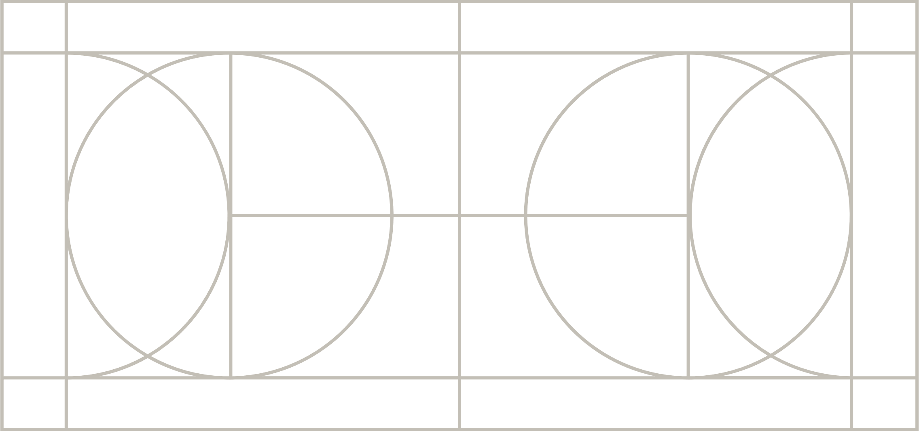
UTF-8
This Photo by Unknown Author is licensed under CC BY-SA

Slide 42
Decimal Point Numbers

Slide 43
Representing Real Numbers
Standard Representation: IEEE 754 Floating Point
Express the number in scientific notation
-0.0002589 becomes -2.589 * 10⁻⁴
Need to store sign, exponent, and mantissa (the fraction)
32-bit floating point representation:
sign (1 bit), exponent (8 bits), mantissa (23 bits)
64-bits:
sign (1 bit), exponent (11 bits), mantissa (52 bits)

Slide 44
IEEE 754 – 32 Bit
This Photo by Unknown Author is licensed under CC BY-SA

Slide 45
Problems with Real Numbers
How many real numbers are there? Infinity
How many real numbers are there between 0 and 1? Infinity
How many values can be represented by 32 or 64 bits?
2³² = 4.2 billion,
2⁶⁴ = 1.8 x 10¹⁹
Largest values: 2³² – 1 and 2⁶⁴ – 1
What’s the problem?

Slide 46
Problems with Real Numbers
Problem: some real numbers exist that cannot be represented exactly in floating point
(eg. 1/3 = 0.3333333…., sqrt(2) = 1.414213…).
Thus floating point numbers only approximate real numbers (and maintaining accuracy is a very important concern!).

Slide 47
Image Data

Slide 48
Encoding Images
Common Techniques
Vector Images
Vector images: “line work” Image is encoded as a collection of geometric primitives such as points, lines, curves.
Raster Images
Raster images: constructed from a grid of pixels (picture elements), where each picture is assigned a color

Slide 49
Representing Colors
How do we represent a color as a sequence of bits?
Can represent almost any color as a combination of some red, some green, and some blue. Typically use a scale from 0 (no light of that color) to 255 (full on for that color). Yields 256x256x256 = 16 million different possible colors.
(256 = 16*16 or two hex symbols)
To represent an image: 3 color components for each pixel (becomes a lot of bytes very quickly!)

Slide 50
Videos
Raster image storage formats like jpg heavily use ‘compression’ to reduce storage size
Basic ideas, reduce quantity of colours stored, and group idea of ‘where colours are’ to store less information
Video compression works similar but since video is a sequence of frames where each frame is an image, they also make use of reducing data by grouping idea of ‘colours stay the same and where’ across multiple frames
Great example of compression failure → confetti
When confetti is in image, the colour of spot changes every frame and nearby spots are different each frame
This means more info is needed per frame, as a result at the same data rate, the image quality will go down (boxy artifacts will appear, or even decoding breaks down)
This is the same reasons sports struggle with compressed video

Slide 51
Onward to … decisions.
Jonathan Hudson
jwhudson@ucalgary.ca
https://pages.cpsc.ucalgary.ca/~hudsonj/

