Slide 1
Programming: Writing a Program
CPSC 217: Introduction to Computer Science for Multidisciplinary Studies I
Fall 2020
Jonathan Hudson, Ph.D
Instructor
Department of Computer Science
University of Calgary
Tuesday, September 8, 2020

Slide 2
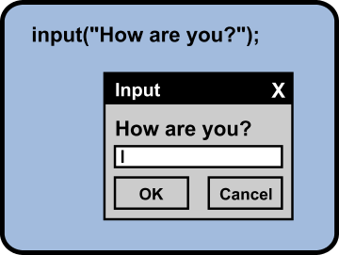
Input
A built-in function to get an input form the user.
sName = input("Please enter your name: ")
The obtained value will be stored in the variable in string form.
You need to convert the value type if necessary.
Variable
Function

Slide 3
Meaningful sentences
Provide meaningful sentences to communicate questions and results to the user.

Slide 4
Errors

Slide 5
Types of Errors
Three categories
Syntax
Runtime
Logic

Slide 6
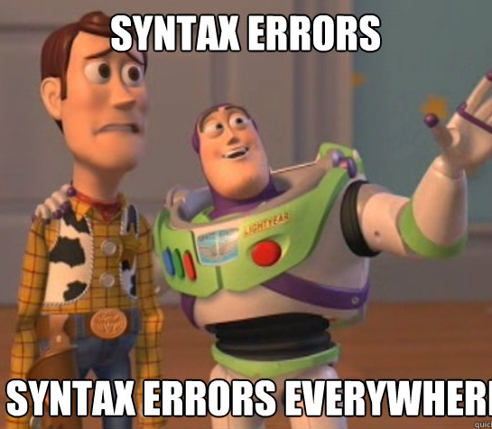
Syntax errors
Syntax refers to the structure of a program and the rules about that structure.
Easiest to find (your program will not begin to run)
Python is not so forgiving → displays an error message and quit.
The compiler / interpreter finds syntax errors
Example:
name = "Jim
print(77

Slide 7
Runtime errors
Does not appear until the program is run (harder to find)
Also called exceptions
Example:
callMe = "Maybe"
print(callme)

Slide 8
Semantic/Logic Errors
Program will run successfully
It does not produce the correct answer:
It does what you told it to do
The hardest to find!
Result of a wrong algorithm
Identifying is tricky!
Example:
x = 3
y = 4
average = x + y / 2
print(average)

Slide 9
Remember
Getting errors in your code does not make you a bad programmer.
Submitting code with error does!
Errorless code is the minimum requirement
You need to debug your code
Add comments to your code

Slide 10
Explore First Program

Slide 11
What Does this Program Do?
x = float(input())
y = (x - 32) * 5/9
print(y)
What’s wrong with this program?

Slide 12
Fahrenheit to Celsius

Slide 13
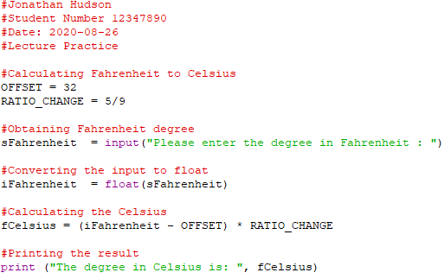
Comments
Notes and explanations in natural language
Intended only for the human reader → Completely ignored by the interpreter
# token starts a comment
Commenting is necessary!

Slide 14
Importing

Slide 15
Import
import <Module Name>
Import the packages that you need only!
Example:
import math
import turtle

Slide 16
Math Functions
Many additional math functions are available
Located in the math library
Import the math library
Precede the name of the function with math.
Examples:
math.sqrt(x)
math.floor(x)
math.ceil(x)
math.cos(x)

Slide 17
Area of a circle

Slide 18
Data Types

Slide 19
Data Types
Some operations are only well defined for certain types
1 + 2
“Hello” + “ World”
1 + “Hello”
2 + “4”
1 / 3
2.0 / 4
“Hello”*3

Slide 20
Data Types
Some operations are only well defined for certain types
1 + 2 → GOOD
“Hello” + “ World” → GOOD
1 + “Hello” → TYPE ERROR
2 + “4” → TYPE ERROR
1 / 3 → GOOD
2.0 / 4 → GOOD
“Hello”*3 → GOOD

Slide 21
Type Conversions (Casting)
Python permits you to convert from one type to another
"1.0" / "3.0" → Makes no sense to python
float("1.0") / float("3.0") → But this does
float("asdf") → However this doesn’t
Other type conversions: int, bool, str

Slide 22
Type Conversions (Casting)
Python permits you to convert from one type to another
int(“1”) → 1
str(1) → “1”
float(“1.0”) → 1.0
bool(“True”) → True

Slide 23
Formatting

Slide 24
Formatting
Sometimes print doesn’t display things the way we would like
print(1 / 3.0) gives 0.333333333333
What if we want 0.33?

Slide 25
Formatting
Basic python format method can be used to format floats
Parts
A string “pi is %.2f”
Format float to 2 decimals %.2f
Format symbol for strings %
The value(s) to format (math.pi)
Example:
import math
print(“pi is %.2f when” % (math.pi))
print(“rounded to 2 decimal places”)

Slide 26
Turtle - Drawing

Slide 27
Alex the turtle

Slide 28
Onward to … information and data.
Jonathan Hudson
jwhudson@ucalgary.ca
https://pages.cpsc.ucalgary.ca/~hudsonj/

