Slide 1
Programming
CPSC 217: Introduction to Computer Science for Multidisciplinary Studies I
Fall 2020
Jonathan Hudson, Ph.D
Instructor
Department of Computer Science
University of Calgary
Friday, September 18, 2020

Slide 2
How Do We Solve Problems with a Computer?
First question: How do we learn?

Slide 3
What does it mean to understand something?

Slide 4
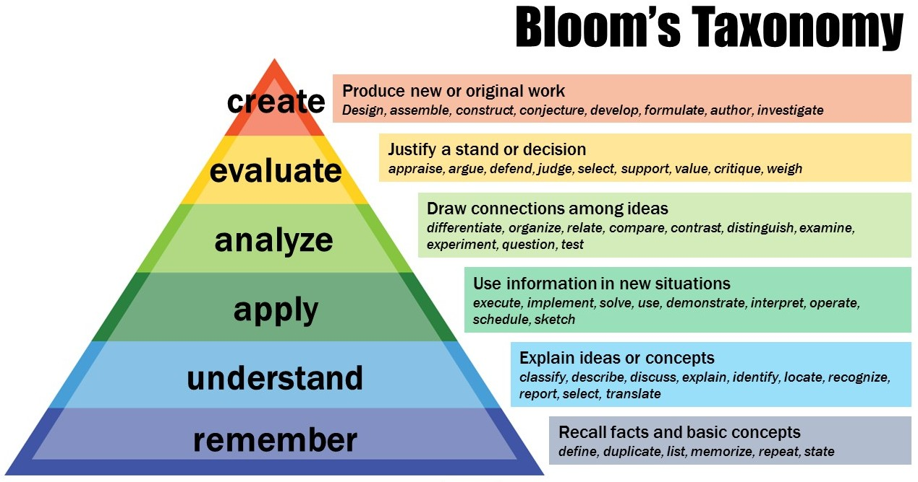
This Photo by Unknown Author is licensed under CC BY-NC

Slide 5
Solving Problems
How do we solve problems?

Slide 6
Solving Problems
How do we solve problems?
Break original problem into smaller, more easily solvable parts and repeat on the smaller sub-problems.
Similar process used in expository writing (break topic up into easily-understandable bits, express in coherent way).

Slide 7
Top Down Design
Start with the entire problem
01
Break the problem into approximately 3 to 5 smaller steps
02
Repeat the process for each step that is still too complex
03

Slide 8
What is an Algorithm?

Slide 9
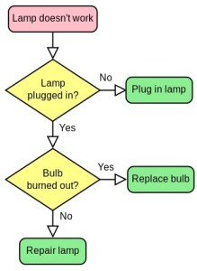
What is an Algorithm?
This Photo by Unknown Author is licensed under CC BY-SA-NC

Slide 10
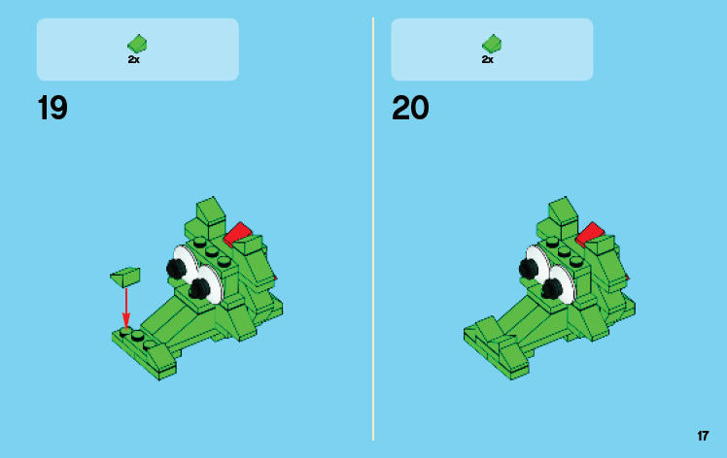
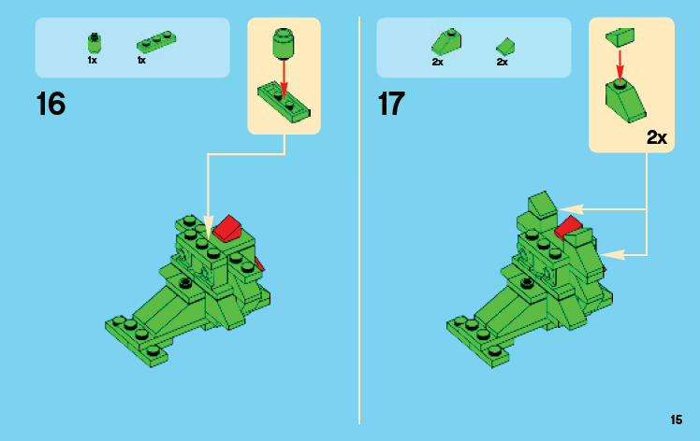
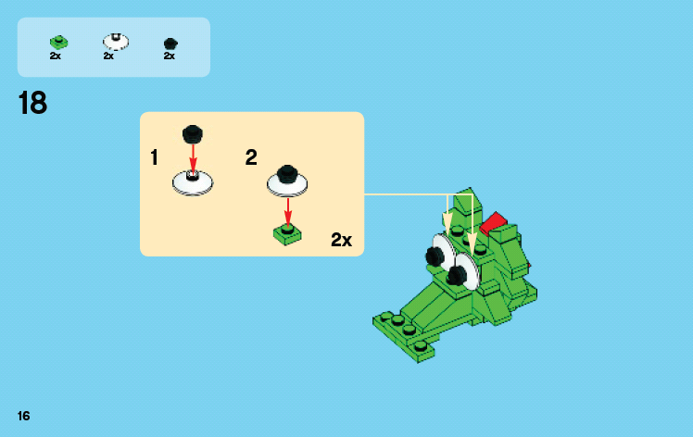
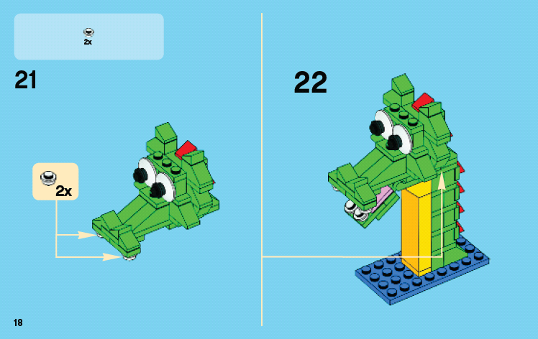

Slide 11
What is an Algorithm?
Algorithm: A finite sequence of effective (unambiguous, possible) steps to solve a problem.
Expressed in English, human-oriented form
Result of top-down design (or other problem solving strategy)
A well written algorithm can be written in any computer programming language

Slide 12
What is Programming?

Slide 13
What is Programming?
Programming: the process of creating software by translating algorithms into a computer language.
Algorithm: human readable form, layout/syntax is free as long as a reasonable person can understand it
Computer Program: computer readable form, precise syntax that must be followed exactly, will do exactly what you say (not what you meant!)

Slide 14
Where Are We Going?
Computers are tools that we use to solve problems
Need to understand the problem that we want to solve
Need to understand how a computer works to model the problem
Need to learn how to program the computer to solve the problem

Slide 15
Programming Languages
Many programming languages available
Offer different features
Each has its own strengths and weaknesses
Common features
Allow us to control the behaviour of a computer
Defined syntactic and semantic rules
Syntactic – what does a valid statement look like
Semantic – what is meaning of a statement

Slide 16
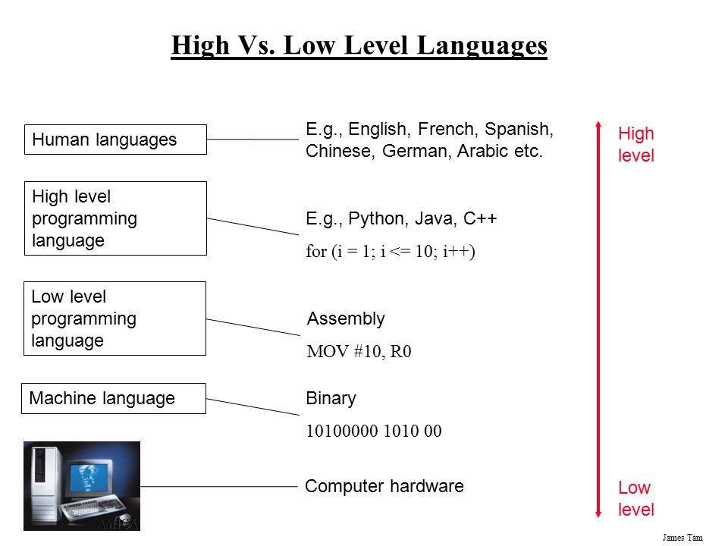
High Level Vs. Low Level Languages
Ambiguity,
Redundancy,..
Accuracy,
Concise,…

Slide 17
Using Python
Python 3 is the official programming language for this course.
There are different ways to tell Python to execute your code:
Interactive coding
System command lines and files
This course does not encourage the use of IDE such as Eclipse
We encourage direct interaction with the computer systems

Slide 18
Compiler/Interpreter

Slide 19
Programming
Computer programs are stored in source files
Human readable / editable
Can also be understood by a computer
typically have the extension .py
Once the file is created, it is run using the python interpreter
python myfile.py

Slide 20
Compilers Vs. Interpreter
A compiler:
Is like translating an entire book and give it to a reader.
A compiler reads the program and translates it completely before the program starts running
An interpreter
is like translating a line at a time and give the line to the uses until the book is finished.
It processes the program a little at a time, alternately reading lines and performing computations.

Slide 21
Compiler or Interpreter
Many modern languages use both processes.
They are first compiled into a lower level language, called byte code, and then interpreted by a program called a virtual machine.
Python uses both processes, but because of the way programmers interact with it, it is usually considered an interpreted language.

Slide 22
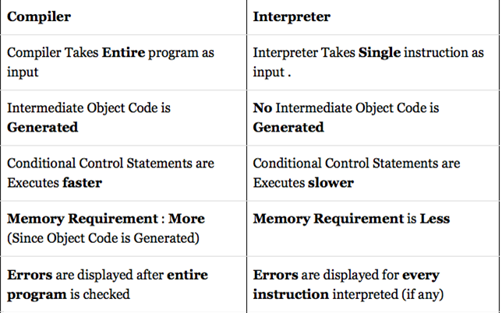
Difference between Compiler and Interpreter

Slide 23
Coding

Slide 24
Interactive coding
>>> is a Python prompt indicating that python is ready to accept commands
Python Functions:
print() → prints text to the screen
exit() → exits python

Slide 25
Command lines and files
You can check your version using python –version
If the result is 2.X.X then
You will have to use: python3 hello.py

Slide 26
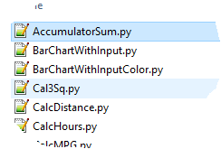
Command Lines and Files
Source code is a file containing your code often referred to as a program.
The filename ends with a .py suffix e.g. hello.py
To execute on CPSC computers: python hello.py in the command prompt
To save the output into a file: python hello.py > output.txt

Slide 27
Onward to … variables.
Jonathan Hudson
jwhudson@ucalgary.ca
https://pages.cpsc.ucalgary.ca/~hudsonj/

