Slide 1
Recursion
CPSC 217: Introduction to Computer Science for Multidisciplinary Studies I
Fall 2020
Jonathan Hudson, Ph.D
Instructor
Department of Computer Science
University of Calgary
Monday, December 7, 2020

Slide 2
Recursion
Definition:
See Recursion
Defining something in terms of itself
Generally using a smaller or simpler version
Recursive Function
A function that calls itself

Slide 3
Recursion
A programming technique whereby a function calls itself either directly or indirectly
indirectly (mutual recursive)
def fun ():
:
fun ()
:
def fun1 ():
fun2 ()
def fun2 ():
fun1 ()
fun()
Directly

Slide 4
Recursion
A well-formed recursive function normally has two cases
Base Case:
Does not make a recursive call
Permits function to return (allowing us to fall out of the function calls)
Without a well-formed base case, you will have infinite recursive calls leading to the popular StackOverFlowException or equivalently RecursionError in Python
Recursive Case:
Function calls itself
Generally must be a call to a smaller or simpler version of the problem

Slide 5
Tail Recursion

Slide 6
Tail Recursion
a tail call is a subroutine call performed as the final action of a function (Ex. A final return statement)
If a tail call calls the function itself, then this function is called tail recursive

Slide 7
Tail Recursion
Typically when a function is called a record of memory (stack frame) is stored to track state from the previous function call
But a tail recursive function doesn’t need anything from before the final function call
Modern compilers can identify this and reduce the process into an iterative loop for you. Although this is not guaranteed.
python is a procedural language, there is a class of languages called functional languages which will often guarantee this behaviour

Slide 8
Usage of Recursion

Slide 9
Useful Examples of Recursion
Drawing fractals
Finding a path through a maze
Flood fill / “paint bucket” tool
Merge sort, quick sort, binary search
Finding the total size of all of the files in a directory and its subdirectories
Parsing / evaluating expressions (how your code compiler knows you have syntax errors!)
…

Slide 10
Factorial

Slide 11
A Small Example - Factorial
Computing n factorial (n!):
Defined as the result of multiplying all numbers from n to 1 for all n>0. If n == 0, then result is 1.
$$n!=\left\{\begin{aligned}1 n=0 \\ n×\left(n−1\right)! n>0\end{aligned}\right\}$$
0! → 1
1! → 1*1 = 1
2! → 2*1*1 = 2
3! → 3*2*1*1 = 6

Slide 12
A Small Example - Factorial
Computing n factorial:
Using a loop:
Initialize a variable named answer to 1 (the answer to 0!)
for i ranging from 2 to n (inclusive)
Multiply answer by i, storing the result back into answer
return answer

Slide 13
A Small Example - Factorial
Computing n factorial:
Using a loop:
Initialize a variable named answer to 1 (the answer to 0!)
for i ranging from 2 to n (inclusive)
Multiply answer by i, storing the result back into answer
return answer
Another solution comes from the definition

Slide 14
A Small Example
Recursive Definition!
Another solution
By definition, 0! == 1
View n! == n * (n-1)!

Slide 15
A Small Example
Recursive Definition!
Another solution
BASE CASE, 0! == 1
RECURSIVE CASE, n! == n * (n-1)!

Slide 16
Factorial - Memory

Slide 17
A Small Example - Factorial
def factorial(n):
if n == 0: #BASE CASE
return 1
return n * factorial(n-1) #RECURSIVE CASE
Note: code is easy, directly follows from recursive definition
How does it look like in memory?

Slide 18
A Small Example - Factorial
Let’s trace this code:
def factorial(n):
if n == 0: #BASE CASE
return 1
return n * factorial(n-1) #RECURSIVE CASE
factorial(3)

Slide 19
A Small Example - Factorial - Walkthrough
Code:
STACK
def factorial(n):
if n == 0:
return 1
return n * factorial(n-1)
factorial(3)
Trace:

Slide 20
A Small Example - Factorial - Walkthrough
Code:
STACK
def factorial(n):
if n == 0:
return 1
return n * factorial(n-1)
factorial(3)
I1
Trace:
Factorial(3)
n=3

Slide 21
A Small Example - Factorial - Walkthrough
Code:
STACK
I1
def factorial(n):
if n == 0:
return 1
return n * factorial(n-1)
factorial(3)
Trace:
n=3
Factorial(3)
n=3

Slide 22
A Small Example - Factorial - Walkthrough
Code:
STACK
def factorial(n):
if n == 0:
return 1
return n * factorial(n-1)
factorial(3)
I1
Trace:
n=3
Factorial(3)
n=3

Slide 23
A Small Example - Factorial - Walkthrough
Code:
STACK
def factorial(n):
if n == 0:
return 1
return n * factorial(n-1)
factorial(3)
FALSE
I1
Trace:
n=3
Factorial(3)
n=3

Slide 24
A Small Example - Factorial - Walkthrough
Code:
STACK
def factorial(n):
if n == 0:
return 1
return n * factorial(n-1)
factorial(3)
I1
Trace:
n=3
return 3*(factorial(2))
Factorial(3)
n=3

Slide 25
A Small Example - Factorial - Walkthrough
Code:
STACK
I2
def factorial(n):
if n == 0:
return 1
return n * factorial(n-1)
factorial(3)
I1
Trace:
n=2
return 3*(factorial(2))
Factorial(2)
n=2
Factorial(3)
n=3

Slide 26
A Small Example - Factorial - Walkthrough
Code:
STACK
def factorial(n):
if n == 0:
return 1
return n * factorial(n-1)
factorial(3)
I2
I1
Trace:
n=2
return 3*(factorial(2))
Factorial(2)
n=2
Factorial(3)
n=3

Slide 27
A Small Example - Factorial - Walkthrough
Code:
STACK
def factorial(n):
if n == 0:
return 1
return n * factorial(n-1)
factorial(3)
FALSE
I2
I1
Trace:
n=2
return 3*(factorial(2))
Factorial(2)
n=2
Factorial(3)
n=3

Slide 28
A Small Example - Factorial - Walkthrough
Code:
STACK
def factorial(n):
if n == 0:
return 1
return n * factorial(n-1)
factorial(3)
I2
Trace:
n=2
return 3*(2*factorial(1))
Factorial(2)
n=2
Factorial(3)
n=3

Slide 29
A Small Example - Factorial - Walkthrough
Code:
STACK
I3
def factorial(n):
if n == 0:
return 1
return n * factorial(n-1)
factorial(3)
I2
Factorial(1)
n=1
Trace:
n=1
return 3*(2*factorial(1))
Factorial(2)
n=2
Factorial(3)
n=3

Slide 30
A Small Example - Factorial - Walkthrough
Code:
STACK
def factorial(n):
if n == 0:
return 1
return n * factorial(n-1)
factorial(3)
I3
I2
Factorial(1)
n=1
Trace:
n=1
return 3*(2*factorial(1))
Factorial(2)
n=2
Factorial(3)
n=3

Slide 31
A Small Example - Factorial - Walkthrough
Code:
STACK
def factorial(n):
if n == 0:
return 1
return n * factorial(n-1)
factorial(3)
FALSE
I3
I2
Factorial(1)
n=1
Trace:
n=1
return 3*(2*factorial(1))
Factorial(2)
n=2
Factorial(3)
n=3

Slide 32
A Small Example - Factorial - Walkthrough
Code:
STACK
def factorial(n):
if n == 0:
return 1
return n * factorial(n-1)
factorial(3)
I3
Factorial(1)
n=1
Trace:
n=1
return 3*(2*(1*factorial(0)))
Factorial(2)
n=2
Factorial(3)
n=3

Slide 33
A Small Example - Factorial - Walkthrough
Code:
STACK
I4
def factorial(n):
if n == 0:
return 1
return n * factorial(n-1)
factorial(3)
Factorial(1)
n=0
I3
Factorial(1)
n=1
Trace:
n=0
return 3*(2*(1*factorial(0)))
Factorial(2)
n=2
Factorial(3)
n=3

Slide 34
A Small Example - Factorial - Walkthrough
Code:
STACK
def factorial(n):
if n == 0:
return 1
return n * factorial(n-1)
factorial(3)
Factorial(1)
n=0
I4
I3
Factorial(1)
n=1
Trace:
n=0
return 3*(2*(1*factorial(0)))
Factorial(2)
n=2
Factorial(3)
n=3

Slide 35
A Small Example - Factorial - Walkthrough
Code:
STACK
def factorial(n):
if n == 0:
return 1
return n * factorial(n-1)
factorial(3)
Factorial(1)
n=0
TRUE
I4
I3
Factorial(1)
n=1
Trace:
n=0
return 3*(2*(1*factorial(0)))
Factorial(2)
n=2
Factorial(3)
n=3

Slide 36
A Small Example - Factorial - Walkthrough
Code:
STACK
def factorial(n):
if n == 0:
return 1
return n * factorial(n-1)
factorial(3)
Factorial(1)
n=0
I4
I3
Factorial(1)
n=1
Trace:
n=0
return 3*(2*(1*factorial(0)))
Factorial(2)
n=2
Factorial(3)
n=3

Slide 37
A Small Example - Factorial - Walkthrough
Code:
STACK
def factorial(n):
if n == 0:
return 1
return n * factorial(n-1)
factorial(3)
Factorial(1)
n=0
I4
I3
Factorial(1)
n=1
Trace:
n=0
return 3*(2*(1*factorial(0)))
Factorial(2)
n=2
factorial(0) return 1
Factorial(3)
n=3

Slide 38
A Small Example - Factorial - Walkthrough
Code:
STACK
pop
def factorial(n):
if n == 0:
return 1
return n * factorial(n-1)
factorial(3)
Factorial(1)
n=0
I3
Factorial(1)
n=1
Trace:
n=1
return 3*(2*(1*1))
Factorial(2)
n=2
Factorial(3)
n=3

Slide 39
A Small Example - Factorial - Walkthrough
Code:
STACK
def factorial(n):
if n == 0:
return 1
return n * factorial(n-1)
factorial(3)
I3
Factorial(1)
n=1
Trace:
n=1
return 3*(2*(1*1))
Factorial(2)
n=2
Factorial(3)
n=3

Slide 40
A Small Example - Factorial - Walkthrough
Code:
STACK
def factorial(n):
if n == 0:
return 1
return n * factorial(n-1)
factorial(3)
I3
Factorial(1)
n=1
Trace:
n=1
return 3*(2*(1*1))
Factorial(2)
n=2
factorial(1) returns 1*1 = 1
Factorial(3)
n=3

Slide 41
A Small Example - Factorial - Walkthrough
Code:
STACK
def factorial(n):
if n == 0:
return 1
return n * factorial(n-1)
factorial(3)
pop
I2
Factorial(1)
n=1
Trace:
n=2
return 3*(2*1)
Factorial(2)
n=2
Factorial(3)
n=3

Slide 42
A Small Example - Factorial - Walkthrough
Code:
STACK
def factorial(n):
if n == 0:
return 1
return n * factorial(n-1)
factorial(3)
I2
Trace:
n=2
return 3*(2*1)
Factorial(2)
n=2
Factorial(3)
n=3

Slide 43
A Small Example - Factorial - Walkthrough
Code:
STACK
def factorial(n):
if n == 0:
return 1
return n * factorial(n-1)
factorial(3)
I2
Trace:
n=2
return 3*(2*1)
Factorial(2)
n=2
factorial(2) returns 2*1 = 2
Factorial(3)
n=3

Slide 44
A Small Example - Factorial - Walkthrough
Code:
STACK
def factorial(n):
if n == 0:
return 1
return n * factorial(n-1)
factorial(3)
I1
Trace:
pop
n=3
return 3*2
Factorial(2)
n=2
Factorial(3)
n=3

Slide 45
A Small Example - Factorial - Walkthrough
Code:
STACK
def factorial(n):
if n == 0:
return 1
return n * factorial(n-1)
factorial(3)
I1
Trace:
n=3
return 3*2
Factorial(3)
n=3

Slide 46
A Small Example - Factorial - Walkthrough
Code:
STACK
def factorial(n):
if n == 0:
return 1
return n * factorial(n-1)
factorial(3)
I1
Trace:
n=3
return 3*2
factorial(3) returns 3*2 = 6
Factorial(3)
n=3

Slide 47
A Small Example - Factorial - Walkthrough
Code:
STACK
def factorial(n):
if n == 0:
return 1
return n * factorial(n-1)
factorial(3)
I1
Trace:
n=3
return 6
pop
Factorial(3)
n=3

Slide 48
A Small Example - Factorial - Walkthrough
Code:
STACK
def factorial(n):
if n == 0:
return 1
return n * factorial(n-1)
factorial(3)
I1
Trace:
6

Slide 49
Fibonacci

Slide 50
Fibonacci Numbers
A sequence of values:
0, 1, 1, 2, 3, 5, 8, 13, 21, 34, 55, …

Slide 51
Fibonacci Numbers
A sequence of values:
0, 1, 1, 2, 3, 5, 8, 13, 21, 34, 55, …
Defined recursively:
By definition:
fib(0) is 0
fib(1) is 1

Slide 52
Fibonacci Numbers
A sequence of values:
0, 1, 1, 2, 3, 5, 8, 13, 21, 34, 55, …
Defined recursively:
By definition:
fib(0) is 0
fib(1) is 1
Remaining values:
Formed by computing the sum of the previous two values in the sequence

Slide 53
Fibonacci Numbers
A sequence of values:
0, 1, 1, 2, 3, 5, 8, 13, 21, 34, 55, …
Defined recursively:
By definition:
fib(0) is 0
fib(1) is 1
Remaining values:
fib(n) = fib(n-1)+fib(n-2)

Slide 54
Fibonacci Numbers
Note that there are two base cases here!
Eg. fib(4)
fib(4) = fib(3) + fib(2)
fib(3) = fib(2) + fib(1)
fib(2) = fib(1) + fib(0)
fib(1) = 1
fib(0) = 0

Slide 55
Fibonacci Numbers
Note that there are two base cases here!
Eg. fib(4)
fib(4) = fib(3) + fib(2) =fib(1)+fib(0)+fib(1)+fib(1)+fib(0)=3
fib(3) = fib(2) + fib(1) = fib(1)+fib(0)+fib(1)=2
fib(2) = fib(1) + fib(0) =1
fib(1) = 1
fib(0) = 0

Slide 56
Example - Fibonacci Numbers
Note that there are two base cases here!
Eg. fib(4)
fib(4) = fib(3) + fib(2) =fib(1)+fib(0)+fib(1) + fib(1)+fib(0)=3
fib(3) = fib(2) + fib(1) = fib(1)+fib(0)+fib(1)=2
fib(2) = fib(1) + fib(0) =1
fib(1) = 1
fib(0) = 0
fib(3)
fib(2)
fib(2)

Slide 57
Fibonacci Numbers
Note that there are two base cases here!
Eg. fib(5)
fib(5) = fib(4) + fib(3) =fib(1)+fib(0)+fib(1)+fib(1)+fib(0)+ fib(1)+fib(0)+fib(1)=5
fib(4) = fib(3) + fib(2) =fib(1)+fib(0)+fib(1)+fib(1)+fib(0)=3
fib(3) = fib(2) + fib(1) = fib(1)+fib(0)+fib(1)=2
fib(2) = fib(1) + fib(0) =1
fib(1) = 1
fib(0) = 0

Slide 58
Example - Fibonacci Numbers
Note that there are two base cases here!
Eg. fib(5)
fib(5) = fib(4) + fib(3) =fib(1)+fib(0)+fib(1)+fib(1)+fib(0)+ fib(1)+fib(0)+fib(1)=5
fib(4) = fib(3) + fib(2) =fib(1)+fib(0)+fib(1)+fib(1)+fib(0)=3
fib(3) = fib(2) + fib(1) = fib(1)+fib(0)+fib(1)=2
fib(2) = fib(1) + fib(0) =1
fib(1) = 1
fib(0) = 0
fib(4)
fib(3)

Slide 59
Fibonacci Numbers
def fibRec(n):
if n == 0:
return 0
if n == 1:
return 1
return fibRec(n-1) + fibRec(n-2)

Slide 60
Example - Fibonacci Numbers - Visualization
$$fib(n)=\left(\begin{aligned}0 n=0 \\ 1 n=1 \\ fib\left(n−1\right)+fib\left(n−2\right) n>1\end{aligned}\right)$$
fib(4)
fib(4)

Slide 61
Example - Fibonacci Numbers - Visualization
$$fib(n)=\left(\begin{aligned}0 n=0 \\ 1 n=1 \\ fib\left(n−1\right)+fib\left(n−2\right) n>1\end{aligned}\right)$$
fib(4) → fib(3) + fib(2)
fib(4)

Slide 62
Example - Fibonacci Numbers - Visualization
$$fib(n)=\left(\begin{aligned}0 n=0 \\ 1 n=1 \\ fib\left(n−1\right)+fib\left(n−2\right) n>1\end{aligned}\right)$$
fib(4) → fib(3) + fib(2)
The expression is evaluated left to right. So, fib(3) is calculated first.
fib(4)

Slide 63
Example - Fibonacci Numbers - Visualization
$$fib(n)=\left(\begin{aligned}0 n=0 \\ 1 n=1 \\ fib\left(n−1\right)+fib\left(n−2\right) n>1\end{aligned}\right)$$
fib(3)
fib(4-1)
fib(4)
fib(3)

Slide 64
Example - Fibonacci Numbers - Visualization
$$fib(n)=\left(\begin{aligned}0 n=0 \\ 1 n=1 \\ fib\left(n−1\right)+fib\left(n−2\right) n>1\end{aligned}\right)$$
fib(3) → fib(2) + fib(1)
fib(4-1)
fib(4)
fib(3)

Slide 65
Example - Fibonacci Numbers - Visualization
$$fib(n)=\left(\begin{aligned}0 n=0 \\ 1 n=1 \\ fib\left(n−1\right)+fib\left(n−2\right) n>1\end{aligned}\right)$$
fib(3) → fib(2) + fib(1)
Similarly, fib(2) is evaluated first.
fib(4-1)
fib(4)
fib(3)

Slide 66
Example - Fibonacci Numbers - Visualization
$$fib(n)=\left(\begin{aligned}0 n=0 \\ 1 n=1 \\ fib\left(n−1\right)+fib\left(n−2\right) n>1\end{aligned}\right)$$
fib(2)
fib(4-1)
fib(4)
fib(3)
fib(3-1)
fib(2)

Slide 67
Example - Fibonacci Numbers - Visualization
$$fib(n)=\left(\begin{aligned}0 n=0 \\ 1 n=1 \\ fib\left(n−1\right)+fib\left(n−2\right) n>1\end{aligned}\right)$$
fib(2) → fib(1) + fib(0)
fib(4-1)
fib(4)
fib(3)
fib(3-1)
fib(2)

Slide 68
Example - Fibonacci Numbers - Visualization
$$fib(n)=\left(\begin{aligned}0 n=0 \\ 1 n=1 \\ fib\left(n−1\right)+fib\left(n−2\right) n>1\end{aligned}\right)$$
fib(2) → fib(1) + fib(0)
fib(1) is evaluated first
fib(4-1)
fib(4)
fib(3)
fib(3-1)
fib(2)

Slide 69
Example - Fibonacci Numbers - Visualization
$$fib(n)=\left(\begin{aligned}0 n=0 \\ 1 n=1 \\ fib\left(n−1\right)+fib\left(n−2\right) n>1\end{aligned}\right)$$
fib(1)
fib(4-1)
fib(4)
fib(3)
fib(3-1)
fib(2)
fib(2-1)
fib(1)

Slide 70
Example - Fibonacci Numbers - Visualization
$$fib(n)=\left(\begin{aligned}0 n=0 \\ 1 n=1 \\ fib\left(n−1\right)+fib\left(n−2\right) n>1\end{aligned}\right)$$
fib(1) → 1
fib(1) returns 1 to caller
fib(4-1)
fib(4)
fib(3)
fib(3-1)
fib(2)
fib(2-1)
fib(1)

Slide 71
Example - Fibonacci Numbers - Visualization
$$fib(n)=\left(\begin{aligned}0 n=0 \\ 1 n=1 \\ fib\left(n−1\right)+fib\left(n−2\right) n>1\end{aligned}\right)$$
fib(1) → 1
fib(1) returns 1 to caller
fib(4-1)
fib(4)
fib(3)
fib(3-1)
fib(2)
1
fib(1)

Slide 72
Example - Fibonacci Numbers - Visualization
$$fib(n)=\left(\begin{aligned}0 n=0 \\ 1 n=1 \\ fib\left(n−1\right)+fib\left(n−2\right) n>1\end{aligned}\right)$$
fib(2) → 1 + fib(0)
Now, fib(0) is evaluated.
fib(4-1)
fib(4)
fib(3)
fib(3-1)
fib(2)
1
fib(1)

Slide 73
Example - Fibonacci Numbers - Visualization
$$fib(n)=\left(\begin{aligned}0 n=0 \\ 1 n=1 \\ fib\left(n−1\right)+fib\left(n−2\right) n>1\end{aligned}\right)$$
fib(0)
fib(4-1)
fib(4)
fib(3)
fib(3-1)
fib(2)
fib(2-2)
1
fib(1)
fib(0)

Slide 74
Example - Fibonacci Numbers - Visualization
$$fib(n)=\left(\begin{aligned}0 n=0 \\ 1 n=1 \\ fib\left(n−1\right)+fib\left(n−2\right) n>1\end{aligned}\right)$$
fib(0) → 0
fib(0) returns 0 to caller
fib(4-1)
fib(4)
fib(3)
fib(3-1)
fib(2)
fib(2-2)
1
fib(1)
fib(0)

Slide 75
Example - Fibonacci Numbers - Visualization
$$fib(n)=\left(\begin{aligned}0 n=0 \\ 1 n=1 \\ fib\left(n−1\right)+fib\left(n−2\right) n>1\end{aligned}\right)$$
fib(0) → 0
fib(0) returns 0 to caller
fib(4-1)
fib(4)
fib(3)
fib(3-1)
fib(2)
1
0
fib(1)
fib(0)

Slide 76
Example - Fibonacci Numbers - Visualization
$$fib(n)=\left(\begin{aligned}0 n=0 \\ 1 n=1 \\ fib\left(n−1\right)+fib\left(n−2\right) n>1\end{aligned}\right)$$
fib(2) → 1+0 = 1
Now, fib(2) returns 1 to the caller
fib(4-1)
fib(4)
fib(3)
fib(3-1)
fib(2)
1
0
fib(1)
fib(0)

Slide 77
Example - Fibonacci Numbers - Visualization
$$fib(n)=\left(\begin{aligned}0 n=0 \\ 1 n=1 \\ fib\left(n−1\right)+fib\left(n−2\right) n>1\end{aligned}\right)$$
fib(2) → 1+0 = 1
Now, fib(2) returns 1 to the caller
fib(4-1)
fib(4)
fib(3)
1
fib(2)
1
0
fib(1)
fib(0)

Slide 78
Example - Fibonacci Numbers - Visualization
$$fib(n)=\left(\begin{aligned}0 n=0 \\ 1 n=1 \\ fib\left(n−1\right)+fib\left(n−2\right) n>1\end{aligned}\right)$$
fib(3) → 1 + fib(1)
Now, fib(1) is calculated
fib(4-1)
fib(4)
fib(3)
1
fib(2)
1
0
fib(1)
fib(0)

Slide 79
Example - Fibonacci Numbers - Visualization
$$fib(n)=\left(\begin{aligned}0 n=0 \\ 1 n=1 \\ fib\left(n−1\right)+fib\left(n−2\right) n>1\end{aligned}\right)$$
fib(1)
fib(4-1)
fib(4)
fib(3)
1
fib(3-2)
fib(2)
fib(1)
1
0
fib(1)
fib(0)

Slide 80
Example - Fibonacci Numbers - Visualization
$$fib(n)=\left(\begin{aligned}0 n=0 \\ 1 n=1 \\ fib\left(n−1\right)+fib\left(n−2\right) n>1\end{aligned}\right)$$
fib(1) → 1
fib(1) returns 1 to the caller.
fib(4-1)
fib(4)
fib(3)
1
fib(3-2)
fib(2)
fib(1)
1
0
fib(1)
fib(0)

Slide 81
Example - Fibonacci Numbers - Visualization
$$fib(n)=\left(\begin{aligned}0 n=0 \\ 1 n=1 \\ fib\left(n−1\right)+fib\left(n−2\right) n>1\end{aligned}\right)$$
fib(1) → 1
fib(1) returns 1 to the caller.
fib(4-1)
fib(4)
fib(3)
1
1
fib(2)
fib(1)
1
0
fib(1)
fib(0)

Slide 82
Example - Fibonacci Numbers - Visualization
$$fib(n)=\left(\begin{aligned}0 n=0 \\ 1 n=1 \\ fib\left(n−1\right)+fib\left(n−2\right) n>1\end{aligned}\right)$$
fib(3) → 1 + 1 = 2
Now, fib(3) returns 2 to the caller.
fib(4-1)
fib(4)
fib(3)
1
1
fib(2)
fib(1)
1
0
fib(1)
fib(0)

Slide 83
Example - Fibonacci Numbers - Visualization
$$fib(n)=\left(\begin{aligned}0 n=0 \\ 1 n=1 \\ fib\left(n−1\right)+fib\left(n−2\right) n>1\end{aligned}\right)$$
fib(3) → 1 + 1 = 2
Now, fib(3) returns 2 to the caller.
2
fib(4)
fib(3)
1
1
fib(2)
fib(1)
1
0
fib(1)
fib(0)

Slide 84
Example - Fibonacci Numbers - Visualization
$$fib(n)=\left(\begin{aligned}0 n=0 \\ 1 n=1 \\ fib\left(n−1\right)+fib\left(n−2\right) n>1\end{aligned}\right)$$
fib(4) → 3 + fib(2)
2
fib(4)
fib(3)
1
1
fib(2)
fib(1)
1
0
fib(1)
fib(0)

Slide 85
Example - Fibonacci Numbers - Visualization
$$fib(n)=\left(\begin{aligned}0 n=0 \\ 1 n=1 \\ fib\left(n−1\right)+fib\left(n−2\right) n>1\end{aligned}\right)$$
fib(4) → 3 + fib(2)
fib(2) is calculated.
2
fib(4)
fib(3)
1
1
fib(2)
fib(1)
1
0
fib(1)
fib(0)

Slide 86
Example - Fibonacci Numbers - Visualization
$$fib(n)=\left(\begin{aligned}0 n=0 \\ 1 n=1 \\ fib\left(n−1\right)+fib\left(n−2\right) n>1\end{aligned}\right)$$
fib(2)
2
fib(4)
fib(4-2)
fib(3)
fib(2)
1
1
fib(2)
fib(1)
1
0
fib(1)
fib(0)

Slide 87
Example - Fibonacci Numbers - Visualization
$$fib(n)=\left(\begin{aligned}0 n=0 \\ 1 n=1 \\ fib\left(n−1\right)+fib\left(n−2\right) n>1\end{aligned}\right)$$
fib(2) → fib(1) + fib(0)
Similar to before, fib(2) will return 1
2
fib(4)
fib(4-2)
fib(3)
fib(2)
1
1
1
0
fib(2)
fib(1)
fib(1)
fib(0)
1
0
fib(1)
fib(0)

Slide 88
Example - Fibonacci Numbers - Visualization
$$fib(n)=\left(\begin{aligned}0 n=0 \\ 1 n=1 \\ fib\left(n−1\right)+fib\left(n−2\right) n>1\end{aligned}\right)$$
fib(2) → 1
fib(2) will return 1 to the caller
2
fib(4)
fib(4-2)
fib(3)
fib(2)
1
1
1
0
fib(2)
fib(1)
fib(1)
fib(0)
1
0
fib(1)
fib(0)

Slide 89
Example - Fibonacci Numbers - Visualization
$$fib(n)=\left(\begin{aligned}0 n=0 \\ 1 n=1 \\ fib\left(n−1\right)+fib\left(n−2\right) n>1\end{aligned}\right)$$
fib(2) → 1
fib(2) will return 1 to the caller
2
fib(4)
1
fib(3)
fib(2)
1
1
1
0
fib(2)
fib(1)
fib(1)
fib(0)
1
0
fib(1)
fib(0)

Slide 90
Example - Fibonacci Numbers - Visualization
$$fib(n)=\left(\begin{aligned}0 n=0 \\ 1 n=1 \\ fib\left(n−1\right)+fib\left(n−2\right) n>1\end{aligned}\right)$$
fib(4) → 2 + 1 = 3
Answer is 3.
2
fib(4)
1
fib(3)
fib(2)
1
1
1
0
fib(2)
fib(1)
fib(1)
fib(0)
1
0
fib(1)
fib(0)

Slide 91
Advantages

Slide 92
Advantages of Recursion
Very well suited to some problems
Tree traversals
Flood fill
Fractal images
Quick sort / merge sort
…
Often easier to implement, sometimes faster than iterative

Slide 93
Notice Anything About Fibonacci Numbers
?

Slide 94
Notice Anything About Fibonacci Numbers
We called fib(1), fib(0) many many many times
Why not store this information once

Slide 95
Dynamic Programming

Slide 96
Dynamic Programming
def fibDyn(n):
fib = [0, 1]
for i in range(2,n+1):
fib.append(fib[i-2]+fib[i-1])
return fib[n]
n= | 0 | 1 | 2 | 3 | 4 | 5 | 6 | 7 | …
fib(n) | 0 | 1 | 1 | 2 | 3 | 5 | 8 | 13

Slide 97
Advantages of Dynamic Programming
Dynamic programming is recursive in concept
but we store solutions we already found!
We start bottom up instead of top down
Generally we find ourselves calculating many solutions at the bottom we find again and again
Let’s calculate it once and store it
Generally faster than similar recursive solution
We don’t have to push information on the stack with recursion calls (we store our own state instead)

Slide 98
Advantages of Dynamic Programming
Tricky to implement (especially for more complex problems see CPSC 413)
But not always faster, or guaranteed to take less space than similar recursive solution
Sometimes we don’t need need to track all this state, recursion lets us dispose of information stored on stack as the function call returns

Slide 99
Iterative Programming

Slide 100
Iterative Programming
Sometimes we can notice in dynamic programming that we didn’t need to store all the previous function calls
Or we can noticed that each function call was base iteratively on the previous function calls

Slide 101
Iterative Programming
def fibIter(n):
if n == 0:
return 0
if n == 1:
return 1
prev1 = 1
prev2 = 0
result = None
for i in range(2,n+1):
result = prev1 + prev2
prev2 = prev1
prev1 = result
return result

Slide 102
Advantages of Iteration
Typically
Faster (but not always)
Requires less memory (most of the time)
But some problems are messy to express iteratively

Slide 103
Fractals

Slide 104
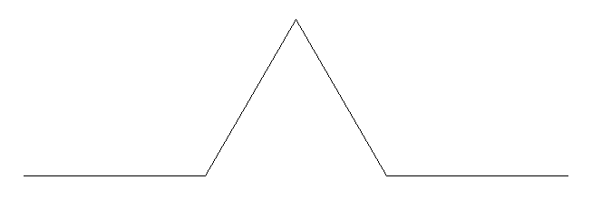
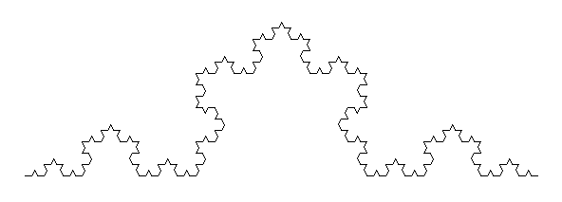
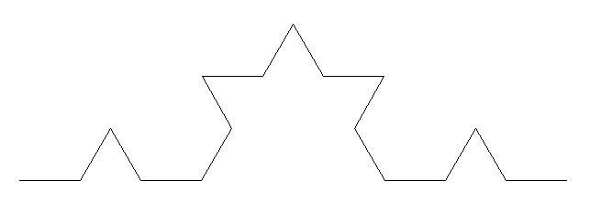
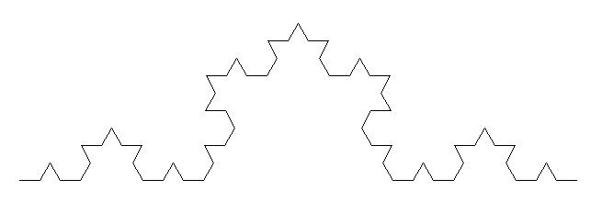
Fractals
Self similar images
Often have reasonably simple recursive definitions
1 4
2
3

Slide 105
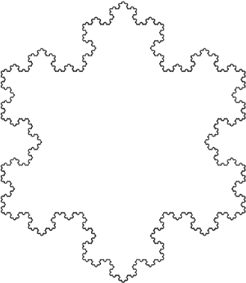
Koch Snowflake

Slide 106
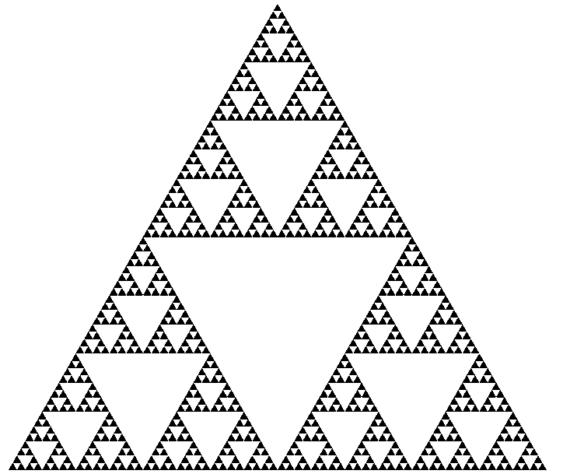
Sierpinski Triangle
Sierpinski Trianglge
Source: http://commons.wikimedia.org/wiki/File:Sierpinski-Trigon-7.svg
License: Public Domain

Slide 107
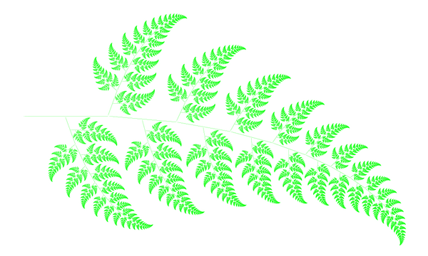
Fractal Fern
Fractal Fern
Source: http://schools-wikipedia.org/images/67/6740.png.htm
License: Creative Commons Attribution-Share Alike 3.0 Unported http://creativecommons.org/licenses/by-sa/3.0/deed.en

Slide 108
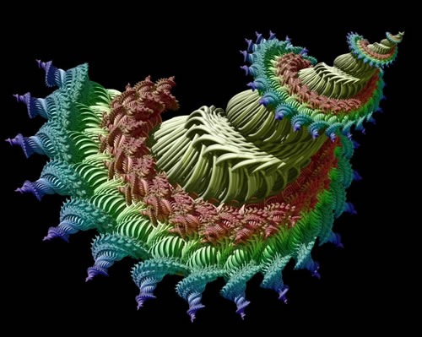
Fractal Art
Spiral Fantasy by Alfred Laing

Slide 109
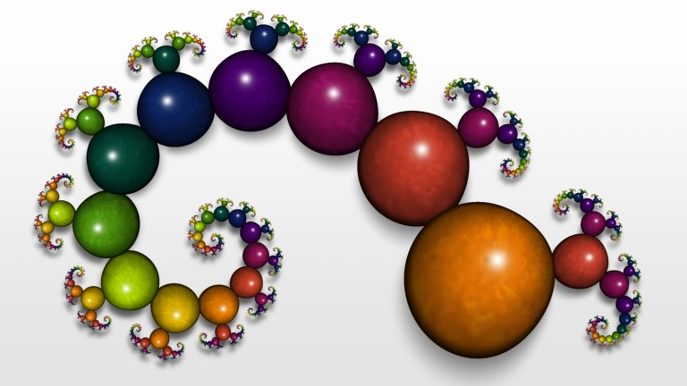
Fractal Art
Simple Thing by Philip Taylor

Slide 110
Fractal Art
Edenesque by Helen Grainge (left)
Rose by Keith Mackay (right)

Slide 111
Mazes

Slide 112
Maze Path Finding
Consider a two dimensional list containing 4 different values
Entrance for the maze
Exit for the maze
Open spaces
Walls
Assume that the maze is fully enclosed

Slide 113
Maze Path Finding
Algorithm solve(map, x, y)
If the current square is a wall or a space we have already visited, return failure
If the current square is the exit point, mark it as part of the solution and return success
Mark the current square as part of the solution
If solve(map, x, y+1) is successful, return success
If solve(map, x, y-1) is successful, return success
If solve(map, x+1, y) is successful, return success
If solve(map, x-1, y) is successful, return success
Mark the current square as visited but not part of the solution
Return failure

Slide 114
Maze Path Finding
def solve(map,x,y):
if map[x][y] == “wall” or map[x][y] == “visited”:
return False
if map[x][y] == “exit”:
print “Go to (%d,%d)” % (x,y)
return True

Slide 115
Maze Path Finding
print “Go to (%d,%d)” % (x,y)
if solve(map,x,y+1):
return True
elif solve(map,x,y-1):
return True
elif solve(map,x+1,y):
return True
elif solve(map,x-1,y):
return True
else:
map[x][y] = “visited”
return False

Slide 116
Recursion – Beyond Algorithms

Slide 117
Why recursion
Recursive implementation is the perfect ﬁt for naturally recursive problems.
The result of one step depends on the previous steps.
There is a base case where the process will stop at.
e.g., search, games, various math problems
Computationally elegant
Easy to program than using loops
Tradeoffs:
Function calls can be costly in terms of memory and time

Slide 118
Induction
Recursive functions performance and even their results are often shown via proofs using induction
Base Case: Where recursion bottoms out and returns
Inductive Case: Where recursion calls another functions call
Induction is generally be taught in CPSC 271, 331, and 413

Slide 119
Example
def binary_search(t_list, k):
if len(t_list) != 0:
center = len(t_list)//2
if t_list[center] == k:
return True
if t_list[center] > k:
return binary_search(t_list[:center], k)
else:
return binary_search(t_list[center+1:], k)
return False

Slide 120
Onward to … CPSC 219.
Jonathan Hudson
jwhudson@ucalgary.ca
https://pages.cpsc.ucalgary.ca/~hudsonj/

